Slide 1
Start-Up - Discussion
1/5/15
You have all studied The Civil War in history classes. Take a minute with your VERTICAL partner to discuss the following:
What effect did The Civil War have on our country as a whole?
What effect do you think it might have on literature in our country?
Whole class discussion

Slide 2
Start-Up - Writing
Knowing that the beginning of The Civil War came at about the same time as the beginning of the period in American Literature known as the American Realistic period:
What do you think “realism” refers to in literature?
What sort of writing do you think we will be reading?

Slide 3
Today’s Objective
By the end of the period, students will have an understanding of Walt Whitman’s place in the Civil War and begin an analysis of how his experiences may have affected his writing.
CCSS.ELA-LITERACY.CCRA.R.6

Slide 4
Walt Whitman and The Civil War
In 1862, The Civil War had begun. Whitman saw a list of injured soldiers that included his brother.
He immediately left to try and find him and he did in Falmouth, VA.
Whitman travelled with George to Washington D.C., where he began visiting and caring for wounded soldiers.
He kept journals of his experiences during this entire time period.
Watch

Slide 5
Walt Whitman and The Civil War
Whitman also continued to write poetry during this time.
Watch
In 1865, he published “Drum Taps,” a book of poetry about the war.
He added, in 1865, 18 more poems in “Sequel to Drum Taps,” which included the poems he wrote about Abraham Lincoln and his assassination.

Slide 6
Start-Up - Discussion
1/6/15
With your VERTICAL partner, discuss the following:
Whitman witnessed the war firsthand, in the camps and in the hospitals.
Do you think the war might have changed the way Whitman thought about death?
Why and how?
Whole class discussion

Slide 7
Start-Up - Writing
1/6/15
Whitman witnessed the war firsthand, in the camps and in the hospitals.
Do you think the war might have changed the way Whitman thought about death?
Why and how?
Whole class discussion

Slide 8
Today’s Objective
By the end of the period, students will be able to analyze a piece of poetry by Walt Whitman from the American Realistic Period (Civil War Era), and compare it to an earlier piece with a focus on his different treatments/views on a similar topic (death).
CCSS.ELA-LITERACY.RL.11.4
CCSS.ELA-LITERACY.RL.11.5
CCSS.ELA-LITERACY.RL.11.9

Slide 9
Discussion
Re-read “Song of Myself, 52.”
Take a few minutes to discuss the poem and its meaning in your groups. Focus on Whitman’s views on death. Try to help each other remember what we discussed about this poem before the break.
Whole class discussion

Slide 10
“A Sight in Camp in the Daybreak Gray and Dim”
Published in 1865 as a part of Whitman’s book of war poetry called Drum Taps.
First, read the poem silently to yourself.
Now, in your groups, discuss your initial thoughts of the poem.
Whole Class Discussion
Now let’s look at the poem piece by piece.
Answer the following questions on your papers.

Slide 11
“A Sight in Camp in the Daybreak Gray and Dim”
What is the setting of the poem?
What is the speaker’s mood at the beginning of the poem?

Slide 12
“A Sight in Camp in the Daybreak Gray and Dim”
3. What does the speaker see that
makes him curious? Why do you think
he is curious?
4. Why do you think he mentions
that they are lying “untended?”
5. What is the symbolism of the
one blanket covering all
three bodies?

Slide 13
Start-Up - Discussion
1/7/15
Re-read “A Sight in Camp in the Daybreak Gray and Dim” silently.
Think about what some of your first impressions/initial reactions were to this poem yesterday. Discuss the following with your HORIZONTAL partner:
Did your thinking about the first two stanzas of the poem change after we discussed them?
How?
Did you understand the poem better after we talked about it? Why? What was made more clear?

Slide 14
Start-Up - Writing
Now write about something YOUR PARTNER had to say. Did the discussion of the poem help them understand it? How?

Slide 15
Today’s Objective
By the end of the period, students will be able to analyze a piece of poetry by Walt Whitman from the American Realistic Period (Civil War Era), and compare it to an earlier piece with a focus on his different treatments/views on a similar topic (death).
CCSS.ELA-LITERACY.RL.11.4
CCSS.ELA-LITERACY.RL.11.5
CCSS.ELA-LITERACY.RL.11.9

Slide 16
“A Sight in Camp in the Daybreak Gray and Dim”
6. How does the speaker describe the first soldier uncovered?
7. What could the old man symbolize to Whitman?

Slide 17
“A Sight in Camp in the Daybreak Gray and Dim”
8. How does the speaker describe the second soldier uncovered?
9. What could the young man symbolize to Whitman?

Slide 18
“A Sight in Camp in the Daybreak Gray and Dim”
10. How does the speaker describe the third
soldier uncovered?
11. Who does Whitman say he sees in the face
of the third soldier?
12. What could the middle-aged man symbolize
to Whitman?

Slide 19
Homework
Answer the additional questions on the back of your poem page in complete sentences.
If you use quotes from the poem, BE SURE TO CITE!
(Whitman, Line___)

Slide 20
Start- Up - Discussion
1/8/15
With your group, discuss the following:
How would you describe Whitman’s view of death in “A Sight in Camp in the Daybreak Gray and Dim”?
Is it more “realistic” than in “Song of Myself, 52”?
Why do you say so?

Slide 21
Start-Up - Writing
How would you describe Whitman’s view of death in “A Sight in Camp in the Daybreak Gray and Dim”?
Is it more “realistic” than in “Song of Myself, 52”?
Why do you say so?

Slide 22
Today’s Objective
By the end of the period, students will analyze Civil War journal entries of Walt Whitman and compare them to his poetry of the same period; focusing on similarities in theme and content.
CCSS.ELA-LITERACY.RL.11.9
CCSS.ELA-LITERACY.RL.11.1

Slide 23
Whitman’s Journals
The Walt Whitman Archive contains over 500 documents/entries that were NOT poetry.
About 60 of these entries are journal entry writing Whitman did during the Civil War.
We will be taking a look at four of these today.

Slide 24
Group Activity
Each group has been given four separate excerpts from Whitman’s journals.
Taking turns in your group, each person will read one of the journal excerpts to the group.
After each reading, the group should take a few minutes to discuss that journal excerpt and how it could be related to the poem “A Sight in Camp in the Daybreak Gray and Dim.”

Slide 25
Group Activity
Once all four excerpts have been read and discussed, your group will be given a question sheet.
Looking at the questions and the excerpts, as a group you must choose which excerpt best matches the theme(s) being asked about in each question.
After discussion and after deciding which passage best fits which question, each member of the group is responsible for writing at least one answer on behalf of the group.

Slide 26
Start-Up - Discussion
1/9/15
Yesterday, we looked at four different entries from Whitman’s journals. Each one told a specific story. With your HORIZONTAL partner discuss the following:
Which story stood out to you…as the most memorable, or the saddest, or the most interesting? Why?

Slide 27
Start-Up - Writing
Of the four journal entries we read, which one stuck in your mind the most? Why? What was it about that particular story that made it memorable? What specific details stayed with you after you read it?

Slide 28
Continuing: Group Activity
Each group has been given four separate excerpts from Whitman’s journals.
Taking turns in your group, each person will read one of the journal excerpts to the group.
After each reading, the group should take a few minutes to discuss that journal excerpt and how it could be related to the poem “A Sight in Camp in the Daybreak Gray and Dim.”

Slide 29
Continuing: Group Activity
Once all four excerpts have been read and discussed, your group will be given a question sheet.
Looking at the questions and the excerpts, as a group you must choose which excerpt best matches the theme(s) being asked about in each question.
After discussion and after deciding which passage best fits which question, each member of the group is responsible for writing at least one answer on behalf of the group.

Slide 30
While You Wait
Get out one piece of lined paper.
Study the photograph that I will be putting up on the screen.
In AS MUCH REALISTIC DETAIL AS POSSIBLE, describe the scene shown in the photograph…not just the picture itself…include any sounds, smells, etc. you think might have accompanied the real scene when the picture was taken.
Use complete sentences, use vivid adjectives and language that will affect the senses of the person reading it

Slide 31
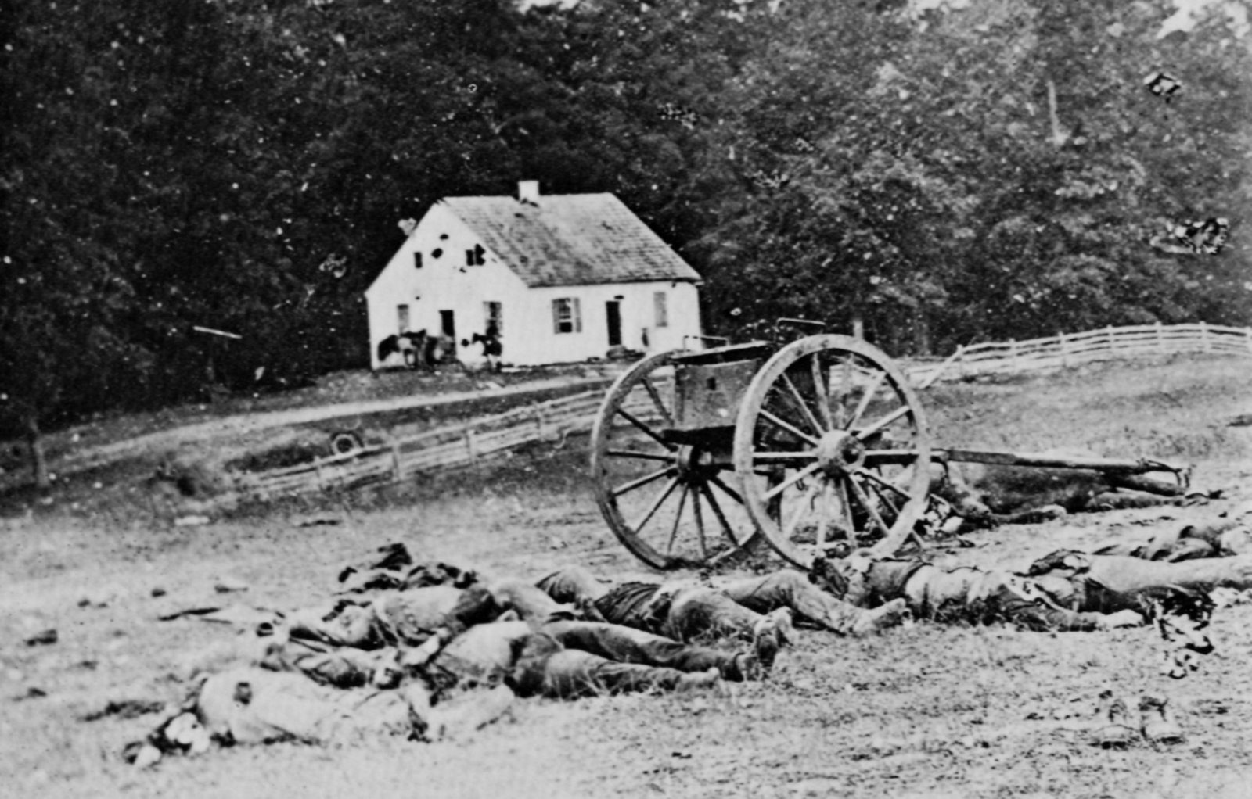

Slide 32
Next Week
On Monday, Tuesday, and Wednesday of next week, we will meet IN THE LIBRARY.
You will be completing some college/career surveys and activities and working on your personal Weebly webpage that will become an important part of your Senior portfolio and can be used in the Senior interview process.
DO NOT COME HERE M,T,W…REPORT STRAIGHT TO THE LIBRARY ALL THREE DAYS!

