Slide 1
Two Ways to Get to Know Each Other
8/12/2020

Slide 2
TODAY’S AGENDA
8/12/2020
Introduction
Google Classroom
Syllabus and Student Contract
Question Time
TODAY’S OBJECTIVES
SL.10.4. Present information, findings,
and supporting evidence clearly,
concisely, and logically

Slide 3
It All Begins With…
Understanding!

Slide 4
Understanding…
that this is NEW to ALL of us!
You’ve never had to go to school like this before, AND I have never had to teach like this before.
It is going to take time and patience on ALL our parts.
I am making a commitment to being patient this year, BUT I need YOU to make a commitment to giving me YOUR BEST WORK.

Slide 5
Understanding…
how this class will work.
Google Classroom
This is the KEY to everything! ALL notes, powerpoints, documents, and assignments will be given through GC.
Syllabus
I have placed a digital copy of the syllabus in GC for you AND YOUR PARENTS/GUARDIANS to look over.
It contains information on EXPECTATIONS, ATTENDANCE, GRADING, MAKE-UP WORK, PLAGIARISM, and more.

Slide 6
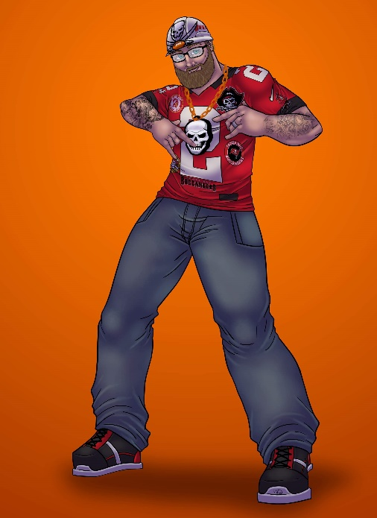
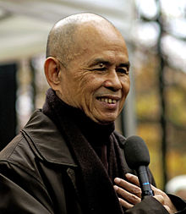
ASSIGNMENT ALERT
SIGNATURES
“Every thought you produce, anything you say, any action you do, it bears your signature”
When you sign something (even digitally):
IT SIGNIFIES YOUR UNDERSTANDING OF THE DOCUMENT YOU SIGN.
IT SIGNIFIES YOUR AGREEMENT WITH WHAT YOU HAVE READ AND UNDERSTOOD.
Thich Nhat Hanh
(1996- )
Vietnamese Monk
and Peace Activist

Slide 7
Understanding…
how this class will work.
Student Contract
In Google Classroom, you have your FIRST ASSIGNMENT.
It is labeled “Student Contract.”
Normally, I would have you sign these and have your parents/guardians sign as well, but since we can not collect physical paper, you will:
READ THE SYLLABUS AND SHARE IT WITH YOUR PARENT/GUARDIAN
MAKE NOTE OF ANY QUESTIONS THAT YOU HAVE REGARDING THE SYLLABUS, OR ANY QUESTIONS NOT ANSWERED BY THE SYLLABUS
TYPE YOUR FULL NAME IN THE BOX PROVIDED IN THE CONTRACT.
HAVE YOUR PARENT/GUARDIAN PUT THEIR NAME IN THE BOX PROVIDED FOR THEM
TURN IT IN BY FRIDAY!

Slide 8
Understanding…
how this class will work.
Tomorrow, we will take time to discuss the syllabus and answer questions you may have.

Slide 9
It All Begins With…
Understanding!
“People don't care how much you know until they know how much you care.” ― Theodore Roosevelt
“You can’t hate someone whose story you know.”
― Margaret J. Wheatley

Slide 10
Understanding…
each other and how we work/teach/learn
Question Time!

Slide 11
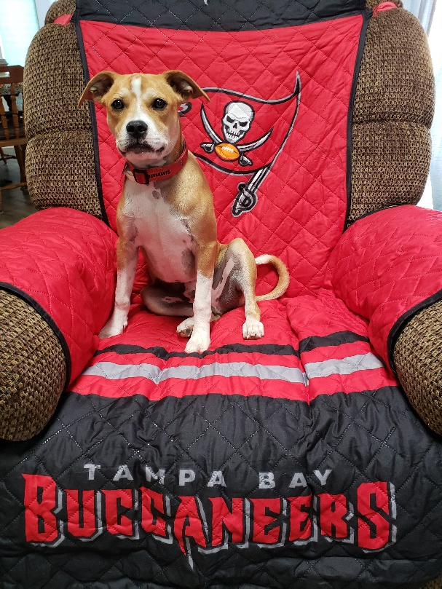
Welcome Back
8/13/2020
Lee Roy
is happy
you are
here!

Slide 12
TODAY’S AGENDA
8/13/2020
Syllabus Discussion / Answer Questions
Understanding Each Other
20 Questions
TODAY’S OBJECTIVES
SL.10.4. Present information, findings,
and supporting evidence clearly,
concisely, and logically.

Slide 13
Two Ways to Get to Know Each Other
20 Questions
60 Second Speeches

Slide 14
20 Questions
Go to Google Classroom
Find the assignment labeled, “20 Questions”
You will be working on this during your Independent Work
time today.

Slide 15
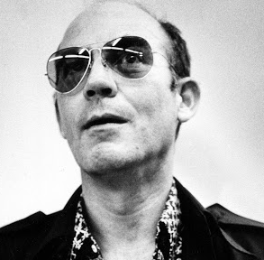
ASSIGNMENT ALERT
CAUTION
“Anything worth doing
is worth
doing right.”
When working on an assignment
in this class:
FOLLOW ALL INSTRUCTIONS
ASK IF YOU DON’T UNDERSTAND
DO YOUR BEST TO DO IT RIGHT
ASK AGAIN IF YOU NEED TO!!
Hunter S. Thompson
(1937-2005)
American Journalist,
And Author

Slide 16
Independent Work Time
Begin Working on
Your 20 Questions
Document.
It is DUE Monday!

Slide 17
ASSIGNMENT ALERT
CAUTION
“Better three hours too soon than a minute too late.”
DUE DATES
ALL assignments will have DUE DATES!
Late work WILL BE ACCEPTED but MAY LOSE POINTS!
See the SYLLABUS for Late Work Policy specifics
William Shakespeare
(1564 – 1616)
Poet, Playwright, actor

Slide 18
Welcome Back
8/14/2020
Lee Roy
is tired too, but here we go!

Slide 19
TODAY’S AGENDA
8/14/2020
Answer Questions
Understanding Each Other
60 Second Speeches
TODAY’S OBJECTIVES
SL.10.4. Present information, findings,
and supporting evidence clearly,
concisely, and logically.

Slide 20
60 Second Speeches
Go to Google Classroom
Find the assignment labeled, “60 Second Speeches”
This includes: Information, Instructions, and an
OUTLINE that will be TURNED IN

Slide 21
60 Second Speeches
Your speech must include:
Name
Age
Your speech may include:
Where did your name come from? What is significant about it?
Where and when were you born?
Family – Tell about them – parents (or whomever you live with), brothers and sisters (or whomever lives with you)?
Hobbies – What do you like to do in your free time (sports, video games, etc.)?
Favorites – foods, places to hang out, sports teams, activities, movies, TV shows, etc.
You will submit to me:
An outline of your speech
Make sure you keep a copy for yourself to use when you speak in front of the class.
You will be graded using the following criteria:
Content – Did you give enough information?
Time – You will lose points for going over or under time. One point will be deducted for every 5 seconds over or under 1 minute.
Fluency – You will lose points for “umm,” “uhh,” or awkward pauses in your speech.
**PRACTICE GIVING YOUR SPEECH (IN FRONT OF A MIRROR OR FOR YOUR FAMILY OR FRIENDS! TIMING AND FLUENCY OF SPEECH ARE IMPORTANT**

Slide 22
60 Second Speeches
You WILL NOT be delivering your speeches to the class,
BUT
They MAY be viewed by your classmates!
For your 60 Second Speeches, we will be using
FLIPGRID

Slide 23
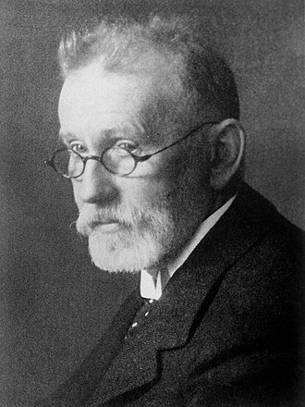
ASSIGNMENT ALERT
NEW TECH
“To err is human, but to really foul things up you need a computer.”
Go to Google Classroom … In the COURSE STREAM, find my announcement about Flipgrid. It contains your LINK to join the Flipgrid Group for this class!
In the Flipgrid Group, you will find a Topic labeled, “60 Second Speeches.”
I have left you an example. You can watch it later if you want to see how I did mine!
Now that you are SIGNED IN to the group, you should be able to record a video response to my example.
Paul Ehrlich
(1854 – 1915)
Nobel prize-winning
German physician
and scientist

Slide 24
Independent Work Time
Begin Working on
Your 60 Second Speech Outline.
It is DUE NEXT WEDNESDAY 8/19!

