Slide 1
Start-Up - Discussion
1/9/18
In your triads, discuss the following:
Have you ever been lied to? How did it make you feel? When you found out the truth, did it change how you viewed the person who lied to you?

Slide 2
Start-Up - Writing
1/9/18
Now write about what the partner to your right had to say:
Have you ever been lied to? How did it make you feel? When you found out the truth, did it change how you viewed the person who lied to you?

Slide 3
Today we will be discussing…
Source Credibility
Specifically with regard to internet research.

Slide 4
Unit Objectives
1- By the end of the unit, students will be able to cite strong and thorough textual evidence to support analysis of what the text says explicitly as well as inferences drawn from the text.
CCSS.ELA-LITERACY.RI.9-10.1

Slide 5
Unit Objectives
2- By the end of the unit, students will be able to write arguments to support claims in an analysis of substantive topics or texts, using valid reasoning and relevant and sufficient evidence.
CCSS.ELA-LITERACY.W.9-10.1

Slide 6
Unit Objectives
3- By the end of the unit, students will be able to delineate and evaluate the argument and specific claims in a text, assessing whether the reasoning is valid and the evidence is relevant and sufficient; identify false statements and fallacious reasoning.
CCSS.ELA-LITERACY.RI.9-10.8

Slide 7
Today’s Objective
By the end of the period, students will understand and be able to define what credibility means as it relates to web research. They will be able to understand the CRAAP method for determining the credibility of the sources they use.
CCSS.ELA-LITERACY.RI.9-10.8

Slide 8
CREDIBILITY
Definition:
1) The quality of being trusted.
2) The quality of being convincing or believable.
Definition Location: https://www.google.com/search?rlz=1C1CHFX_enUS507&oq=credibility&sugexp=chrome,mod=0&sourceid=chrome&ie=UTF-8&q=credibility&safe=active#hl=en&safe=active&rlz=1C1CHFX_enUS507&sclient=psy-ab&q=define:+credibility&oq=define:+credibility&gs_l=serp.3...4426.5384.0.5567.8.8.0.0.0.6.187.989.0j7.7.0.les%3B..0.0...1c.1.gcH2UsFheZc&pbx=1&fp=1&bpcl=35466521&biw=1280&bih=923&bav=on.2,or.r_gc.r_pw.r_cp.r_qf.&cad=b&sei=6pSNUL2WConk9ATH64GYDQ

Slide 9
Group Conversation
Why is credibility important? How do you know if a source is credible or not?
Consider this video.
What assumptions has this woman made? What does this clip tell us about information on the internet?
Notes:
https://www.youtube.com/watch?v=3DZbSlkFoSU

Slide 10
Evaluating Sources
You should ALWAYS determine a source's credibility BEFORE using it.
Do not waste your time on a source that makes your research questionable!

Slide 11
Evaluating Sources
So what steps can you take to ensure you are using a credible source?
One way is to use The C.R.A.A.P. METHOD
Please complete the notetaking handout as you watch this next video – you will be asked to use this method to evaluate sources.
Notes:
https://youtu.be/EyMT08mD7Ds

Slide 12
Let’s do a Quick Review
1- _CURRENCY____________________. When was the information ___PUBLISHED____________, __EDITED___________________, and/or ___REVISED____________________?
2- R is for __RELEVANCE____________________. Does it provide a __SUPERFICIAL______ treatment or a detailed __ANALYSIS________?Is the information ____RELATED_______ and relevant to your topic? Is the ___READERSHIP___________ level appropriate?

Slide 13
A is for _AUTHORITY_. Who are the ___AUTHORS_ and/or __EDITORS_ and what are their __CREDENTIALS_?
A is for _ACCURACY_. Does the source match your UNDERSTANDING_of the topic? Can you _VERIFY_ the claims in other sources? NEVER rely on just one source! Is there a _BIBLIOGRAPHY_ or list of works cited?

Slide 14
P is for __PURPOSE_. Is the _PURPOSE_ stated? Is the subject approached from an __OBJECTIVE_________ standpoint? If not, what is the author’s _BIAS_ and how might it __INFLUENCE_ the information presented?
Using these criteria to CRITICALLY_ __EVALUATE_ sources of information will help to ensure that you’re only using QUALITY SOURCES of information!

Slide 15
C.R.A.A.P. FORM
 | Questions | Answers/Notes | Usable Source Y or N
CURRENCY | When was the information published, edited, or revised?
RELEVANCE | How is it related to your topic? Does it give enough detail? Is the reading level appropriate?
 | What is unique about the site? Does it offer something others do not?
 | Would you get better information in a book? An encyclopedia?
AUTHORITY | Who is/are the author(s) or editor(s)?
 | What are their credentials?
ACCURACY | Can you verify claims made by the source? Does it provide citations, references or a bibliography/work cited?
 | What are the authors documented sources?
PURPOSE | Is the purpose of the article/source stated?
 | Is the subject approached objectively? If not, what is the author’s bias? How do you know?

Slide 16
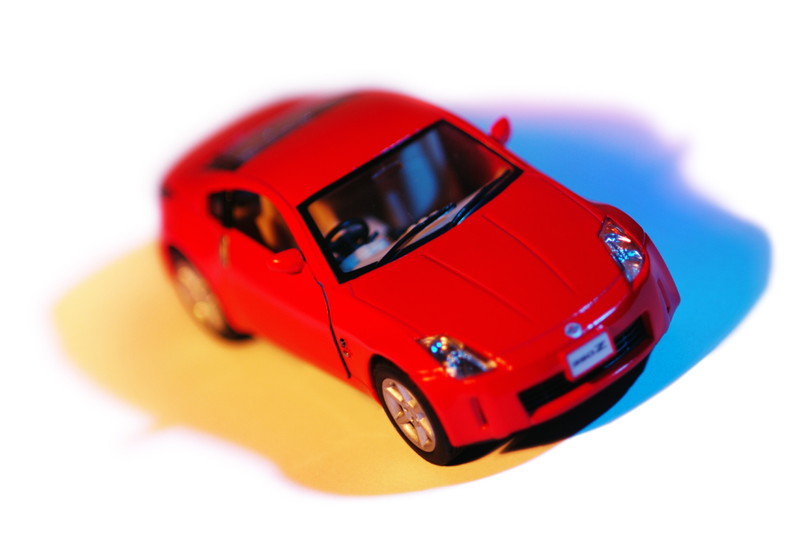
Let’s Practice
You have saved your hard earned money and now you’re ready to buy your first new car – What step do you take next?

Slide 17
Do you go directly to the car dealer and buy that car?
Would you ask a friend or family member that has the same type of car for information/advice?
Would you maybe want to check Consumer reports to find if it really gets the gas mileage it is supposed to? How often it breaks down?
Something else?

Slide 18
Let’s Consider the Car Dealer
Currency – Is his information up to date?
Relevant – Will he give you all the right information to make an informed decision – or just tell you how great the stereo sounds?
Authority – Is the car dealer an expert? An expert at cars or an expert at sales?
Accuracy – This is where you should confirm what the salesman tells you by checking other sources
Purpose – What is the car salesman ultimate goal here? So perhaps a bit of bias might be involved?

Slide 19
One More Hint
CHECK THE TOP-LEVEL DOMAIN NAME
Definition:
The rightmost label in a domain name or URL.
Definition Location: http://support.microsoft.com/kb/300684
Examples: .com .edu .gov
.org .mil .net

Slide 20
Domain Names
.com
Commercial site. The information provided by commercial interests is generally going to shed a positive light on the product it promotes. While this information might not necessarily be false, you might be getting only part of the picture.
.edu
Educational institution. Sites using this domain name are schools ranging from kindergarten to higher education. If you take a look at your school's URL you'll notice that it ends with the domain .edu. Information from sites within this domain must be examined very carefully. If it is from a department or research center at a educational institution, it can generally be taken as credible.

Slide 21
Domain Names
.gov
Government. If you come across a site with this domain, then you're viewing a federal government site. All branches of the United States federal government use this domain. Information such as Census statistics, Congressional hearings, and Supreme Court rulings would be included in sites with this domain. The information is considered to be from a credible source.
.org
Traditionally a non-profit organization. Organizations such as the American Red Cross or PBS (Public Broadcasting System) use this domain suffix. Generally, the information in these types of sites is credible and unbiased, but there are examples of organizations that strongly advocate specific points of view over others, such as the National Right to Life Committee and Planned Parenthood. You probably want to give this domain a closer scrutiny these days.

Slide 22
Domain Names
.mil
Military. This domain suffix is used by the various branches of the Armed Forces of the United States.
.net
Network. You might find any kind of site under this domain suffix. It acts as a catch-all for sites that don't fit into any of the preceding domain suffixes. Information from these sites should be given careful scrutiny.

Slide 23
TOMORROW it’s YOUR TURN!
Tomorrow, you will be given two articles to evaluate using the CRAAP Method.
You will decide, based on your results, which article would be the best to use.
You will include a one paragraph explanation of why that article is more CREDIBLE!
Your CRAAP forms and your paragraph will be due Thursday!

Slide 24
EXIT TICKET
In what ways do you think using a source that is not credible is similar to being lied to?
1/9/18

Slide 25
Start-Up - Discussion
1/10/18
In your triads, discuss the following:
Of the 5 categories of evaluation in the CRAAP Method (Currency, Relevance, Authority, Accuracy, and Purpose), which one would you say is the MOST IMPORTANT when evaluating a source?

Slide 26
Start-Up - Writing
1/10/18
Now write about the following:
Of the 5 categories of evaluation in the CRAAP Method (Currency, Relevance, Authority, Accuracy, and Purpose), which one would you say is the MOST IMPORTANT when evaluating a source?

Slide 27
Unit Objectives
1- By the end of the unit, students will be able to cite strong and thorough textual evidence to support analysis of what the text says explicitly as well as inferences drawn from the text.
CCSS.ELA-LITERACY.RI.9-10.1

Slide 28
Unit Objectives
2- Write arguments to support claims in an analysis of substantive topics or texts, using valid reasoning and relevant and sufficient evidence.
CCSS.ELA-LITERACY.W.9-10.1

Slide 29
Unit Objectives
3- Delineate and evaluate the argument and specific claims in a text, assessing whether the reasoning is valid and the evidence is relevant and sufficient; identify false statements and fallacious reasoning.
CCSS.ELA-LITERACY.RI.9-10.8

Slide 30
Today’s Objective
By the end of the period, students will be able to understand the CRAAP method for determining the credibility of the sources they use and have an opportunity to practice the use of that method.
CCSS.ELA-LITERACY.RI.9-10.8

Slide 31
Let’s Give It a Try
I am doing some research on the harmful
effects of video games.
In order to make sure my research paper
is accurate, I have to search for
CREDIBLE SOURCES!
In my search for sources, I found two that I think might contain information I can use.
The question is: WHICH ONE SHOULD I
USE???
For that, I use the CRAAP Test!

Slide 32
Potential Sources
Article 1
Article 2

Slide 33
Article 1
 | Questions: | Answers: | Usable source?
Currency | When was the information published, edited, or revised? | 10/21/15 | Y or N
Relevance | How is it related to your topic? Does it give enough detail? Is the reading level appropriate? | It’s more about how to stop the bad effects. Not much actual details. | Y or N
Authority | Who is/are the author(s) or editor(s)? What are their credentials? | Mark Knapp. Gaming editor, not medical expert. | Y or N
Accuracy | Can you verify claims made by the source? Does it provide citations, references or a bibliography/work cited? | No sources listed. No way to verify claims. | Y or N
Purpose | Is the purpose of the article/source stated? Is the subject approached objectively? If not, what is the author’s bias? | The purpose is more to tell how to correct for the bad effects of gaming. The author is a gamer so he is probably in favor of gaming. | Y or N

Slide 34
Article 2
 | Questions: | Answers: | Usable source?
Currency | When was the information published, edited, or revised? | 10/15/15 | Y or N
Relevance | How is it related to your topic? Does it give enough detail? Is the reading level appropriate? | It discusses the effects of video games on vision, behavior and brain activity. It has details. | Y or N
Authority | Who is/are the author(s) or editor(s)? What are their credentials? | Dr. Michelle Noonan. PhD in Neuroscience. Published in medical journals. | Y or N
Accuracy | Can you verify claims made by the source? Does it provide citations, references or a bibliography/work cited? | The article has references listed that I can check. | Y or N
Purpose | Is the purpose of the article/source stated? Is the subject approached objectively? If not, what is the author’s bias? | To point out specific effects of video games on specific brain regions. She mentions possible positives too, so no bias shown. | Y or N

Slide 35
YOUR TURN
In the document provided, there are two CRAAP forms.
I have given you the URLs, Article Titles, and Author’s Names for two articles that both deal with the same topic.

Slide 36
YOUR TURN
Your job is to read both articles and then evaluate them using the CRAAP Form to see which one would be the better to use for a research paper.
Once you have evaluated both sources, you will write a paragraph in which you explain which of the two articles is more credible based on your CRAAP Evaluation form results.
You must give specific examples from the articles themselves or from the websites where the articles are found to support your claim.

Slide 37
HOMEWORK
Complete your C.R.A.A.P. Evaluation practice forms and paragraphs.
They are
DUE TOMORROW!

Slide 38
Exit Ticket
1/10/18
Of the 5 categories of evaluation in the CRAAP Method (Currency, Relevance, Authority, Accuracy, and Purpose), which one would you say is the LEAST IMPORTANT when evaluating a source?

