Slide 1
Start-Up - Discussion
4/13/18
In your triads, discuss the following:
Look at this short list of historical terms:
Jim Crow Laws, KKK, Segregation/Desegregation,
The Great Depression, The Scottsboro Boys,
Brown vs. The Board of Education
Which of the things on this list are you familiar with?
Discuss these items with your group. Share your knowledge with them and gain knowledge from them.

Slide 2
Start-Up - Writing
4/13/18
Now write about the following:
Choose the item from this short list of historical terms with which you are the MOST familiar:
Jim Crow Laws, KKK, Segregation/Desegregation,
The Great Depression, The Scottsboro Boys,
Brown vs. The Board of Education
In your own words, define the term you chose and explain it’s significance in American history.

Slide 3
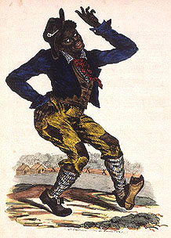
“Jim Crow” Laws
From the 1880s to the 1960s most states enforced segregation through the “Jim Crow” laws named after a black-faced character in minstrel shows.
Through these laws legal punishments could be imposed on people for having contact with members of another race.

Slide 4
Jim Crow Guide
1. A Black male could not offer his hand (to shake hands) with a White male because it implied being socially equal. Obviously, a Black male could not offer his hand or any other part of his body to a White woman, because he risked being accused of rape.
2. Blacks and Whites were not supposed to eat together. If they did eat together, Whites were to be served first, and some sort of partition was to be placed between them.
3. Under no circumstance was a Black male to offer to light the cigarette of a White female -- that gesture implied intimacy.
4. Blacks were not allowed to show public affection toward one another in public, especially kissing, because it offended Whites.

Slide 5
Jim Crow Guide
5. Blacks were introduced to Whites, never Whites to Blacks.
6. Whites did not use courtesy titles of respect when referring to Blacks, for example, Mr., Mrs., Miss., Sir, or Ma'am. Instead, Blacks were called by their first names or by “boy” or “girl” (regardless of age). Blacks had to use courtesy titles when referring to Whites, and were not allowed to call them by their first names.
7. If a Black person rode in a car driven by a White person, the Black person sat in the back seat, or the back of a truck.
8. White motorists had the right-of-way at all intersections.

Slide 7
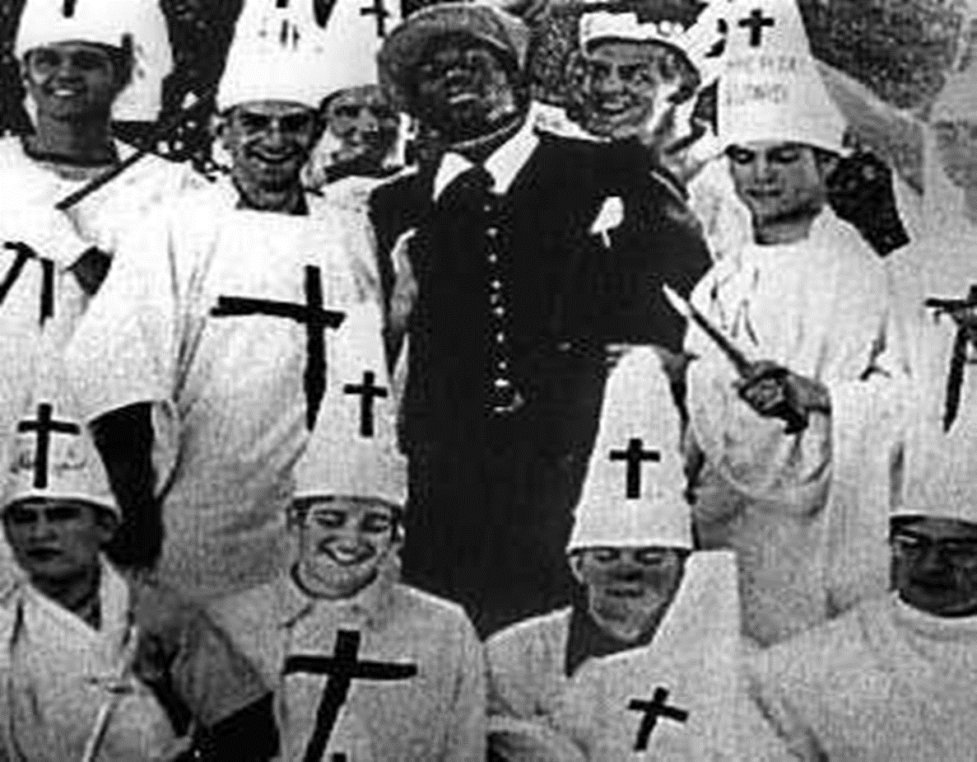
The KKK
After the Civil War, The Ku Klux Klan was formed as a secret society that promoted white supremacy using violence and terrorism to undo the gains that former slaves had made.
However, after the 1920s the KKK was no longer secretive about their work and public violence against Blacks, including lynching, became common occurrences.

Slide 8
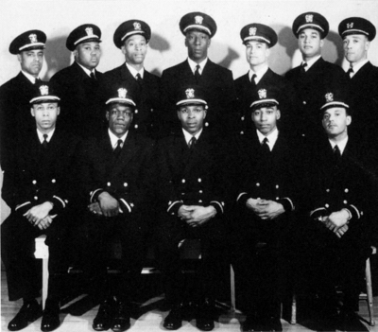
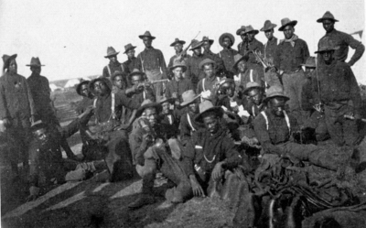
After WW1
Even though Blacks had fought bravely for the US in WW1, they returned home from Europe to find the same, if not worse, discrimination and segregation.
The economic struggles of the 1930s seemed only to worsen the situation.

Slide 9
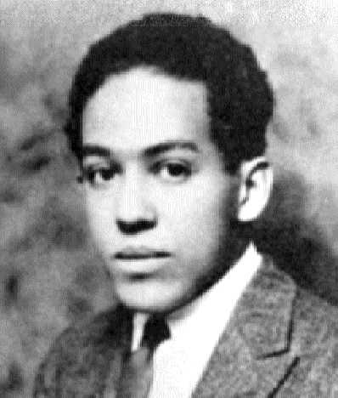
Langston Hughes (1902-1967)
“Will V-Day Be Me-Day Too?”
…I am a Negro American
Out to defend my land…
I’ve seen my buddy lying
Where he fell.
I’ve watched him dying
I promised him that I would try
To make our land a land
Where his son could be a man –
And there’d be no Jim Crow birds
Left in our sky…
So this is what I want to know:
When we see Victory’s glow,
Will you still let old Jim Crow
hold me back?
…will Dixie Lynch me still
When I return?…

Slide 10
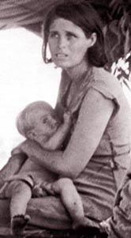
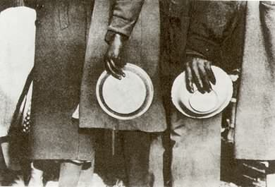
The Great Depression (1930s)
The Depression hit the South especially hard
Everyone seemed to be living in poverty
Americans turned away from the rest of the world and away from each other
During these years of turmoil, discontent started to grow in the minds of Whites and Blacks alike.

Slide 11
Inspiration for the Story
When Harper Lee was a child, the Scottsboro Trials took place in Alabama.
These trials are commonly thought to be the inspiration for To Kill a Mockingbird, though Lee denies this.

Slide 12
The Scottsboro Boys
On March 25, 1931, the nine black young men, as well as several white young men, rode a train illegally.
The boys got into a fight, and the white boys were kicked off the train.
They told station masters at the closest stop they had been beaten by the black boys. Police arranged to arrest them at the next station.

Slide 13
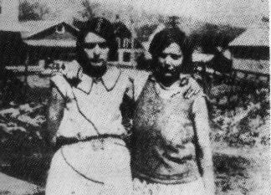
The Scottsboro Boys
At the next stop, to avoid being punished themselves, Ruby Bates and Victoria Price – both prostitutes -- claimed the black boys raped them.
Bates later recanted her story.
On March 30, 1931, all of the
Scottsboro Boys were indicted
by an all-white jury.
Ruby Bates and Victoria Price
in 1931

Slide 14
The Scottsboro Boys
Because their parents could not afford good lawyers, all were convicted and sentenced to death – even 13-year-old Roy Wright.
Wright’s trial was declared a mistrial.
The cases quickly became famous, causing rallies and riots.

Slide 15
The Scottsboro Boys
In November, the U.S. Supreme Court overturned all the convictions on the ground that due process was not followed.
The State of Alabama had not provided legal counsel to any of the defendants.
The new trials began in March 1933, with each defendant tried separately.
There were a total of four rounds of trials.

Slide 16
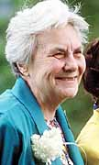
Harper Lee (1926-2016)
To add to the complexity of the story, Harper Lee wrote it during a time of even greater social turbulence in the United States.
In the 1950s the winds of change began to blow and Black Americans were no longer willing to be treated as lesser human beings.

Slide 17
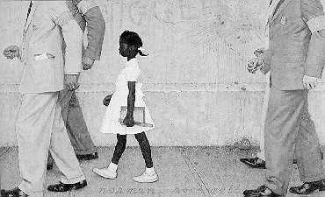
Brown vs. Board of Education
In 1954, after 2 years in court, the nation was shocked by a landmark decision to grant Linda Brown, a Black fifth-grader, admission into a white elementary school in Topeka, Kansas.
The decision engendered feelings of triumph and outrage across a country that had lived under the weight of racial segregation and discrimination for over 100 years.

Slide 18
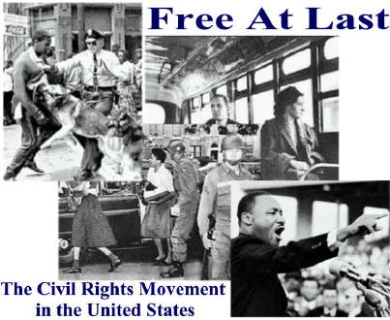
The Winds of Change
Soon, average Black citizens across the country began speaking out against oppression and demanding equal rights. This was the beginning of America’s Civil Rights Movement.

Slide 19
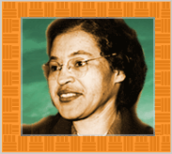
Rosa Parks (1913-2005)
In 1955, after a long day of work, 42-year-old Rosa Parks refused to give up her seat to a white man on a Montgomery County bus
This set off peaceful and violent protests throughout the South.

Slide 20
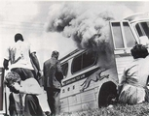
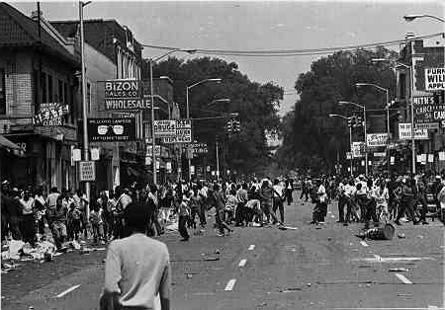
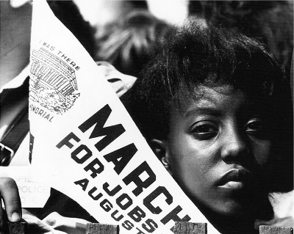
Television Changes Everything
By this time, many families had televisions and as images of Southern race riots and violent protests reached into American homes the magnitude of Southern racism began to sink into the American consciousness.
Moreover, the rest of the world began to frown upon America’s treatment of Blacks, and segregation, like slavery, became a national embarrassment for a country who had fought in two world wars as great liberators of the down-trodden masses.

Slide 21
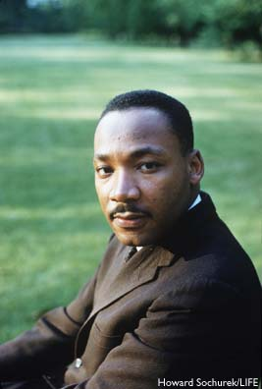
Dr. Martin Luther King (1929-1968)
Black Hero-Leaders began to rally together Black Americans in order to fight oppression and for a country where all men were truly treated as equals.

Slide 22
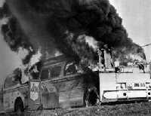
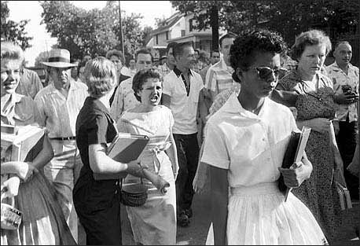
Desegregation
A national and international call for desegregation of the South rang out and Blacks and Whites all over the country started putting pressure on governments to amend the segregation laws.
Those individuals, both Black and White, who fought for Civil Rights were under constant attack from White Supremacists who were unwilling to accept Black Americans as equals
Many freedom-fighters died for their efforts

Slide 23
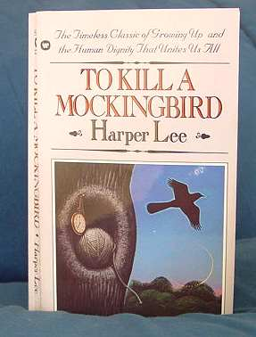
To Kill a Mockingbird
In the Fall of 1960, in the middle of the Civil Rights Movement, To Kill a Mockingbird was published.
It shot to the top of the New York Times best seller list.
A country was finally ready to listen to the story of segregation and open their minds to the possibility of an America where Whites and Blacks could live together as equals.

Slide 24
Exit Ticket
4/13/18
Now write about the following:
Choose one item from this short list of historical terms with which you were NOT familiar:
Jim Crow Laws, KKK, Segregation/Desegregation,
The Great Depression, The Scottsboro Boys,
Brown vs. The Board of Education
Now that we have reviewed them, in your own words, define the term you chose and explain it’s significance in American history.

Slide 25
Start-Up - Discussion
4/16/18
In your triads, discuss the following:
After our discussion last Friday about the historical context, what do you think the setting of the novel will be?
How do you think the great depression might affect the characters in the novel?
What do you think their attitudes towards black people might be?

Slide 26
Start-Up - Writing
4/16/18
Write about the following:
After our discussion last Friday about the historical context, what do you think the setting of the novel will be?
How do you think the great depression might affect the characters in the novel?
What do you think their attitudes towards black people might be?

Slide 27
Unit Objectives
CCSS.ELA-LITERACY.RL.9-10.1
Cite strong and thorough textual evidence to support analysis of what the text says explicitly as well as inferences drawn from the text.
CCSS.ELA-LITERACY.RL.9-10.2
Determine a theme or central idea of a text and analyze in detail its development over the course of the text, including how it emerges and is shaped and refined by specific details; provide an objective summary of the text.
CCSS.ELA-LITERACY.RL.9-10.3
Analyze how complex characters (e.g., those with multiple or conflicting motivations) develop over the course of a text, interact with other characters, and advance the plot or develop the theme.

Slide 28
Today’s Objective
Analyze the first chapter of a novel to identify details that establish point of view, character, and setting.

Slide 29
As We Read…
Note any words and phrases that give you clues about the narrator’s personality and establish her voice.
Look for unknown words and phrases. Try to determine the meaning of the words by using context clues, word parts, or a dictionary.
Note the names of characters who are related to the narrator as well as the words that tell you how they are related.

Slide 30
Homework
Vocabulary for Chapters 1-5
DUE TOMORROW
To Kill Questions for Chapter 1 in Google Classroom
DUE MONDAY

Slide 31
Exit Ticket
4/16/18
Write about the following:
Write a short description of the character of Scout.
What do we know about her based on what we read today?

Slide 32
Start-Up - Discussion
4/17/18
In your triads, discuss the following:
Based on yesterday’s reading, why do you think the people of Maycomb were not friendly with the Radley family?
What are some specific things the Radley’s did or did not do that made people wonder about them?

Slide 33
Start-Up - Writing
4/17/18
Write about the following:
Based on yesterday’s reading, why do you think the people of Maycomb were not friendly with the Radley family?
What are some specific things the Radley’s did or did not do that made people wonder about them?

Slide 34
Unit Objectives
CCSS.ELA-LITERACY.RL.9-10.1
Cite strong and thorough textual evidence to support analysis of what the text says explicitly as well as inferences drawn from the text.
CCSS.ELA-LITERACY.RL.9-10.2
Determine a theme or central idea of a text and analyze in detail its development over the course of the text, including how it emerges and is shaped and refined by specific details; provide an objective summary of the text.
CCSS.ELA-LITERACY.RL.9-10.3
Analyze how complex characters (e.g., those with multiple or conflicting motivations) develop over the course of a text, interact with other characters, and advance the plot or develop the theme.

Slide 35
Today’s Objectives
Analyze fictional text and make connections to characters and plot events.

Slide 36
As We Read…
Look at the conflict between Scout and Miss Caroline.
Find quotes that serve as evidence that Scout and Miss Caroline are both “starting off on the wrong foot in every way.”

Slide 37
Homework
Read Chapter 3 in
To Kill a Mockingbird
Answer the questions for Chapters
1-3 in the Google Classroom Document “To Kill Questions Chapters 1-5”
DUE MONDAY 4/23
Study vocabulary. There will be a quiz on Friday!

Slide 38
Exit Ticket
4/17/18
Write about the following:
Much is said about Boo Radley in the second half of Chapter 1.
Give two examples of things that were said that you think are true and two examples of things you think are just rumors.

Slide 39
Start-Up - Discussion
4/18/18
In your triads, discuss the following:
How does Atticus describe the Ewell family in Chapter 3 (40-41)? Give specific examples.
Why do you think he says that the Ewells are “members of an exclusive society made up of Ewells?”

Slide 40
Start-Up - Writing
4/18/18
Write about the following:
How does Atticus describe the Ewell family in Chapter 3 (40-41)? Give specific examples.
Why do you think he says that the Ewells are “members of an exclusive society made up of Ewells?”

Slide 41
Unit Objectives
CCSS.ELA-LITERACY.RL.9-10.1
Cite strong and thorough textual evidence to support analysis of what the text says explicitly as well as inferences drawn from the text.
CCSS.ELA-LITERACY.RL.9-10.2
Determine a theme or central idea of a text and analyze in detail its development over the course of the text, including how it emerges and is shaped and refined by specific details; provide an objective summary of the text.
CCSS.ELA-LITERACY.RL.9-10.3
Analyze how complex characters (e.g., those with multiple or conflicting motivations) develop over the course of a text, interact with other characters, and advance the plot or develop the theme.

Slide 42
Today’s Objectives
Analyze fictional text and make connections to characters and plot events.

Slide 43
Homework
Finish Reading Chapter 4
Answer the questions for Chapters
1-4 in the Google Classroom Document “To Kill Questions Chapters 1-5”
DUE MONDAY 4/23

Slide 44
Exit Ticket
4/18/18
Write about the following:
What did Scout find in the knot in the tree?
What did Scout and Jem find the second time?
Where do you think those things came from and why would they be left there?

Slide 45
Start-Up - Discussion
4/19/18
In your triads, discuss the following:
At the end of Chapter 4, Scout says that there were two reasons why she wanted to stop playing “Boo Radley.”
What were they?
Which one of the two reasons would you say had more of an affect on her?
Do you think Atticus knew what they were playing?

Slide 46
Start-Up - Writing
4/19/18
Write about the following:
At the end of Chapter 4, Scout says that there were two reasons why she wanted to stop playing “Boo Radley.”
What were they?
Which one of the two reasons would you say had more of an affect on her?
Do you think Atticus knew what they were playing?

Slide 47
Unit Objectives
CCSS.ELA-LITERACY.RL.9-10.1
Cite strong and thorough textual evidence to support analysis of what the text says explicitly as well as inferences drawn from the text.
CCSS.ELA-LITERACY.RL.9-10.2
Determine a theme or central idea of a text and analyze in detail its development over the course of the text, including how it emerges and is shaped and refined by specific details; provide an objective summary of the text.
CCSS.ELA-LITERACY.RL.9-10.3
Analyze how complex characters (e.g., those with multiple or conflicting motivations) develop over the course of a text, interact with other characters, and advance the plot or develop the theme.

Slide 48
Today’s Objectives
Review vocabulary from Chapters 1-5
Analyze fictional text and make connections to characters and plot events.

Slide 49
Vocabulary Review
Shall we…
SLAM?

Slide 50
Small Group Read…
Today you will be doing a read around in your groups.
Each person must take a turn reading and read at least two paragraphs.
You are responsible for reading Pages 54-61 (stop @ “Next morning”).
If your group does not finish the reading, you are responsible for finishing to page 61 for homework.

Slide 51
As You Read…
Pay attention to what Miss Maudie says about Arthur “Boo” Radley.
When you finish…
Work on Chapter Questions

Slide 52
Homework
Answer the questions for Chapters
1-5 in the Google Classroom Document “To Kill Questions Chapters 1-5”
DUE MONDAY 4/23
STUDY VOCABULARY!
QUIZ TOMORROW!

Slide 53
Exit Ticket
4/19/18
Write about the following:
What do you think Miss Maudie was trying to tell Scout when she mentioned the Bible and a bottle of whiskey?
What sort of man do you think Boo Radley’s father was?
How do you think that might have affected Boo?

Slide 54
No Start-Up Today You have a VOCAB QUIZ
4/20/18

Slide 55
Unit Objectives
CCSS.ELA-LITERACY.RL.9-10.1
Cite strong and thorough textual evidence to support analysis of what the text says explicitly as well as inferences drawn from the text.
CCSS.ELA-LITERACY.RL.9-10.2
Determine a theme or central idea of a text and analyze in detail its development over the course of the text, including how it emerges and is shaped and refined by specific details; provide an objective summary of the text.
CCSS.ELA-LITERACY.RL.9-10.3
Analyze how complex characters (e.g., those with multiple or conflicting motivations) develop over the course of a text, interact with other characters, and advance the plot or develop the theme.

Slide 56
Today’s Objectives
Review vocabulary from Chapters 1-5
Analyze fictional text and make connections to characters and plot events.

Slide 57
Independent Read
When you are finished with your quiz, get out your book and begin reading Chapter 5 where your group left off yesterday.
Read Pages 61 to the end of the chapter.
If you do not finish the reading in class, you are responsible for finishing it for homework.

Slide 58
Homework
Answer the questions for Chapters
1-5 in the Google Classroom Document “To Kill Questions Chapters 1-5”
DUE MONDAY 4/23 by 7:00 a.m.

Slide 59
NO Exit Ticket Today (Don’t forget to check Google Classroom this afternoon after 3:00 if you are looking to reclaim points on your essay)
4/20/18

Slide 60
Start-Up - Discussion
4/23/18
In your triads, discuss the following:
What was Jem and Dill’s plan regarding Boo Radley in Chapter 5?
How did they get caught?
How did Atticus trick Jem?

Slide 61
Start-Up - Writing
4/23/18
Write about the following:
What was Jem and Dill’s plan regarding Boo Radley in Chapter 5?
How did they get caught?
How did Atticus trick Jem?

Slide 62
Unit Objectives
CCSS.ELA-LITERACY.RL.9-10.1
Cite strong and thorough textual evidence to support analysis of what the text says explicitly as well as inferences drawn from the text.
CCSS.ELA-LITERACY.RL.9-10.2
Determine a theme or central idea of a text and analyze in detail its development over the course of the text, including how it emerges and is shaped and refined by specific details; provide an objective summary of the text.
CCSS.ELA-LITERACY.RL.9-10.3
Analyze how complex characters (e.g., those with multiple or conflicting motivations) develop over the course of a text, interact with other characters, and advance the plot or develop the theme.

Slide 63
Today’s Objectives
Analyze fictional text and make connections to characters and plot events.

Slide 64
Homework
READ CHAPTER 7
(quiz tomorrow)
CH 6-10 Vocabulary – DUE WEDNESDAY
Work on the questions for Chapter
6-7 in the Google Classroom Document “To Kill Questions Chapters 6-10”
DUE MONDAY 4/30

Slide 65
Exit Ticket
4/23/18
Write about the following:
What were some of the things Jem and Scout found in the knot in the tree?
What were there thoughts as to where the things were coming from?
What happened to the knot in the tree and why?

Slide 66
Start-Up - Discussion
4/23/18
In your triads, discuss the following:
What was Jem and Dill’s plan regarding Boo Radley in Chapter 5?
How did they get caught?
How did Atticus trick Jem?

Slide 67
Start-Up - Writing
4/23/18
Write about the following:
What was Jem and Dill’s plan regarding Boo Radley in Chapter 5?
How did they get caught?
How did Atticus trick Jem?

Slide 68
Unit Objectives
CCSS.ELA-LITERACY.RL.9-10.1
Cite strong and thorough textual evidence to support analysis of what the text says explicitly as well as inferences drawn from the text.
CCSS.ELA-LITERACY.RL.9-10.2
Determine a theme or central idea of a text and analyze in detail its development over the course of the text, including how it emerges and is shaped and refined by specific details; provide an objective summary of the text.
CCSS.ELA-LITERACY.RL.9-10.3
Analyze how complex characters (e.g., those with multiple or conflicting motivations) develop over the course of a text, interact with other characters, and advance the plot or develop the theme.

Slide 69
Today’s Objectives
Analyze fictional text and make connections to characters and plot events.

Slide 70
Homework
READ CHAPTER 7
(quiz tomorrow)
CH 6-10 Vocabulary – DUE WEDNESDAY
Work on the questions for Chapter
6-7 in the Google Classroom Document “To Kill Questions Chapters 6-10”
DUE MONDAY 4/30

Slide 71
Exit Ticket
4/23/18
Write about the following:
Why did Scout say that she and Jem were “parting ways?”
What does she mean by that?
How is the relationship between them changing?

Slide 72
Start-Up - QUIZ
4/24/18
Your Start-up for today is the quiz on Chapter 7.
The link is in Google Classroom.
You have 5 minutes to complete the quiz.

Slide 73
Unit Objectives
CCSS.ELA-LITERACY.RL.9-10.1
Cite strong and thorough textual evidence to support analysis of what the text says explicitly as well as inferences drawn from the text.
CCSS.ELA-LITERACY.RL.9-10.2
Determine a theme or central idea of a text and analyze in detail its development over the course of the text, including how it emerges and is shaped and refined by specific details; provide an objective summary of the text.
CCSS.ELA-LITERACY.RL.9-10.3
Analyze how complex characters (e.g., those with multiple or conflicting motivations) develop over the course of a text, interact with other characters, and advance the plot or develop the theme.

Slide 74
Today’s Objectives
Analyze fictional text and make connections to characters and plot events.

Slide 75
Homework
FINISH READING CHAPTER 8
CH 6-10 Vocabulary – DUE TOMORROW
BY 7:00 a.m.
Work on the questions for Chapter
6-8 in the Google Classroom Document “To Kill Questions Chapters 6-10”
DUE MONDAY 4/30

Slide 76
Exit Ticket
4/24/18
Write about the following:
When was the last time it snowed in Maycomb?
What did Jem want to do?
How did he end up doing it?
Why did Atticus make him change it?

Slide 77
Start-Up - Writing
4/25/18
Write about the following:
Where did the blanket come from that was wrapped around Scout?
Why does this make sense based on what we already know?

Slide 78
Unit Objectives
CCSS.ELA-LITERACY.RL.9-10.1
Cite strong and thorough textual evidence to support analysis of what the text says explicitly as well as inferences drawn from the text.
CCSS.ELA-LITERACY.RL.9-10.2
Determine a theme or central idea of a text and analyze in detail its development over the course of the text, including how it emerges and is shaped and refined by specific details; provide an objective summary of the text.
CCSS.ELA-LITERACY.RL.9-10.3
Analyze how complex characters (e.g., those with multiple or conflicting motivations) develop over the course of a text, interact with other characters, and advance the plot or develop the theme.

Slide 79
Today’s Objectives
Review vocabulary from Chapters 6-10
Analyze fictional text and make connections to characters and plot events.

Slide 80
Vocabulary Review
Shall we…
SLAM?

Slide 81
Small Group Read…
Today you will be doing a read around of Chapter 9 in your groups.
Each person must take a turn reading and read at least two paragraphs.
You are responsible for reading Pages 99-106 (stop @ “Finch’s Landing”).
If your group does not finish the reading, you are responsible for finishing to page 106 for homework.

Slide 82
Homework
Answer the questions for Chapters
1-9 in the Google Classroom Document “To Kill Questions Chapters 1-10”
DUE MONDAY 4/30
STUDY VOCABULARY!
QUIZ FRIDAY!

Slide 83
Exit Ticket
4/25/18
Write about the following:
What reasons does Atticus give for his decision to defend Tom Robinson?
Why does he say that they will not win the case?
According to Atticus, who are they fighting this time?

Slide 84
Start-Up - Writing
4/26/18
Write about the following:
Why did Scout nearly get in a fight with Cecil Jacobs?
Why did she walk away?
How did she say that she felt after walking away?

Slide 85
Unit Objectives
CCSS.ELA-LITERACY.RL.9-10.1
Cite strong and thorough textual evidence to support analysis of what the text says explicitly as well as inferences drawn from the text.
CCSS.ELA-LITERACY.RL.9-10.2
Determine a theme or central idea of a text and analyze in detail its development over the course of the text, including how it emerges and is shaped and refined by specific details; provide an objective summary of the text.
CCSS.ELA-LITERACY.RL.9-10.3
Analyze how complex characters (e.g., those with multiple or conflicting motivations) develop over the course of a text, interact with other characters, and advance the plot or develop the theme.

Slide 86
Small Group Read…
Today you will be doing a read around in your groups.
Each person must take a turn reading and read at least two paragraphs.
You are responsible for reading Pages 106-117 (stop @ the end of CH 9).
If your group does not finish the reading, you are responsible for finishing to the end of CH 9 for homework.

Slide 87
Homework
Answer the questions for Chapters
1-9 in the Google Classroom Document “To Kill Questions Chapters 1-10”
DUE MONDAY 4/30
YOU WILL HAVE A QUIZ ON CHAPTERS 1-10 ON MONDAY 4/30!
STUDY VOCABULARY!
QUIZ TOMORROW!

Slide 88
Exit Ticket
4/26/18
Write about the following:
Why did Scout get into a fight with Francis?
What did Francis say was the reason for the fight?
After she told Uncle Jack the truth, why did she ask him not to do anything?

Slide 89
4/27/18
NO START-UP
TODAY
YOU HAVE A
VOCABULARY QUIZ!

Slide 90
Unit Objectives
CCSS.ELA-LITERACY.RL.9-10.1
Cite strong and thorough textual evidence to support analysis of what the text says explicitly as well as inferences drawn from the text.
CCSS.ELA-LITERACY.RL.9-10.2
Determine a theme or central idea of a text and analyze in detail its development over the course of the text, including how it emerges and is shaped and refined by specific details; provide an objective summary of the text.
CCSS.ELA-LITERACY.RL.9-10.3
Analyze how complex characters (e.g., those with multiple or conflicting motivations) develop over the course of a text, interact with other characters, and advance the plot or develop the theme.

Slide 91
When you finish your quiz…
Today, YOU are responsible for reading CH 10 AS A SILENT INDEPENDENT READ.
If you do not finish the reading in class, you are responsible for finishing to the end of CH 10 for homework.

Slide 92
Homework
Answer the questions for Chapters
1-10 in the Google Classroom Document “To Kill Questions Chapters 1-10”
DUE MONDAY 4/30 BY 7:00 a.m.
YOU WILL HAVE A QUIZ ON CHAPTERS 1-10 ON MONDAY 4/30!

Slide 93
NO
EXIT TICKET
TODAY
4/27/18

Slide 94
4/30/18
NO START-UP
TODAY
YOU HAVE A
QUIZ!
Go straight to Google Classroom and begin!

Slide 95
Unit Objectives
CCSS.ELA-LITERACY.RL.9-10.1
Cite strong and thorough textual evidence to support analysis of what the text says explicitly as well as inferences drawn from the text.
CCSS.ELA-LITERACY.RL.9-10.2
Determine a theme or central idea of a text and analyze in detail its development over the course of the text, including how it emerges and is shaped and refined by specific details; provide an objective summary of the text.
CCSS.ELA-LITERACY.RL.9-10.3
Analyze how complex characters (e.g., those with multiple or conflicting motivations) develop over the course of a text, interact with other characters, and advance the plot or develop the theme.

Slide 96
Today’s Objectives
Review Chapters 1-10
Analyze fictional text and make connections to characters and plot events.
Introduce vocabulary for CH 11-15

Slide 97
When you finish your chapter quiz…
Please make sure you have read the note in Google Classroom about resubmitting assignments.
Work on vocabulary for Chapters 11-15.
You will have a vocab quiz on Friday!

Slide 98
Homework
Finish vocab for CH 11-15.
Quiz on these words on Friday!

Slide 99
EXIT TICKET
4/30/18
What would you say was the most significant event in Chapters 9-10?
Why was it significant?
How did it affect the story?

Slide 100
Start-Up - Discussion
5/1/18
In your triads, discuss the following:
In Chapter 10, we find out where the novel gets its title.
What does Atticus tell Jem about mockingbirds?
What does Miss Maudie have to say about them?
What character or characters does the mockingbird remind you of?

Slide 101
Start-Up - Writing
5/1/18
Write about the following:
In Chapter 10, we find out where the novel gets its title.
What does Atticus tell Jem about mockingbirds?
What does Miss Maudie have to say about them?
What character or characters does the mockingbird remind you of?

Slide 102
Unit Objectives
CCSS.ELA-LITERACY.RL.9-10.1
Cite strong and thorough textual evidence to support analysis of what the text says explicitly as well as inferences drawn from the text.
CCSS.ELA-LITERACY.RL.9-10.2
Determine a theme or central idea of a text and analyze in detail its development over the course of the text, including how it emerges and is shaped and refined by specific details; provide an objective summary of the text.
CCSS.ELA-LITERACY.RL.9-10.3
Analyze how complex characters (e.g., those with multiple or conflicting motivations) develop over the course of a text, interact with other characters, and advance the plot or develop the theme.

Slide 103
Today’s Objectives
Analyze fictional text and make connections to characters and plot events.

Slide 104
As You Read…
What is Jem’s punishment for his “attack” on Mrs. Dubose?
Pay attention to what happens to Mrs. Dubose when Jem is reading to her.

Slide 105
Homework
Finish reading CH 11
Answer the questions for Chapter
11 in the Google Classroom Document “To Kill Questions Chapters 11-15”
DUE MONDAY 5/7/18
VOCABULARY SHEETS DUE TOMORROW!
QUIZ FRIDAY!

Slide 106
Exit Ticket
5/1/18
Write about the following:
What do you think Atticus meant when he said “The one thing that doesn’t abide by majority rule is a person’s conscience?”
How can we apply that attitude to our daily lives?

Slide 107
5/2/18
NO START-UP
TODAY

Slide 108
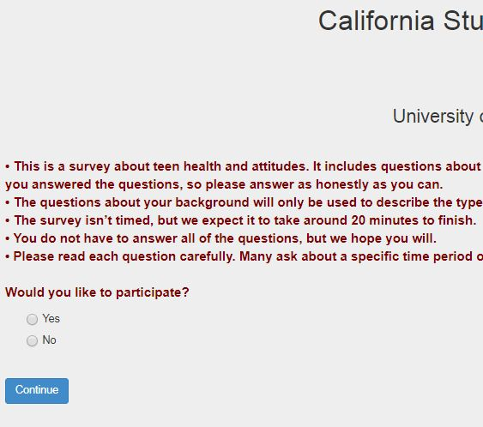
CSTS (CA Student Tobacco Survey)
Today we need to take a time out for a few to have you complete this survey.
It will take about 20-25 minutes to take.
To begin, go to the link at the top of your Google Classroom page.
On that screen, click YES
and then click CONTINUE

Slide 109
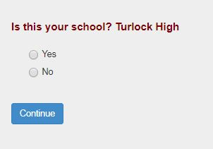
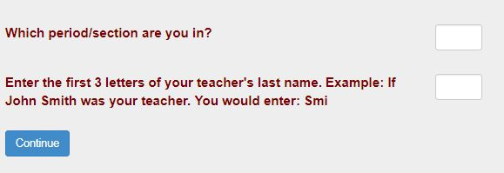
CSTS (CA Student Tobacco Survey)
On the next screen, check to make sure it says Turlock High, click yes and click continue.
Enter your CLASS PERIOD #
Enter MCE in the second box.
Continue through until you complete the survey.

Slide 110
When you finish your survey…
Today, YOU are responsible for reading CH 12 AS A SILENT INDEPENDENT READ.
If you do not finish the reading in class, you are responsible for finishing to the end of CH 12 AND all of CH 13 for homework.

Slide 111
Homework
Finish reading through the end of
CH 13.
(mini-quiz tomorrow)
Answer the questions for Chapters
11-13 in the Google Classroom Document “To Kill Questions Chapters 11-15”
DUE MONDAY 5/7 BY 7:00 a.m.

Slide 112
NO
EXIT TICKET
TODAY
5/2/18

Slide 113
5/3/18
YOUR START-UP
TODAY
IS
A QUIZ ON
CHAPTERS 12-13!
Go straight to Google Classroom and begin!

Slide 114
Unit Objectives
CCSS.ELA-LITERACY.RL.9-10.1
Cite strong and thorough textual evidence to support analysis of what the text says explicitly as well as inferences drawn from the text.
CCSS.ELA-LITERACY.RL.9-10.2
Determine a theme or central idea of a text and analyze in detail its development over the course of the text, including how it emerges and is shaped and refined by specific details; provide an objective summary of the text.
CCSS.ELA-LITERACY.RL.9-10.3
Analyze how complex characters (e.g., those with multiple or conflicting motivations) develop over the course of a text, interact with other characters, and advance the plot or develop the theme.

Slide 115
Today’s Objectives
Analyze fictional text and make connections to characters and plot events.

Slide 116
As We Read…
What does Aunt Alexandra think of Calpurnia?
Why did Dill run away?

Slide 117
Homework
Finish reading through the end of
CH 14.
Answer the questions for Chapters
11-14 in the Google Classroom Document “To Kill Questions Chapters 11-15”
DUE MONDAY 5/7 BY 7:00 a.m.
Vocab Quiz TOMORROW!

Slide 118
EXIT TICKET
5/3/18
What do you think Scout says that she felt “the starched walls of a pink cotton penitentiary closing in on” her?
Why is this such a hard thing for Scout?

Slide 119
5/4/18
NO START-UP
TODAY
You have A QUIZ
On VOCAB FOR CH 11-15
Before you take the quiz,
Let’s review with a NEW spin on an old game!
REVERSE WORD SLAM!!!

Slide 120
Unit Objectives
CCSS.ELA-LITERACY.RL.9-10.1
Cite strong and thorough textual evidence to support analysis of what the text says explicitly as well as inferences drawn from the text.
CCSS.ELA-LITERACY.RL.9-10.2
Determine a theme or central idea of a text and analyze in detail its development over the course of the text, including how it emerges and is shaped and refined by specific details; provide an objective summary of the text.
CCSS.ELA-LITERACY.RL.9-10.3
Analyze how complex characters (e.g., those with multiple or conflicting motivations) develop over the course of a text, interact with other characters, and advance the plot or develop the theme.

Slide 121
Today’s Objectives
Analyze fictional text and make connections to characters and plot events.

Slide 122
When you finish your QUIZ…
Reading CH 15 AS A SMALL GROUP READ.
If you do not finish the reading in class, you are responsible for finishing to the end of CH 15 for homework.

Slide 123
Homework
Finish reading through the end of
CH 15.
Answer the questions for Chapters
11-15 in the Google Classroom Document “To Kill Questions Chapters 11-15”
DUE MONDAY 5/7 BY 7:00 a.m.

Slide 124
5/4/18
NO EXIT TICKET

Slide 125
Start-Up - Discussion
5/7/18
In your triads, discuss the following:
In Chapter 15, why does Atticus take the light and leave the house at night?
What do the men who gather at the jail want?
How does Scout’s presence change Mr. Cunningham’s mind?

Slide 126
Start-Up - Writing
5/7/18
Write about the following:
In Chapter 15, why does Atticus take the light and leave the house at night?
What do the men who gather at the jail want?
How does Scout’s presence change Mr. Cunningham’s mind?

Slide 127
Unit Objectives
CCSS.ELA-LITERACY.RL.9-10.1
Cite strong and thorough textual evidence to support analysis of what the text says explicitly as well as inferences drawn from the text.
CCSS.ELA-LITERACY.RL.9-10.2
Determine a theme or central idea of a text and analyze in detail its development over the course of the text, including how it emerges and is shaped and refined by specific details; provide an objective summary of the text.
CCSS.ELA-LITERACY.RL.9-10.3
Analyze how complex characters (e.g., those with multiple or conflicting motivations) develop over the course of a text, interact with other characters, and advance the plot or develop the theme.

Slide 128
Today’s Objectives
Analyze fictional text and make connections to characters and plot events.

Slide 129
As You Read…
What does Atticus say about the people in a mob?
How are the people in/around Maycomb treating the day of the trial?

Slide 130
Homework
Finish reading CH 16
Answer the questions for Chapter
16 in the Google Classroom Document “To Kill Questions Chapters 16-23”
DUE MONDAY 5/14/18
Complete the vocabulary sheet for CH 16-23 in Google Classroom.
DUE WEDNESDAY
QUIZ FRIDAY!

Slide 131
Exit Ticket
5/7/18
Write about the following:
Atticus says that Mr. Cunningham is still their friend. How can he believe that in spite of what happened the night before, even when he admits that Mr. Cunningham might have hurt him?
What did he mean when he said that we all have our “blind spots?”

Slide 132
Start-Up - Discussion
5/8/18
In your triads, discuss the following:
In Chapter 16, what do we find out about why Atticus took Tom Robinson’s case?
Does this change the way you think about Atticus at all?
If he had no choice, why are the townspeople still upset with him?

Slide 133
Start-Up - Writing
5/8/18
Write about the following:
In Chapter 16, what do we find out about why Atticus took Tom Robinson’s case?
Does this change the way you think about Atticus at all?
If he had no choice, why are the townspeople still upset with him?

Slide 134
Unit Objectives
CCSS.ELA-LITERACY.RL.9-10.1
Cite strong and thorough textual evidence to support analysis of what the text says explicitly as well as inferences drawn from the text.
CCSS.ELA-LITERACY.RL.9-10.2
Determine a theme or central idea of a text and analyze in detail its development over the course of the text, including how it emerges and is shaped and refined by specific details; provide an objective summary of the text.
CCSS.ELA-LITERACY.RL.9-10.3
Analyze how complex characters (e.g., those with multiple or conflicting motivations) develop over the course of a text, interact with other characters, and advance the plot or develop the theme.

Slide 135
Today’s Objectives
Analyze fictional text and make connections to characters and plot events.

Slide 136
Homework
Answer the questions for Chapter
16-19 in the Google Classroom Document “To Kill Questions Chapters 16-23”
DUE MONDAY 5/14/18
Complete the vocabulary sheet for CH 16-23 in Google Classroom.
DUE TOMORROW
VOCAB QUIZ FRIDAY!

Slide 137
Exit Ticket
5/8/18
Write about the following:
Based on the evidence presented in the courtroom, do you believe Tom Robison to be innocent or guilty?
Why?
What evidence was the most convincing?
Do you think the jury will agree with your conclusion?

Slide 138
Start-Up - Discussion
5/9/18
In your triads, discuss the following:
Why did Dill start crying and have to leave the courtroom?
Who did he use as an example of how lawyers should talk to witnesses?
Why did Scout say that was not a good example?

Slide 139
Start-Up - Writing
5/9/18
Write about the following:
Why did Dill start crying and have to leave the courtroom?
Who did he use as an example of how lawyers should talk to witnesses?
Why did Scout say that was not a good example?

Slide 140
Unit Objectives
CCSS.ELA-LITERACY.RL.9-10.1
Cite strong and thorough textual evidence to support analysis of what the text says explicitly as well as inferences drawn from the text.
CCSS.ELA-LITERACY.RL.9-10.2
Determine a theme or central idea of a text and analyze in detail its development over the course of the text, including how it emerges and is shaped and refined by specific details; provide an objective summary of the text.
CCSS.ELA-LITERACY.RL.9-10.3
Analyze how complex characters (e.g., those with multiple or conflicting motivations) develop over the course of a text, interact with other characters, and advance the plot or develop the theme.

Slide 141
Today’s Objectives
Analyze fictional text and make connections to characters and plot events.

Slide 142
Small Group Read – CH 20&21
Today you will be doing a read around in your groups.
Each person must take a turn reading and read at least two paragraphs.
You are responsible for reading Pages 267-283 (All of CH 20 & 21).
If your group does not finish the reading, you are responsible for finishing to page 283 for homework.

Slide 143
Homework
Finish reading CH 20 & 21
Answer the questions for Chapter
16-21 in the Google Classroom Document “To Kill Questions Chapters 16-23”
DUE MONDAY 5/14/18
STUDY FOR THE
VOCAB QUIZ FRIDAY!

Slide 144
Exit Ticket
5/9/18
Write about the following:
What was the jury’s verdict?
Atticus said he knew he wouldn’t win before he even started, so how do you think he feels when they announce the verdict?
How do you think Jem and Scout feel? Why?

Slide 145
5/10/18
YOUR START-UP
TODAY
IS
A QUIZ ON
CHAPTERS 20 - 21!
Go straight to Google Classroom and begin!

Slide 146
Unit Objectives
CCSS.ELA-LITERACY.RL.9-10.1
Cite strong and thorough textual evidence to support analysis of what the text says explicitly as well as inferences drawn from the text.
CCSS.ELA-LITERACY.RL.9-10.2
Determine a theme or central idea of a text and analyze in detail its development over the course of the text, including how it emerges and is shaped and refined by specific details; provide an objective summary of the text.
CCSS.ELA-LITERACY.RL.9-10.3
Analyze how complex characters (e.g., those with multiple or conflicting motivations) develop over the course of a text, interact with other characters, and advance the plot or develop the theme.

Slide 147
Today’s Objectives
Analyze fictional text and make connections to characters and plot events.

Slide 148
Vocabulary Review
Shall we…
SLAM?

Slide 149
Homework
Finish reading CH 22
Answer the questions for Chapter
16-22 in the Google Classroom Document “To Kill Questions Chapters 16-23”
DUE MONDAY 5/14/18
STUDY FOR THE
VOCAB QUIZ TOMORROW!

Slide 150
Exit Ticket
5/10/18
Write about the following:
What do you think Jem meant when he told Miss Maudie that it was “like bein’ a caterpillar in a cocoon”?
What has changed about the way he see his hometown and the people in it?

Slide 151
NO Start-Up Today You have a VOCAB QUIZ!
5/11/18

Slide 152
Unit Objectives
CCSS.ELA-LITERACY.RL.9-10.1
Cite strong and thorough textual evidence to support analysis of what the text says explicitly as well as inferences drawn from the text.
CCSS.ELA-LITERACY.RL.9-10.2
Determine a theme or central idea of a text and analyze in detail its development over the course of the text, including how it emerges and is shaped and refined by specific details; provide an objective summary of the text.
CCSS.ELA-LITERACY.RL.9-10.3
Analyze how complex characters (e.g., those with multiple or conflicting motivations) develop over the course of a text, interact with other characters, and advance the plot or develop the theme.

Slide 153
Today’s Objectives
Analyze fictional text and make connections to characters and plot events.

Slide 154
When you finish your QUIZ…
Read CH 23 as a SILENT READ
If you do not finish the reading in class, you are responsible for finishing to the end of CH 23 for homework.

Slide 155
Homework
Finish reading CH 23
(Mini-quiz Monday)
Answer the questions for Chapter
16-23 in the Google Classroom Document “To Kill Questions Chapters 16-23”
DUE MONDAY 5/14/18

Slide 156
NO Exit Ticket
5/11/18

Slide 157
5/14/18
YOUR START-UP
TODAY
IS
A QUIZ ON
CHAPTER 23!
Go straight to Google Classroom and begin!

Slide 158
Unit Objectives
CCSS.ELA-LITERACY.RL.9-10.1
Cite strong and thorough textual evidence to support analysis of what the text says explicitly as well as inferences drawn from the text.
CCSS.ELA-LITERACY.RL.9-10.2
Determine a theme or central idea of a text and analyze in detail its development over the course of the text, including how it emerges and is shaped and refined by specific details; provide an objective summary of the text.
CCSS.ELA-LITERACY.RL.9-10.3
Analyze how complex characters (e.g., those with multiple or conflicting motivations) develop over the course of a text, interact with other characters, and advance the plot or develop the theme.

Slide 159
Today’s Objectives
Analyze fictional text and make connections to characters and plot events.

Slide 160
Homework
Answer the questions for Chapter
24 in the Google Classroom Document “To Kill Questions Chapters 24-31”
DUE MONDAY 5/21/18 by 7:00 a.m.
Complete the vocabulary sheet for CH 24-31 in Google Classroom.
DUE WEDNESDAY!
VOCAB QUIZ FRIDAY!

Slide 161
EXIT TICKET
5/14/18
What do you think Miss Maudie meant when she said, “His food doesn’t stick going down, does it?”
What is she actually saying about Mrs Merriweather and the other ladies agreeing with her?

Slide 162
Start-Up - Discussion
5/15/18
In your triads, discuss the following:
What did Miss Maudie say was the “highest tribute” they were paying Atticus?
Who does she say is paying it?

Slide 163
Start-Up - Writing
5/15/18
Write about the following:
What did Miss Maudie say was the “highest tribute” they were paying Atticus?
Who does she say is paying it?

Slide 164
Unit Objectives
CCSS.ELA-LITERACY.RL.9-10.1
Cite strong and thorough textual evidence to support analysis of what the text says explicitly as well as inferences drawn from the text.
CCSS.ELA-LITERACY.RL.9-10.2
Determine a theme or central idea of a text and analyze in detail its development over the course of the text, including how it emerges and is shaped and refined by specific details; provide an objective summary of the text.
CCSS.ELA-LITERACY.RL.9-10.3
Analyze how complex characters (e.g., those with multiple or conflicting motivations) develop over the course of a text, interact with other characters, and advance the plot or develop the theme.

Slide 165
Today’s Objectives
Analyze fictional text and make connections to characters and plot events.

Slide 166
Homework
Finish reading CH 25-26
Answer the questions for Chapter
24-26 in the Google Classroom Document “To Kill Questions Chapters 16-23”
DUE MONDAY 5/21/18
Complete the vocabulary sheet for CH 24-31 in Google Classroom.
DUE WEDNESDAY!
VOCAB QUIZ FRIDAY!

Slide 167
Exit Ticket
5/15/18
Write about the following:
What was Cecil Jacob’s current event in Miss Gates’ class?
What was Miss Gates’ opinion on Hitler’s persecution of the Jews?
What was the hypocrisy that Scout saw in Miss Gates?

Slide 168
NO Start-Up Today
5/16/18

Slide 169
NO Exit Ticket
5/16/18

Slide 170
Start-Up - Discussion
5/17/18
In your triads, discuss the following:
What happened to Jem and Scout when they were on their way home from the Halloween Carnival (and pageant)?
How did they manage to get away and get home (relatively) safe?

Slide 171
Start-Up - Writing
5/17/18
Write about the following:
What happened to Jem and Scout when they were on their way home from the Halloween Carnival (and pageant)?
How did they manage to get away and get home (relatively) safe?

Slide 172
Unit Objectives
CCSS.ELA-LITERACY.RL.9-10.1
Cite strong and thorough textual evidence to support analysis of what the text says explicitly as well as inferences drawn from the text.
CCSS.ELA-LITERACY.RL.9-10.2
Determine a theme or central idea of a text and analyze in detail its development over the course of the text, including how it emerges and is shaped and refined by specific details; provide an objective summary of the text.
CCSS.ELA-LITERACY.RL.9-10.3
Analyze how complex characters (e.g., those with multiple or conflicting motivations) develop over the course of a text, interact with other characters, and advance the plot or develop the theme.

Slide 173
Today’s Objectives
Analyze fictional text and make connections to characters and plot events.

Slide 174
Vocabulary Review
Shall we…
SLAM?

Slide 175
Exit Ticket
5/17/18
Write about the following:
Who did Atticus think killed Bob Ewell?
Who actually killed him?
Why does Sheriff Tate lie?
What does Scout say about that?

Slide 176
5/18/18
NO START-UP
TODAY
You have A QUIZ
On VOCAB FOR CH 24-31

Slide 177
Unit Objectives
CCSS.ELA-LITERACY.RL.9-10.1
Cite strong and thorough textual evidence to support analysis of what the text says explicitly as well as inferences drawn from the text.
CCSS.ELA-LITERACY.RL.9-10.2
Determine a theme or central idea of a text and analyze in detail its development over the course of the text, including how it emerges and is shaped and refined by specific details; provide an objective summary of the text.
CCSS.ELA-LITERACY.RL.9-10.3
Analyze how complex characters (e.g., those with multiple or conflicting motivations) develop over the course of a text, interact with other characters, and advance the plot or develop the theme.

Slide 178
English 10 FINALS
You will have TWO finals for this class.
One will be a 50 question multiple choice test.
The other will be a final project which you will complete next week and present to the class on final exam days.
You will choose ONE of the FIVE project options to complete.
Each is worth 100 points in the “Finals” category of Aeries, making them worth 10% of your overall class grade.
Regardless of which project you choose, you MUST complete the Final Project Checklist DAILY next week!
Failure to complete the checklist and get it initialed on any given day next week will result in a deduction from your final project grade.

Slide 179
English 10 FINALS
Your FINAL PROJECTS are DUE on TUESDAY THE 29TH AT THE BEGINNING (FIRST 2 MINUTES) OF CLASS!
ABSOLUTELY NO LATE WORK WILL BE ACCEPTED!!!

Slide 180
English 10 Final Projects
Option 1 – The One-Pager
A one pager is a single-page response to your reading that connects the ideas in the book to your thoughts creatively.
The purpose of the one-pager is so that your audience will understand the big ideas, themes, and connections within the book.

Slide 181
English 10 Final Projects
Option 1 – The One-Pager
Must do:
Title and border (5 points)
Write the title of the book and author’s name somewhere on the page (this can be done creatively!).
Include a border that reflects the unit of learning or theme. This can include words, pictures, symbols, or quotes from the text.
Two meaningful questions (10 points)
These should not be yes or no questions, but how or why questions.
Answers should include specific textual evidence and be cited by page number EX: (54)
Draw images (15 points)
Draw THREE images that represent themes, characters, conflict, or the setting of the book.
These should be strongly connected to the book and should stand out.
Interesting quotes (10 points)
Find two interesting quotes.
Include quotation marks and a citation.
If your passage/quote is a part of dialogue, include the character’s name who said it.

Slide 182
English 10 Final Projects
Option 1 – The One-Pager (cont.)
Must do:
Text opinion (on the back) (10 points)
In five to seven sentences add what your overall opinion of the novel is and what you would say when you recommend the book.
This, along with your name and period, is the ONLY aspect to go on the back of your paper.
Grammar, spelling, and mechanics (5 points)
There are little to no problems with grammar, spelling, mechanics.
Be colorful and neat. (5 points)
Your entire page should be filled with these elements.
If you find you have extra room, repeat any of the above steps/ elements.
No space should be blank. THERE SHOULD BE NO WHITE SPACE
Nothing should be left in pencil.
Your name,class period, and text opinion should be on the BACK of the one-pager.

Slide 183
English 10 Final Projects
Option 1 – The One-Pager (cont.)
You pick 2 from the following list:
Poem (15 points)
Write a poem about a part of the novel (such as a character, conflict, theme, etc.). If you struggle with writing poetry, consider an acrostic poem – each letter represents a word.
Personal statement (15 points)
Write THREE personal statements or connections about what you’ve read (these are not simple opinions).
EX: “I could relate to the main character feeling lost in the book because it reminded me of when I got to high school and didn’t know anyone.
Figurative language (15 points)
Create THREE examples of figurative language (simile, metaphor, hyperbole, alliteration, etc.) emphasizing some part of the novel (characters, conflicts, themes, settings, etc.)
Song (15 points)
Find two songs that represents a theme of the novel. Include the song title, singer/ band, and an explanation (at least 3 sentences) of how the lyrics connect to the book.
Connections (15 points)
What connections can you make between what you read today and the world outside of the story? There may be a connection to happenings at school, the community or the world, to similar events at other times or places, to other people or problems that you are reminded of, or to other stories/books that you have read.
Write three insightful, descriptive connections between you and the reading.

Slide 184
English 10 Final Projects
Option 1 – The One-Pager (cont.)
Presentation of Project (10 points)
Extra credit (up to 10 points): Pick an additional item from the list of five for up to five points of extra credit.

Slide 185
English 10 Final Projects
Option 2 – The Newspaper
The Newspaper Project is a single-page response to your reading that connects the ideas in the book to your thoughts creatively.
The purpose of the project is so that your audience will understand the big ideas, themes, and connections within the book.
This can be created digitally, but MUST be printed out for submission.

Slide 186
English 10 Final Projects
Option 2 – The Newspaper
Must do:
Title and Image (5 Points)
Create a title for your newspaper. You may NOT use “The Maycomb Tribune” (the actual paper from the story) as your title.
Include an image that reflects the novel or a theme from the novel.
One Headline Article - 200 word minimum (20 points)
Headlines are meant to do two things: draw attention to the story through eye-catching language and to summarize the main point of the story.
All headlines need a present tense verb.
Headlines should also give the reader some basic information. Think 5 W’s and 1H (who, what, when, where, why, and how) and choose the most important ones.
Should include quotes from the novel from at least two characters “interviewed.”
An Additional News Story - 150 word minimum (10 points)
Choose another important historical event that happened in the time of the novel (Summer, 1935).
Write a “National” or World” news article that gives details of that event.
Like your headline article, include the 5 Ws and 1 H.

Slide 187
English 10 Final Projects
Option 2 – The Newspaper (cont.)
Must do:
One Editorial Article - 150 word minimum (10 points)
An editorial is an article that presents a writer’s opinion on an issue. Much in the same manner of a lawyer, editorial writers build on an argument and try to persuade readers to think the same way they do.
Editorials are meant to influence public opinion, promote critical thinking, and sometimes cause people to take action on an issue.
In essence, an editorial is an opinionated news story where the writer presents his/her side cohesively and persuasively.
Two Pictures (5 points)
Find or draw two interesting pictures to go with your articles.
Grammar, spelling, and mechanics (5 points)
There are little to no problems with grammar, spelling, mechanics.
Be colorful and neat. (5 points)
Your entire page should be filled with these elements.
If you find you have extra room, repeat any of the above steps/ elements.
No space should be blank.
Nothing should be left in pencil.
Your name and class period should be on the BACK of the paper.

Slide 188
English 10 Final Projects
Option 2 – The Newspaper (cont.)
You pick 2 from the following list:
Personality Profile (15 points)
A human-interest story about a person who deserves recognition for something he/she did.
Choose a character OTHER THAN JEM, SCOUT, OR ATTICUS and write about them and something significant they did that affected the plot or showed a theme in the novel.
Eg: Dill, Miss Maudie, Mr. Underwood, Mr. Dolphus Raymond
Dear Abby section (15 points)
An advice column, including at least one letter asking a question related to the novel and or one of its themes and a response from the “advice columnist.”
Letter to the Editor (15 points)
Choose a minor character and write a letter to the editor of your newspaper in your character’s voice. You’d need to choose an event from the novel that prompts you to write.
Most people write letters to the editor when they have a problem with an issue that affects the community or when they want to praise the efforts of a community member.
Letters to the editor express the writer’s opinion.
Obituaries (15 points)
Choose 2 characters in the novel who die (Tom, Mrs. Radley, Mrs. Dubose) and write their obituaries.
Obituaries typically include: where and when they were born, where and when they died, who they leave behind (family and friends), and something (from the novel) they will be remembered for.
Comic Strip (Only choose this option if you have the skill to do it) (15 points)
Choose a theme from the novel and create a clever comic that illustrates the theme in a humorous way.
Must be at least 4 frames in length.

Slide 189
English 10 Final Projects
Option 2 – The Newspaper (cont.)
Presentation of Project (10 points)
Extra credit (up to 10 points): Pick an additional item from the list of five for up to five points of extra credit.

Slide 190
English 10 Final Projects
Option 3 – The Diorama
The Diorama Project is a three-dimensional, visual response to your reading that connects the ideas in the book to your thoughts creatively.
The purpose of the project is so that your audience will understand the big ideas, themes, and connections within the book.
If you choose this option, you must turn in the diorama itself AND the written elements (these can be all on one printed document).

Slide 191
English 10 Final Projects
Option 3 – The Diorama
Must do:
Title and Background (5 Points)
The title of the novel and the author’s name should appear somewhere on your diorama
Create a background image that reflects the novel or a theme from the novel.
One Symbolic Element - (20 points)
Choose something from the novel that is symbolic and create a 3-D representation of it in your diorama.
Write one complete paragraph (5-7 sentences minimum) explaining what that item is and what it symbolizes in the story.
Two Characters (10 points)
Choose two characters from the story and create a 3-D representation of them in your diorama.
Write TWO complete paragraphs (1 paragraph per character, 5-7 sentences minimum) describing each of the characters you chose.
NOT PHYSICAL DESCRIPTION…CHARACTER DESCRIPTION – personality, things that make them interesting, how they contribute to the story
A Significant Event (10 points)
The main focus of your diorama should be on ONE important moment in the story. Looking at your diorama, I should instantly be able to tell what moment you are portraying.
Write one complete paragraph (5-7 sentences minimum) describing the event you chose, why it was important to the plot, and why you chose it.

Slide 192
English 10 Final Projects
Option 3 – The Diorama (cont.)
Must do:
Two Pictures (5 points)
On the OUTSIDE SIDES of your diorama, include two pictures (can be drawn or printed out) that you think represent two different THEMES of the story.
For each image, include a written caption that explains what the image is and what theme it represents.
Grammar, spelling, and mechanics (5 points)
There are little to no problems with grammar, spelling, mechanics.
Be colorful and neat. (5 points)
Your entire diorama should be filled with these elements.
If you find you have extra room, repeat any of the above steps/ elements.
No space should be blank.
Nothing should be left in pencil.
Your name and class period should be on the BACK of the diorama.

Slide 193
English 10 Final Projects
Option 2 – The Diorama (cont.)
You pick 2 from the following list:
(These can be on the inside sides or part of your background)
Poem (15 points)
Write a poem about a part of the novel (such as a character, conflict, theme, etc.). If you struggle with writing poetry, consider an acrostic poem – each letter represents a word.
Personal statement (15 points)
Write THREE personal statements or connections about what you’ve read (these are not simple opinions).
EX: “I could relate to the main character feeling lost in the book because it reminded me of when I got to high school and didn’t know anyone.
Figurative language (15 points)
Create THREE examples of figurative language (simile, metaphor, hyperbole, alliteration, etc.) emphasizing some part of the novel (characters, conflicts, themes, settings, etc.)
Song (15 points)
Find two songs that represents a theme of the novel. Include the song title, singer/ band, and an explanation (at least 3 sentences) of how the lyrics connect to the book.
Connections (15 points)
What connections can you make between what you read today and the world outside of the story? There may be a connection to happenings at school, the community or the world, to similar events at other times or places, to other people or problems that you are reminded of, or to other stories/books that you have read.
Write three insightful, descriptive connections between you and the reading.

Slide 194
English 10 Final Projects
Option 1 – The One-Pager (cont.)
Presentation of Project (10 points)
Extra credit (up to 10 points): Pick an additional item from the list of five for up to five points of extra credit.

Slide 195
English 10 Final Projects
Option 4 – The Re-write
The Rewrite Project is a response to your reading that connects the ideas in the book to your thoughts creatively.
You are to write 3 scenes in the story from a different main character’s point of view in a personal diary style.
The purpose of the project is so that your audience will understand the big ideas, themes, and connections within the book.

Slide 196
English 10 Final Projects
Option 4 – The Rewrite
Must do:
Title and Image Cover Page (5 Points)
Create a cover page for your re-write. You may NOT use the actual title of the novel as your title.
Include an image that reflects the novel or a theme from the novel.
Rewrite Scene 1 - 150 word minimum (25 points)
Choose a scene from the story and re-write it from the perspective of one of the main characters.
Be sure to include all of the important details from the original scene.
Your re-write should be in the style of that character’s personal journal.
Include personal insights into the scene that would be expected from the chosen character.
Rewrite Scene 2 - 150 word minimum (25 points)
Choose a scene from the story and re-write it from the perspective of the same main character.
Be sure to include all of the important details from the original scene.
Your re-write should be in the style of that character’s personal journal.
Include personal insights into the scene that would be expected from the chosen character.

Slide 197
English 10 Final Projects
Option 4 – The Re-write (cont.)
Must do:
Rewrite Scene 3 - 150 word minimum (25 points)
Choose a scene from the story and re-write it from the perspective of the same main character.
Be sure to include all of the important details from the original scene.
Your re-write should be in the style of that character’s personal journal.
Include personal insights into the scene that would be expected from the chosen character.
Grammar, spelling, and mechanics (5 points)
There are little to no problems with grammar, spelling, mechanics.
Be colorful and neat. (5 points)
Your journals should be artistically and creatively bound.
Journals should be NEATLY handwritten.
Your name and class period should be on the BACK of the project.

Slide 198
English 10 Final Projects
Option 4 – The Re-write (cont.)
You pick 2 from the following list. These should be included AFTER the journal entries in your project.
Poem (15 points)
Write a poem about a part of the novel from the point of view of the character you are journaling as. If you struggle with writing poetry, consider an acrostic poem – each letter represents a word.
Personal statement (15 points)
Write a personal statement sharing how YOU personally relate to the character you chose to journal as.
EX: “I could relate to the main character__________________ feeling lost in the book because it reminded me of when I got to high school and didn’t know anyone.
Figurative language (15 points)
Create THREE examples of figurative language (simile, metaphor, hyperbole, alliteration, etc.) emphasizing some part of the character and their importance to the novel.
Song (15 points)
Find two songs that somehow connects to the character you chose. Include the song title, singer/ band, and an explanation (at least 3 sentences) of how the lyrics connect to the character.

Slide 199
English 10 Final Projects
Option 4 – The Re-write (cont.)
Presentation of Project (10 points)
Extra credit (up to 10 points): Pick an additional item from the list of five for up to five points of extra credit.

Slide 200
English 10 Final Projects
Option 5 – The Newsreel
The Newsreel Project is a video response to your reading that connects the ideas in the book to your thoughts creatively.
The purpose of the project is so that your audience will understand the big ideas, themes, and connections within the book.

Slide 201
English 10 Final Projects
Option 4 – The Newsreel (cont.)
Must do:
Title and Image (5 Points)
Create a title for your newsreel.
Include an image that reflects the novel or a theme from the novel.
One Headline Story – 2 minute minimum (20 points)
Headlines stories are meant to do two things: draw attention to the story through eye-catching language and to summarize the main point of the story.
All headline story titles need a present tense verb.
Headlines should also give the reader some basic information. Think 5 W’s and 1H (who, what, when, where, why, and how) and choose the most important ones.
Should include “interviews” of at least two characters.
An Additional World or National News Story – 1 minute minimum (10 points)
Choose another important historical event that happened in the time of the novel (Summer, 1935).
Report on a “National” or World” news event, giving details of that event.
Like your headline story, include the 5 Ws and 1 H.

Slide 202
English 10 Final Projects
Option 4 – The Newsreel (cont.)
Must do:
One Editorial Segment - 1 minute minimum (10 points)
An editorial segment is a segment that presents a news personality’s opinion on an issue. Much in the same manner of a lawyer, editorialists build on an argument and try to persuade readers to think the same way they do.
Editorial segments are meant to influence public opinion, promote critical thinking, and sometimes cause people to take action on an issue.
In essence, an editorial is an opinionated news story where the news personality presents his/her side cohesively and persuasively.
Two Pictures (5 points)
Find or draw two interesting pictures to go with your stories. Have them displayed on screen during your report.
Grammar and mechanics (5 points)
There are little to no problems with grammar or mechanics.
Be creative and visually stimulating. (5 points)
Your entire video should be between 4-6 minutes in length.
If you find you have extra time, repeat any of the above steps/ elements.
Your name and class period should be in the credits at the end of the reel.

Slide 203
English 10 Final Projects
Option 4 – The Newsreel (cont.)
You pick 2 from the following list.
Personality Profile (15 points)
A human-interest story about a person who deserves recognition for something he/she did.
Choose a character OTHER THAN JEM, SCOUT, OR ATTICUS and write about them and something significant they did that affected the plot or showed a theme in the novel.
Eg: Dill, Miss Maudie, Mr. Underwood, Mr. Dolphus Raymond
Commercial (15 points)
Create a product or business that would be used in Maycomb around the time of the novel and that somehow connects with an event in the novel (shovels, air rifles, a costume shop, etc.)
Create a commercial for that product that might air on a newsreel. Be creative. Include a slogan and logo for the company or product.
Obituaries (15 points)
Choose 2 characters in the novel who die (Tom, Mrs. Radley, Mrs. Dubose) and read their obituaries.
Obituaries typically include: where and when they were born, where and when they died, who they leave behind (family and friends), and something (from the novel) they will be remembered for.
A Sports Segment (15 points)
Create a sports segment focused on an event from the novel (the fight between Scout and Walter, The tire rolling incident, Atticus’ shooting display)

Slide 204
English 10 Final Projects
Option 4 – The Re-write (cont.)
Presentation of Project (10 points)
Extra credit (up to 10 points): Pick an additional item from the list of five for up to five points of extra credit.

Slide 205
English 10 Final Projects
BY MONDAY YOU MUST:
Decide which project option you plan to complete.
Decide which TWO “You Choose” elements you will include in your project.
Report those choices to Mr. McElroy
THERE WILL BE NO CHANGING PROJECTS OR OPTIONS ONCE THEY ARE RECORDED!!!

Slide 206
Homework
Finish the questions for Chapter
24-31 in the Google Classroom Document “To Kill Questions Chapters 16-23”
DUE MONDAY 5/21/18
Make your choices for your final project and COME READY TO WORK ON IT!!!

Slide 207
NO Exit Ticket
5/18/18

Slide 208
Start-Up
Complete the “I plan to” portion of your checklist for today.
Today’s Goals
1- Report your choice of project and your choices of “you choose” elements to Mr. McElroy.
2- Complete at least 1 element of your project.
Exit Ticket
Complete the “I finished” portion of your checklist and get it initialed.
5/21/18

Slide 209
Start-Up
Complete the “I plan to” portion of your checklist for today.
Today’s Goals
1- Report your choice of project and your choices of “you choose” elements to Mr. McElroy.
2- Complete at least 2 elements of your project.
Exit Ticket
Complete the “I finished” portion of your checklist and get it initialed.
5/22/18

Slide 210
Start-Up
Complete the “I plan to” portion of your checklist for today.
Today’s Goals
1- Report your choice of project and your choices of “you choose” elements to Mr. McElroy.
2- Complete at least 1 element of your project.
Exit Ticket
Complete the “I finished” portion of your checklist and get it initialed.
5/23/18

Slide 211
Start-Up
Complete the “I plan to” portion of your checklist for today.
Today’s Goals
1- Report your choice of project and your choices of “you choose” elements to Mr. McElroy.
2- Complete at least 2 elements of your project.
Exit Ticket
Complete the “I finished” portion of your checklist and get it initialed.
5/24/18

Slide 212
FINAL EXAM
REVIEW
DAY!
Remember, Tuesday is the LAST DAY to turn in late/missing assignments!
NOTHING turned in after 2:51 on Tuesday will be graded!
5/25/18

