Slide 1
Start-Up - Discussion
1/9/19
In your triads, discuss the following:
Look at this short list of historical terms:
Jim Crow Laws, KKK, Segregation/Desegregation,
The Great Depression, The Scottsboro Boys,
Brown vs. The Board of Education
Which of the things on this list are you familiar with?
Discuss these items with your group. Share your knowledge with them and gain knowledge from them.

Slide 2
Start-Up - Writing
1/9/19
Now write about the following:
Choose the item from this short list of historical terms with which you are the MOST familiar:
Jim Crow Laws, KKK, Segregation/Desegregation,
The Great Depression, The Scottsboro Boys,
Brown vs. The Board of Education
In your own words, define the term you chose and explain it’s significance in American history.

Slide 3
Unit Objectives
CCSS.ELA-LITERACY.RL.9-10.1
Cite strong and thorough textual evidence to support analysis of what the text says explicitly as well as inferences drawn from the text.
CCSS.ELA-LITERACY.RL.9-10.2
Determine a theme or central idea of a text and analyze in detail its development over the course of the text, including how it emerges and is shaped and refined by specific details; provide an objective summary of the text.
CCSS.ELA-LITERACY.RL.9-10.3
Analyze how complex characters (e.g., those with multiple or conflicting motivations) develop over the course of a text, interact with other characters, and advance the plot or develop the theme.

Slide 4
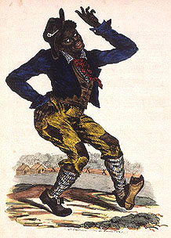
“Jim Crow” Laws
From the 1880s to the 1960s most states enforced segregation through the “Jim Crow” laws named after a black-faced character in minstrel shows.
Through these laws legal punishments could be imposed on people for having contact with members of another race.

Slide 5
Jim Crow Guide
1. A Black male could not offer his hand (to shake hands) with a White male because it implied being socially equal. Obviously, a Black male could not offer his hand or any other part of his body to a White woman, because he risked being accused of rape.
2. Blacks and Whites were not supposed to eat together. If they did eat together, Whites were to be served first, and some sort of partition was to be placed between them.
3. Under no circumstance was a Black male to offer to light the cigarette of a White female -- that gesture implied intimacy.
4. Blacks were not allowed to show public affection toward one another in public, especially kissing, because it offended Whites.

Slide 6
Jim Crow Guide
5. Blacks were introduced to Whites, never Whites to Blacks.
6. Whites did not use courtesy titles of respect when referring to Blacks, for example, Mr., Mrs., Miss., Sir, or Ma'am. Instead, Blacks were called by their first names or by “boy” or “girl” (regardless of age). Blacks had to use courtesy titles when referring to Whites, and were not allowed to call them by their first names.
7. If a Black person rode in a car driven by a White person, the Black person sat in the back seat, or the back of a truck.
8. White motorists had the right-of-way at all intersections.

Slide 8
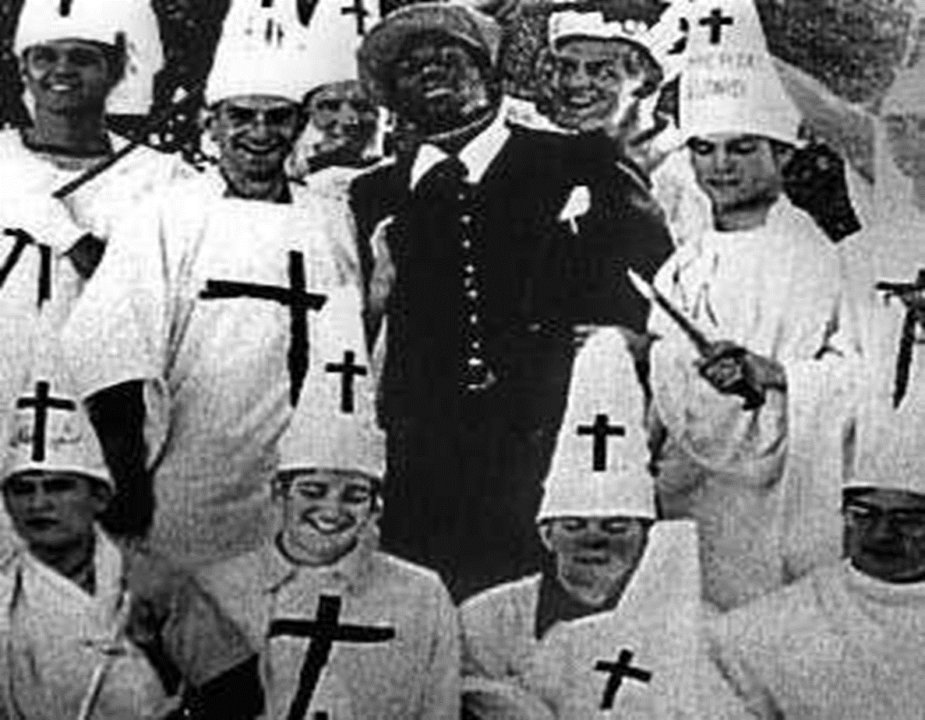
The KKK
After the Civil War, The Ku Klux Klan was formed as a secret society that promoted white supremacy using violence and terrorism to undo the gains that former slaves had made.
However, after the 1920s the KKK was no longer secretive about their work and public violence against Blacks, including lynching, became common occurrences.

Slide 9
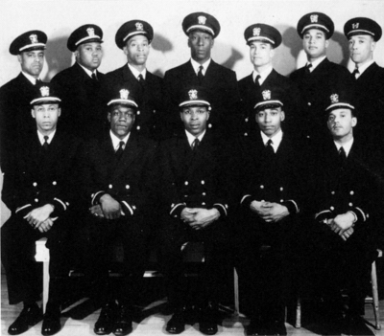
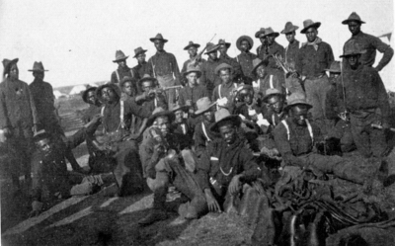
After WW1
Even though Blacks had fought bravely for the US in WW1, they returned home from Europe to find the same, if not worse, discrimination and segregation.
The economic struggles of the 1930s seemed only to worsen the situation.

Slide 10
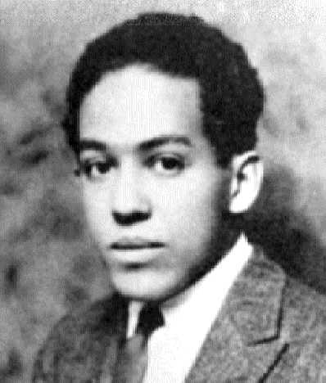
Langston Hughes (1902-1967)
“Will V-Day Be Me-Day Too?”
…I am a Negro American
Out to defend my land…
I’ve seen my buddy lying
Where he fell.
I’ve watched him dying
I promised him that I would try
To make our land a land
Where his son could be a man –
And there’d be no Jim Crow birds
Left in our sky…
So this is what I want to know:
When we see Victory’s glow,
Will you still let old Jim Crow
hold me back?
…will Dixie Lynch me still
When I return?…

Slide 11
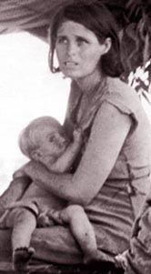
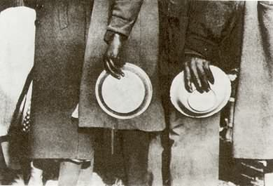
The Great Depression (1930s)
The Depression hit the South especially hard
Everyone seemed to be living in poverty
Americans turned away from the rest of the world and away from each other
During these years of turmoil, discontent started to grow in the minds of Whites and Blacks alike.

Slide 12
Inspiration for the Story
When Harper Lee was a child, the Scottsboro Trials took place in Alabama.
These trials are commonly thought to be the inspiration for To Kill a Mockingbird, though Lee denies this.

Slide 13
The Scottsboro Boys
On March 25, 1931, the nine black young men, as well as several white young men, rode a train illegally.
The boys got into a fight, and the white boys were kicked off the train.
They told station masters at the closest stop they had been beaten by the black boys. Police arranged to arrest them at the next station.

Slide 14
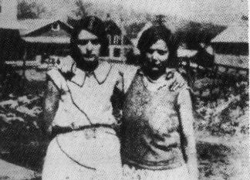
The Scottsboro Boys
At the next stop, to avoid being punished themselves, Ruby Bates and Victoria Price – both prostitutes -- claimed the black boys raped them.
Bates later recanted her story.
On March 30, 1931, all of the
Scottsboro Boys were indicted
by an all-white jury.
Ruby Bates and Victoria Price
in 1931

Slide 15
The Scottsboro Boys
Because their parents could not afford good lawyers, all were convicted and sentenced to death – even 13-year-old Roy Wright.
Wright’s trial was declared a mistrial.
The cases quickly became famous, causing rallies and riots.

Slide 16
The Scottsboro Boys
In November, the U.S. Supreme Court overturned all the convictions on the ground that due process was not followed.
The State of Alabama had not provided legal counsel to any of the defendants.
The new trials began in March 1933, with each defendant tried separately.
There were a total of four rounds of trials.

Slide 17
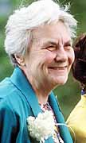
Harper Lee (1926-2016)
To add to the complexity of the story, Harper Lee wrote it during a time of even greater social turbulence in the United States.
In the 1950s the winds of change began to blow and Black Americans were no longer willing to be treated as lesser human beings.

Slide 18
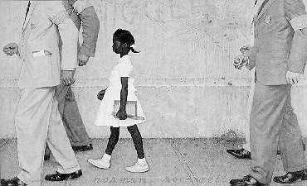
Brown vs. Board of Education
In 1954, after 2 years in court, the nation was shocked by a landmark decision to grant Linda Brown, a Black fifth-grader, admission into a white elementary school in Topeka, Kansas.
The decision engendered feelings of triumph and outrage across a country that had lived under the weight of racial segregation and discrimination for over 100 years.

Slide 19
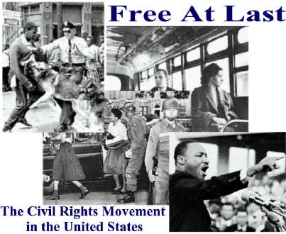
The Winds of Change
Soon, average Black citizens across the country began speaking out against oppression and demanding equal rights. This was the beginning of America’s Civil Rights Movement.

Slide 20
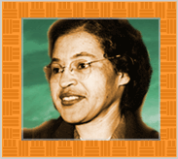
Rosa Parks (1913-2005)
In 1955, after a long day of work, 42-year-old Rosa Parks refused to give up her seat to a white man on a Montgomery County bus
This set off peaceful and violent protests throughout the South.

Slide 21
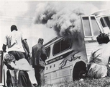
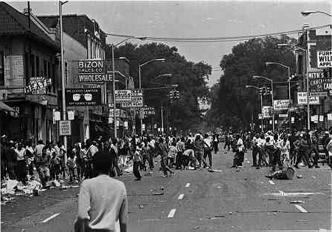
Television Changes Everything
By this time, many families had televisions and as images of Southern race riots and violent protests reached into American homes the magnitude of Southern racism began to sink into the American consciousness.
Moreover, the rest of the world began to frown upon America’s treatment of Blacks, and segregation, like slavery, became a national embarrassment for a country who had fought in two world wars as great liberators of the down-trodden masses.

Slide 22
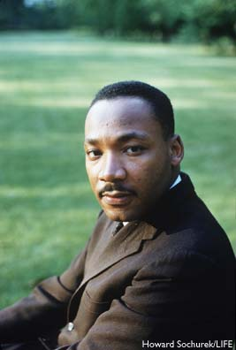
Dr. Martin Luther King (1929-1968)
Black Hero-Leaders began to rally together Black Americans in order to fight oppression and for a country where all men were truly treated as equals.

Slide 23
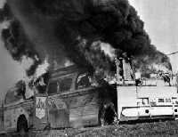
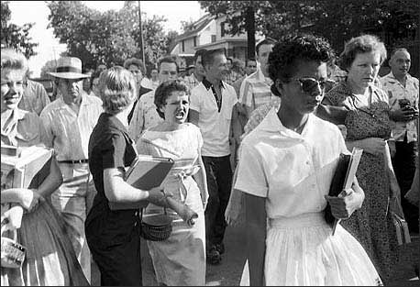
Desegregation
A national and international call for desegregation of the South rang out and Blacks and Whites all over the country started putting pressure on governments to amend the segregation laws.
Those individuals, both Black and White, who fought for Civil Rights were under constant attack from White Supremacists who were unwilling to accept Black Americans as equals
Many freedom-fighters died for their efforts

Slide 24
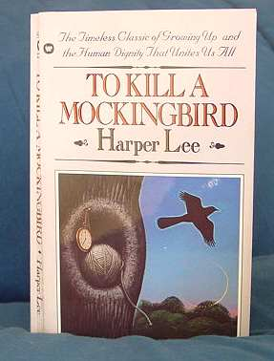
To Kill a Mockingbird
In the Fall of 1960, in the middle of the Civil Rights Movement, To Kill a Mockingbird was published.
It shot to the top of the New York Times best seller list.
A country was finally ready to listen to the story of segregation and open their minds to the possibility of an America where Whites and Blacks could live together as equals.

Slide 25
Exit Ticket
1/9/19
Now write about the following:
Choose one item from this short list of historical terms with which you were NOT familiar:
Jim Crow Laws, KKK, Segregation/Desegregation,
The Great Depression, The Scottsboro Boys,
Brown vs. The Board of Education
Now that we have reviewed them, in your own words, define the term you chose and explain it’s significance in American history.

Slide 26
Start-Up - Discussion
1/10/19
In your triads, discuss the following:
After our discussion yesterday about the historical context, what do you think the setting of the novel will be like?
How do you think the great depression might affect the characters in the novel?
What do you think their attitudes towards black people might be?

Slide 27
Start-Up - Writing
1/10/19
Write about the following:
After our discussion last Friday about the historical context, what do you think the setting of the novel will be like?
How do you think the great depression might affect the characters in the novel?
What do you think their attitudes towards black people might be?

Slide 28
Unit Objectives
CCSS.ELA-LITERACY.RL.9-10.1
Cite strong and thorough textual evidence to support analysis of what the text says explicitly as well as inferences drawn from the text.
CCSS.ELA-LITERACY.RL.9-10.2
Determine a theme or central idea of a text and analyze in detail its development over the course of the text, including how it emerges and is shaped and refined by specific details; provide an objective summary of the text.
CCSS.ELA-LITERACY.RL.9-10.3
Analyze how complex characters (e.g., those with multiple or conflicting motivations) develop over the course of a text, interact with other characters, and advance the plot or develop the theme.

Slide 29
Today’s Objective
Analyze the first chapter of a novel to identify details that establish point of view, character, and setting.

Slide 30
As We Read…
Look for unknown words and phrases. Try to determine the meaning of the words by using context clues, word parts, or a dictionary.
Note any words and phrases that give you clues about the narrator’s personality and establish her voice.
Note the names of characters who are related to the narrator as well as the words that tell you how they are related.

Slide 31
Homework
Finish Chapter 1
Vocabulary for Chapters 1-5
DUE FRIDAY 1/18
To Kill Questions for Chapter 1 in Google Classroom
DUE TUESDAY 1/22

Slide 32
Exit Ticket
1/10/19
Write about the following:
Write a short description of the character of Scout.
What do we know about her based on what we read today?

Slide 33
Start-Up - Discussion
1/11/19
In your triads, discuss the following:
What was the bet that Dill made with Jem? What did Dill want to happen?
What is the significance of the last line in the chapter?
What do you think it was showing?

Slide 34
Start-Up - Writing
1/11/19
Write about the following:
What was the bet that Dill made with Jem? What did Dill want to happen?
What is the significance of the last line in the chapter? What do you think it was?

Slide 35
Unit Objectives
CCSS.ELA-LITERACY.RL.9-10.1
Cite strong and thorough textual evidence to support analysis of what the text says explicitly as well as inferences drawn from the text.
CCSS.ELA-LITERACY.RL.9-10.2
Determine a theme or central idea of a text and analyze in detail its development over the course of the text, including how it emerges and is shaped and refined by specific details; provide an objective summary of the text.
CCSS.ELA-LITERACY.RL.9-10.3
Analyze how complex characters (e.g., those with multiple or conflicting motivations) develop over the course of a text, interact with other characters, and advance the plot or develop the theme.

Slide 36
Today’s Objectives
Analyze fictional text and make connections to characters and plot events.

Slide 37
As We Read…
Look at the conflict between Scout and Miss Caroline.
Find quotes that serve as evidence that Scout and Miss Caroline are both “starting off on the wrong foot in every way.”

Slide 38
Homework
Read Chapter 3 in
To Kill a Mockingbird
(55:35)
Answer the questions for Chapters
1-3 in the Google Classroom Document “To Kill Questions Chapters 1-5”
DUE TUESDAY 1/22
Continue working on vocabulary. There will be a quiz NEXT Friday!

Slide 39
Exit Ticket
1/11/19
Write about the following:
Much is said about Boo Radley in the second half of Chapter 1.
Give two examples of things that were said that you think are true and two examples of things you think are just rumors.

Slide 40
Start-Up - Discussion
1/14/19
In your triads, discuss the following:
How does Atticus describe the Ewell family in Chapter 3 (40-41)? Give specific examples.
Why do you think he says that the Ewells are “members of an exclusive society made up of Ewells?”

Slide 41
Start-Up - Writing
1/14/19
Write about the following:
How does Atticus describe the Ewell family in Chapter 3 (40-41)? Give specific examples.
Why do you think he says that the Ewells are “members of an exclusive society made up of Ewells?”

Slide 42
Unit Objectives
CCSS.ELA-LITERACY.RL.9-10.1
Cite strong and thorough textual evidence to support analysis of what the text says explicitly as well as inferences drawn from the text.
CCSS.ELA-LITERACY.RL.9-10.2
Determine a theme or central idea of a text and analyze in detail its development over the course of the text, including how it emerges and is shaped and refined by specific details; provide an objective summary of the text.
CCSS.ELA-LITERACY.RL.9-10.3
Analyze how complex characters (e.g., those with multiple or conflicting motivations) develop over the course of a text, interact with other characters, and advance the plot or develop the theme.

Slide 43
Today’s Objectives
Analyze fictional text and make connections to characters and plot events.

Slide 44
Homework
Finish Reading Chapter 4 (Pg 54)
Answer the questions for Chapters
1-4 in the Google Classroom Document “To Kill Questions Chapters 1-5”
DUE TUESDAY 1/22

Slide 45
Exit Ticket
1/14/19
Write about the following:
What did Scout find in the knot in the tree?
What did Scout and Jem find the second time?
Where do you think those things came from and why would they be left there?

Slide 46
Start-Up - Discussion
1/15/19
In your triads, discuss the following:
At the end of Chapter 4, Scout says that there were two reasons why she wanted to stop playing “Boo Radley.”
What were they?
Which one of the two reasons would you say had more of an affect on her?
Do you think Atticus knew what they were playing?

Slide 47
Start-Up - Writing
1/15/19
Write about the following:
At the end of Chapter 4, Scout says that there were two reasons why she wanted to stop playing “Boo Radley.”
What were they?
Which one of the two reasons would you say had more of an affect on her?
Do you think Atticus knew what they were playing?

Slide 48
Unit Objectives
CCSS.ELA-LITERACY.RL.9-10.1
Cite strong and thorough textual evidence to support analysis of what the text says explicitly as well as inferences drawn from the text.
CCSS.ELA-LITERACY.RL.9-10.2
Determine a theme or central idea of a text and analyze in detail its development over the course of the text, including how it emerges and is shaped and refined by specific details; provide an objective summary of the text.
CCSS.ELA-LITERACY.RL.9-10.3
Analyze how complex characters (e.g., those with multiple or conflicting motivations) develop over the course of a text, interact with other characters, and advance the plot or develop the theme.

Slide 49
Today’s Objectives
Analyze fictional text and make connections to characters and plot events.

Slide 50
As You Read…
Pay attention to what Miss Maudie says about Arthur “Boo” Radley.

Slide 51
Homework
Answer the questions for Chapters
1-5 in the Google Classroom Document “To Kill Questions Chapters 1-5”
DUE TUESDAY 1/22
STUDY VOCABULARY!
QUIZ FRIDAY!

Slide 52
Exit Ticket
1/15/19
Write about the following:
What do you think Miss Maudie was trying to tell Scout when she mentioned the Bible and a bottle of whiskey?
What sort of man do you think Boo Radley’s father was?
How do you think that might have affected Boo?

Slide 53
Start-Up - Discussion
1/16/19
In your triads, discuss the following:
Miss Maudie says that, “Atticus Finch is the same in his house as he is on the public streets.”
What does she mean by this?
What does this tell us about the type of man Atticus is?

Slide 54
Start-Up - Writing
1/16/19
Write about the following:
Miss Maudie says that, “Atticus Finch is the same in his house as he is on the public streets.”
What does she mean by this?
What does this tell us about the type of man Atticus is?

Slide 55
Unit Objectives
CCSS.ELA-LITERACY.RL.9-10.1
Cite strong and thorough textual evidence to support analysis of what the text says explicitly as well as inferences drawn from the text.
CCSS.ELA-LITERACY.RL.9-10.2
Determine a theme or central idea of a text and analyze in detail its development over the course of the text, including how it emerges and is shaped and refined by specific details; provide an objective summary of the text.
CCSS.ELA-LITERACY.RL.9-10.3
Analyze how complex characters (e.g., those with multiple or conflicting motivations) develop over the course of a text, interact with other characters, and advance the plot or develop the theme.

Slide 56
As You Read…
Pay attention to Atticus’ reaction to what Jem, Scout and Dill were doing.

Slide 57
Homework
Vocab sheets for Ch 1-5 DUE FRIDAY! There will be a QUIZ on vocab Friday!
Answer the questions for Chapters
1-5 in the Google Classroom Document “To Kill Questions Chapters 1-5”
DUE TUESDAY 1/22 by 7:00 a.m.

Slide 58
Exit Ticket
1/16/19
Write about the following:
How did Atticus trick Jem into admitting that they had been playing a game about Boo Radley’s life?
Why did Jem decide that he didn’t want to be a lawyer after all?

Slide 59
Start-Up - Discussion
1/17/19
In your triads, discuss the following:
Based on what we know of Boo Radley, do you think he would have come out if he had gotten Jem’s note?
Why or why not?

Slide 60
Start-Up - Writing
1/17/19
Write about the following:
Based on what we know of Boo Radley, do you think he would have come out if he had gotten Jem’s note?
Why or why not?

Slide 61
Unit Objectives
CCSS.ELA-LITERACY.RL.9-10.1
Cite strong and thorough textual evidence to support analysis of what the text says explicitly as well as inferences drawn from the text.
CCSS.ELA-LITERACY.RL.9-10.2
Determine a theme or central idea of a text and analyze in detail its development over the course of the text, including how it emerges and is shaped and refined by specific details; provide an objective summary of the text.
CCSS.ELA-LITERACY.RL.9-10.3
Analyze how complex characters (e.g., those with multiple or conflicting motivations) develop over the course of a text, interact with other characters, and advance the plot or develop the theme.

Slide 62
Today’s Objectives
Review vocabulary from Chapters 1-5

Slide 63
Vocabulary Review
Shall we…
SLAM?

Slide 64
Homework
Vocab sheets for Ch 1-5 DUE TOMORROW!
There will be a QUIZ on vocab Friday!
Answer the questions for Chapters
1-5 in the Google Classroom Document “To Kill Questions Chapters 1-5”
DUE TUESDAY 1/22 by 7:00 a.m.

Slide 65
Exit Ticket
1/17/19
Write about the following:
Predict:
Do you think Jem, Scout, and Dill will ever actually get to meet Boo Radley?
What do you think that meeting would be like if they did?

Slide 66
No Start-Up Today It is a QUIZ DAY!
1/18/19

Slide 67
Today’s Objectives
Review vocabulary from Chapters 1-5
Analyze fictional text and make connections to characters and plot events.

Slide 68
NO Exit Ticket Today When you are finished with your quizZES, work on your questions for Chapters 1-5. They are DUE TUESDAY by 7:00 a.m. Vocabulary for Chapters 6-10 is already in Google Classroom.
1/18/19

Slide 69
Start-Up - Discussion
1/22/19
In your triads, discuss the following:
Choose any one of the characters we have met in the book so far:
Describe that character to your group.
Focus on what we know about their PERSONALITY and CHARACTER
(NOT PHYSICAL DESCRIPTION)

Slide 70
Start-Up - Writing
1/22/19
Write about the following:
Choose any one of the characters we have met in the book so far:
Describe that character.
Focus on what we know about their PERSONALITY and CHARACTER
(NOT PHYSICAL DESCRIPTION)

Slide 71
Unit Objectives
CCSS.ELA-LITERACY.RL.9-10.1
Cite strong and thorough textual evidence to support analysis of what the text says explicitly as well as inferences drawn from the text.
CCSS.ELA-LITERACY.RL.9-10.2
Determine a theme or central idea of a text and analyze in detail its development over the course of the text, including how it emerges and is shaped and refined by specific details; provide an objective summary of the text.
CCSS.ELA-LITERACY.RL.9-10.3
Analyze how complex characters (e.g., those with multiple or conflicting motivations) develop over the course of a text, interact with other characters, and advance the plot or develop the theme.

Slide 72
Today’s Objectives
Analyze fictional text and make connections to characters and plot events.

Slide 73
Homework
READ CHAPTER 7
CH 6-10 Vocabulary – DUE FRIDAY
Work on the questions for Chapter
6-7 in the Google Classroom Document “To Kill Questions Chapters 6-10”
DUE MONDAY 1/28

Slide 74
Exit Ticket
1/22/19
Write about the following:
What did Dill see when he looked in the Radley’s window?
What did Scout see that caused them to run away?
What happened to Jem during their escape?

Slide 75
Start-Up - Discussion
1/23/19
In your triads, discuss the following:
What were some (name at least 2) of the things Jem and Scout found in the tree in Chapter 7?
What did they leave in the tree?
What ends up happening to the tree and why?

Slide 76
Start-Up - Writing
1/23/19
Write about the following:
What were some (name at least 2) of the things Jem and Scout found in the tree in Chapter 7?
What did they leave in the tree?
What ends up happening to the tree and why?

Slide 77
Unit Objectives
CCSS.ELA-LITERACY.RL.9-10.1
Cite strong and thorough textual evidence to support analysis of what the text says explicitly as well as inferences drawn from the text.
CCSS.ELA-LITERACY.RL.9-10.2
Determine a theme or central idea of a text and analyze in detail its development over the course of the text, including how it emerges and is shaped and refined by specific details; provide an objective summary of the text.
CCSS.ELA-LITERACY.RL.9-10.3
Analyze how complex characters (e.g., those with multiple or conflicting motivations) develop over the course of a text, interact with other characters, and advance the plot or develop the theme.

Slide 78
Today’s Objectives
Analyze fictional text and make connections to characters and plot events.

Slide 79
Small Group Read…
Today you will be doing a read around in your groups.
Each person must take a turn reading and read at least two paragraphs.
You are responsible for reading Chapter 8.
If your group does not finish the chapter, you are responsible for finishing Chapter 8 as well as reading Chapter 9 for homework.

Slide 80
Homework
FINISH READING THROUGH CHAPTER 9
CH 6-10 Vocabulary – DUE FRIDAY
BY 7:00 a.m.
Work on the questions for Chapter
6-10 in the Google Classroom Document “To Kill Questions Chapters 6-10”
DUE MONDAY 1/28

Slide 81
Exit Ticket
1/23/19
Write about the following:
When was the last time it snowed in Maycomb?
What did Jem want to do?
How did he end up doing it?
Why did Atticus make him change it?

Slide 82
Start-Up - Writing
1/24/19
Write about the following:
Where did the blanket come from that was wrapped around Scout?
Why does this make sense based on what we already know?

Slide 83
Unit Objectives
CCSS.ELA-LITERACY.RL.9-10.1
Cite strong and thorough textual evidence to support analysis of what the text says explicitly as well as inferences drawn from the text.
CCSS.ELA-LITERACY.RL.9-10.2
Determine a theme or central idea of a text and analyze in detail its development over the course of the text, including how it emerges and is shaped and refined by specific details; provide an objective summary of the text.
CCSS.ELA-LITERACY.RL.9-10.3
Analyze how complex characters (e.g., those with multiple or conflicting motivations) develop over the course of a text, interact with other characters, and advance the plot or develop the theme.

Slide 84
Today’s Objectives
Review vocabulary from Chapters 6-10
Analyze fictional text and make connections to characters and plot events.

Slide 85
Vocabulary Review
Shall we…
SLAM?

Slide 86
Homework
Finish Reading Chapter 10!!
CH 6-10 Vocabulary – DUE TOMORROW
BY 7:00 a.m.
Answer the questions for Chapters
1-9 in the Google Classroom Document “To Kill Questions Chapters 1-10”
DUE MONDAY 1/28
STUDY VOCABULARY!
QUIZ TOMORROW!

Slide 87
Exit Ticket
1/24/19
Write about the following:
What reasons does Atticus give for his decision to defend Tom Robinson?
Why does he say that they will not win the case?
According to Atticus, who are they fighting this time?

Slide 88
No Start-Up Today It is a QUIZ DAY! NO TALKING DURING QUIZZES!!!
1/25/19

Slide 89
Today’s Objectives
Review vocabulary from Chapters 6-10
Analyze fictional text and make connections to characters and plot events.

Slide 90
NO Exit Ticket Today When you are finished with your quizZES, work on your questions for Chapters 6-10. They are DUE MONDAY by 7:00 a.m. Vocabulary for Chapters 11-15 is already in Google Classroom, so if you are finished with the quizzes and questions, get started on that!
1/25/19

Slide 91
Start-Up - Discussion
1/28/19
In your triads, discuss the following:
In Chapter 10, we find out where the novel gets its title.
What does Atticus tell Jem about mockingbirds?
What does Miss Maudie have to say about them?
What character or characters does the mockingbird remind you of?

Slide 92
Start-Up - Writing
1/28/19
Write about the following:
In Chapter 10, we find out where the novel gets its title.
What does Atticus tell Jem about mockingbirds?
What does Miss Maudie have to say about them?
What character or characters does the mockingbird remind you of?

Slide 93
Unit Objectives
CCSS.ELA-LITERACY.RL.9-10.1
Cite strong and thorough textual evidence to support analysis of what the text says explicitly as well as inferences drawn from the text.
CCSS.ELA-LITERACY.RL.9-10.2
Determine a theme or central idea of a text and analyze in detail its development over the course of the text, including how it emerges and is shaped and refined by specific details; provide an objective summary of the text.
CCSS.ELA-LITERACY.RL.9-10.3
Analyze how complex characters (e.g., those with multiple or conflicting motivations) develop over the course of a text, interact with other characters, and advance the plot or develop the theme.

Slide 94
Today’s Objectives
Analyze fictional text and make connections to characters and plot events.

Slide 95
As You Read…
What is Jem’s punishment for his “attack” on Mrs. Dubose?
Pay attention to what happens to Mrs. Dubose when Jem is reading to her.

Slide 96
Homework
Finish reading CH 11
Answer the questions for Chapter
11 in the Google Classroom Document
DUE TOMORROW
VOCABULARY SLIDES DUE FRIDAY!
QUIZ FRIDAY!

Slide 97
Exit Ticket
1/28/19
Write about the following:
What do you think Atticus meant when he said “The one thing that doesn’t abide by majority rule is a person’s conscience?”
How can we apply that attitude to our daily lives?

Slide 98
Start-Up - Discussion
1/29/19
In your triads, discuss the following:
Which of the messages (themes) that we discussed do you think Harper Lee was trying to present in Chapter 11?
What evidence from the chapter supports your claim?

Slide 99
Start-Up - Writing
1/28/19
Write about the following:
Which of the messages (themes) that we discussed do you think Harper Lee was trying to present in Chapter 11?
What evidence from the chapter supports your claim?

Slide 100
Unit Objectives
CCSS.ELA-LITERACY.RL.9-10.1
Cite strong and thorough textual evidence to support analysis of what the text says explicitly as well as inferences drawn from the text.
CCSS.ELA-LITERACY.RL.9-10.2
Determine a theme or central idea of a text and analyze in detail its development over the course of the text, including how it emerges and is shaped and refined by specific details; provide an objective summary of the text.
CCSS.ELA-LITERACY.RL.9-10.3
Analyze how complex characters (e.g., those with multiple or conflicting motivations) develop over the course of a text, interact with other characters, and advance the plot or develop the theme.

Slide 101
Today’s Objectives
Analyze fictional characters and their development over the course of a novel.

Slide 102
Character Analysis
By definition, a character analysis is the process of evaluating the specific traits of a literary character, this will include consideration of additional elements such as the role they play in the story and the various conflicts they experience.
Your job is to analyze one of the main characters we have encountered so far in To Kill A Mockingbird. You will do so using the “Laser Focus” method.

Slide 103
Character Analysis
Looks Actions Speech Effect Reasoning | Feelings Obligations Conflicts Understandings Shifts

Slide 104
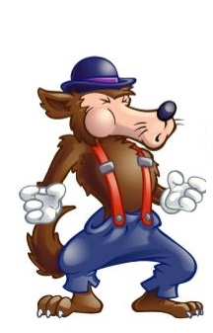
Big Bad

Slide 105
Character Analysis - Laser
Looks - Describe the character’s physical appearance. Remember to include things like age, size (compared to other characters), hair and eye color (if known), and any other significant details (eg: scars, tattoos, disabilities, etc.).
Remember: The PERSONALITY and MOTIVATIONS of a character are more important than their appearance. This should be the shortest section of your analysis.

Slide 106
Character Analysis - Laser
Actions - What does the character DO in the story? What do his or her actions show us about who the character is? How do his or her actions affect the plot?
Remember: Focus on impact moments in the story (moments that have a direct effect on the plot or characters). Minimum of TWO examples of actions WITH PROPERLY CITED EVIDENCE.

Slide 107
Character Analysis - Laser
Speech - WHAT does the character say in the story and HOW do they say it? Does the way they speak reveal anything about their character (background, education, maturity level, etc.)? Are they rude? Polite? Sarcastic? Formal? Casual? How do the things they say affect the plot?
Remember: Diction (word choice) is important and can tell us a lot about a character. Minimum of TWO examples of speech WITH PROPERLY CITED EVIDENCE.

Slide 108
Character Analysis - Laser
Effect - How does this character (their words, actions, thoughts, etc.) affect other characters in the story? What do other characters say about them? How do other characters react to them? How do their choices cause or solve conflicts for other characters?
Remember: Some characters have “history” with your character (they have known them longer...since before the story starts for us), so the way they react to them, speak to them, and speak about them can tell us a lot. Minimum of TWO examples of effect WITH PROPERLY CITED EVIDENCE.

Slide 109
Character Analysis - Laser
Reasoning - What are the character’s motivations (why they do and say what they do)? What drives them? What is important to them? What are their thought processes like (if they are revealed)?
Remember: Unless the character you chose is the NARRATOR of the story, you may not get to see directly into their thoughts. In these instances, we must INFER what and how they are thinking and their motivations through their words and actions. Minimum of TWO examples of thoughts/motivations WITH PROPERLY CITED EVIDENCE.

Slide 110
Character Analysis - Focus
Feelings - How do the characters emotions and emotional connections to others affect their choices? What emotions are they feeling strongly enough to drive them to action?
Remember: If one character cares for another, they are motivated by that emotion. The same is true if they fear them, are jealous of them, or despise them. Minimum of TWO examples of emotions/emotional connections WITH PROPERLY CITED EVIDENCE.

Slide 111
Character Analysis - Focus
Obligations - What does your character owe other characters and what do they owe him or her (eg: money, respect, love, an apology, etc.)? How are they tied to other characters?
Remember: If one person feels like they owe someone, or that they are owed something, it changes the way they behave. Minimum of TWO examples of obligations WITH PROPERLY CITED EVIDENCE.

Slide 112
Character Analysis - Focus
Conflict: With whom, or with what, is your character in conflict? Is there internal conflict, external conflict, or both? Is your character the protagonist or antagonist (or something in between)?
Remember: Without conflict, there is no story! Your character’s conflict pushes the plot forward. Minimum of TWO examples of conflicts WITH PROPERLY CITED EVIDENCE.

Slide 113
Character Analysis - Focus
Understandings - What does your character know? About other characters? About themselves? Do they have any secrets or things that only they know? Also, what do they NOT know or WANT to know?
Remember: If a character wants or needs knowledge, they may be inclined to take risks or do things outside their “normal.” Minimum of TWO examples of understandings/questions WITH PROPERLY CITED EVIDENCE.

Slide 114
Character Analysis - Focus
Shifts - How does your character change over the course of the story? Do their priorities shift? Do their beliefs change? Do they grow, learn, mature? Or are they a static (unchanging) character?
Remember: In most good novels, the characters change the plot, but the plot also changes the characters. Minimum of TWO examples of ways the character changes WITH PROPERLY CITED EVIDENCE.

Slide 115
Homework
VOCABULARY SLIDES DUE FRIDAY!
VOCAB QUIZ FRIDAY!

Slide 116
Exit Ticket
1/29/19
Write about the following:
Which character would you choose to write about?
Why would you choose them?
Do you identify with this character in any way?

Slide 117
Start-Up - Discussion
1/30/19
In your triads, discuss the following:
Of the parts to LASER analysis you will be working on today, which one would you say is the most important to understanding a character?
(LOOKS, ACTIONS, SPEECH, EFFECTS, REASONING)
Why is that element so important?

Slide 118
Start-Up - Writing
1/30/19
Write about the following:
Of the parts to LASER analysis you will be working on today, which one would you say is the most important to understanding a character?
(LOOKS, ACTIONS, SPEECH, EFFECTS, REASONING)
Why is that element so important?

Slide 119
Unit Objectives
CCSS.ELA-LITERACY.RL.9-10.1
Cite strong and thorough textual evidence to support analysis of what the text says explicitly as well as inferences drawn from the text.
CCSS.ELA-LITERACY.RL.9-10.2
Determine a theme or central idea of a text and analyze in detail its development over the course of the text, including how it emerges and is shaped and refined by specific details; provide an objective summary of the text.
CCSS.ELA-LITERACY.RL.9-10.3
Analyze how complex characters (e.g., those with multiple or conflicting motivations) develop over the course of a text, interact with other characters, and advance the plot or develop the theme.

Slide 120
Today’s Objectives
Analyze fictional characters and their development over the course of a novel.

Slide 121
Character Analysis
Looks Actions Speech Effect Reasoning

Slide 122
Character Analysis - Laser
Looks - Describe the character’s physical appearance. Remember to include things like age, size (compared to other characters), hair and eye color (if known), and any other significant details (eg: scars, tattoos, disabilities, etc.).
Remember: The PERSONALITY and MOTIVATIONS of a character are more important than their appearance. This should be the shortest section of your analysis.

Slide 123
Character Analysis - Laser
Actions - What does the character DO in the story? What do his or her actions show us about who the character is? How do his or her actions affect the plot?
Remember: Focus on impact moments in the story (moments that have a direct effect on the plot or characters). Minimum of TWO examples of actions WITH PROPERLY CITED EVIDENCE.

Slide 124
Character Analysis - Laser
Speech - WHAT does the character say in the story and HOW do they say it? Does the way they speak reveal anything about their character (background, education, maturity level, etc.)? Are they rude? Polite? Sarcastic? Formal? Casual? How do the things they say affect the plot?
Remember: Diction (word choice) is important and can tell us a lot about a character. Minimum of TWO examples of speech WITH PROPERLY CITED EVIDENCE.

Slide 125
Character Analysis - Laser
Effect - How does this character (their words, actions, thoughts, etc.) affect other characters in the story? What do other characters say about them? How do other characters react to them? How do their choices cause or solve conflicts for other characters?
Remember: Some characters have “history” with your character (they have known them longer...since before the story starts for us), so the way they react to them, speak to them, and speak about them can tell us a lot. Minimum of TWO examples of effect WITH PROPERLY CITED EVIDENCE.

Slide 126
Character Analysis - Laser
Reasoning - What are the character’s motivations (why they do and say what they do)? What drives them? What is important to them? What are their thought processes like (if they are revealed)?
Remember: Unless the character you chose is the NARRATOR of the story, you may not get to see directly into their thoughts. In these instances, we must INFER what and how they are thinking and their motivations through their words and actions. Minimum of TWO examples of thoughts/motivations WITH PROPERLY CITED EVIDENCE.

Slide 127
Homework
Character Analysis
DUE MONDAY @ 7:00 a.m.!
VOCABULARY SLIDES DUE FRIDAY @ 7:00 a.m.!
VOCAB QUIZ FRIDAY!

Slide 128
Exit Ticket
1/30/19
Write about the following:
Which element(s) of LASER are you finding the most difficult to come up with characteristics and evidence for?
Why do you think that is?

Slide 129
Start-Up - Discussion
1/31/19
In your triads, discuss the following:
Think about all of the things your character has DONE in the novel so far.
Choose ONE of these actions that you think is an “impact moment” in the story.
What does your character do in this moment?
Why is it important to the plot?

Slide 130
Start-Up - Writing
1/31/19
Write about the following:
Think about all of the things your character has DONE in the novel so far.
Choose ONE of these actions that you think is an “impact moment” in the story.
What does your character do in this moment?
Why is it important to the plot?

Slide 131
Unit Objectives
CCSS.ELA-LITERACY.RL.9-10.1
Cite strong and thorough textual evidence to support analysis of what the text says explicitly as well as inferences drawn from the text.
CCSS.ELA-LITERACY.RL.9-10.2
Determine a theme or central idea of a text and analyze in detail its development over the course of the text, including how it emerges and is shaped and refined by specific details; provide an objective summary of the text.
CCSS.ELA-LITERACY.RL.9-10.3
Analyze how complex characters (e.g., those with multiple or conflicting motivations) develop over the course of a text, interact with other characters, and advance the plot or develop the theme.

Slide 132
Today’s Objectives
Analyze fictional characters and their development over the course of a novel.

Slide 133
Today’s Work
You have one thing on your plates today:
Character Analysis!
Get work done!!!

Slide 134
Homework
Character Analysis
DUE MONDAY @ 7:00 a.m.!
VOCABULARY SLIDES DUE FRIDAY @ 7:00 a.m.!
VOCAB QUIZ FRIDAY!

Slide 135
Exit Ticket
1/31/19
Write about the following:
Think about all of the things your character has SAID in the novel so far.
Choose ONE of these quotes that you think is important to your analysis.
What does your character say in this moment?
Why is it important to the plot?

Slide 136
No Start-Up Today It is a QUIZ DAY!
2/1/19

Slide 137
Vocabulary Review
Before you quiz…
Shall we…
SLAM?

Slide 138
Homework
Character Analysis
DUE MONDAY @ 7:00 a.m.!
NEW VOCABULARY SLIDES for Chapters 16-23 are in Google Classroom. Due next Friday!

Slide 139
Start-Up - Discussion
2/4/19
In your triads, discuss the following:
Atticus says that Jem needed to know Mrs. Dubose because he wanted him to “see what real courage is.”
Do you agree that Mrs. Dubose is a good example of courage?
Why or why not?

Slide 140
Start-Up - Writing
2/4/19
Write about the following:
Atticus says that Jem needed to know Mrs. Dubose because he wanted him to “see what real courage is.”
Do you agree that Mrs. Dubose is a good example of courage?
Why or why not?

Slide 141
Unit Objectives
CCSS.ELA-LITERACY.RL.9-10.1
Cite strong and thorough textual evidence to support analysis of what the text says explicitly as well as inferences drawn from the text.
CCSS.ELA-LITERACY.RL.9-10.2
Determine a theme or central idea of a text and analyze in detail its development over the course of the text, including how it emerges and is shaped and refined by specific details; provide an objective summary of the text.
CCSS.ELA-LITERACY.RL.9-10.3
Analyze how complex characters (e.g., those with multiple or conflicting motivations) develop over the course of a text, interact with other characters, and advance the plot or develop the theme.

Slide 142
As You Read…
Pay attention to the differences between Calpurnia’s church and the one Jem and Scout are used to?
What do we learn about Calpurnia?

Slide 143
Homework
Finish Reading Chapter 12 and Chapter 13.
Vocab slides for Ch 16-23 DUE FRIDAY! There will be a QUIZ on vocab Friday!
Answer the questions for Chapters
12 and 13 in the Google Classroom Document “To Kill Questions Chapters 12-15”
DUE MONDAY 2/11 by 7:00 a.m.

Slide 144
Exit Ticket
2/4/19
Write about the following:
What was unusual or surprising about the church service Jem and Scout went to?
What did you think of how Reverend Sykes took up the collection?
Do you agree or disagree with his methods?

Slide 145
Start-Up - Discussion
2/5/19
In your triads, discuss the following:
Why did Aunt Alexandra come to Maycomb?
Why did Scout lie to Atticus and say she was happy about it?
What does Aunt Alexandra try to teach them?

Slide 146
Start-Up - Writing
2/5/19
Write about the following:
Why did Aunt Alexandra come to Maycomb?
Why did Scout lie to Atticus and say she was happy about it?
What does Aunt Alexandra try to teach them?

Slide 147
Unit Objectives
CCSS.ELA-LITERACY.RL.9-10.1
Cite strong and thorough textual evidence to support analysis of what the text says explicitly as well as inferences drawn from the text.
CCSS.ELA-LITERACY.RL.9-10.2
Determine a theme or central idea of a text and analyze in detail its development over the course of the text, including how it emerges and is shaped and refined by specific details; provide an objective summary of the text.
CCSS.ELA-LITERACY.RL.9-10.3
Analyze how complex characters (e.g., those with multiple or conflicting motivations) develop over the course of a text, interact with other characters, and advance the plot or develop the theme.

Slide 148
Small Group Read…
Today you will be doing a read around in your groups.
Each person must take a turn reading and read at least two paragraphs.
You are responsible for reading Chapter 14.
If your group does not finish the chapter, you are responsible for finishing Chapter 14.

Slide 149
As You Read…
What does Aunt Alexandra think of Calpurnia?
Why did Dill run away?

Slide 150
Homework
Finish Reading Chapter 14.
Vocab slides for Ch 16-23 DUE FRIDAY! There will be a QUIZ on vocab Friday!
Answer the questions for Chapters
12 - 14 in the Google Classroom Document “To Kill Questions Chapters 12-15”
DUE MONDAY 2/11 by 7:00 a.m.

Slide 151
Exit Ticket
2/5/19
Write about the following:
What do you think Scout says that she felt “the starched walls of a pink cotton penitentiary closing in on” her?
Why is this such a hard thing for Scout?

Slide 152
Start-Up - Discussion
2/6/19
In your triads, discuss the following:
What did Aunt Alexandra try to convince Atticus to do?
What was his response?
Why does this response seem typical for Atticus?

Slide 153
Start-Up - Writing
2/6/19
Write about the following:
What did Aunt Alexandra try to convince Atticus to do?
What was his response?
Why does this response seem typical for Atticus?

Slide 154
Unit Objectives
CCSS.ELA-LITERACY.RL.9-10.1
Cite strong and thorough textual evidence to support analysis of what the text says explicitly as well as inferences drawn from the text.
CCSS.ELA-LITERACY.RL.9-10.2
Determine a theme or central idea of a text and analyze in detail its development over the course of the text, including how it emerges and is shaped and refined by specific details; provide an objective summary of the text.
CCSS.ELA-LITERACY.RL.9-10.3
Analyze how complex characters (e.g., those with multiple or conflicting motivations) develop over the course of a text, interact with other characters, and advance the plot or develop the theme.

Slide 155
As You Read…
Pay attention to the EFFECT Scout has on the “Old Sarum Bunch.”

Slide 156
Homework
Finish Reading Chapter 15.
Vocab slides for Ch 16-23 DUE FRIDAY! There will be a QUIZ on vocab Friday!
Answer the questions for Chapters
12 - 15 in the Google Classroom Document “To Kill Questions Chapters 12-15”
DUE MONDAY 2/11 by 7:00 a.m.

Slide 157
Exit Ticket
2/6/19
Write about the following:
Why did Sheriff Tate want to move Tom Robinson?
What was he afraid would happen?
How does Atticus solve the problem?

Slide 158
Start-Up - Discussion
2/7/19
In your triads, discuss the following:
In Chapter 15, how was what Scout did to Mr. Cunningham and the men of Old Sarum similar to what Mr. Levy did to the Ku Klux Klan?
What does this tell us about the type of men who would join the Klan or a lynch mob?

Slide 159
Start-Up - Writing
2/7/19
Write about the following:
In Chapter 15, how was what Scout did to Mr. Cunningham and the men of Old Sarum similar to what Mr. Levy did to the Ku Klux Klan?
What does this tell us about the type of men who would join the Klan or a lynch mob?

Slide 160
Unit Objectives
CCSS.ELA-LITERACY.RL.9-10.1
Cite strong and thorough textual evidence to support analysis of what the text says explicitly as well as inferences drawn from the text.
CCSS.ELA-LITERACY.RL.9-10.2
Determine a theme or central idea of a text and analyze in detail its development over the course of the text, including how it emerges and is shaped and refined by specific details; provide an objective summary of the text.
CCSS.ELA-LITERACY.RL.9-10.3
Analyze how complex characters (e.g., those with multiple or conflicting motivations) develop over the course of a text, interact with other characters, and advance the plot or develop the theme.

Slide 161
LASER FOCUS CHARACTER ANALYSIS
Today, I want to take another look at the work you did last week on character analysis.
All those that were turned in have been graded and returned.
A MAJORITY of those graded did poorly (25/50 or less).
Let’s look at some examples…

Slide 162
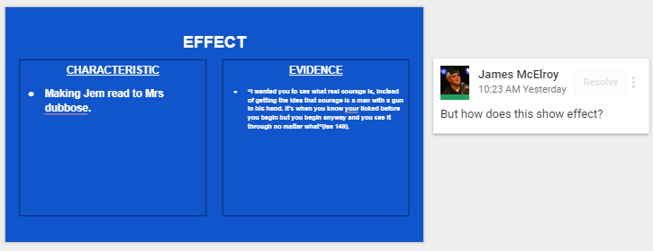
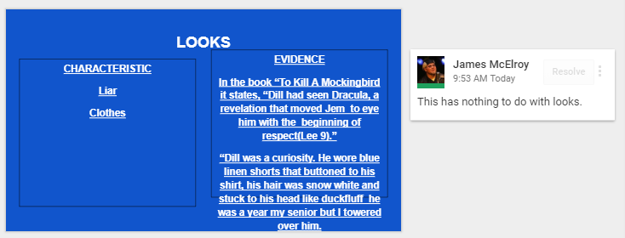
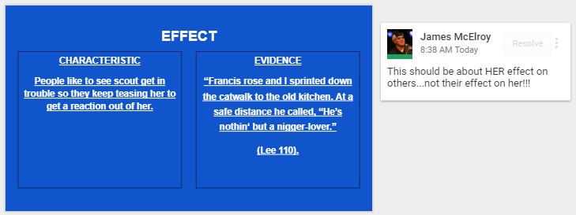
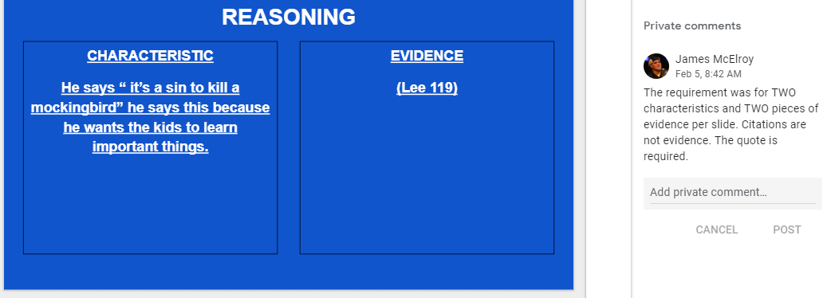
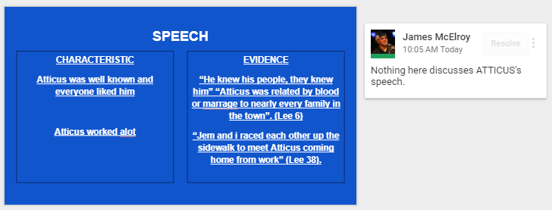

Slide 163
LASER FOCUS CHARACTER ANALYSIS
Now let’s look at some examples
of what was expected!

Slide 165
LASER FOCUS CHARACTER ANALYSIS
If you NEVER TURNED IT IN…
Now you know exactly what it should look like.
Turn it in and make sure it’s right!
Yes, you still lose some points for lateness.
If you turned it in and got a score you are not happy with…
You have ONE SHOT to re-do it and make additions/corrections/changes.
You have until the end of class tomorrow to resubmit it.
If you did it right the first time…
Work on Chapter Questions or study vocab.

Slide 166
Homework
Vocab slides for Ch 16-23 DUE TOMORROW!
There will be a QUIZ on vocab Friday!
Answer the questions for Chapters
12 - 15 in the Google Classroom Document “To Kill Questions Chapters 12-15”
DUE MONDAY 2/11 by 7:00 a.m.

Slide 167
Exit Ticket
2/7/19
Write about the following:
Why did Jem disobey Atticus in front of the jail?
What was he trying to do?
How did it change the way this scene played out?

Slide 168
No Start-Up Today It is a QUIZ DAY!
2/8/19

Slide 169
NO Exit Ticket Today When you are finished with your quizZES, work on: - LASER Character Analysis – resubmit must be by the end of the period - Chapter Questions DUE MONDAY - Next week’s vocabulary – already in GC
2/8//19

Slide 170
Start-Up
2/11/19
NO START-UPS
OR
EXIT TICKETS
THIS WEEK!

Slide 171
Unit Objectives
CCSS.ELA-LITERACY.RL.9-10.1
Cite strong and thorough textual evidence to support analysis of what the text says explicitly as well as inferences drawn from the text.
CCSS.ELA-LITERACY.RL.9-10.2
Determine a theme or central idea of a text and analyze in detail its development over the course of the text, including how it emerges and is shaped and refined by specific details; provide an objective summary of the text.
CCSS.ELA-LITERACY.RL.9-10.3
Analyze how complex characters (e.g., those with multiple or conflicting motivations) develop over the course of a text, interact with other characters, and advance the plot or develop the theme.

Slide 172
Small Group Read…
Today you will be doing a read around in your groups.
Each person must take a turn reading and read at least two paragraphs.
You are responsible for reading Chapter 16.
If your group does not finish the chapter, you are responsible for finishing Chapter 16.

Slide 173
As You Read…
How are the people in/around Maycomb treating the day of the trial?

Slide 174
Homework
Finish Reading Chapter 16.
Vocab slides for Ch 24-31 DUE FRIDAY! There will be a QUIZ on vocab NEXT Friday!
Answer the questions for Chapter
16 in the Google Classroom Document “To Kill Questions Chapters 16-23”
DUE MONDAY 2/25 by 7:00 a.m.

Slide 175
District Formative Assessment
2/12/19
Log in to CLEVER using your school email and normal password
Select SCHOOL CITY
Click TAKE ASSESSMENTS flipcard
Click ELA GRADE 10 POST-TEST
When finished, hit SUBMIT.
Use extra time to get questions or vocab done.

Slide 176
NO Start-Up TODAY!
2/19/19

Slide 177
Unit Objectives
CCSS.ELA-LITERACY.RL.9-10.1
Cite strong and thorough textual evidence to support analysis of what the text says explicitly as well as inferences drawn from the text.
CCSS.ELA-LITERACY.RL.9-10.2
Determine a theme or central idea of a text and analyze in detail its development over the course of the text, including how it emerges and is shaped and refined by specific details; provide an objective summary of the text.
CCSS.ELA-LITERACY.RL.9-10.3
Analyze how complex characters (e.g., those with multiple or conflicting motivations) develop over the course of a text, interact with other characters, and advance the plot or develop the theme.

Slide 178
Argumentative Writing
Today, we will be pausing our reading to do a ONE PERIOD ARGUMENTATIVE WRITING ASSESSMENT!
You will be writing using the TBDAT format, which we have used several times before.
Let’s review it quickly…

Slide 179
TBDAT
T – Topic Sentence
B – Background
D – Detail (also known as evidence)
A – Analysis (also known as commentary)
T – Tie Back (also known as concluding sentence)

Slide 180
Topic Sentence
The main idea of the paragraph. IT SHOULD ANSWER THE PROMPT!
It explains what you will prove in that paragraph.
This should not be a specific detail from the story, but rather it should take a stance on an issue from the story that can be debated.

Slide 181
Background
Gives the background of the supporting detail.
WHO says the quote or does the action?
WHEN does he/she say that or do that?
WHERE does the action take place?
Comes before the supporting detail in the paragraph

Slide 182
Detail (Evidence, Quote)
This is the evidence that comes directly from the story.
You should be able to turn to a page and say, “See, it happens right here.”
Can be a direct quote that a character says or a specific detail of an event that occurs.

Slide 183
Analysis
Explains the significance of the detail.
What does that quote literally mean?
PARAPHRASE IT!
What does that quote or event show?
WHY IS IT IMPORTANT?
HOW DOES IT HELP MAKE YOUR POINT?

Slide 184
Tie Back
RESTATE your main point in a new way!
Connect the detail and the analysis back to the topic sentence.

Slide 185
FAILURE TO PROPERLY CITE YOUR SOURCE WILL RESULT IN A ZERO ON THE ASSIGNMENT WITH NO CHANCE TO RECLAIM THAT GRADE, AS PER THE COURSE SYLLABUS AND ACADEMIC HONESTY POLICY!
Proper citation for this novel is SIMPLE!
Example:
“It’s never an insult to be called what somebody thinks is a bad name. It just shows you how poor that person is, it doesn’t hurt you” (Lee 144).

Slide 186
The PROMPT
Do you believe Mayella Ewell is a victim or villain?
TRIAL TESTIMONY
Bob Ewell- 227-238
Mayella Ewell- 239-252
Tom Robinson- 254-265

Slide 187
When You Are Finished…
Start reading Chapter 20
Finish for HW
We will discuss them tomorrow!

Slide 188
Homework
FINISH READING CHAPTER
20
FINISH the questions for Chapter
16-23 in “TKaM Questions Chapters 16-23”
DUE MONDAY 2/25/19
Don’t forget the vocabulary sheet for CH 24-31 in Google Classroom.
DUE FRIDAY!
VOCAB QUIZ FRIDAY!

Slide 189
NO Exit Ticket
2/19/19

Slide 190
Start-Up - Discussion
2/20/19
In your triads, discuss the following:
What is your opinion of Mr. Dolphus Raymond?
According to him, why does he act the way he does?
Do you think he is right to act/live the way he does? Why?

Slide 191
Unit Objectives
CCSS.ELA-LITERACY.RL.9-10.1
Cite strong and thorough textual evidence to support analysis of what the text says explicitly as well as inferences drawn from the text.
CCSS.ELA-LITERACY.RL.9-10.2
Determine a theme or central idea of a text and analyze in detail its development over the course of the text, including how it emerges and is shaped and refined by specific details; provide an objective summary of the text.
CCSS.ELA-LITERACY.RL.9-10.3
Analyze how complex characters (e.g., those with multiple or conflicting motivations) develop over the course of a text, interact with other characters, and advance the plot or develop the theme.

Slide 192
Homework
Answer the questions for Chapter
16-23 in “TKaM Questions Chapters 16-23”
DUE MONDAY 5/14/18
Don’t forget the vocabulary sheet for CH 24-31 in Google Classroom.
DUE FRIDAY!
VOCAB QUIZ FRIDAY!

Slide 193
Start-Up - Discussion
2/21/19
In your triads, discuss the following:
What do you think Jem meant when he said it was “like bein’ a caterpillar in a cocoon?”
How has this event changed Jem’s view of Maycomb and humanity in general?

Slide 194
No Start-Up Today
2/21/19

Slide 195
Unit Objectives
CCSS.ELA-LITERACY.RL.9-10.1
Cite strong and thorough textual evidence to support analysis of what the text says explicitly as well as inferences drawn from the text.
CCSS.ELA-LITERACY.RL.9-10.2
Determine a theme or central idea of a text and analyze in detail its development over the course of the text, including how it emerges and is shaped and refined by specific details; provide an objective summary of the text.
CCSS.ELA-LITERACY.RL.9-10.3
Analyze how complex characters (e.g., those with multiple or conflicting motivations) develop over the course of a text, interact with other characters, and advance the plot or develop the theme.

Slide 196
Vocabulary Review
Shall we…
SLAM?

Slide 197
Small Group Read…
Today you will be doing a read around in your groups.
Each person must take a turn reading and read at least two paragraphs.
You are responsible for reading Chapter 23.
If your group does not finish the chapter, you are responsible for finishing Chapter 23.

Slide 198
Homework
Finish Reading Chapter 23.
Vocab slides for Ch 24-31 DUE TOMORROW!
There will be a QUIZ on vocab TOMORROW!
Answer ALL questions for Chapter
16-23 in the Google Classroom Document “TKaM Chapters 16-23”
DUE MONDAY 2/25 by 7:00 a.m.

Slide 199
NO Start-Up or Exit Ticket Today When you are finished with your quizZES, begin SILENT READING Chapter 24! HOMEWORK -Vocab slides were DUE this morning! -Chapter Questions DUE MONDAY - Finish reading Chapter 24
2/22/19

Slide 200
Start-Up - Discussion
2/25/19
In your triads, discuss the following:
What were the women of the “Missionary Tea” talking about?
What did Miss Maudie mean when she said to Mrs. Merriweather, “His food doesn’t stick going down does it?”
What was Mrs. Merriweather doing?

Slide 201
Start-Up - Writing
2/25/19
Write about the following:
What were the women of the “Missionary Tea” talking about?
What did Miss Maudie mean when she said to Mrs. Merriweather, “His food doesn’t stick going down does it?”
What was Mrs. Merriweather doing?

Slide 202
Unit Objectives
CCSS.ELA-LITERACY.RL.9-10.1
Cite strong and thorough textual evidence to support analysis of what the text says explicitly as well as inferences drawn from the text.
CCSS.ELA-LITERACY.RL.9-10.2
Determine a theme or central idea of a text and analyze in detail its development over the course of the text, including how it emerges and is shaped and refined by specific details; provide an objective summary of the text.
CCSS.ELA-LITERACY.RL.9-10.3
Analyze how complex characters (e.g., those with multiple or conflicting motivations) develop over the course of a text, interact with other characters, and advance the plot or develop the theme.

Slide 203
Homework
Reading Chapter 27.
Answer the questions for Chapters
24-27 in the Google Classroom Document “To Kill Questions Chapters 24-31”
DUE MONDAY 3/4 by 7:00 a.m.

Slide 204
Exit Ticket
2/25/19
Write about the following:
What was the topic of the current event in Scout’s classroom?
What did Mrs. Gates think about Hitler and his persecution of others?
Why did Scout feel she was being a hypocrite?

Slide 205
Start-Up
2/27/19
FOR YOUR START-UP TODAY…
1- Open Google Classroom.
2- Open YOUR Trial Analysis TBDAT Paragraph.
3- Read over your paragraph AND the scoring rubric found at the bottom of the page.
In Your Groups, discuss your paragraphs and scores. Did you get the score you think you should have? Why or why not? Can you see the mistakes you made according to the rubric?

Slide 206
Today’s Objectives
CCSS.ELA-LITERACY.RL.9-10.1
Cite strong and thorough textual evidence to support analysis of what the text says explicitly as well as inferences drawn from the text.
CCSS.ELA-LITERACY.RL.9-10.3
Analyze how complex characters (e.g., those with multiple or conflicting motivations) develop over the course of a text, interact with other characters, and advance the plot or develop the theme.

Slide 207
TKaM Trial Analysis - Revisited
Today, we will be taking another look at your Trial Analysis TBDAT Paragraphs.
There are still a lot of very common mistakes, so today we will look at some samples to see what some common errors are.
We are going to do this as BOTH an individual AND a group activity!
Let’s start by looking at the first sample paragraph as a class…

Slide 208
Sample Paragraph #1
In the novel To Kill a Mockingbird, by Harper Lee, the character Mayella Ewell is a victim, not to Tom Robinson, but to her father, Bob Ewell. During the scene in the courtroom, while Tom is giving his testimony, it is revealed that Mayella is possibly being sexually abused by her father. As Tom gives his testimony, he says, “‘She says she never kissed a grown man before an’ she might as well kiss a nigger. She says what her papa do to her don’t count’” (Lee, 260). Later into his testimony he also says, “‘Mr. Ewell yonder hollered through th’ window… ‘He says you goddamn whore, I’ll kill ya’” (Lee, 260). These quotes explain that as Mayella forces herself onto Tom, she tells him that the intimate actions she has with her father are not the same as kissing another grown man. Also, the reaction from her father suggests that they have previously had sexual encounters, and the insulting name Bob calls Mayella could also suggest that their encounters were not always consensual. The events in the courtroom scene of To Kill a Mockingbird by Harper Lee suggests that Mayella Ewell is being sexually abused by her father, Bob Ewell, showing that Mayella is a victim to her father.

Slide 209
Topic Sentence
In the novel To Kill a Mockingbird, by Harper Lee, the character Mayella Ewell is a victim, not to Tom Robinson, but to her father, Bob Ewell.
Learning Targets (Content) | Strong Evidence 4 | Some Evidence 3 | Little Evidence 2 | No Evidence 1
Topic Sentence Introduces the main point/claim | Topic Sentence: -Introduces main point/claim -Clear, precise, and arguable | Topic Sentence: -Introduces main point/claim -May need to be more arguable or precise | Topic Sentence: -Main point/claim is implied (needs to be directly stated) -May need to be more arguable or precise | Topic Sentence: -Unclear or missing a topic sentence

Slide 210
Background
During the scene in the courtroom, while Tom is giving his testimony, it is revealed that Mayella is possibly being sexually abused by her father. As Tom gives his testimony, he says…
Learning Targets (Content) | Strong Evidence 4 | Some Evidence 3 | Little Evidence 2 | No Evidence 1
Background Introductory information to the evidence. Background should provide who, what, where, or when information about detail. | Background: -Restates key information/ideas expressed by author -Accurate, concise, and original introduction to evidence -Properly integrates background with evidence (not dropped in quote) | Background: -Restates information/ideas expressed by the author -May be lengthy or too short -Somewhat integrates background with evidence (not dropped in quote) | Background: -Needs to restate in a new version the key ideas/information expressed by author -Does not integrate background with evidence (drops in quote) | Background: - No evidence of background information.

Slide 211
Detail
As Tom gives his testimony, he says, “‘She says she never kissed a grown man before an’ she might as well kiss a nigger. She says what her papa do to her don’t count’” (Lee, 260). Later into his testimony he also says, “‘Mr. Ewell yonder hollered through th’ window… ‘He says you goddamn whore, I’ll kill ya’” (Lee, 260).
Learning Targets (Content) | Strong Evidence 4 | Some Evidence 3 | Little Evidence 2 | No Evidence 1
Detail Provides evidence that supports main claim (such as examples, quotes, facts, statistics etc. ) | Evidence: -Supports the main point/claim -Relevant and logical -Proper Citation (MLA Style) | Evidence: -Supports or somewhat supports main point/claim -Minor errors in citation (MLA Style) | Evidence: -Evidence is unrelated to main point/claim (needs evidence that supports topic sentence) -May need proper citations (MLA) | Evidence: -Missing evidence

Slide 212
Analysis
These quotes explain that as Mayella forces herself onto Tom, she tells him that the intimate actions she has with her father are not the same as kissing another grown man. Also, the reaction from her father suggests that they have previously had sexual encounters, and the insulting name Bob calls Mayella could also suggest that their encounters were not always consensual.
Learning Targets (Content) | Strong Evidence 4 | Some Evidence 3 | Little Evidence 2 | No Evidence 1
Analysis Breaks apart the evidence (referring to specific words, phrases, or ideas) and explains HOW it supports the claim/main idea | Analysis: -Explains, interprets, and discusses how the evidence supports the main idea/claim -Logical and insightful | Analysis: -Explains, interprets and discusses the evidence -Logical interpretation -Does not fully explain how this evidence supports the main idea | Analysis: -Needs to provide an interpretation of how the evidence supports the main idea/claim -Retells rather than analyzes the evidence | Analysis: -Missing analysis

Slide 213
Tie Back
The events in the courtroom scene of To Kill a Mockingbird by Harper Lee suggests that Mayella Ewell is being sexually abused by her father, Bob Ewell, showing that Mayella is a victim to her father.
Learning Targets (Content) | Strong Evidence 4 | Some Evidence 3 | Little Evidence 2 | No Evidence 1
Tie Back Emphasizes how the evidence connects to main idea/claim | Concluding Sent: -Emphasizes the connection between the evidence and the main idea/claim | Concluding Sent: -An implied connection is made between evidence and main idea/claim | Concluding Sent: -Concluding statement is off topic -Needs to make a connection between evidence and the main idea/claim | Concluding Sent: -Missing a concluding sentence

Slide 214
YOUR TURN
Take the next 3 minutes to read over and record YOUR score for Sample Paragraph 2.
Now take 1 minute to share your score with your group. If your group scored it differently, discuss why.
Come to a consensus on the most appropriate score for the paragraph.
Record the score on your score sheet as “Group Score.”

Slide 215
YOUR TURN
Take the next 3 minutes to read over and record YOUR score for Sample Paragraph 3.
Now take 1 minute to share your score with your group. If your group scored it differently, discuss why.
Come to a consensus on the most appropriate score for the paragraph.
Record the score on your score sheet.

Slide 216
YOUR TURN
Take the next 3 minutes to read over and record YOUR score for Sample Paragraph 4.
Now take 1 minute to share your score with your group. If your group scored it differently, discuss why.
Come to a consensus on the most appropriate score for the paragraph.
Record the score on your score sheet.

Slide 217
YOUR TURN
Take the next 3 minutes to read over and record YOUR score for Sample Paragraph 5.
Now take 1 minute to share your score with your group. If your group scored it differently, discuss why.
Come to a consensus on the most appropriate score for the paragraph.
Record the score on your score sheet.

Slide 218
YOUR TURN
Take the next 3 minutes to read over and record YOUR score for Sample Paragraph 6.
Now take 1 minute to share your score with your group. If your group scored it differently, discuss why.
Come to a consensus on the most appropriate score for the paragraph.
Record the score on your score sheet.

Slide 219
Next Steps…
Go to Google Classroom and open up YOUR Trial Analysis Paragraph. DO NOT LOOK AT THE RUBRIC AT THE BOTTOM YET!
Now, using the same steps, analyze your own paragraph and determine a score you think is appropriate.

Slide 220
Next Steps…
Now go to the bottom of your document and look at the rubric there. It shows the score that I gave your paragraph. It also shows where you gained or loat points (highlighted in rubric).
Does the score you assessed match the one I gave? If not, try to determine why not. What did I notice that you didn’t?
Now that you have an even better idea of how these were scored, you SHOULD be able to make changes/corrections to yours, right?????
Now go back to your paragraph and make those changes and corrections. HIGHLIGHT ANY CHANGES YOU MAKE IN GREEN SO I WILL SEE IT CLEARLY!!!

Slide 221
Homework
You have until FRIDAY to make changes/corrections to your Trial Analysis Paragraphs.
NO RESUBMITS WILL BE ACCEPTED AFTER FRIDAY!
Read Chapter 28.
Answer ALL questions for Chapter
24-28 in the Google Classroom Document “TKaM Chapters 24-31”
DUE MONDAY 3/4 by 7:00 a.m.

Slide 222
No Exit Ticket
2/27/19

Slide 223
Start-Up - Writing
2/28/19
Write about the following:
In 4 to 5 sentences, write a summary of the major events of
CHAPTER 28
Which you should have read last night!

Slide 224
Unit Objectives
CCSS.ELA-LITERACY.RL.9-10.1
Cite strong and thorough textual evidence to support analysis of what the text says explicitly as well as inferences drawn from the text.
CCSS.ELA-LITERACY.RL.9-10.2
Determine a theme or central idea of a text and analyze in detail its development over the course of the text, including how it emerges and is shaped and refined by specific details; provide an objective summary of the text.
CCSS.ELA-LITERACY.RL.9-10.3
Analyze how complex characters (e.g., those with multiple or conflicting motivations) develop over the course of a text, interact with other characters, and advance the plot or develop the theme.

Slide 225
Homework
You have until TOMORROW to make changes/corrections to your Trial Analysis Paragraphs.
NO RESUBMITS WILL BE ACCEPTED AFTER TOMORROW!
Answer ALL questions for Chapter
24-31 in the Google Classroom Document “TKaM Chapters 24-31”
DUE MONDAY 3/4 by 7:00 a.m.

Slide 226
Exit Ticket
2/28/19
Write about the following:
Who killed Bob Ewell?
Why did Sheriff Tate want to lie about it?
Who was he protecting?
From what?

Slide 227
No Start-Up Today It is a QUIZ DAY!
3/1/19

Slide 228
Homework
Answer ALL questions for Chapter
24-31 in the Google Classroom Document “TKaM Chapters 24-31”
DUE MONDAY 3/4 by 7:00 a.m.

Slide 229
No Start-Up Today It is a QUIZ DAY!
3/4/19

Slide 230
No Start-Up Today
3/5/19

Slide 231
Start-Up - Discussion
3/5/19
In your groups, discuss the following:
What are at least two or three differences you have noticed between the novel and the movie?
Do the things left out of the movie take away from the story?

Slide 232
Start-Up - Writing
3/5/19
Write about the following:
What are at least two or three differences you have noticed between the novel and the movie?
Do the things left out of the movie take away from the story?

Slide 233
Exit Ticket
3/5/19
Write about the following:
What’s one way that the character you chose to analyze has “shifted,” or changed, over the course of the novel? Was that change a positive or negative one? Why?

Slide 234
Start-Up - Discussion
3/6/19
In your groups, discuss the following:
Think about the character you have been working with on the LASER FOCUS analysis.
What conflicts have they been involved in over the course of the novel?
Were they involved in internal conflicts? External conflicts?
Would your character be considered the protagonist or antagonist in those conflicts?

Slide 235
Start-Up - Writing
3/6/19
Write about the following:
Think about the character you have been working with on the LASER FOCUS analysis.
What conflicts have they been involved in over the course of the novel?
Were they involved in internal conflicts? External conflicts?
Would your character be considered the protagonist or antagonist in those conflicts?

Slide 236
Unit Objectives
CCSS.ELA-LITERACY.RL.9-10.1
Cite strong and thorough textual evidence to support analysis of what the text says explicitly as well as inferences drawn from the text.
CCSS.ELA-LITERACY.RL.9-10.2
Determine a theme or central idea of a text and analyze in detail its development over the course of the text, including how it emerges and is shaped and refined by specific details; provide an objective summary of the text.
CCSS.ELA-LITERACY.RL.9-10.3
Analyze how complex characters (e.g., those with multiple or conflicting motivations) develop over the course of a text, interact with other characters, and advance the plot or develop the theme.

Slide 237
Today’s Objectives
Analyze fictional characters and their development over the course of a novel.

Slide 238
Character Analysis
Looks Actions Speech Effect Reasoning | Feelings Obligations Conflicts Understandings Shifts

Slide 239
Character Analysis - Focus
Feelings - How do the characters emotions and emotional connections to others affect their choices? What emotions are they feeling strongly enough to drive them to action?
Remember: If one character cares for another, they are motivated by that emotion. The same is true if they fear them, are jealous of them, or despise them. Minimum of TWO examples of emotions/emotional connections WITH PROPERLY CITED EVIDENCE.

Slide 240
Character Analysis - Focus
Obligations - What does your character owe other characters and what do they owe him or her (eg: money, respect, love, an apology, etc.)? How are they tied to other characters?
Remember: If one person feels like they owe someone, or that they are owed something, it changes the way they behave. Minimum of TWO examples of obligations WITH PROPERLY CITED EVIDENCE.

Slide 241
Character Analysis - Focus
Conflict: With whom, or with what, is your character in conflict? Is there internal conflict, external conflict, or both? Is your character the protagonist or antagonist (or something in between)?
Remember: Without conflict, there is no story! Your character’s conflict pushes the plot forward. Minimum of TWO examples of conflicts WITH PROPERLY CITED EVIDENCE.

Slide 242
Character Analysis - Focus
Understandings - What does your character know? About other characters? About themselves? Do they have any secrets or things that only they know? Also, what do they NOT know or WANT to know?
Remember: If a character wants or needs knowledge, they may be inclined to take risks or do things outside their “normal.” Minimum of TWO examples of understandings/questions WITH PROPERLY CITED EVIDENCE.

Slide 243
Character Analysis - Focus
Shifts - How does your character change over the course of the story? Do their priorities shift? Do their beliefs change? Do they grow, learn, mature? Or are they a static (unchanging) character?
Remember: In most good novels, the characters change the plot, but the plot also changes the characters. Minimum of TWO examples of ways the character changes WITH PROPERLY CITED EVIDENCE.

Slide 244
Homework
LASER FOCUS Character Analysis
DUE FRIDAY by 7:00 a.m.

Slide 245
Exit Ticket
3/6/19
Write about the following:
What’s one thing that your character knows or understands that no one else in the book does?
Is it a true “secret” that they try to keep or just some knowledge no one else has?
Do they do anything with that knowledge? Does it affect the story?

Slide 246
Start-Up - Discussion
3/7/19
In your groups, discuss the following:
Think about the character you have been working with on the LASER FOCUS analysis.
Which other characters would you say that your character is connected to emotionally?
(Remember: They don’t have to be family to be emotionally connected.)
Share, with your group, one time in the novel when you think that emotional connection pushed your character to action.

Slide 247
Start-Up - Writing
3/6/19
Write about the following:
Think about the character you have been working with on the LASER FOCUS analysis.
Which other characters would you say that your character is connected to emotionally?
(Remember: They don’t have to be family to be emotionally connected.)
Share, in writing, one time in the novel when you think that emotional connection pushed your character to action.

Slide 248
Unit Objectives
CCSS.ELA-LITERACY.RL.9-10.1
Cite strong and thorough textual evidence to support analysis of what the text says explicitly as well as inferences drawn from the text.
CCSS.ELA-LITERACY.RL.9-10.2
Determine a theme or central idea of a text and analyze in detail its development over the course of the text, including how it emerges and is shaped and refined by specific details; provide an objective summary of the text.
CCSS.ELA-LITERACY.RL.9-10.3
Analyze how complex characters (e.g., those with multiple or conflicting motivations) develop over the course of a text, interact with other characters, and advance the plot or develop the theme.

Slide 249
Today’s Objectives
Analyze fictional characters and their development over the course of a novel.

Slide 250
Character Analysis
 | Feelings Obligations Conflicts Understandings Shifts

Slide 251
Homework
LASER FOCUS Character Analysis
DUE FRIDAY by 7:00 a.m.

Slide 252
Exit Ticket
3/7/19
Write about the following:
Thinking about how your character changed over the course of the novel, what event in the story do you think caused them to change the most?
Why would that cause them to change?

Slide 253
Start-Up - Discussion
3/8/19
In your groups, discuss the following:
What one thing from the novel, To Kill a Mockingbird, do you think you will remember the most?
(A particular scene, character, image, or theme)
Why do you think that will stay with you?

Slide 254
Start-Up - Writing
3/8/19
Write about the following:
What one thing from the novel, To Kill a Mockingbird, do you think you will remember the most?
(A particular scene, character, image, or theme)
Why do you think that will stay with you?

Slide 255
Unit Objectives
CCSS.ELA-LITERACY.RL.9-10.1
Cite strong and thorough textual evidence to support analysis of what the text says explicitly as well as inferences drawn from the text.
CCSS.ELA-LITERACY.RL.9-10.2
Determine a theme or central idea of a text and analyze in detail its development over the course of the text, including how it emerges and is shaped and refined by specific details; provide an objective summary of the text.
CCSS.ELA-LITERACY.RL.9-10.3
Analyze how complex characters (e.g., those with multiple or conflicting motivations) develop over the course of a text, interact with other characters, and advance the plot or develop the theme.

Slide 256
English 10 FINAL PROJECTS
Your FINAL PROJECTS are DUE on FRIDAY THE 15^{TH!}
ABSOLUTELY NO LATE WORK WILL BE ACCEPTED!!!

Slide 257
English 10 Final Projects
Option 1 – The One-Pager
A one pager is a single-page response to your reading that connects the ideas in the book to your thoughts creatively.
The purpose of the one-pager is so that your audience will understand the big ideas, themes, and connections within the book.

Slide 258
English 10 Final Projects
Option 1 – The One-Pager
Must do:
Title and border (5 points)
Write the title of the book and author’s name somewhere on the page (this can be done creatively!).
Include a border that reflects the unit of learning or theme. This can include words, pictures, symbols, or quotes from the text.
Two meaningful questions (10 points)
These should not be yes or no questions, but how or why questions.
Answers should include specific textual evidence and be cited by page number EX: (54)
Draw images (15 points)
Draw THREE images that represent themes, characters, conflict, or the setting of the book.
These should be strongly connected to the book and should stand out.
Interesting quotes (10 points)
Find two interesting quotes.
Include quotation marks and a citation.
If your passage/quote is a part of dialogue, include the character’s name who said it.

Slide 259
English 10 Final Projects
Option 1 – The One-Pager (cont.)
Must do:
Text opinion (on the back) (10 points)
In five to seven sentences add what your overall opinion of the novel is and what you would say when you recommend the book.
This, along with your name and period, is the ONLY aspect to go on the back of your paper.
Grammar, spelling, and mechanics (5 points)
There are little to no problems with grammar, spelling, mechanics.
Be colorful and neat. (5 points)
Your entire page should be filled with these elements.
If you find you have extra room, repeat any of the above steps/ elements.
No space should be blank. THERE SHOULD BE NO WHITE SPACE
Nothing should be left in pencil.
Your name,class period, and text opinion should be on the BACK of the one-pager.

Slide 260
English 10 Final Projects
Option 1 – The One-Pager (cont.)
You pick 2 from the following list:
Poem (15 points)
Write a poem about a part of the novel (such as a character, conflict, theme, etc.). If you struggle with writing poetry, consider an acrostic poem – each letter represents a word.
Personal statement (15 points)
Write THREE personal statements or connections about what you’ve read (these are not simple opinions).
EX: “I could relate to the main character feeling lost in the book because it reminded me of when I got to high school and didn’t know anyone.
Figurative language (15 points)
Create THREE examples of figurative language (simile, metaphor, hyperbole, alliteration, etc.) emphasizing some part of the novel (characters, conflicts, themes, settings, etc.)
Song (15 points)
Find two songs that represents a theme of the novel. Include the song title, singer/ band, and an explanation (at least 3 sentences) of how the lyrics connect to the book.
Connections (15 points)
What connections can you make between what you read today and the world outside of the story? There may be a connection to happenings at school, the community or the world, to similar events at other times or places, to other people or problems that you are reminded of, or to other stories/books that you have read.
Write three insightful, descriptive connections between you and the reading.

Slide 261
English 10 Final Projects
Option 1 – The One-Pager (cont.)
Presentation of Project (10 points)
Extra credit (up to 10 points): Pick an additional item from the list of five for up to five points of extra credit.

Slide 262
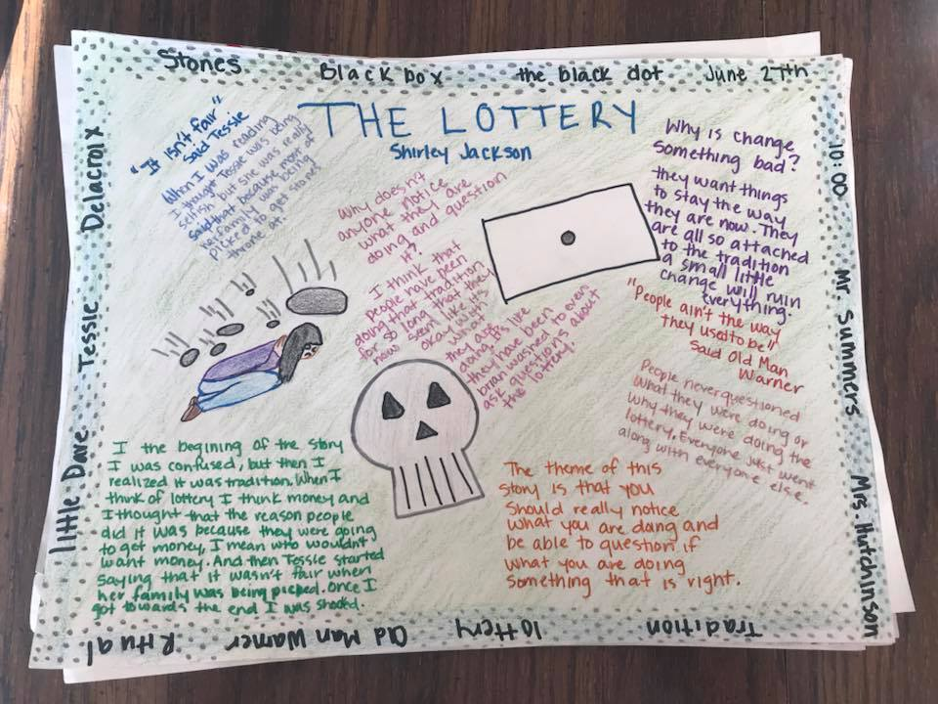
English 10 Final Projects
Option 1 – The One-Pager (cont.)

Slide 263
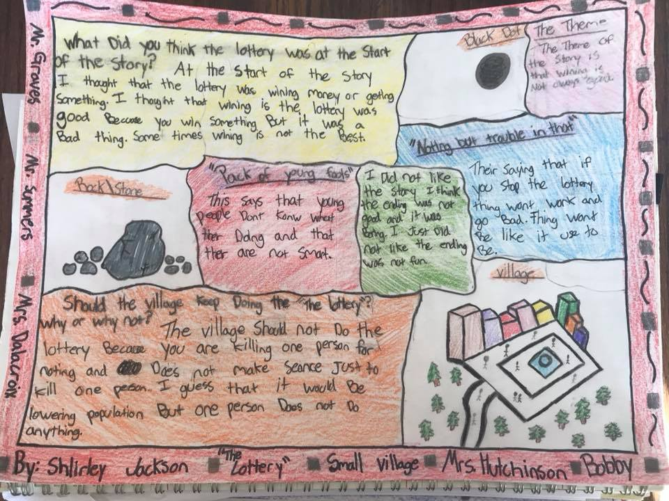
English 10 Final Projects
Option 1 – The One-Pager (cont.)

Slide 264
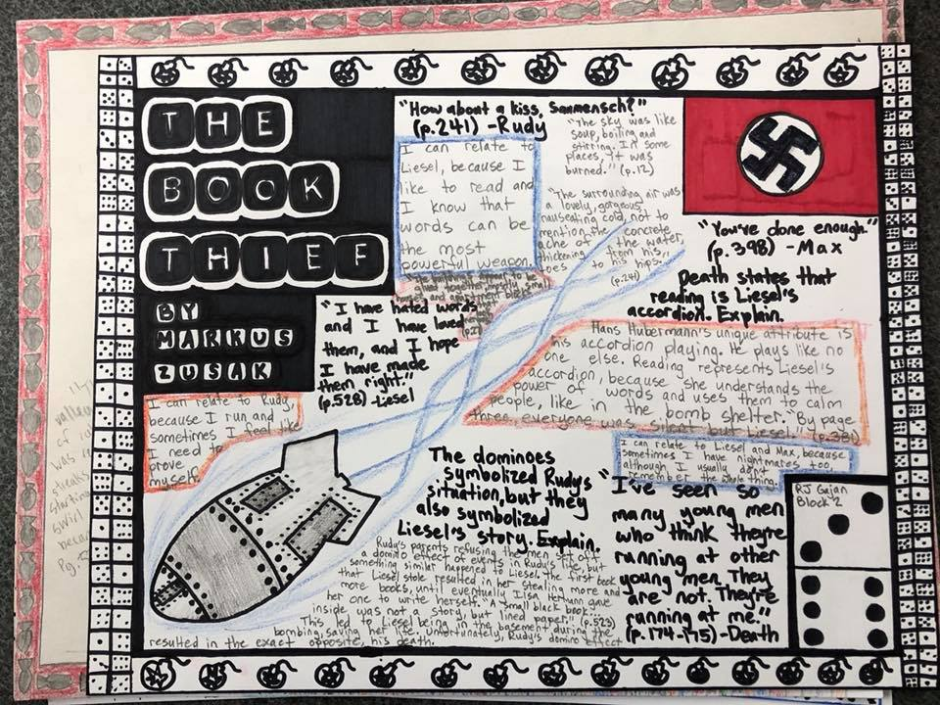
English 10 Final Projects
Option 1 – The One-Pager (cont.)

Slide 265
English 10 Final Projects
Option 2 – The Newspaper
The Newspaper Project is a single-page response to your reading that connects the ideas in the book to your thoughts creatively.
The purpose of the project is so that your audience will understand the big ideas, themes, and connections within the book.
This can be created digitally, but MUST be printed out for submission.

Slide 266
English 10 Final Projects
Option 2 – The Newspaper
Must do:
Title and Image (5 Points)
Create a title for your newspaper. You may NOT use “The Maycomb Tribune” (the actual paper from the story) as your title.
Include an image that reflects the novel or a theme from the novel.
One Headline Article - 200 word minimum (20 points)
Headlines are meant to do two things: draw attention to the story through eye-catching language and to summarize the main point of the story.
All headlines need a present tense verb.
Headlines should also give the reader some basic information. Think 5 W’s and 1H (who, what, when, where, why, and how) and choose the most important ones.
Should include quotes from the novel from at least two characters “interviewed.”
An Additional News Story - 150 word minimum (10 points)
Choose another important historical event that happened in the time of the novel (Summer, 1935).
Write a “National” or World” news article that gives details of that event.
Like your headline article, include the 5 Ws and 1 H.

Slide 267
English 10 Final Projects
Option 2 – The Newspaper (cont.)
Must do:
One Editorial Article - 150 word minimum (10 points)
An editorial is an article that presents a writer’s opinion on an issue. Much in the same manner of a lawyer, editorial writers build on an argument and try to persuade readers to think the same way they do.
Editorials are meant to influence public opinion, promote critical thinking, and sometimes cause people to take action on an issue.
In essence, an editorial is an opinionated news story where the writer presents his/her side cohesively and persuasively.
Two Pictures (5 points)
Find or draw two interesting pictures to go with your articles.
Grammar, spelling, and mechanics (5 points)
There are little to no problems with grammar, spelling, mechanics.
Be colorful and neat. (5 points)
Your entire page should be filled with these elements.
If you find you have extra room, repeat any of the above steps/ elements.
No space should be blank.
Nothing should be left in pencil.
Your name and class period should be on the BACK of the paper.

Slide 268
English 10 Final Projects
Option 2 – The Newspaper (cont.)
You pick 2 from the following list:
Personality Profile (15 points)
A human-interest story about a person who deserves recognition for something he/she did.
Choose a character OTHER THAN JEM, SCOUT, OR ATTICUS and write about them and something significant they did that affected the plot or showed a theme in the novel.
Eg: Dill, Miss Maudie, Mr. Underwood, Mr. Dolphus Raymond
Dear Abby section (15 points)
An advice column, including at least one letter asking a question related to the novel and or one of its themes and a response from the “advice columnist.”
Letter to the Editor (15 points)
Choose a minor character and write a letter to the editor of your newspaper in your character’s voice. You’d need to choose an event from the novel that prompts you to write.
Most people write letters to the editor when they have a problem with an issue that affects the community or when they want to praise the efforts of a community member.
Letters to the editor express the writer’s opinion.
Obituaries (15 points)
Choose 2 characters in the novel who die (Tom, Mrs. Radley, Mrs. Dubose) and write their obituaries.
Obituaries typically include: where and when they were born, where and when they died, who they leave behind (family and friends), and something (from the novel) they will be remembered for.
Comic Strip (Only choose this option if you have the skill to do it) (15 points)
Choose a theme from the novel and create a clever comic that illustrates the theme in a humorous way.
Must be at least 4 frames in length.

Slide 269
English 10 Final Projects
Option 2 – The Newspaper (cont.)
Presentation of Project (10 points)
Extra credit (up to 10 points): Pick an additional item from the list of five for up to five points of extra credit.

Slide 270
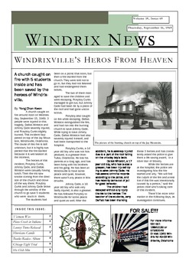
English 10 Final Projects
Option 2 – The Newspaper (cont.)

Slide 271
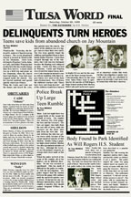
English 10 Final Projects
Option 2 – The Newspaper (cont.)

Slide 272
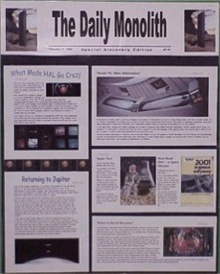
English 10 Final Projects
Option 2 – The Newspaper (cont.)

Slide 273
English 10 Final Projects
Option 3 – The Diorama
The Diorama Project is a three-dimensional, visual response to your reading that connects the ideas in the book to your thoughts creatively.
The purpose of the project is so that your audience will understand the big ideas, themes, and connections within the book.
If you choose this option, you must turn in the diorama itself AND the written elements (these can be all on one printed document).

Slide 274
English 10 Final Projects
Option 3 – The Diorama
Must do:
Title and Background (5 Points)
The title of the novel and the author’s name should appear somewhere on your diorama
Create a background image that reflects the novel or a theme from the novel.
One Symbolic Element - (20 points)
Choose something from the novel that is symbolic and create a 3-D representation of it in your diorama.
Write one complete paragraph (5-7 sentences minimum) explaining what that item is and what it symbolizes in the story.
Two Characters (10 points)
Choose two characters from the story and create a 3-D representation of them in your diorama.
Write TWO complete paragraphs (1 paragraph per character, 5-7 sentences minimum) describing each of the characters you chose.
NOT PHYSICAL DESCRIPTION…CHARACTER DESCRIPTION – personality, things that make them interesting, how they contribute to the story
A Significant Event (10 points)
The main focus of your diorama should be on ONE important moment in the story. Looking at your diorama, I should instantly be able to tell what moment you are portraying.
Write one complete paragraph (5-7 sentences minimum) describing the event you chose, why it was important to the plot, and why you chose it.

Slide 275
English 10 Final Projects
Option 3 – The Diorama (cont.)
Must do:
Two Pictures (5 points)
On the OUTSIDE SIDES of your diorama, include two pictures (can be drawn or printed out) that you think represent two different THEMES of the story.
For each image, include a written caption that explains what the image is and what theme it represents.
Grammar, spelling, and mechanics (5 points)
There are little to no problems with grammar, spelling, mechanics.
Be colorful and neat. (5 points)
Your entire diorama should be filled with these elements.
If you find you have extra room, repeat any of the above steps/ elements.
No space should be blank.
Nothing should be left in pencil.
Your name and class period should be on the BACK of the diorama.

Slide 276
English 10 Final Projects
Option 2 – The Diorama (cont.)
You pick 2 from the following list:
(These can be on the inside sides or part of your background)
Poem (15 points)
Write a poem about a part of the novel (such as a character, conflict, theme, etc.). If you struggle with writing poetry, consider an acrostic poem – each letter represents a word.
Personal statement (15 points)
Write THREE personal statements or connections about what you’ve read (these are not simple opinions).
EX: “I could relate to the main character feeling lost in the book because it reminded me of when I got to high school and didn’t know anyone.
Figurative language (15 points)
Create THREE examples of figurative language (simile, metaphor, hyperbole, alliteration, etc.) emphasizing some part of the novel (characters, conflicts, themes, settings, etc.)
Song (15 points)
Find two songs that represents a theme of the novel. Include the song title, singer/ band, and an explanation (at least 3 sentences) of how the lyrics connect to the book.
Connections (15 points)
What connections can you make between what you read today and the world outside of the story? There may be a connection to happenings at school, the community or the world, to similar events at other times or places, to other people or problems that you are reminded of, or to other stories/books that you have read.
Write three insightful, descriptive connections between you and the reading.

Slide 277
English 10 Final Projects
Option 3 – The Diorama (cont.)
Presentation of Project (10 points)
Extra credit (up to 10 points): Pick an additional item from the list of five for up to five points of extra credit.

Slide 278
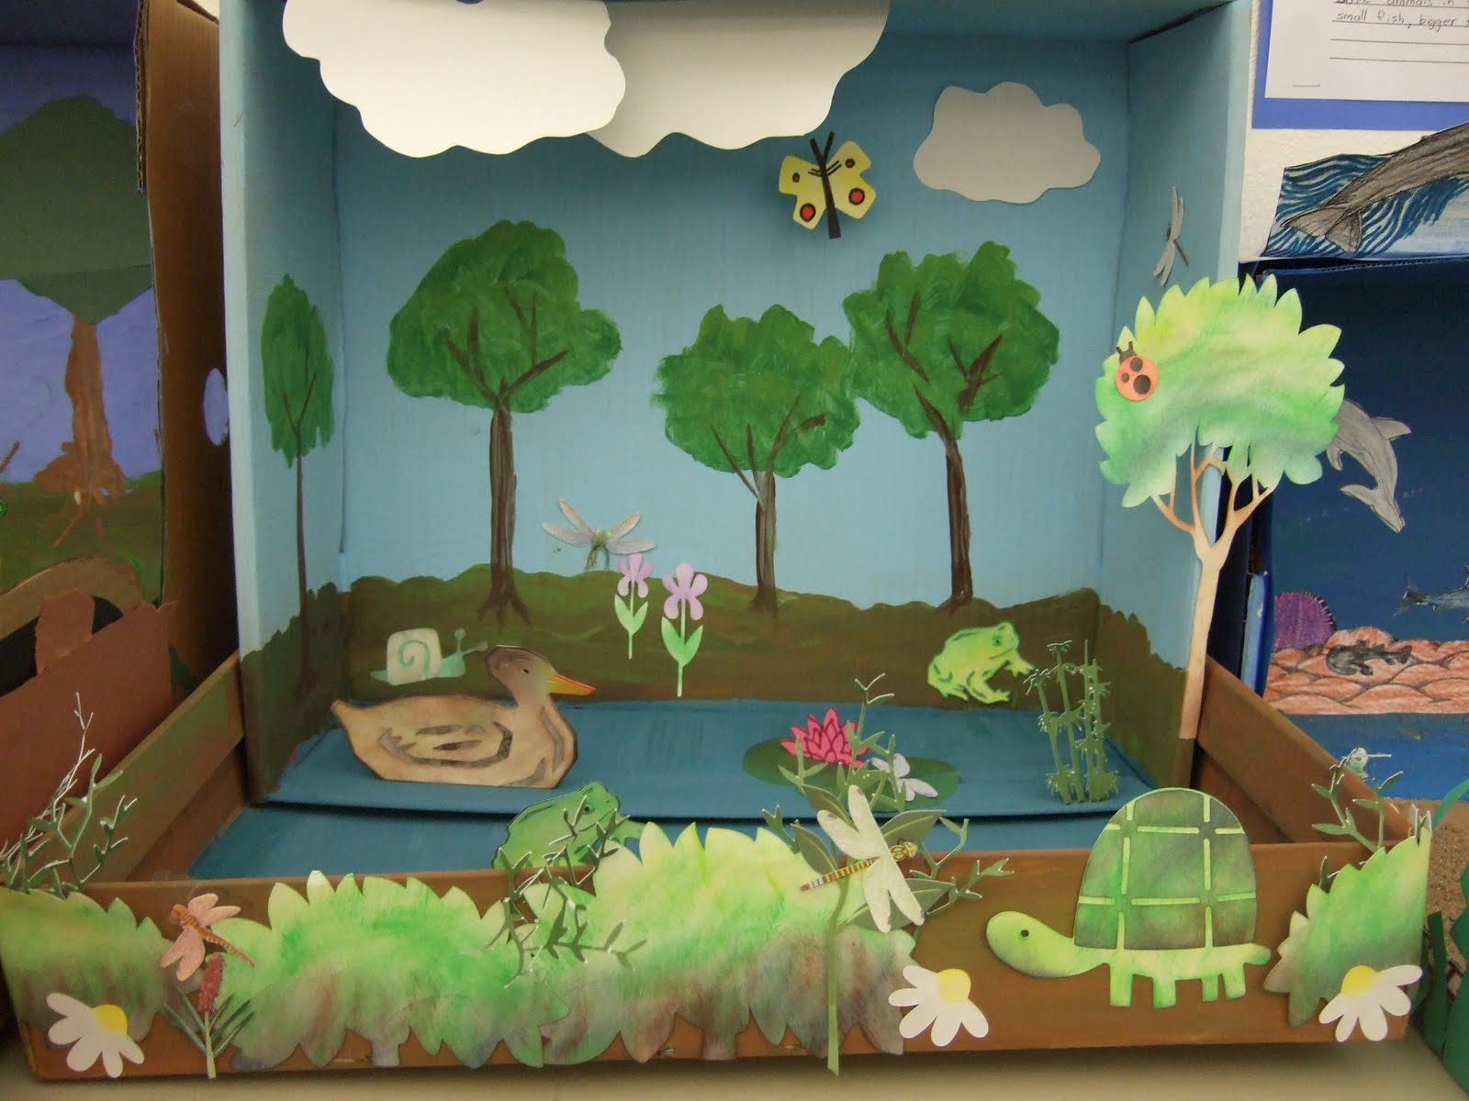
English 10 Final Projects
Option 3 – The Diorama (cont.)

Slide 279
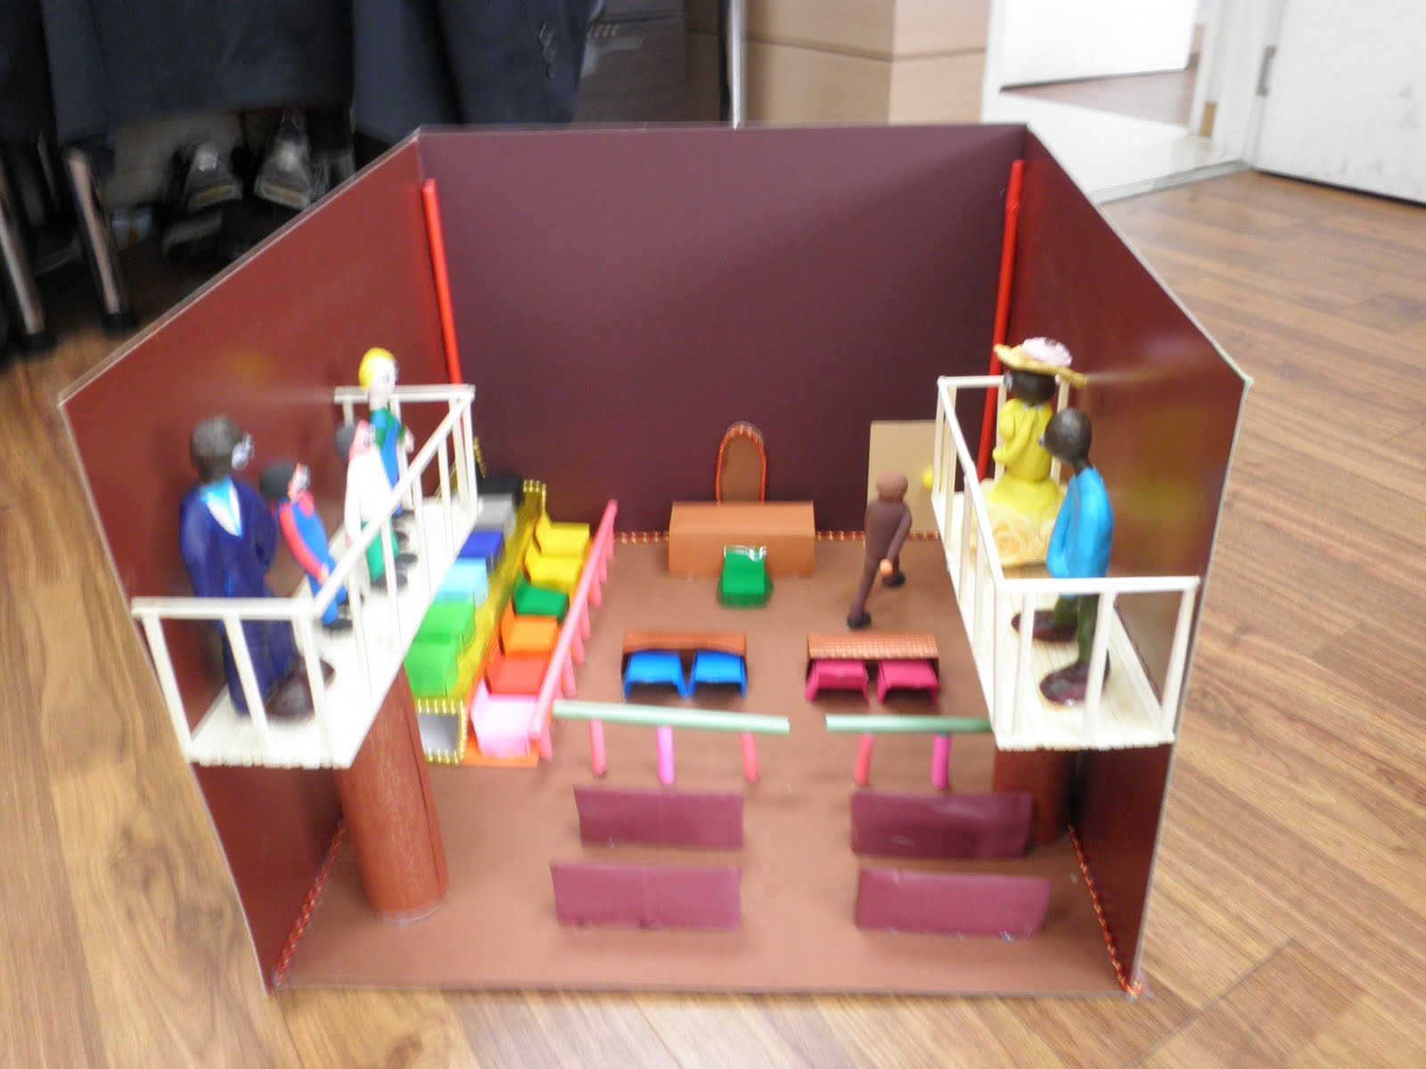
English 10 Final Projects
Option 3 – The Diorama (cont.)

Slide 280
English 10 Final Projects
Option 4 – The Re-write
The Rewrite Project is a response to your reading that connects the ideas in the book to your thoughts creatively.
You are to write 3 scenes in the story from a different main character’s point of view in a personal diary style.
The purpose of the project is so that your audience will understand the big ideas, themes, and connections within the book.

Slide 281
English 10 Final Projects
Option 4 – The Rewrite
Must do:
Title and Image Cover Page (5 Points)
Create a cover page for your re-write. You may NOT use the actual title of the novel as your title.
Include an image that reflects the novel or a theme from the novel.
Rewrite Scene 1 - 150 word minimum (25 points)
Choose a scene from the story and re-write it from the perspective of one of the main characters.
Be sure to include all of the important details from the original scene.
Your re-write should be in the style of that character’s personal journal.
Include personal insights into the scene that would be expected from the chosen character.
Rewrite Scene 2 - 150 word minimum (25 points)
Choose a scene from the story and re-write it from the perspective of the same main character.
Be sure to include all of the important details from the original scene.
Your re-write should be in the style of that character’s personal journal.
Include personal insights into the scene that would be expected from the chosen character.

Slide 282
English 10 Final Projects
Option 4 – The Re-write (cont.)
Must do:
Rewrite Scene 3 - 150 word minimum (25 points)
Choose a scene from the story and re-write it from the perspective of the same main character.
Be sure to include all of the important details from the original scene.
Your re-write should be in the style of that character’s personal journal.
Include personal insights into the scene that would be expected from the chosen character.
Grammar, spelling, and mechanics (5 points)
There are little to no problems with grammar, spelling, mechanics.
Be colorful and neat. (5 points)
Your journals should be artistically and creatively bound.
Journals should be NEATLY handwritten.
Your name and class period should be on the BACK of the project.

Slide 283
English 10 Final Projects
Option 4 – The Re-write (cont.)
You pick 2 from the following list. These should be included AFTER the journal entries in your project.
Poem (15 points)
Write a poem about a part of the novel from the point of view of the character you are journaling as. If you struggle with writing poetry, consider an acrostic poem – each letter represents a word.
Personal statement (15 points)
Write a personal statement sharing how YOU personally relate to the character you chose to journal as.
EX: “I could relate to the main character__________________ feeling lost in the book because it reminded me of when I got to high school and didn’t know anyone.
Figurative language (15 points)
Create THREE examples of figurative language (simile, metaphor, hyperbole, alliteration, etc.) emphasizing some part of the character and their importance to the novel.
Song (15 points)
Find two songs that somehow connects to the character you chose. Include the song title, singer/ band, and an explanation (at least 3 sentences) of how the lyrics connect to the character.

Slide 284
English 10 Final Projects
Option 4 – The Re-write (cont.)
Presentation of Project (10 points)
Extra credit (up to 10 points): Pick an additional item from the list of five for up to five points of extra credit.

Slide 285
English 10 Final Projects
Option 5 – The Newsreel
The Newsreel Project is a video response to your reading that connects the ideas in the book to your thoughts creatively.
The purpose of the project is so that your audience will understand the big ideas, themes, and connections within the book.

Slide 286
English 10 Final Projects
Option 5 – The Newsreel (cont.)
Must do:
Title and Image (5 Points)
Create a title for your newsreel.
Include an image that reflects the novel or a theme from the novel.
One Headline Story – 2 minute minimum (20 points)
Headlines stories are meant to do two things: draw attention to the story through eye-catching language and to summarize the main point of the story.
All headline story titles need a present tense verb.
Headlines should also give the reader some basic information. Think 5 W’s and 1H (who, what, when, where, why, and how) and choose the most important ones.
Should include “interviews” of at least two characters.
An Additional World or National News Story – 1 minute minimum (10 points)
Choose another important historical event that happened in the time of the novel (Summer, 1935).
Report on a “National” or World” news event, giving details of that event.
Like your headline story, include the 5 Ws and 1 H.

Slide 287
English 10 Final Projects
Option 5 – The Newsreel (cont.)
Must do:
One Editorial Segment - 1 minute minimum (10 points)
An editorial segment is a segment that presents a news personality’s opinion on an issue. Much in the same manner of a lawyer, editorialists build on an argument and try to persuade readers to think the same way they do.
Editorial segments are meant to influence public opinion, promote critical thinking, and sometimes cause people to take action on an issue.
In essence, an editorial is an opinionated news story where the news personality presents his/her side cohesively and persuasively.
Two Pictures (5 points)
Find or draw two interesting pictures to go with your stories. Have them displayed on screen during your report.
Grammar and mechanics (5 points)
There are little to no problems with grammar or mechanics.
Be creative and visually stimulating. (5 points)
Your entire video should be between 4-6 minutes in length.
If you find you have extra time, repeat any of the above steps/ elements.
Your name and class period should be in the credits at the end of the reel.

Slide 288
English 10 Final Projects
Option 5 – The Newsreel (cont.)
You pick 2 from the following list.
Personality Profile (15 points)
A human-interest story about a person who deserves recognition for something he/she did.
Choose a character OTHER THAN JEM, SCOUT, OR ATTICUS and write about them and something significant they did that affected the plot or showed a theme in the novel.
Eg: Dill, Miss Maudie, Mr. Underwood, Mr. Dolphus Raymond
Commercial (15 points)
Create a product or business that would be used in Maycomb around the time of the novel and that somehow connects with an event in the novel (shovels, air rifles, a costume shop, etc.)
Create a commercial for that product that might air on a newsreel. Be creative. Include a slogan and logo for the company or product.
Obituaries (15 points)
Choose 2 characters in the novel who die (Tom, Mrs. Radley, Mrs. Dubose) and read their obituaries.
Obituaries typically include: where and when they were born, where and when they died, who they leave behind (family and friends), and something (from the novel) they will be remembered for.
A Sports Segment (15 points)
Create a sports segment focused on an event from the novel (the fight between Scout and Walter, The tire rolling incident, Atticus’ shooting display)

Slide 289
English 10 Final Projects
Option 5 – The Newsreel (cont.)
Presentation of Project (10 points)
Extra credit (up to 10 points): Pick an additional item from the list of five for up to five points of extra credit.

Slide 290
PRESENTATION OF PROJECTS
Rather than using class time for presentations, you will be doing a VIDEO PRESENTATION of your project.
Your video presentations are DUE on the SAME DAY as your projects are due in class, FRIDAY MARCH 15th.
Your videos must be submitted to me BY EMAIL to
jmcelroy@turlockusd.org
BY THE END OF THE PERIOD ON FRIDAY 3/15!
THAT MEANS YOU ACTUALLY NEED TO HAVE YOUR PROJECTS FINISHED BY AT LEAST THURSDAY EVENING, SO YOU CAN DO YOUR VIDEO PRESENTATION AND GET IT SUBMITTED ON TIME!

Slide 291
HOMEWORK
By MONDAY, you need to have chosen a project option AND decided which “You Choose” elements you plan to include!
PLEASE NOTE: ONCE YOU HAVE CHOSEN A PROJECT AND ELEMENTS, YOU WILL NOT BE ALLOWED TO CHANGE THEM!!!

Slide 292
Exit Ticket
3/8/19
Write about the following:
Which one of the 5 project options do you think you will choose to do?
Why is that one your choice?
Which project would you least like to try and complete?
Why?

Slide 293
Start-Up
Complete the “I plan to” portion of your checklist for today.
Today’s Goals
1- Report your choice of project and your choices of “you choose” elements to Mr. McElroy.
2- Complete at least 1 element of your project.
Exit Ticket
Complete the “I finished” portion of your checklist and get it initialed.
3/11/18

Slide 294
Start-Up
Complete the “I plan to” portion of your checklist for today.
Today’s Goals
1- Report your choice of project and your choices of “you choose” elements to Mr. McElroy.
2- Complete at least TWO (2) elements of your project.
Exit Ticket
Complete the “I finished” portion of your checklist and get it initialed.
3/12/18

Slide 295
Start-Up
Complete the “I plan to” portion of your checklist for today.
Today’s Goals
1- Report your choice of project and your choices of “you choose” elements to Mr. McElroy.
2- Complete at least 1 element of your project.
Exit Ticket
Complete the “I finished” portion of your checklist and get it initialed.
3/13/18

