Slide 1
Start-Up - Discussion
WATCH
With your groups, discuss the following:
What was this video designed to make fun of? Is it successful in making its point?

Slide 2
Start-Up - Writing
Now write about it.
What was this video designed to make fun of?
Is it successful in making its point?
Why or why not?

Slide 3
Parody
A literary or musical work in which the style of an author or work is closely imitated for comic effect or in ridicule.
makes fun of another work by imitating some aspect of it.
meant for mocking; not typically containing anything serious.
does not intend to bring about societal change.
can make fun of literature, film, advertising, popular culture, etc.

Slide 4
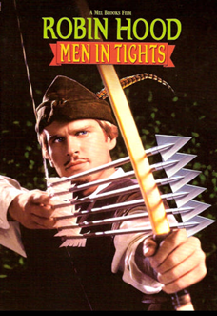
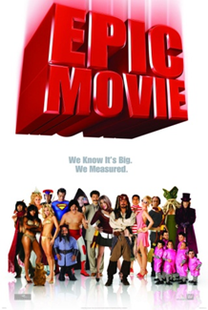
Parody
You Should Be familiar with Parody…
In Music
“Weird Al” Yankovic
In Film
Robin Hood: Men in Tights
Scary Movie 1, 2, 3, and 4
Not Another Teen Movie
Dance Flick
Epic Movie

Slide 5
Satire
A way of using humor to show the weaknesses or bad qualities of a person, government, society, etc.
ridicules the shortcomings of people or institutions in an attempt to bring about a change.
makes a serious point, usually through humor, while attacking some aspect of society.
often uses irony and exaggeration to make its point.
can sometimes use parody to make a point (but not all parodies are satire!)

Slide 6
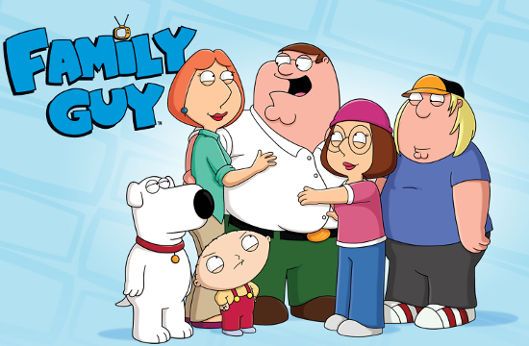
Satire
You are probably familiar with satire…
On Television
The Simpsons
The Daily Show
The Colbert Report
On the Internet
The Onion
The Daily Currant

Slide 7
The “Tools” of Satire and Parody
Hyperbole – over exaggeration – “I have a ton of homework”
Understatement or Litote – The opposite of hyperbole. “It’s a bit breezy today” (said during a hurricane).
Irony – discrepancy between expectation and reality. Includes sarcasm.
Puns – make a play on the double meaning of words etc.
Caricature – over exaggerate a person’s features or habits to show how ridiculous they are
Fantasy- creation of an absurd world that does not follow the rules of reason or common sense

Slide 8
Satire or Parody?
Satire

Slide 9
Satire or Parody?
Parody

Slide 10
Satire or Parody?
Both

Slide 11
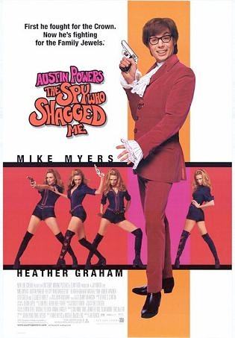
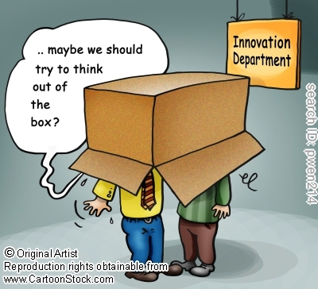
Satire or Parody?
Discuss each image in your groups. Identify them as satire or parody. What are they ridiculing?
Image 1 Image 2

Slide 12
Teenage Affluenza
Class Discussion – What do you think “Affluenza” might mean? What do you think this film might be about?
1. Identify the main ideas in the film clip.
What is being criticized or discredited?
What do you think the filmmaker wants changed?
4. What tools of satire/parody are being used?

Slide 13
Exit Ticket
In your own words, define both terms, parody and satire, and explain the difference between the two.

Slide 14
Previewing and Predicting
Survey the text – Are there any text features or reading aids? What is the overall length and number of paragraphs in the text? How is the text structured?
Make a prediction about the genre – What kind of writing is this? What do you expect to see in the text?
Scan the title and predict the topic – What will this text be about? What type of information do you think you will find?
Read the FIRST and LAST paragraphs – What information did you find out from reading the first and last paragraphs? Was your first prediction accurate?

Slide 15
Previewing and Predicting
Using the article “Radical Atheists Bomb ‘The Flinstones’ For Contradicting Theory Of Evolution,” answer the questions on the Previewing and Predicting worksheet.
Now answer the questions on the back of the page:
What is the point that this article is trying to make?
What “tools” of satire are being used to make that point?
Once you complete and turn in the Previewing and Predicting worksheet, you may begin the next assignment, The Onion Webquest.

Slide 16
Start-Up - Writing
Is the video clip an example of satire or parody? What is being ridiculed here? What is the ultimate goal or purpose of the video (this answer should help you determine if it is satire or parody!

Slide 17
The Onion Webquest
Go to the English III tab on my webpage.
Click on the link to The Onion Webquest (Google document).
MAKE A COPY SO YOU CAN ADD YOUR INFORMATION.
SET THE SHARE SETTINGS SO I CAN VIEW AND EDIT YOUR COPY.
SUBMIT IT USING THE “TURN IN YOUR ASSIGNMENTS” FORM ON MY WEBPAGE.

Slide 18
The Onion Webquest
Complete the webquest, following the instructions on the document.
Your completed webquest is due tomorrow.

Slide 19
Start-Up - Discussion
With your VERTICAL partner, discuss the following:
Are you familiar with the name Mark Twain?
If so, what do you know about him?
Have you ever read any of his works?
If so, which ones?
Class Discussion

Slide 20
Start-Up - Writing
Now write about the following:
Are you familiar with the name Mark Twain?
If so, what do you know about him?
If not, what did you learn in partner/class discussion?
Have you ever read any of his works?
If so, which ones?
If not, what were some that were mentioned in partner/class conversation?

Slide 21
Mark Twain
(1835 – 1910)
Born in November 30, 1835 in Florida, Missouri.
His real name was Samuel Clemens.
He grew up in Hannibal, Missouri, right next to the Mississippi River; which inspired his most famous novels.
Worked as a writer and editor for his brother’s newspaper and later, in an attempt to make more money, he worked as a riverboat pilot.
In 1861, when the Civil War started, riverboat trade ended. He joined the confederate army for a short time but then deserted and moved west to avoid the draft.

Slide 22
Mark Twain
(1835 – 1910)
He worked as a reporter and editorial writer while in the west.
At some point while out west, he started using the pen-name Mark Twain, which is riverboat slang for the depth of water needed for a boat to safely pass.
He gained popularity quickly as a writer and lecturer.
Published Tom Sawyer in 1876 and Huckleberry Finn in 1884.

Slide 23
The War Prayer
Originally written in 1905 as a protest to the Philippine-American War.
Mostly due to pressure from his family and editors, it was never published during his lifetime. They felt it would hurt his popularity as a writer and lecturer.
Finally published after WWI in a 1923 anthology of his writing.

Slide 24
The War Prayer
Listen/ Read along.
Now let’s WATCH it.
Let’s take a closer look at the “unspoken prayer.”

Slide 25
The War Prayer
You will be answering questions related to this short story. You will have the remainder of the period today AND tomorrow to complete the questions.
The last question is to be NO LESS THAN 2 PARAGRAPHS, and must include CITATIONS. Failure to CITE guarantees you a ZERO!

Slide 26
Exit Ticket
Tell me, in your own words, what message
you think Mark Twain was trying to get across through this satirical story?
Do you think it’s a valid message?
Why or why not?

Slide 27
Start-Up - Discussion
WATCH this version of “The War Prayer”
Now discuss the following with your group:
What are some similarities and/or differences between the text version, the video from yesterday, and the video from today?
Class Discussion

Slide 28
Start-Up - Writing
Now write about the following:
What are some similarities and/or differences between the text version, the video from yesterday, and the video from today?
Do you think the “modernized” version of Twain’s story is true to the original?
Do you think Twain’s message is still applicable today? Why or why not?

Slide 29
The War Prayer
You will be completing the questions related to this short story from yesterday. Your completed questions are DUE TOMORROW.
The last question is to be NO LESS THAN 2 PARAGRAPHS, and must include CITATIONS. Failure to CITE guarantees you a ZERO!

Slide 30
Start-Up - Discussion
Do you agree or disagree with the following statement:
Man is the highest form of life on our planet; more intelligent, more capable, and/or “better” than any other animal on Earth.
Take a moment to consider this statement, and then discuss it with your HORIZONTAL partner.
Class Discussion

Slide 31
Start-Up - Writing
In writing, agree or disagree with the following statement:
Man is the highest form of life on our planet; more intelligent, more capable, and/or “better” than any other animal on Earth.
You must provide at least one example or piece of evidence to support your opinion.

Slide 32
The Lowest Animal
Written in 1896, but not published until 1962 as part of a collection called “Letters From The Earth.”
As we read, look for examples of “tools of satire” that Twain uses in this essay. Highlight any that you find.
We will stop frequently as we go through the text to discuss examples.

Slide 33
The “Tools” of Satire and Parody
Hyperbole – over exaggeration – “I have a ton of homework”
Understatement or Litote – The opposite of hyperbole. “It’s a bit breezy today” (said during a hurricane).
Irony – discrepancy between expectation and reality. Includes sarcasm.
Puns – make a play on the double meaning of words etc.
Caricature – over exaggerate a person’s features or habits to show how ridiculous they are
Fantasy- creation of an absurd world that does not follow the rules of reason or common sense

Slide 34
Start-Up - Writing
Choose one example of a “tool of satire” we read in Twain’s essay yesterday. Quote the line it was found in. Now discuss what tool of satire it was, why you think it qualifies, and whether or not you thought it was effective in helping to make his point.

Slide 35
The “Tools” of Satire and Parody
Hyperbole – over exaggeration – “I have a ton of homework”
Understatement or Litote – The opposite of hyperbole. “It’s a bit breezy today” (said during a hurricane).
Irony – discrepancy between expectation and reality. Includes sarcasm.
Puns – make a play on the double meaning of words etc.
Caricature – over exaggerate a person’s features or habits to show how ridiculous they are
Fantasy- creation of an absurd world that does not follow the rules of reason or common sense

Slide 36
Essay Assignment
In “The Lowest Animal,” Mark Twain argues that humans are actually not as great as we seem to think we are. Your job, in no less than five paragraphs, is to either defend man against Twain’s argument, giving evidence to support your claim that man is better than Twain seems to think OR to further condemn man with even more examples and evidence that prove we are as low as Twain claims.
Whichever argument you choose to make, you must provide at least three (3) unique examples or pieces of evidence to support your argument. If you use any quotes from Twain’s essay BE SURE TO CITE!!!

Slide 37
Start-Up
Grab a Chromebook and log in.
Open up a Google document. Title it: YOUR LAST NAME and TWAIN ARGUMENT.
Change the share settings to: PEOPLE AT MUHSD.K12.CA.US WITH THE LINK CAN EDIT
Go to my webpage and TURN IT IN. The assignment name is Twain Argument.

Slide 38
Essay Assignment
In “The Lowest Animal,” Mark Twain argues that humans are actually not as great as we seem to think we are. Your job, in no less than five paragraphs, is to either defend man against Twain’s argument, giving evidence to support your claim that man is better than Twain seems to think OR to further condemn man with even more examples and evidence that prove we are as low as Twain claims.

Slide 39
Whichever argument you choose to make, you must provide at least three (3) unique examples or pieces of evidence to support your argument. If you use any quotes from Twain’s essay or any other sources BE SURE TO CITE!!!
If you use any other sources besides Twain’s essay, you MUST include a Works Cited page
You have the remainder of the period today and all of class tomorrow to work on your essay. All essays are due no later than MIDNIGHT TOMORROW (WED).
THIS MUST BE IN MLA FORMAT

Slide 40
Start-Up
Grab a Chromebook and log in.
Continue working on your Twain Argument essay.

Slide 41
Essay Assignment
In “The Lowest Animal,” Mark Twain argues that humans are actually not as great as we seem to think we are. Your job, in no less than five paragraphs, is to either defend man against Twain’s argument, giving evidence to support your claim that man is better than Twain seems to think OR to further condemn man with even more examples and evidence that prove we are as low as Twain claims.

