Slide 1
Start-Up - Discussion
9/14/17
What do you think of when you hear the words Roman Empire? Or Julius Caesar?
Are you familiar with the history of the Roman Empire?
What do you know?
What do you know about Julius Caesar?

Slide 2
Start-Up - Writing
9/14/17
What do you think of when you hear the words Roman Empire? Or Julius Caesar?
Are you familiar with the history of the Roman Empire?
What do you know?
What do you know about Julius Caesar?

Slide 3
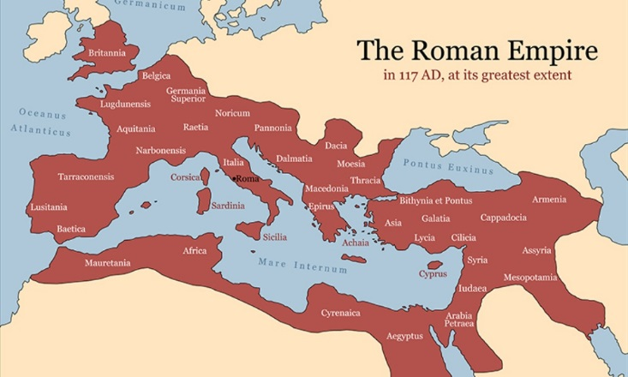
The Roman Empire

Slide 4
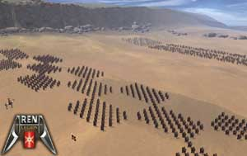
Roman Warfare

Slide 5
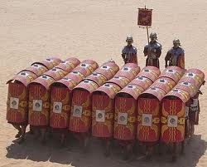
Soldiers
Fought in battle formations.
Overwhelmed their foes with their numbers
Laid siege to many a strong hold and waited for the other side to starve.
Notes:
The British Armies would you similar tactics until after the American Civil War.

Slide 6
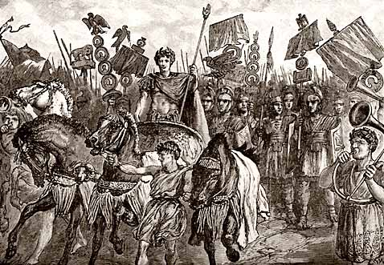
Caesar’s Great Battles
Siege of Alesia lasted one month. It killed nearly 80% of Gaul’s population.

Slide 7
Slavery
Slavery in ancient Rome played an important role in society and the economy.
Besides manual labor, slaves performed many domestic services, and might be employed at highly skilled jobs and professions.
Teachers, accountants, and
physicians were often slaves.

Slide 8
Slaves and Warfare
During times of great war the government would seize the people of the country and could sell them into slavery.
This was considered acceptable as the citizens seized were considered “spoils of war”.
This is how the Roman Empire funded their wars.

Slide 9
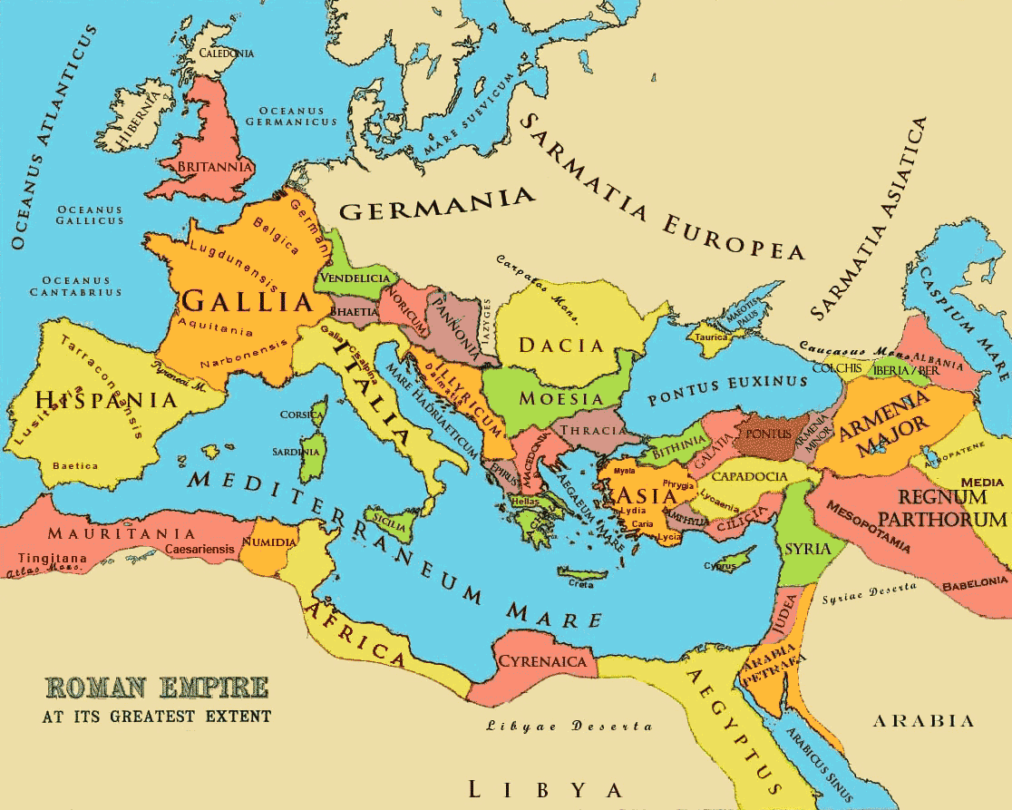
Notes:
Slaves were taken from every major country in Europe. Those slaves who were acquired in Greece were sought after as they were often highly educated.

Slide 10
The Coliseum
One of the seven wonders of the modern world.
Designed by an unknown architect.
It was built to a practical design that allowed for crowds to hear everything from the floor of the Coliseum.
It had 80 arched entrances allowing easy access to 55,000 spectators, who were seated according to rank.
The Coliseum is huge, an ellipse 188 yards long and 156 yards wide.
It is the largest building from the classical world still standing.

Slide 11
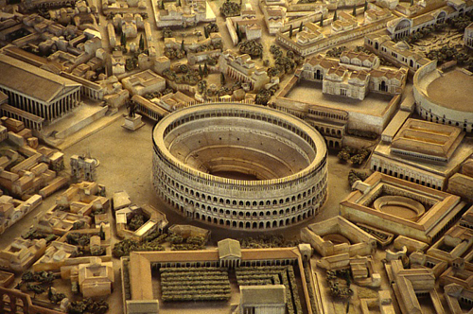
Coliseum

Slide 12
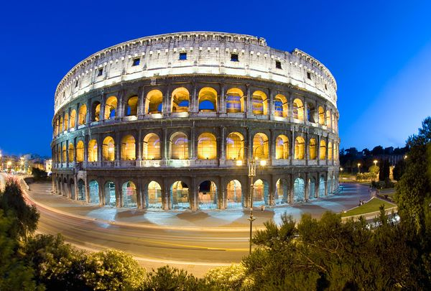
Now

Slide 13
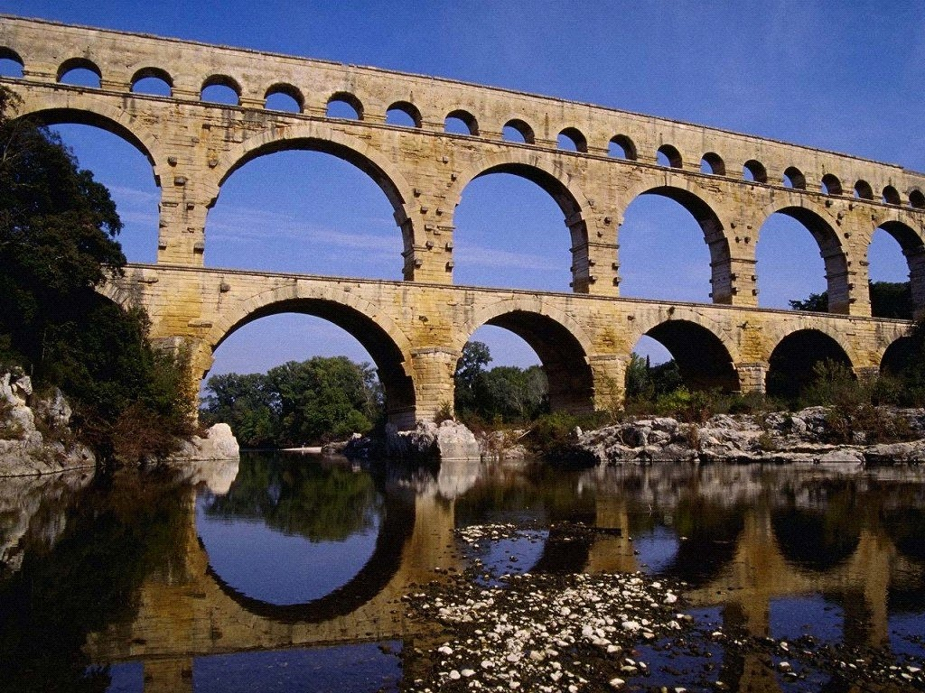
Aqueduct

Slide 14
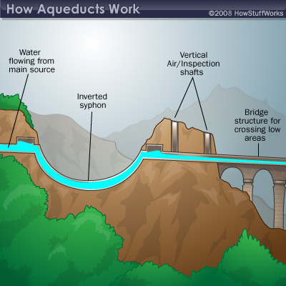
Aqueduct
Ancient aqueducts were essentially man-made streams conducting water downhill from the natural sources to the destination.

Slide 15
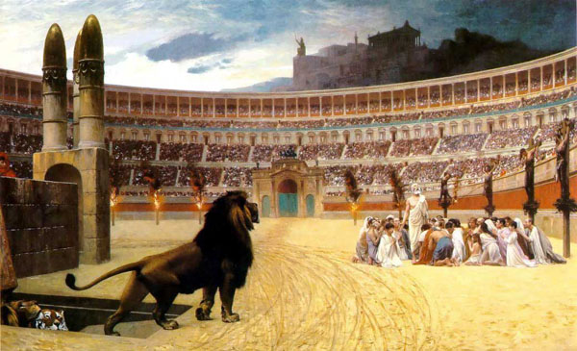
Entertainment

Slide 16
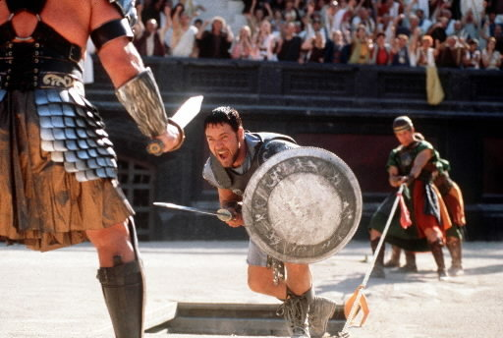
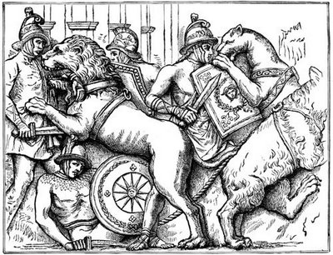
Gladiators
Some gladiators were volunteers who risked their legal and social standing and their lives by appearing in the arena.
Most were despised as slaves, schooled under harsh conditions, socially marginalized, and segregated even in death.
Notes:
Had there own cemetery. If one died without begging for mercy their body was treated well, if they died dishonorably their skull would be crushed, or they would be stabbed with a red hot poker.

Slide 17
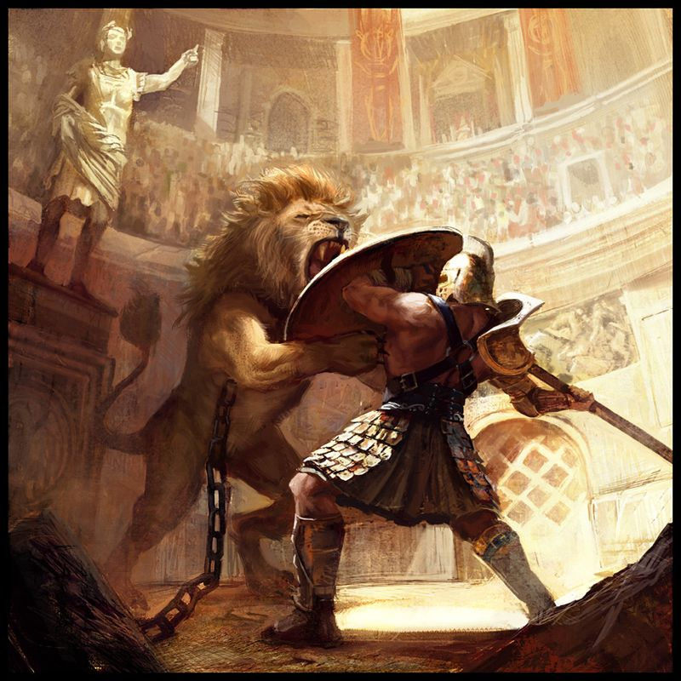

Slide 18
Four Horse Power
In the Roman form of chariot racing, teams represented different groups of financial backers and sometimes competed for the services of particularly skilled drivers.
The spectators became so violent that the government took over the events and regulated the teams.

Slide 19
Roman Drama
You thought our movies were bad!
The ancient Romans found pleasure in
tales that included incest, murder, Gods
taking mortals as their spouse, bloody
battles, suicide, betrayal, patricide,
matricide and infanticide.

Slide 20
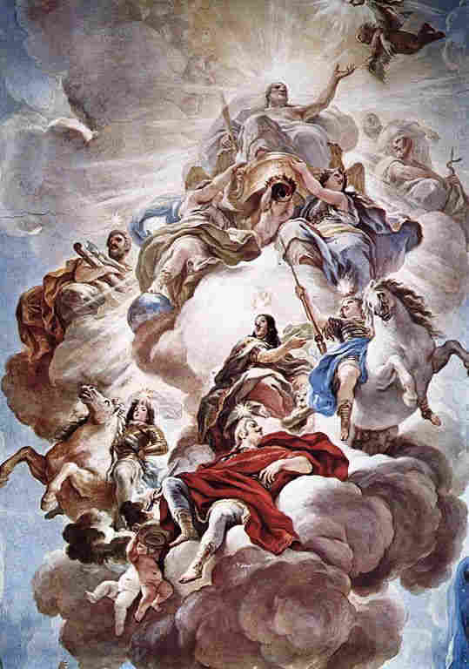
The Gods
Roman gods often embodied the vices and virtues of mortal man.
These gods and goddesses often embodied excess and vindictiveness.

Slide 21
Gods and Mortals
Many stories include the gods and goddesses having affairs with normal men and women.
These “children of the gods” became great thinkers and heroes.
Notes:
Hercules was the son of Zeus, Caesar claims to be descendant of Aphrodite

Slide 22
Exit Ticket
9/14/17
What are three interesting, surprising or unusual facts you learned about Ancient Rome or its culture?
What are some similarities between Roman culture and our present day culture in America?

Slide 23
Start-Up - Writing
9/15/17
What are some elements of Roman government which we have borrowed in the United States?
Do you think they are working well?
If so, what is good about them?
If not, what is bad about them?

Slide 24
Julius Caesar Intro
Today we will begin watching a video which will introduce the story of Julius Caesar that we find in Shakespeare’s play.
The first part of the video is NOT in Shakespeare’s play. Think of it as a prequel to Shakespeare’s play.
You will be responsible for the Intro questions. They will be due after we finish watching the intro (probably Tues or Weds of next week).

Slide 25
Exit Ticket
9/15/17
Describe the character of Caesar based on what we saw in the video today (NOT physical description).
What type of man is he?
How would you describe his personality?

Slide 26
No Start-Up No Exit Ticket
9/18/17
Today we will continue watching the video which introduces the story of Julius Caesar that we find in Shakespeare’s play.
You will be responsible for the intro questions. They will be DUE Wednesday.

Slide 27
No Start-Up No Exit Ticket
9/19/17
Today we will finish watching the video which introduces the story of Julius Caesar that we find in Shakespeare’s play.
You are responsible for the Intro questions. They will be
DUE TOMORROW!!!

Slide 28
9/20 – 9/21 – District Assessment
Logon to SchoolCity at
https://student.schoolcity.com/studentprod16.tusd
Username =
Firstname lastinitial last two
Ex: JaneB65
Password = 8-digit birthdate
Ex: 07042001
Click on “Take Assessments”
Click on test name:
ELA Grade 10 Pre-test 17-18

Slide 29
YES…
This assessment
COUNTS
as a
GRADE!

Slide 30
If You Are Finished…
Work QUIETLY on make-up work for this class or for another class!
There should still be NO TALKING!

Slide 31
Start-Up - Discussion
9/22/17
Have you ever read Shakespeare before? What have you read?
Did you find it difficult to understand?
Why do you think that was?
If you have never read Shakespeare, what do you think might make it difficult to understand?

Slide 32
Start-Up - Writing
9/22/17
No
Start-Up
Writing

Slide 33
CCS Standards
CCSS.ELA-LITERACY.RL.9-10.3
Analyze how complex characters (e.g., those with multiple or conflicting motivations) develop over the course of a text, interact with other characters, and advance the plot or develop the theme.
CCSS.ELA-LITERACY.RL.9-10.4
Determine the meaning of words and phrases as they are used in the text, including figurative and connotative meanings; analyze the cumulative impact of specific word choices on meaning and tone (e.g., how the language evokes a sense of time and place; how it sets a formal or informal tone).

Slide 34
Objectives
By the end of the unit, students will be able to:
Identify important traits of both main and supporting characters in Shakespeare’s Julius Caesar, and develop an understanding of their impact on the plot of the play.
Determine the meanings of key vocabulary words as they will be used in the text.

Slide 35
Character Description
Today, we will be doing some “front-loading” of the characters in the play, which we will begin reading next week.
You will want and need to know who these characters are when they enter the play.
You never know when you might have to take a quiz on these characters...

Slide 36
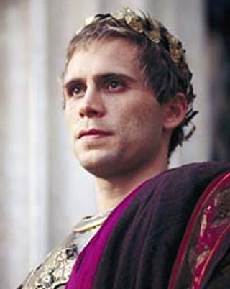
Julius Caesar
A great Roman general who has recently returned to Rome after a military victory in Spain (a.k.a. Gaul). Julius Caesar is not the main character of the play that bears his name; Brutus has over four times as many lines, and the play does not show us Caesar’s point of view.
Nonetheless, virtually every other character is preoccupied with Caesar—specifically, with the possibility that Caesar may soon become king.
If Caesar were to become king, it
would mean the end of Rome’s
republican system of government, in
which senators, representing the
citizens of Rome, wield most of the
power.

Slide 37
Julius Caesar
To noblemen like Brutus and Cassius, who consider themselves the equals of Caesar or any other citizen, Caesar’s coronation would mean they would no longer be free men but rather slaves.
Caesar never explicitly says that he wants to be king—he even refuses the crown three times in a dramatic public display—but everything he says and does demonstrates that he regards himself as special and superior to other mortals. In his own mind, he seems already to be an absolute ruler.

Slide 38
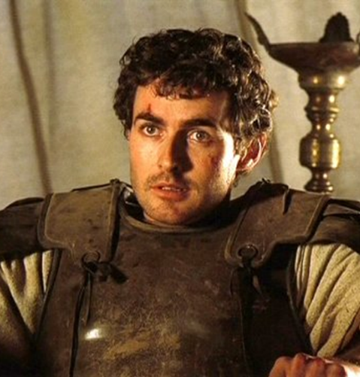
Brutus
A high-ranking, well-regarded Roman nobleman who participates in a conspiracy to assassinate Caesar.
Brutus is motivated by his sense of honor, which requires him to place the good of Rome above his own personal interests or feelings.
Thus, he plots against Caesar in order to preserve the republic even though he loves and admires Caesar personally.
While the other conspirators act out of envy and rivalry, only Brutus truly believes that Caesar’s death will benefit Rome.
Brutus’s sense of honor is also his
weakness, as he tends to assume that
his fellow Romans are as highminded
as he is, which makes it easy for others to
manipulate him.

Slide 39
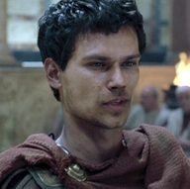
Marc Antony
A loyal friend of Caesar’s. In contrast to the self-disciplined Brutus, Marc Antony is notoriously impulsive and pleasure-seeking, passionate rather than principled.
He is extremely spontaneous and lives in the present moment.
As resourceful as he is
unscrupulous, Marc Antony
proves to be a dangerous
enemy of Brutus and the other
conspirators.

Slide 40
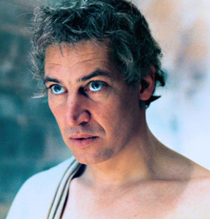
Cassius
A talented general and longtime acquaintance of Caesar. Cassius resents the fact that the Roman populace has come to revere Caesar almost as a god.
He slyly leads Brutus to believe that Caesar has become too powerful and must die, finally converting Brutus to his cause by sending him forged letters claiming that the Roman people support the death of Caesar.
Impulsive and unscrupulous like Antony, Cassius harbors no illusions about
the way the political world works.
A shrewd opportunist, he acts
effectively but lacks integrity.

Slide 41
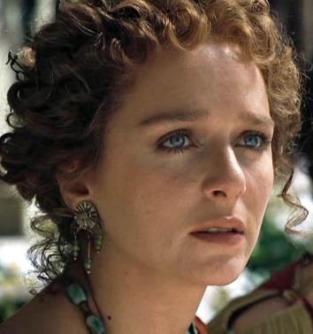
Calphurnia (Calpurnia)
Caesar’s wife. Calphurnia invests great authority in omens and portents.
She warns Caesar against going to the Senate on the Ides of March, for she has had terrible nightmares and heard reports of many bad omens.

Slide 42
Portia
Brutus’s wife and the daughter of a noble Roman (Cato) who took sides against Caesar.
Portia, accustomed to being Brutus’s confidante, is upset to find him so reluctant to speak his mind when she finds him troubled.

Slide 43
Supporting Characters
Octavius - Caesar’s adopted son and appointed successor. Octavius, who had been traveling abroad, returns after Caesar’s death, then joins with Antony and sets off to fight Cassius and Brutus. Antony tries to control Octavius’s movements, but Octavius follows his adopted father’s example and emerges as the authoritative figure, paving the way for his eventual seizure of the reins of Roman government.
Casca - One of the conspirators. Casca is a tribune (an official elected to represent the common people of Rome) who resents Caesar’s ambition. A rough and blunt-speaking man, Casca relates to Cassius and Brutus how Antony offered the crown to Caesar three times and how each time Caesar declined it. Casca insists, however, that Caesar was acting, manipulating the populace into believing that he has no personal ambition. Casca is the first to stab Caesar.

Slide 44
Supporting Characters
Flavius and Murellus - Two tribunes who condemn the plebeians for their fickleness in cheering Caesar when once they cheered for Caesar’s enemy Pompey. Flavius and Murellus are punished for removing the decorations from Caesar’s statues during Caesar’s triumphal parade.
Cicero - A Roman senator renowned for his oratorical skill. Cicero speaks at Caesar’s triumphal parade. He later dies at the order of Antony, Octavius, and Lepidus.

Slide 45
Supporting Characters
Lepidus - The third member of Antony and Octavius’s coalition. Though Antony has a low opinion of Lepidus, Octavius trusts Lepidus’s loyalty.
Decius - A member of the conspiracy. Decius convinces Caesar that Calphurnia misinterpreted her dire nightmares and that, in fact, no danger awaits him at the Senate. Decius leads Caesar right into the hands of the conspirators.

Slide 46
HOMEWORK
Complete the Character Description notes if you have not already. Use the PowerPoint on my website if necessary.
Complete the Act I Vocabulary worksheet (BOTH SIDES).

Slide 47
Exit Ticket
9/22/17
No
Exit
Ticket

Slide 48
Start-Up - Discussion
9/25/17
In your Triads, discuss the following:
The play begins where we left off in the movie…
Why do you think Caesar decided to return to Rome with his army
(even though that was strictly forbidden)?
Do you think the Senate was right to be worried about him? Why?

Slide 49
Start-Up - Writing
9/25/17
Now write about it:
The play begins where we left off in the movie…
Why do you think Caesar decided to return to Rome with his army
(even though that was strictly forbidden)?
Do you think the Senate was right to be worried about him? Why?

Slide 50
CCS Standards
CCSS.ELA-LITERACY.RL.9-10.3
Analyze how complex characters (e.g., those with multiple or conflicting motivations) develop over the course of a text, interact with other characters, and advance the plot or develop the theme.
CCSS.ELA-LITERACY.RL.9-10.4
Determine the meaning of words and phrases as they are used in the text, including figurative and connotative meanings; analyze the cumulative impact of specific word choices on meaning and tone (e.g., how the language evokes a sense of time and place; how it sets a formal or informal tone).

Slide 51
Objectives
By the end of the unit, students will be able to:
Identify important traits of both main and supporting characters in Shakespeare’s Julius Caesar, and develop an understanding of their impact on the plot of the play.
Determine the meanings of key vocabulary words as they will be used in the text.

Slide 52
Reading the Play
We will be starting the reading of the play today.
When we read, we will do so in two different ways, including:
Listening to audio (book on tape)
Reading by Parts
This is my preference!

Slide 53
Reading By Parts
Casting – If we are going to read by parts, we will typically “cast” those parts a day ahead.
Volunteers can choose to play part, or I can choose people.
We will read, for the most part, from the Shakespearean side of the page, but on occasion, we may read from the modernized version.

Slide 54
HOMEWORK
Complete the Act I Cornell Notes questions for Act I Scene i
(Questions 1 – 3)
ANSWER IN COMPLETE SENTENCES!

Slide 55
Exit Ticket
9/25/17
Do you think that Flavius and Murellus are right to be so upset at the people of Rome?
Why or why not?
Why do you think the people of Rome are so quick to change their loyalties?

Slide 56
Start-Up - Discussion
9/26/17
In your Triads, discuss the following:
What did Flavius and Murellus want to do to Caesar’s statues?
Why did they want to do it?
What is Murellus worried about when they do it?

Slide 57
Start-Up - Writing
9/26/17
Now write about it:
What did Flavius and Murellus want to do to Caesar’s statues?
Why did they want to do it?
What is Murellus worried about when they do it?

Slide 58
CCS Standards
CCSS.ELA-LITERACY.RL.9-10.3
Analyze how complex characters (e.g., those with multiple or conflicting motivations) develop over the course of a text, interact with other characters, and advance the plot or develop the theme.
CCSS.ELA-LITERACY.RL.9-10.4
Determine the meaning of words and phrases as they are used in the text, including figurative and connotative meanings; analyze the cumulative impact of specific word choices on meaning and tone (e.g., how the language evokes a sense of time and place; how it sets a formal or informal tone).

Slide 59
Objectives
By the end of the unit, students will be able to:
Identify important traits of both main and supporting characters in Shakespeare’s Julius Caesar, and develop an understanding of their impact on the plot of the play.
Determine the meanings of key vocabulary words as they are used in the text.

Slide 60
HOMEWORK
Complete the Act I Cornell Notes questions
(Front of the page only)
ANSWER IN COMPLETE SENTENCES!

Slide 61
Exit Ticket
9/26/17
What two things does Cassius focus on when he is speaking to Brutus?
Why do you think he chooses to use those two things to persuade Brutus?
Do you think Brutus will be persuaded?

Slide 62
Start-Up - Discussion
9/27/17
In your Triads, discuss the following:
What stories does Cassius tell Brutus to tear down Caesar?
Why do you think he tells him those stories?
What does he hope Brutus will think or do?

Slide 63
Start-Up - Writing
9/27/17
Now write about it:
What stories does Cassius tell Brutus to tear down Caesar?
Why do you think he tells him those stories?
What does he hope Brutus will think or do?

Slide 64
CCS Standards
CCSS.ELA-LITERACY.RL.9-10.3
Analyze how complex characters (e.g., those with multiple or conflicting motivations) develop over the course of a text, interact with other characters, and advance the plot or develop the theme.
CCSS.ELA-LITERACY.RL.9-10.4
Determine the meaning of words and phrases as they are used in the text, including figurative and connotative meanings; analyze the cumulative impact of specific word choices on meaning and tone (e.g., how the language evokes a sense of time and place; how it sets a formal or informal tone).

Slide 65
Objectives
By the end of the unit, students will be able to:
Identify important traits of both main and supporting characters in Shakespeare’s Julius Caesar, and develop an understanding of their impact on the plot of the play.
Determine the meanings of key vocabulary words as they are used in the text.

Slide 66
HOMEWORK
Complete the Act I Cornell Notes questions
(Up to the 2nd question on the back of the page)
ANSWER IN COMPLETE SENTENCES!

Slide 67
Exit Ticket
9/27/17
What does Caesar do after he refuses the crown three times?
Why do you think he did that?
How would that action make him look in the eyes of the common people?

Slide 68
Start-Up - Discussion
9/28/17
In your Triads, discuss the following:
What does Cassius plan to do to convince Brutus?
Why would this move have an effect on Brutus more than it might on anyone else?

Slide 69
Start-Up - Writing
9/28/17
Now write about it:
What does Cassius plan to do to convince Brutus?
Why would this move have an effect on Brutus more than it might on anyone else?

Slide 70
CCS Standards
CCSS.ELA-LITERACY.RL.9-10.3
Analyze how complex characters (e.g., those with multiple or conflicting motivations) develop over the course of a text, interact with other characters, and advance the plot or develop the theme.
CCSS.ELA-LITERACY.RL.9-10.4
Determine the meaning of words and phrases as they are used in the text, including figurative and connotative meanings; analyze the cumulative impact of specific word choices on meaning and tone (e.g., how the language evokes a sense of time and place; how it sets a formal or informal tone).

Slide 71
Objectives
By the end of the unit, students will be able to:
Identify important traits of both main and supporting characters in Shakespeare’s Julius Caesar, and develop an understanding of their impact on the plot of the play.
Determine the meanings of key vocabulary words as they are used in the text.

Slide 72
HOMEWORK
Complete the Act I Cornell Notes questions
ANSWER IN COMPLETE SENTENCES!
They are DUE TOMORROW!

Slide 73
Exit Ticket
9/28/17
What does Cassius tell Casca he is willing to do to avoid living under Caesar’s rule?
What does he accuse Casca of?
Why does he do that?

Slide 74
Start-Up - Discussion
9/28/17
In your Triads, discuss the following:
What does Cassius plan to do to convince Brutus?
Why would this move have an effect on Brutus more than it might on anyone else?

Slide 75
Start-Up - Writing
9/28/17
Now write about it:
What does Cassius plan to do to convince Brutus?
Why would this move have an effect on Brutus more than it might on anyone else?

Slide 76
CCS Standards
CCSS.ELA-LITERACY.RL.9-10.3
Analyze how complex characters (e.g., those with multiple or conflicting motivations) develop over the course of a text, interact with other characters, and advance the plot or develop the theme.
CCSS.ELA-LITERACY.RL.9-10.4
Determine the meaning of words and phrases as they are used in the text, including figurative and connotative meanings; analyze the cumulative impact of specific word choices on meaning and tone (e.g., how the language evokes a sense of time and place; how it sets a formal or informal tone).

Slide 77
Objectives
By the end of the unit, students will be able to:
Identify important traits of both main and supporting characters in Shakespeare’s Julius Caesar, and develop an understanding of their impact on the plot of the play.
Determine the meanings of key vocabulary words as they are used in the text.

Slide 78
HOMEWORK
Complete the Act I Cornell Notes questions
ANSWER IN COMPLETE SENTENCES!
They are
DUE TOMORROW!

Slide 79
Exit Ticket
9/28/17
What does Cassius tell Casca he is willing to do to avoid living under Caesar’s rule?
What does he accuse Casca of?
Why does he do that?

Slide 80
Start-Up - Discussion
9/29/17
In your Triads, discuss the following:
According to Casca, what is the real reason Cassius needs Brutus to be part of the plot?
What does having Brutus involved do for the conspiracy?

Slide 81
Start-Up - Writing
9/29/17
Now write about it:
According to Casca, what is the real reason Cassius needs Brutus to be part of the plot?
What does having Brutus involved do for the conspiracy?

Slide 82
CCS Standards
CCSS.ELA-LITERACY.RL.9-10.3
Analyze how complex characters (e.g., those with multiple or conflicting motivations) develop over the course of a text, interact with other characters, and advance the plot or develop the theme.
CCSS.ELA-LITERACY.RL.9-10.4
Determine the meaning of words and phrases as they are used in the text, including figurative and connotative meanings; analyze the cumulative impact of specific word choices on meaning and tone (e.g., how the language evokes a sense of time and place; how it sets a formal or informal tone).

Slide 83
Objectives
By the end of the unit, students will be able to:
Identify important traits of both main and supporting characters in Shakespeare’s Julius Caesar, and develop an understanding of their impact on the plot of the play.
Determine the meanings of key vocabulary words as they are used in the text.

Slide 84
Act I is Done!
Let’s watch the video!!!
Keep up with the video questions!
They are DUE MONDAY!
Your Act I Cornell Notes questions are DUE TODAY!

Slide 85
Exit Ticket
9/29/17
Name at least three differences between what we read in Act I and what we saw in the movie today.
Is there anything significant about these differences?
What?

Slide 86
No Start-Up Today
Because…
You have a…
10/2/17

Slide 87
Act I Quiz
1 – 11 Multiple Choice
Circle JUST THE LETTER of the correct answer
2 Points each
12 – 15 True/False
2 Points each
16 - 20 Short Answer
Be sure to answer IN COMPLETE SENTENCES
Give AS MUCH DETAIL AS POSSIBLE
5 Points each
TOTAL = 55 POINTS as an ASSESSMENT GRADE, so TAKE YOUR TIME!

Slide 88
When you Finish…
Place your quiz in the TOP basket on the front table.
Get an ACT II VOCABULARY worksheet from the second basket and start working on it.
ACT II VOCAB SHEETS ARE
DUE TOMORROW!!!

Slide 89
No Exit Ticket Today
10/2/17

Slide 90
Start-Up - Discussion
10/3/17
In your Triads, discuss the following:
After talking to Cassius, how do you think Brutus is feeling about Caesar right now?
Cassius told Casca that Brutus is ¾ won over to their cause.
Do you agree or disagree? Why?

Slide 91
Start-Up - Writing
10/3/17
Now write about it:
After talking to Cassius, how do you think Brutus is feeling about Caesar right now?
Cassius told Casca that Brutus is ¾ won over to their cause.
Do you agree or disagree? Why?

Slide 92
CCS Standards
CCSS.ELA-LITERACY.RL.9-10.3
Analyze how complex characters (e.g., those with multiple or conflicting motivations) develop over the course of a text, interact with other characters, and advance the plot or develop the theme.
CCSS.ELA-LITERACY.RL.9-10.4
Determine the meaning of words and phrases as they are used in the text, including figurative and connotative meanings; analyze the cumulative impact of specific word choices on meaning and tone (e.g., how the language evokes a sense of time and place; how it sets a formal or informal tone).

Slide 93
Objectives
By the end of the unit, students will be able to:
Identify important traits of both main and supporting characters in Shakespeare’s Julius Caesar, and develop an understanding of their impact on the plot of the play.
Determine the meanings of key vocabulary words as they are used in the text.

Slide 94
HOMEWORK
Complete the
Act II Scene i
Cornell Notes
(The front of the page)
ANSWER IN COMPLETE SENTENCES!

Slide 95
Exit Ticket
10/3/17
To what animal does Brutus compare Caesar in his soliloquy?
Give two examples of how Brutus makes that comparison and explain what you think he means by it.

Slide 96
Start-Up - Discussion
10/4/17
In your Triads, discuss the following:
Brutus told the other conspirators that they don’t need to swear an oath. Why not? What does he believe is just as strong (or stronger) than any oath they could swear?
What does he say is true of the conspirators if they break their promises?

Slide 97
Start-Up - Writing
10/4/17
Now write about it:
Brutus told the other conspirators that they don’t need to swear an oath. Why not? What does he believe is just as strong (or stronger) than any oath they could swear?
What does he say is true of the conspirators if they break their promises?

Slide 98
CCS Standards
CCSS.ELA-LITERACY.RL.9-10.3
Analyze how complex characters (e.g., those with multiple or conflicting motivations) develop over the course of a text, interact with other characters, and advance the plot or develop the theme.
CCSS.ELA-LITERACY.RL.9-10.4
Determine the meaning of words and phrases as they are used in the text, including figurative and connotative meanings; analyze the cumulative impact of specific word choices on meaning and tone (e.g., how the language evokes a sense of time and place; how it sets a formal or informal tone).

Slide 99
Objectives
By the end of the unit, students will be able to:
Identify important traits of both main and supporting characters in Shakespeare’s Julius Caesar, and develop an understanding of their impact on the plot of the play.
Determine the meanings of key vocabulary words as they are used in the text.

Slide 100
HOMEWORK
Complete the
Act II Scene i
Cornell Notes questions
ANSWER IN COMPLETE SENTENCES!
They are DUE TOMORROW!

Slide 101
Exit Ticket
10/4/17
Do you think Portia is right to demand that Brutus tell he his secrets?
Do wives/girlfriends/
husbands/boyfriends deserve to know every detail of what their significant other is thinking?
Why or why not?

Slide 102
Start-Up - Discussion
10/5/17
In your Triads, discuss the following:
What reasons does Cassius give for wanting to kill Marc Antony?
What reasons does Brutus give for not killing him?
Who do you think is right?
Why?

Slide 103
Start-Up - Writing
10/5/17
Now write about it:
What reasons does Cassius give for wanting to kill Marc Antony?
What reasons does Brutus give for not killing him?
Who do you think is right?
Why?

Slide 104
CCS Standards
CCSS.ELA-LITERACY.RL.9-10.3
Analyze how complex characters (e.g., those with multiple or conflicting motivations) develop over the course of a text, interact with other characters, and advance the plot or develop the theme.
CCSS.ELA-LITERACY.RL.9-10.4
Determine the meaning of words and phrases as they are used in the text, including figurative and connotative meanings; analyze the cumulative impact of specific word choices on meaning and tone (e.g., how the language evokes a sense of time and place; how it sets a formal or informal tone).

Slide 105
Objectives
By the end of the unit, students will be able to:
Identify important traits of both main and supporting characters in Shakespeare’s Julius Caesar, and develop an understanding of their impact on the plot of the play.
Determine the meanings of key vocabulary words as they are used in the text.

Slide 106
Rhetorical Analysis
Remember…Rhetoric =
PERSUASION
Today you will be looking at the soliloquy from Act I Scene i again.
Your job will be to analyze that speech with a focus on Brutus’ use of RHETORIC!
The steps in this process are outlined on your papers, but let’s look at them briefly…

Slide 107
Rhetorical Analysis
Read through Brutus’ soliloquy from Act II Scene I again. Underline the MAIN CLAIM that Brutus makes in this speech. Then identify the supports he uses for this claim.
Use the template in the right-hand column to help you build your paragraph of analysis. YOU MUST USE AT LEAST ONE QUOTE from the soliloquy in your writing. Be sure to CITE that quote (Shakespeare line 16). Be sure to EXPLAIN THE QUOTE AND WHY IT SUPPORTS THE CLAIM!
Using what you have written in the template, rewrite your analysis as a complete, properly formatted, grammatically correct paragraph on the second page. Be sure to double-check spelling, grammar, capitalization etc. THEY WILL ALL COUNT AS PART OF YOUR SCORE!

Slide 108
HOMEWORK
Work on your
rhetorical analysis of Brutus’ soliloquy.
You will have time to work on it in class tomorrow!
It is DUE MONDAY!!

Slide 109
Exit Ticket
10/5/17
Brutus’ soliloquy is definitely meant to be persuasive, but WHO is he trying to persuade?
Why do you think he is struggling so much with this decision?

Slide 110
10/6/17
NO
START-UP
TODAY

Slide 111
CCS Standards
CCSS.ELA-LITERACY.RL.9-10.3
Analyze how complex characters (e.g., those with multiple or conflicting motivations) develop over the course of a text, interact with other characters, and advance the plot or develop the theme.
CCSS.ELA-LITERACY.RL.9-10.4
Determine the meaning of words and phrases as they are used in the text, including figurative and connotative meanings; analyze the cumulative impact of specific word choices on meaning and tone (e.g., how the language evokes a sense of time and place; how it sets a formal or informal tone).

Slide 112
Objectives
By the end of the unit, students will be able to:
Identify important traits of both main and supporting characters in Shakespeare’s Julius Caesar, and develop an understanding of their impact on the plot of the play.
Determine the meanings of key vocabulary words as they are used in the text.

Slide 113
Today’s Work
You have TWO THINGS to work on today…
Work on / Finish your rhetorical analysis of Brutus’ soliloquy.
DUE MONDAY!!!
Create a RECRUITMENT POSTER for the conspiracy!

Slide 114
Recruitment Poster
Throughout history, we have seen the use of “Propaganda Posters” to recruit people; especially into the military.
These posters use BOLD, COLORFUL IMAGES, CATCHY SLOGANS, AND AN OVERALL THEME to catch the eye of potential recruits and make them WANT to be part of something.

Slide 115
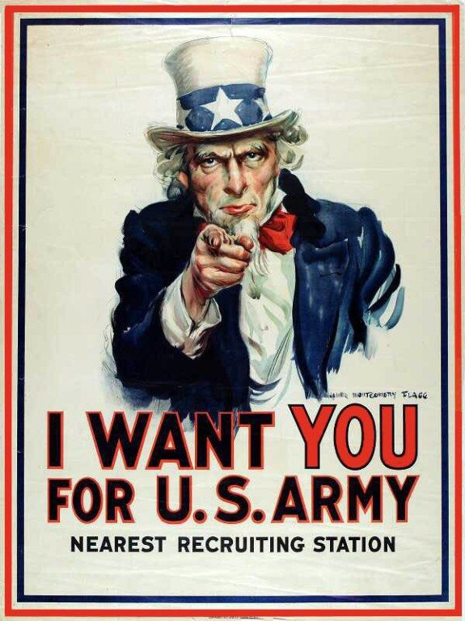
Recruitment Poster
Examples:

Slide 116
Recruitment Poster
Slogan Examples:
Be All You Can Be. - Army
Get an Edge on Life. - Army
It’s Not just a job. It’s an Adventure! - Navy
You and the Navy. Full Speed Ahead - Navy
The Few. The Proud. - Marine Corps
We're Looking For a Few Good Men - Marine Corps
Aim High. - Air Force
Be Part of the Action. – Coast Guard

Slide 117
Recruitment Poster
Your job is to create a recruitment poster for the conspiracy against Caesar! You have to create something that will MAKE PEOPLE WANT TO JOIN THE PLOT TO GET RID OF CAESAR!
Your poster should include:
A Slogan
A Bold Image
A Theme
Contact Information
Your poster should also be TIME PERIOD APPROPRIATE!

Slide 118
HOMEWORK
Finish your rhetorical analysis of Brutus’ soliloquy.
It is DUE MONDAY!!
Finish your Recruitment Poster
It is DUE WEDNESDAY!!

Slide 119
10/6/17
NO
EXIT TICKET
TODAY!

Slide 120
10/9/17
NO
START-UP
TODAY

Slide 121
10/9/17
Today is…
AMNESTY DAY!

Slide 122
Amnesty Day
Amnesty - An act of forgiveness for past offenses, especially to a class of persons as a whole.
Most of you have committed offenses against me and this class.
Today is your day of forgiveness!

Slide 123
Amnesty Day
TODAY ONLY, you have the opportunity to complete and turn in any old/missing work that you owe me WITH NO PENALTY FOR LATENESS!
There are exceptions…
Start-Ups and Exit Tickets can not be claimed under amnesty!
You can not re-do assignments you got lazy on and turned in incomplete. This is ONLY for work you failed to turn in.

Slide 124
Amnesty Day
If you are COMPLETELY caught up and have NO ZEROES OR MISSING ASSIGNMENTS, then you may work on work for another class or find something to do QUIETLY!
NO LISTENING TO MUSIC unless you can show me that you have NO ZEROES AND NO MISSING WORK!

Slide 125
10/9/17
NO
EXIT TICKET
TODAY!

Slide 126
Start-Up - Discussion
10/10/17
In your Triads, discuss the following:
If you were alive during the time of Caesar and you had to make a choice:
Team Caesar or Team Brutus
Which would you choose and why?

Slide 127
Start-Up - Writing
10/10/17
Now write about it:
If you were alive during the time of Caesar and you had to make a choice:
Team Caesar or Team Brutus
Which would you choose and why?

Slide 128
CCS Standards
CCSS.ELA-LITERACY.RL.9-10.3
Analyze how complex characters (e.g., those with multiple or conflicting motivations) develop over the course of a text, interact with other characters, and advance the plot or develop the theme.
CCSS.ELA-LITERACY.RL.9-10.4
Determine the meaning of words and phrases as they are used in the text, including figurative and connotative meanings; analyze the cumulative impact of specific word choices on meaning and tone (e.g., how the language evokes a sense of time and place; how it sets a formal or informal tone).

Slide 129
Objectives
By the end of the unit, students will be able to:
Identify important traits of both main and supporting characters in Shakespeare’s Julius Caesar, and develop an understanding of their impact on the plot of the play.
Determine the meanings of key vocabulary words as they are used in the text.

Slide 130
HOMEWORK
Work on the Cornell Note Questions for Act II Scene ii-iv
QUESTIONS 1-4.

Slide 131
Exit Ticket
10/10/17
Describe Calpurnia’s dream.
What specific elements of the dream relate directly to what we know will happen soon?
Do you think Decius’ interpretation makes any sense? Why or why not?

Slide 132
Start-Up - Discussion
10/11/17
In your Triads, discuss the following:
What was the comment that Trebonius made towards the end on Scene ii?
Why was that comment ironic?
What kind of irony is it?

Slide 133
Start-Up - Writing
10/11/17
Now write about it:
What was the comment that Trebonius made towards the end on Scene ii?
Why was that comment ironic?
What kind of irony is it?

Slide 134
CCS Standards
CCSS.ELA-LITERACY.RL.9-10.3
Analyze how complex characters (e.g., those with multiple or conflicting motivations) develop over the course of a text, interact with other characters, and advance the plot or develop the theme.
CCSS.ELA-LITERACY.RL.9-10.4
Determine the meaning of words and phrases as they are used in the text, including figurative and connotative meanings; analyze the cumulative impact of specific word choices on meaning and tone (e.g., how the language evokes a sense of time and place; how it sets a formal or informal tone).

Slide 135
Objectives
By the end of the unit, students will be able to:
Identify important traits of both main and supporting characters in Shakespeare’s Julius Caesar, and develop an understanding of their impact on the plot of the play.
Determine the meanings of key vocabulary words as they are used in the text.

Slide 136
HOMEWORK
Work on the Cornell Note Questions for Act II Scene ii-iv.
These are
DUE TOMORROW!

Slide 137
Exit Ticket
10/11/17
What do you think the Soothsayer meant when he said he would beg Caesar “to befriend himself”?

Slide 138
Start-Up - Discussion
10/12/17
In your Triads, discuss the following:
What is Artemidorus planning to do when Caesar passes by?
Why do you think he has chosen to do this?
What does he mean when he says “if thou beest not immortal”?

Slide 139
Start-Up - Writing
10/12/17
Now write about it:
What is Artemidorus planning to do when Caesar passes by?
Why do you think he has chosen to do this?
What does he mean when he says “if thou beest not immortal”?

Slide 140
CCS Standards
CCSS.ELA-LITERACY.RL.9-10.3
Analyze how complex characters (e.g., those with multiple or conflicting motivations) develop over the course of a text, interact with other characters, and advance the plot or develop the theme.
CCSS.ELA-LITERACY.RL.9-10.4
Determine the meaning of words and phrases as they are used in the text, including figurative and connotative meanings; analyze the cumulative impact of specific word choices on meaning and tone (e.g., how the language evokes a sense of time and place; how it sets a formal or informal tone).

Slide 141
Objectives
By the end of the unit, students will be able to:
Identify important traits of both main and supporting characters in Shakespeare’s Julius Caesar, and develop an understanding of their impact on the plot of the play.
Determine the meanings of key vocabulary words as they are used in the text.

Slide 142
Rhetorical Analysis
Remember…Rhetoric =
PERSUASION
Today you will be looking at the soliloquy from Act II Scene i again.
Your job will be to analyze that speech with a focus on Portia’s use of RHETORIC!
The steps in this process are outlined on your papers, but let’s look at them briefly…

Slide 143
Rhetorical Analysis
Read through Portia’s speech from Act II Scene I again. Underline the MAIN CLAIM that Brutus makes in this speech. Then identify the supports he uses for this claim.
Use the template in the right-hand column to help you build your paragraph of analysis. YOU MUST USE AT LEAST ONE QUOTE from the soliloquy in your writing. Be sure to CITE that quote (Shakespeare line 16). Be sure to EXPLAIN THE QUOTE AND WHY IT SUPPORTS THE CLAIM!
Using what you have written in the template, rewrite your analysis as a complete, properly formatted, grammatically correct paragraph on the second page. Be sure to double-check spelling, grammar, capitalization etc. THEY WILL ALL COUNT AS PART OF YOUR SCORE!

Slide 144
HOMEWORK
Work on your
rhetorical analysis of Portia’s speech.
You will have time to work on it in class tomorrow!
It is DUE MONDAY!!

Slide 145
Exit Ticket
10/12/17
At the end of Portia’s argument, what does Brutus tell her?
Do you think she has managed to persuade him to open up to her?
Why or why not?

Slide 146
10/13/17
NO
START-UP TODAY

Slide 147
CCS Standards
CCSS.ELA-LITERACY.RL.9-10.3
Analyze how complex characters (e.g., those with multiple or conflicting motivations) develop over the course of a text, interact with other characters, and advance the plot or develop the theme.
CCSS.ELA-LITERACY.RL.9-10.4
Determine the meaning of words and phrases as they are used in the text, including figurative and connotative meanings; analyze the cumulative impact of specific word choices on meaning and tone (e.g., how the language evokes a sense of time and place; how it sets a formal or informal tone).

Slide 148
Objectives
By the end of the unit, students will be able to:
Identify important traits of both main and supporting characters in Shakespeare’s Julius Caesar, and develop an understanding of their impact on the plot of the play.
Determine the meanings of key vocabulary words as they are used in the text.

Slide 149
Act II is Done!
Let’s watch the video!!!
Keep up with the video questions!
They are DUE MONDAY!
Your Rhetorical Analysis of Portia’s speech is also
DUE MONDAY!

Slide 150
10/13/17
NO
EXIT TICKET TODAY

Slide 151
No Start-Up Today
Because…
You have a…
10/16/17

Slide 152
Act II Quiz
1 – 10 Multiple Choice
Circle JUST THE LETTER of the correct answer
2 Points each
11 – 15 Short Answer
Be sure to answer IN COMPLETE SENTENCES
Give AS MUCH DETAIL AS POSSIBLE
5 Points each
TOTAL = 50 POINTS as an ASSESSMENT GRADE, so TAKE YOUR TIME!

Slide 153
When you Finish…
Place your quiz in the TOP basket on the front table.
Get an ACT III VOCABULARY worksheet from the second basket and start working on it.
ACT III VOCAB SHEETS ARE
DUE TOMORROW!!!

Slide 154
No Exit Ticket Today
10/16/17

Slide 155
Start-Up - Discussion
10/17/17
In your Triads, discuss the following:
What are some similarities between the play and the part of the movie you watched Friday?
What are some differences?

Slide 156
Start-Up - Writing
10/17/17
Now write about it:
What are some similarities between the play and the part of the movie you watched Friday?
What are some differences?

Slide 157
CCS Standards
CCSS.ELA-LITERACY.RL.9-10.3
Analyze how complex characters (e.g., those with multiple or conflicting motivations) develop over the course of a text, interact with other characters, and advance the plot or develop the theme.
CCSS.ELA-LITERACY.RL.9-10.4
Determine the meaning of words and phrases as they are used in the text, including figurative and connotative meanings; analyze the cumulative impact of specific word choices on meaning and tone (e.g., how the language evokes a sense of time and place; how it sets a formal or informal tone).

Slide 158
Objectives
By the end of the unit, students will be able to:
Identify important traits of both main and supporting characters in Shakespeare’s Julius Caesar, and develop an understanding of their impact on the plot of the play.
Determine the meanings of key vocabulary words as they are used in the text.

Slide 159
HOMEWORK
Work on the Cornell Note Questions for Act III Scene I (Questions 1-4).

Slide 160
Exit Ticket
10/17/17
Why did Caesar say “Et tu, Brute?”
Why would the betrayal of Brutus hit him harder than any other?

Slide 161
Start-Up - Discussion
10/18/17
In your Triads, discuss the following:
Do you think Marc Antony ran away because he was SCARED or because he was SMART
(or both)?
What makes you think so?

Slide 162
Start-Up - Writing
10/18/17
Now write about it:
Do you think Marc Antony ran away because he was SCARED or because he was SMART
(or both)?
What makes you think so?

Slide 163
CCS Standards
CCSS.ELA-LITERACY.RL.9-10.3
Analyze how complex characters (e.g., those with multiple or conflicting motivations) develop over the course of a text, interact with other characters, and advance the plot or develop the theme.
CCSS.ELA-LITERACY.RL.9-10.4
Determine the meaning of words and phrases as they are used in the text, including figurative and connotative meanings; analyze the cumulative impact of specific word choices on meaning and tone (e.g., how the language evokes a sense of time and place; how it sets a formal or informal tone).

Slide 164
Objectives
By the end of the unit, students will be able to:
Identify important traits of both main and supporting characters in Shakespeare’s Julius Caesar, and develop an understanding of their impact on the plot of the play.
Determine the meanings of key vocabulary words as they are used in the text.

Slide 165
HOMEWORK
Work on the Cornell Note Questions for Act III Scene I.
DUE TOMORROW!

Slide 166
Exit Ticket
10/18/17
Do you think Brutus was right in his reasons for allowing Marc Antony to speak at Caesar’s funeral?
Why or why not?
Do you think it was smart to let him speak second?
Why or why not?

Slide 167
Start-Up - Discussion
10/19/17
In your Triads, discuss the following:
How does finding out that Octavius is camped outside the city change the entire situation for Marc Antony?
Do you think this will have an effect on the way he speaks at Caesar’s funeral? How?

Slide 168
Start-Up - Writing
10/19/17
Now write about it:
How does finding out that Octavius is camped outside the city change the entire situation for Marc Antony?
Do you think this will have an effect on the way he speaks at Caesar’s funeral? How?

Slide 169
CCS Standards
CCSS.ELA-LITERACY.RL.9-10.3
Analyze how complex characters (e.g., those with multiple or conflicting motivations) develop over the course of a text, interact with other characters, and advance the plot or develop the theme.
CCSS.ELA-LITERACY.RL.9-10.4
Determine the meaning of words and phrases as they are used in the text, including figurative and connotative meanings; analyze the cumulative impact of specific word choices on meaning and tone (e.g., how the language evokes a sense of time and place; how it sets a formal or informal tone).

Slide 170
Objectives
By the end of the unit, students will be able to:
Identify important traits of both main and supporting characters in Shakespeare’s Julius Caesar, and develop an understanding of their impact on the plot of the play.
Determine the meanings of key vocabulary words as they are used in the text.

Slide 171
HOMEWORK
Work on the Cornell Note Questions for Act III Scene ii-iii
(1 – 10)

Slide 172
Exit Ticket
10/19/17
Do you think Marc Antony actually had Caesar’s real Will?
Why or why not?
What do you think was his purpose for dragging out the revealing of its contents?

Slide 173
Start-Up - Discussion
10/20/17
In your Triads, discuss the following:
Of the two speeches, which one did you feel was the most compelling/convincing?
What was it about that speech that made it the stronger of the two?

Slide 174
Start-Up - Writing
10/20/17
Now write about it:
Of the two speeches, which one did you feel was the most compelling/convincing?
What was it about that speech that made it the stronger of the two?

Slide 175
CCS Standards
CCSS.ELA-LITERACY.RL.9-10.3
Analyze how complex characters (e.g., those with multiple or conflicting motivations) develop over the course of a text, interact with other characters, and advance the plot or develop the theme.
CCSS.ELA-LITERACY.RL.9-10.4
Determine the meaning of words and phrases as they are used in the text, including figurative and connotative meanings; analyze the cumulative impact of specific word choices on meaning and tone (e.g., how the language evokes a sense of time and place; how it sets a formal or informal tone).

Slide 176
Objectives
By the end of the unit, students will be able to:
Identify important traits of both main and supporting characters in Shakespeare’s Julius Caesar, and develop an understanding of their impact on the plot of the play.
Determine the meanings of key vocabulary words as they are used in the text.

Slide 177
HOMEWORK
Work on the Cornell Note Questions for Act III Scene ii-iii
These are DUE MONDAY!

Slide 178
Exit Ticket
10/20/17
What has Caesar left for the people of Rome?
Do you think he really left that for them? Why or why not?

Slide 179
Start-Up - Discussion
10/23/17
In your Triads, discuss the following:
Support or refute the following:
Shakespeare’s story of Julius Caesar would be the same regardless of the style in which it was written. It could be written in any language and/or dialect and it would still be a classic story.

Slide 180
Start-Up - Writing
10/23/17
Now write about it:
Support or refute the following:
Shakespeare’s story of Julius Caesar would be the same regardless of the style in which it was written. It could be written in any language and/or dialect and it would still be a classic story.

Slide 181
CCS Standards
CCSS.ELA-LITERACY.RL.9-10.3
Analyze how complex characters (e.g., those with multiple or conflicting motivations) develop over the course of a text, interact with other characters, and advance the plot or develop the theme.
CCSS.ELA-LITERACY.RL.9-10.4
Determine the meaning of words and phrases as they are used in the text, including figurative and connotative meanings; analyze the cumulative impact of specific word choices on meaning and tone (e.g., how the language evokes a sense of time and place; how it sets a formal or informal tone).

Slide 182
Objectives
By the end of the unit, students will be able to:
Identify important traits of both main and supporting characters in Shakespeare’s Julius Caesar, and develop an understanding of their impact on the plot of the play.
Determine the meanings of words as they are used in the text, including figurative and connotative meanings.

Slide 183
Caesar Final Assessment
For your final assessment on the play, Julius Caesar, you will be choosing between two assignments.
Both will require a written element and a presentation element.
As this is a FINAL ASSESSMENT, it will be valued at 100 POINTS!

Slide 184
Caesar Final Assessment
YOUR OPTIONS
Option 1 – Complete a rhetorical analysis of TWO speeches from Act III.
Brutus’ speech on Page 106, lines 12-30
Antony’s speech on Page 110, lines 68-103
**You will be required to PRESENT (read) your analysis of the two speeches to the class!**

Slide 185
Caesar Final Assessment
YOUR OPTIONS
Option 2 – Complete a Modern Readers’ Theater rewrite and performance of a scene from the play.
Take a scene from the play and rewrite it in modern language in a modern dialect (eg: southern redneck, California surfer, urban gang).
It MUST include a word for word translation of the scene, replacing Shakespearean language and slang with that of your chosen dialect.
Scenes must be APPROVED by me before you may begin.

Slide 186
Caesar Final Assessment
Option 1 –In your analysis of BOTH speeches, you MUST include:
A sentence determining the speaker’s main claim about the topic they are speaking on in a complete and definite claim sentence.
Three well thought out and explained pieces of evidence from the speech that support the claim you believe the speaker is making.
For each piece of evidence there will also be at least one sentence explaining how that piece of evidence proves the speaker’s claim.
At least one of your pieces of evidence should be a quote, for this piece of evidence there will be an additional sentence describing in modern english what the speaker is saying, and then the explanation sentence describing its support for the claim.
A purpose sentence, describing what the speaker is trying to accomplish with this speech.
A conclusion; at least two sentences explaining why this speech is important to the play, how it gives us insight into who the character is and what they want, and how this speech affects the development of the play.
Given these parameters, your analysis should be at least 10 sentences long, or about a half of a page.
*** YOUR ANALYSIS WILL THEN BE READ TO THE CLASS ***

Slide 187
Caesar Final Assessment
Option 2 –
Group Size: You can have anywhere between 2 and 9 group members.
Scene: There are several scenes which you can choose from for smaller groups. For instance a group of 3 could do Act I scene 1. The only scene that will be approved for 9 cast members will be Act III Scene 1. ALL SCENES NEED TO BE OKAYED BY ME BEFORE YOU BEGIN.
Lines: Everyone in your group should play 1 or 2 characters. Each person should speak several times; ask if you are unsure if a group member has enough lines.
Scripts: EACH PERSON SHOULD HAVE A COMPLETE SCRIPT IN THEIR OWN HANDWRITING. That means each script should have everyone’s lines, not just your own, and not be printed from a computer. Not having a completed script will result in a grade of 0.
**Students will be performing their script in front of the class**

Slide 188
Caesar Final Assessment
Today – Decide which option you will work on. You MUST choose today and report that choice to me!
If Option 1, begin your work analyzing the speeches.
If Option 2, choose your group, get together, and start working on your rewrite.
You will NOT be provided documents for either option.
If you choose option 1, you may hand-write or type your analysis, but it must be submitted in a printed form.
Each group member’s script MUST be handwritten by that group member.

Slide 189
Exit Ticket
10/23/17
Which option did you choose? Why did you choose it?
Do you think the one you chose will be more or less difficult than the other option?
Why?

Slide 190
No
Start-Up
Today
10/24/17

Slide 191
Caesar Final Assessment
Get right back to work on your final assessment.
If you chose Option 1, you should be working independently.
If you chose Option 2, you should be working in your groups.
Remember EVERY MEMBER needs their own HANDWRITTEN script!

Slide 192
Extra Credit
This Extra Credit is ONLY AVAILABLE to those who currently have NO ZEROES or MISSING WORK!
For UP TO 20 POINTS, you may read and summarize Act IV and Act V of the play.
Your summaries of each act should be NO LESS THAN 5 sentences each; a complete paragraph.
Your points will be given based on the thoroughness of your summary. The more detail you give me, the more potential for points.
You MUST DO BOTH ACTS or no points will be awarded.

Slide 193
Homework
Come prepared to present
TOMORROW!!!
THURSDAY!

Slide 194
No
Exit Ticket
Today
10/24/17

Slide 195
No
Start-Up
Today
10/25/17

Slide 196
Caesar Final Assessment
Get right back to work on your final assessment.
If you chose Option 1, you should be working independently.
If you chose Option 2, you should be working in your groups.
Remember EVERY MEMBER needs their own HANDWRITTEN script!

Slide 197
Extra Credit
This Extra Credit is ONLY AVAILABLE to those who currently have NO ZEROES or MISSING WORK!
For UP TO 20 POINTS, you may read and summarize Act IV and Act V of the play.
Your summaries of each act should be NO LESS THAN 5 sentences each; a complete paragraph.
Your points will be given based on the thoroughness of your summary. The more detail you give me, the more potential for points.
You MUST DO BOTH ACTS or no points will be awarded.

Slide 198
Homework
Come prepared to present
TOMORROW!!!

Slide 199
No
Exit Ticket
Today
10/25/17

