Slide 1
Start-Up
What do you think of when you hear the word “romantic”? Have you ever heard of the term Romanticism used to describe a style of literature? What sort of writing do you think a study of American Romanticism would include?

Slide 2
Today’s Objective
10/28/14
By the end of the period, students will be able to identify the major differences between literature in The Age of Reason and literature in The American Romantic Period. They will be able to state the characteristics of romantic literature.

Slide 3
ROMANTICISM
19TH CENTURY
AMERICAN LITERATURE

Slide 4
ROMANTICISM
EMPHASIZES PASSION RATHER THAN REASON
IMAGINATION AND INTUITION RATHER THAN LOGIC

Slide 5
FREE SPONTANEOUS ACTION RATHER THAN ORDER AND RESTRAINT

Slide 6
ROMANTICISM
THE ROMANTICS WERE DISCONTENT WITH THEIR WORLD.
IT FELT COMMERCIAL, INHUMAN, AND STANDARDIZED.

Slide 7
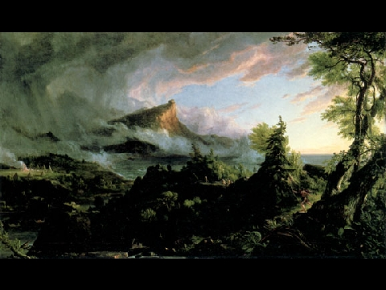
TO ESCAPE MODERN LIFE, ROMANTICS TURNED THEIR INTERESTS TO REMOTE AND FARAWAY PLACES, TO NATURE, AND THE COMMON PEOPLE.

Slide 8
Romanticism in Literature
EMPHASIS ON FICTION/POETRY
EMOTIONAL
IMAGINATIVE
FAR, FAR, AWAY AND/OR A LONG TIME AGO . . .
CAN INCLUDE ELEMENTS OF THE SUPERNATURAL

Slide 9
THE AGE OF REASON
Rationalism – We can arrive at the truth by using our reason rather than relying on intuition, faith, or the authority of the past.

Slide 10
ROMANTICISM
USE INTUITION AND IMAGINATION
TO SEE THE TRUTH

Slide 11
THE AGE OF REASON
God created the earth and then left his creation to run on its own
God as clock-maker
World is a perpetual motion machine

Slide 12
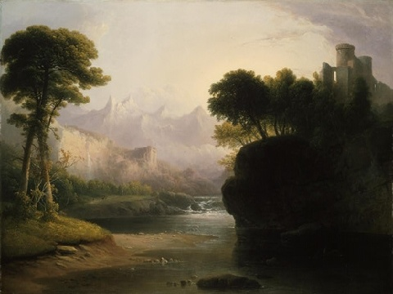
ROMANTICISM
World is a living being
God is all around us

Slide 13
THE AGE OF REASON
THE LITERATURE OF THE PERIOD CONCENTRATES ON REALITY NOT IMAGINATION
MOST OF THE WRITING ADDRESSES POLITICS, SCIENCE, AND SOCIAL CONCERNS

Slide 14
ROMANTICISM . . .
For pleasure, not politics
Literature gets personal
Insights into characters

Slide 15
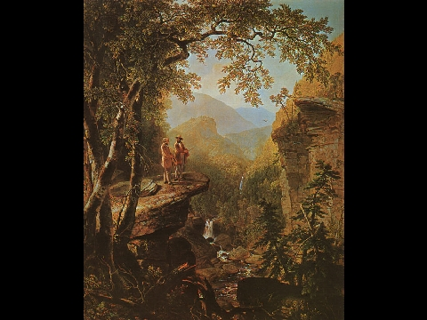
Glorifies the Land
Nature
Celebrates America

Slide 16
REPRESENTATIVE AUTHORS
WASHINGTON IRVING – THE LEGEND OF SLEEPY HOLLOW, RIP VAN WINKLE
NATHANIEL HAWTHORNE
EDGAR ALLAN POE

Slide 17
Transcendentalism
A BELIEF IN A HIGHER REALITY NOT VALIDATED BY NORMAL SENSE OR REASON

Slide 18
TRANSCENDENTALISTS
THE INDIVIDUAL IS THE SPIRITUAL CENTER OF THE UNIVERSE
ALL KNOWLEDGE BEGINS WITH SELF KNOWLEDGE

Slide 19
TRANSCENDENTALISTS
INDIVIDUAL VIRTUE AND HAPPINESS ARE DEPENDENT ON SELF-REALIZATION
NATURE IS A LIVING MYSTERY

Slide 20
REPRESENTATIVE TRANSCENDENTALISTS:
EMERSON
THOREAU
WHITMAN

Slide 21
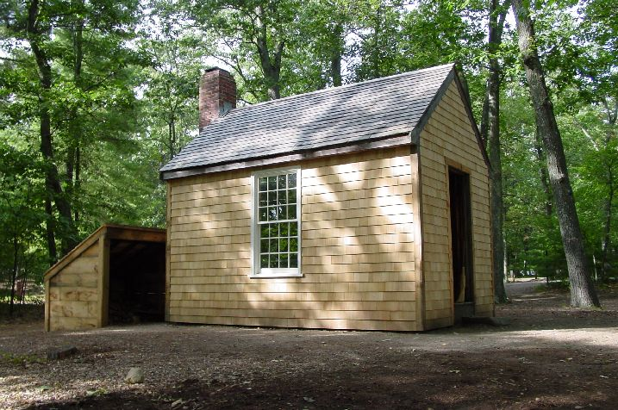
Thoreau’s Cabin

Slide 22
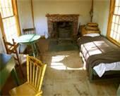
Inside Thoreau’s Cabin

Slide 23
Independent Work
In your Interactive Readers, read the introduction to American Romanticism beginning on Page 67.
Complete all in-text questions on pages 67-72 as you read.
These questions will be DUE tomorrow!

Slide 24
Exit Ticket
In your own words, describe the major differences between literature in The Age of Reason and literature in the Romantic period.

Slide 25
Start-Up
10/29/14
If you had to choose, based on what we discussed yesterday, which group do you think you would agree with/fit in with more, the writers from the Age of Reason or the American Romantics? Why? What characteristics do you see in yourself that would make you say that?

Slide 26
Transcendentalism
Transcendentalism is a philosophy that began in the 1830’s.
It started and was most popular in New England.
Transcendentalism entails that the ideal spiritual state should be attained by individual thinking, not by religion or Science.
Walt Whitman was one of the most prominent Transcendentalists in the Northeast.

Slide 27
Walt Whitman
Walt Whitman was born in 1819 on Long Island.
Whitman wrote “When I Heard the Learn’d Astronomer” in 1865.
Whitman generally does not use any form of rhyme scheme or meter in his poems.

Slide 28
When I Met the Learn’d Astronomer
Learn’d Astronomer quite clearly addresses the Transcendentalist Ideology, specifically how it emphasizes the human being, and not science.
First it shows the scientific perspective, using the words “charts”, “diagrams” and “columns.”
The poem also shows that the scientific approach was rather popular at the time, noting there was “much applause” when the astronomer was lecturing.

Slide 29
When I Met the Learn’d Astronomer
Now read through the poem on your own.
Discuss the following question with your VERTICAL partner: How does this poem reflect the ideas of the Romantics/Transcendentalists?
BE PREPARED TO SHARE

Slide 30
Pro-Transcendentalist Ideas
Subject becomes disinterested in Science
Leaves “by (him)self”
Looks at the night sky from a worldly perspective, not a scientific one

Slide 31
Figurative Language
Read through the poem a second time.
Do you notice any figurative language (repetition, alliteration, etc.)?
Take a moment with your HORIZONTAL partner to point out what you each noticed.
BE PREPARED TO SHARE

Slide 32
Figurative Language
Alliteration: Line 7 “mystical moist”
Repetition (Anaphora): Lines 1-4 “when…”
Consonance: Line 1 “heard the learn’d”
Assonance: Line 6 “Rising and gliding”

Slide 33
Structural Elements
Read through the poem one more time?
Do you notice any structural elements in this poem? Rhyme? Meter?
Discuss this with your quad for a moment. Point out elements to each other.
BE PREPARED TO SHARE

Slide 34
Structural Elements
That was a trick question!
There are none!
In fact, Whitman often wrote in what is known as “Free Verse.”

Slide 35
Free Verse
Free verse is poetry that is free from limitations of regular meter or rhythm and does not rhyme with fixed forms.
Such poems are without rhythms and rhyme schemes; do not follow regular rhyme scheme rules and still provide artistic expression. In this way, the poet can give his own shape to a poem how he/she desires.

Slide 36
Exit Ticket
Have you ever spent time just looking at the stars? When you look up at the sky, does it make you think scientifically or romantically? (remember…NOT romantic like love…romantic like emotion)
Why do you think that is?

