Slide 1
Start-Up - Discussion
8/21/17
In your triads, discuss the following:
What was your favorite reading from last year’s class? Did you like The Most Dangerous Game? Of Mice and Men? Why was this your favorite? The characters? The suspense? The pace? Give an example to explain what you mean.

Slide 2
Start-Up - Writing
8/21/17
Now write about the following:
What was your favorite reading from last year’s class? Did you like The Most Dangerous Game? Of Mice and Men? Why was this your favorite? The characters? The suspense? The pace? Give an example to explain what you mean.

Slide 3
CCS Standards
RI.10.3 Analyze how the author unfolds an analysis or series of ideas or events, including the order in which the points are made, how they are introduced and developed, and the connections that are drawn between them.
L.10.1 Demonstrate command of the conventions of standard English grammar and usage when writing or speaking.
a. Use parallel structure.
b. Use various types of phrases (noun, verb, adjectival, adverbial, participial, prepositional, absolute) and clauses (independent, dependent; noun, relative, adverbial) to convey specific meanings and add variety and interest to writing or presentations.
RI.10.7 Analyze various accounts of a subject told in different mediums (e.g., a person's life story in both print and multimedia), determining which details are emphasized in each account.

Slide 4
Objectives
By the end of this lesson, students should be able to:
Analyze how an author unfolds an analysis or series of events.
Compare and contrast different types of writing/media that discuss the same subject using parallel structure.

Slide 5
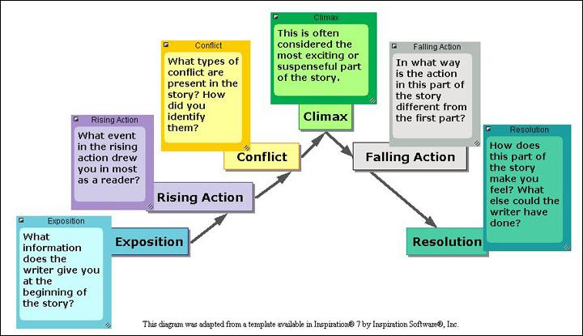
Plot
Definition: the sequence of events in a story

Slide 6
Exposition
The basic situation presents a main character and a conflict

Slide 7
Climax
The story’s most exciting or suspenseful moment, when something happens that decides the outcome of the conflict.

Slide 8
Resolution
The problems are Resolved and the story ends.

Slide 9
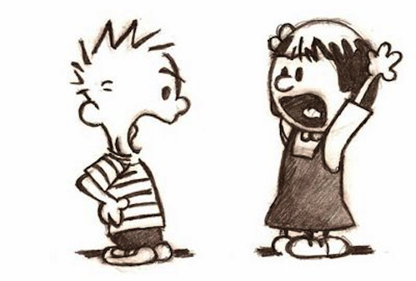
Conflict
A complication or problem that the protagonist faces and drives them to action.

Slide 10
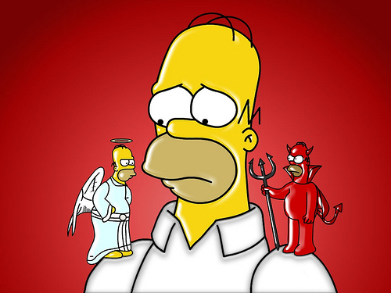
Internal conflict
A struggle between main character and an inside force.
Guilt, rage, grief

Slide 11
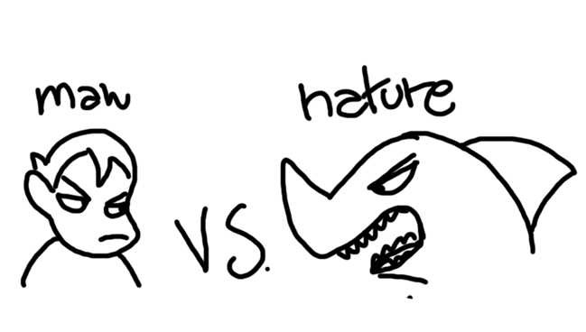
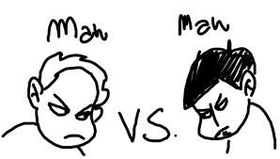
External Conflict
A character struggles against an outside force such as nature, another character, the supernatural or society.

Slide 12
Chronological Order
Time order, beginning with the first event and moving in sequence through the series of events (plot)
EX: Freshman, Sophomore, Junior, Senior, Super Senior.

Slide 13
Flashback
Present action is interrupted with a scene from the past

Slide 14
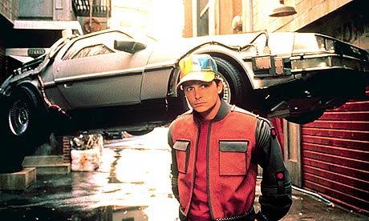
Flash-Forward
Action visits a character’s future

Slide 15
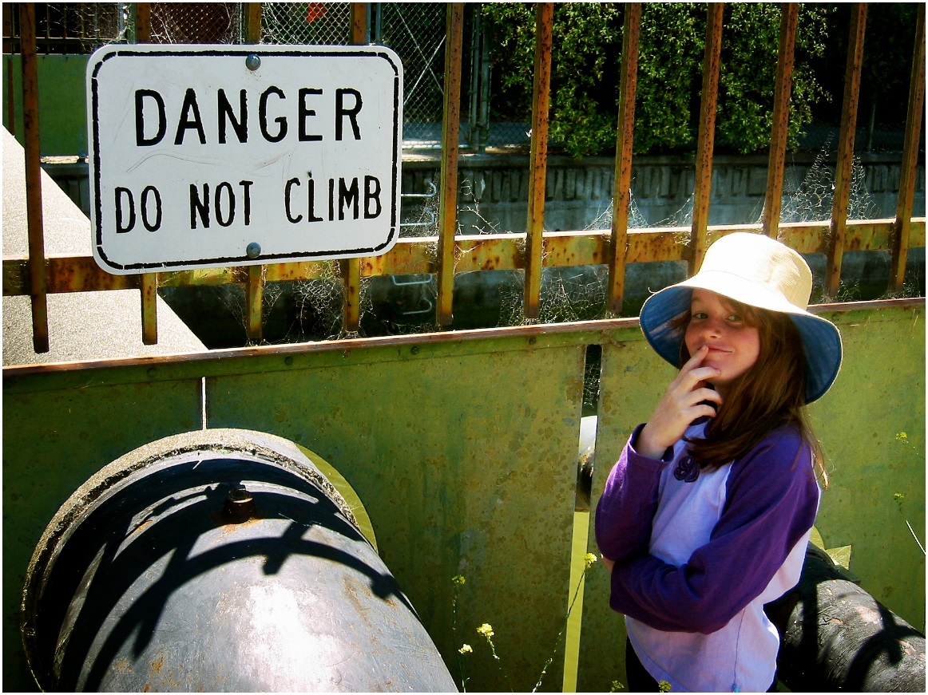
Foreshadowing
Clues are planted that hint at something that will happen later in the plot.

Slide 16
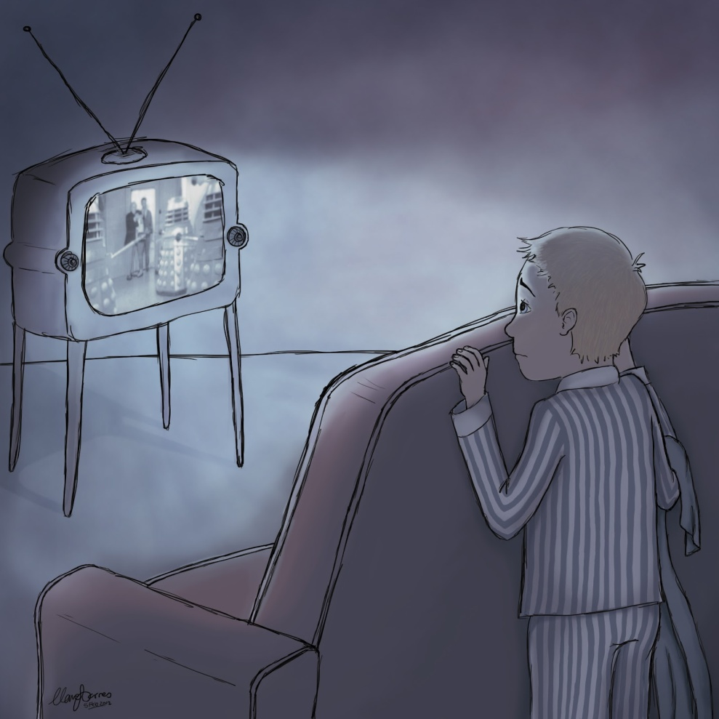
Suspense
Use of time to manipulate and control the reader’s feelings. Ex. Time may be slowed

Slide 17
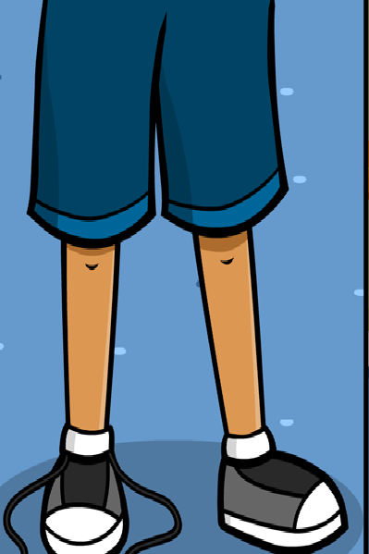
Cause
Reason why something happens

Slide 18
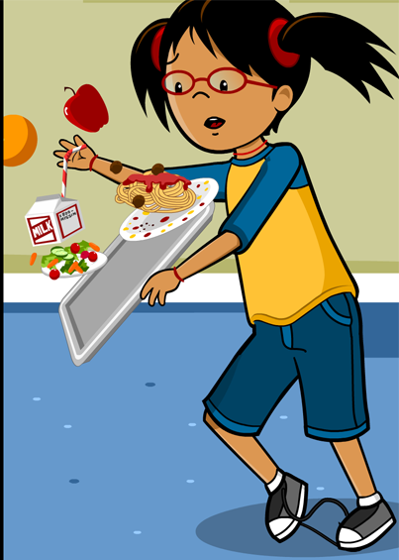
Effect
Result of some event or action

Slide 19
Tone
The author’s attitude toward his subject.

Slide 20
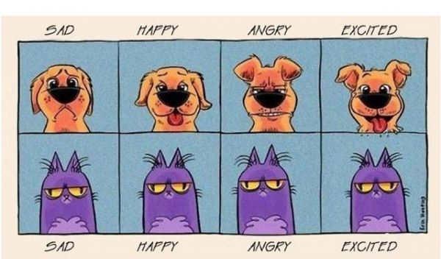
Mood
The feelings that the author creates in the reader.

Slide 21
Diction
Word choice
Often affects tone
Using specialized vocabulary often gives the narrator credence.
EX: Mama Mommy Mom Mother
Evil Parental Figure who has forgotten what it is to be young.

Slide 22
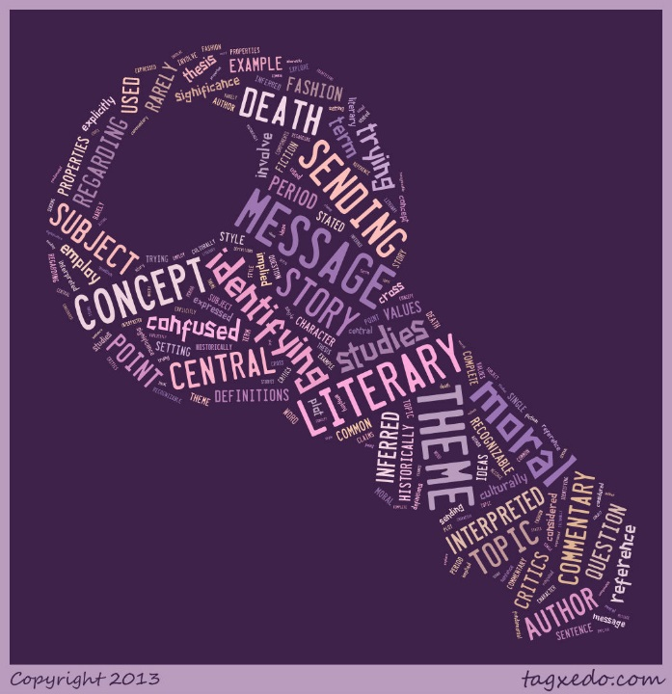
Theme
An idea or insight about life and human nature that gives the story meaning.
Theme is not the moral.
Theme is what the story reveals about life. Is more complex than the moral.
A moral teaches a simple lesson.

Slide 23
Universal Theme
A theme which is easily understood by all people despite cultural differences or geographic location.
exploration confronts the “unknown”
Inaction and regret
First love
Coming of age

Slide 24
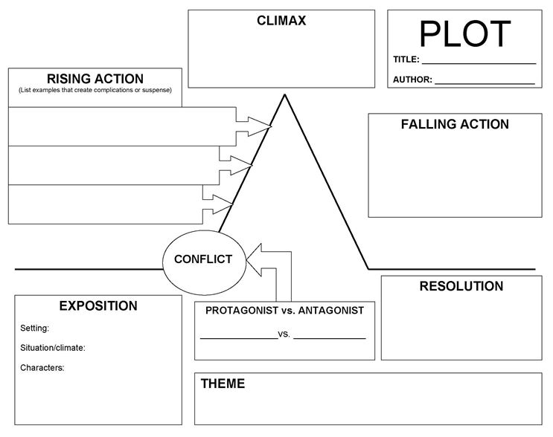
Plot Map (Graph)

Slide 25
“And of Clay We Are Created”
Tomorrow we will begin reading a story from your textbook titled “And Of Clay Are We Created.”
This story is what we call “Historical Fiction”
A fiction story based on real life events.
Before we can read the story, we need to cover some key vocabulary.
You have the word and a definition. Your task is to complete the example sentences for each word AND come up with a synonym for each word.

Slide 26
Homework
60 Second Speeches FRIDAY!!!
Begin taking some notes for your speech
PRACTICE in front of a mirror or with a friend/family member.
TIME YOURSELF!
Vocabulary sheet for “And Of Clay” (Sentences and synonyms) DUE TOMORROW!!
BRING BOOKS TOMORROW!!!!!!!!!

Slide 27
Exit Ticket
8/21/17
Think of a story you have read that has a Universal Theme.
What story is it? What is the theme?
Why do you think that theme is popular in literature/movies/tv?

Slide 28
Start-Up - Discussion
8/22/17
In your triads, discuss the following:
Which do you find more interesting to read; fiction or non-fiction?
What is it about that one that you prefer one over the other?

Slide 29
Start-Up - Writing
8/22/17
Now write about the following:
Which did THE PARTNER TO YOUR RIGHT say they find more interesting to read; fiction or non-fiction?
What is it about that one that they prefer over the other?
Did you agree or disagree with that partner? Why?

Slide 30
CCS Standards
RI.10.3 Analyze how the author unfolds an analysis or series of ideas or events, including the order in which the points are made, how they are introduced and developed, and the connections that are drawn between them.
L.10.1 Demonstrate command of the conventions of standard English grammar and usage when writing or speaking.
a. Use parallel structure.
b. Use various types of phrases (noun, verb, adjectival, adverbial, participial, prepositional, absolute) and clauses (independent, dependent; noun, relative, adverbial) to convey specific meanings and add variety and interest to writing or presentations.

Slide 31
Objectives
By the end of this lesson, students should be able to:
Analyze how an author unfolds an analysis or series of events.
Compare and contrast different types of writing/media that discuss the same subject using parallel structure.

Slide 32
“And of Clay Are We Created”
Today we will begin reading the HISTORICAL FICTION story, “And of Clay Are We Created.”
As you are reading, you will also be filling in your Cornell Notes on the story; attempting to answer the questions found there.
You will also be responsible for filling out a PLOT MAP for the story.
Let’s read…

Slide 33
Homework
60 Second Speeches FRIDAY!!!
Begin taking some notes for your speech
PRACTICE in front of a mirror or with a friend/family member.
TIME YOURSELF!
You should be caught up to where we are in the story on BOTH your Cornell Notes AND your plot map. If you fell behind, get caught up before tomorrow.

Slide 34
Exit Ticket
8/22/17
Why do you think the author chose to tell the story from the wife/girlfriend’s point of view?
How does that change the way we, the readers, see the story?

Slide 35
Start-Up - Discussion
8/23/17
In your triads, discuss the following:
What would you say is the MOOD of the story we were reading yesterday?
How does the writer set/change the mood?
Give an example of a line or quote from the story that helps establish that mood.

Slide 36
Start-Up - Writing
8/23/17
Now write about the following:
What would you say is the MOOD of the story we were reading yesterday?
How does the writer set/change the mood?
Give an example of a line or quote from the story that helps establish that mood.

Slide 37
CCS Standards
RI.10.3 Analyze how the author unfolds an analysis or series of ideas or events, including the order in which the points are made, how they are introduced and developed, and the connections that are drawn between them.
L.10.1 Demonstrate command of the conventions of standard English grammar and usage when writing or speaking.
a. Use parallel structure.
b. Use various types of phrases (noun, verb, adjectival, adverbial, participial, prepositional, absolute) and clauses (independent, dependent; noun, relative, adverbial) to convey specific meanings and add variety and interest to writing or presentations.

Slide 38
Objectives
By the end of this lesson, students should be able to:
Analyze how an author unfolds an analysis or series of events.
Compare and contrast different types of writing/media that discuss the same subject using parallel structure.

Slide 39
“And of Clay Are We Created”
Today we will continue reading the HISTORICAL FICTION story, “And of Clay Are We Created.”
As you are reading, you will also be filling in your Cornell Notes on the story; attempting to answer the questions found there.
You will also be responsible for filling out a PLOT MAP for the story.
Let’s read…

Slide 40
Homework
60 Second Speeches FRIDAY!!!
Begin taking some notes for your speech
PRACTICE in front of a mirror or with a friend/family member.
TIME YOURSELF!
Finish up your vocab charts, your Cornell Notes AND your plot map. They should be complete and ready to turn in tomorrow.

Slide 41
Exit Ticket
8/23/17
How did you feel at the end of the story?
Did the author manage to connect with and affect your emotions?
If so, how do you think she did it?
If not, why not?

Slide 42
Start-Up - Discussion
8/24/17
In your triads, discuss the following:
Do you think the narrator writing as if she had a personal connection to the story made it more emotional for us as readers?
Why or why not?

Slide 43
Start-Up - Writing
8/24/17
Now write about the following:
Do you think the narrator writing as if she had a personal connection to the story made it more emotional for us as readers?
Why or why not?
Give at least two examples from the story to support your statement.

Slide 44
CCS Standards
RI.10.3 Analyze how the author unfolds an analysis or series of ideas or events, including the order in which the points are made, how they are introduced and developed, and the connections that are drawn between them.
L.10.1 Demonstrate command of the conventions of standard English grammar and usage when writing or speaking.
a. Use parallel structure.
b. Use various types of phrases (noun, verb, adjectival, adverbial, participial, prepositional, absolute) and clauses (independent, dependent; noun, relative, adverbial) to convey specific meanings and add variety and interest to writing or presentations.

Slide 45
Objectives
By the end of this lesson, students should be able to:
Analyze how an author unfolds an analysis or series of events.
Compare and contrast different types of writing/media that discuss the same subject using parallel structure.

Slide 46
“Ill-Equipped Rescuers”
Today we will be looking at a news article from the Washington Post about the story that inspired “And of Clay.”
Then you will be working with your triad to do a comparison/contrast of the two media forms.
Let’s read first…
Textbook – Page 267

Slide 47
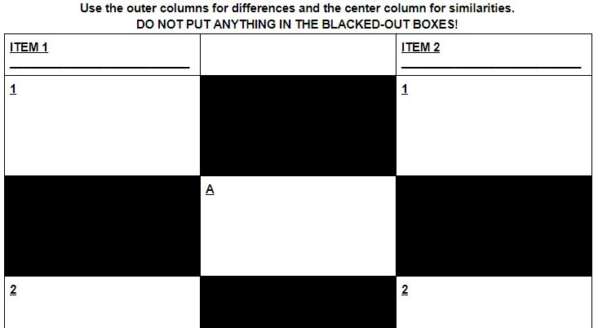
Compare/Contrast
For your comparison/contrast, you will be using something called a Cannon Comparison Chart.
It works like a Venn Diagram.

Slide 48
Compare/Contrast
Go to Google Classroom and open the Cannon Comparison Chart.
Working together with your triad, discuss similarities and differences between the story and the article.
FOCUS ON: The themes and the emotional effect.
AVOID: Shallow similarities/differences
EX: One is a story and one is an article
EX: They both mention the girl

Slide 49
One More Version…
Let’s look at one more version of this story…

Slide 50
Homework
60 Second Speeches TOMORROW!!!
Bring a copy of any notes you use for me!
PRACTICE in front of a mirror or with a friend/family member.
TIME YOURSELF!
Your Comparison/Contrast charts are due by the end of the day tomorrow!

Slide 51
Exit Ticket
8/24/17
Which version of the story had the greatest effect on you personally: the story, the video, or the news article?
Why do you think that was?

Slide 52
60 Second Speeches
8/25/17
No Start-Up/No Exit Ticket
You will be called in random order.

Slide 53
On Monday…
You will have a short quiz on “And of Clay”

