Slide 1
Start-Up - Discussion
8/26/19
Why do you think that we, as human beings, feel the need to belong? To fit in?
How does that feeling of belonging affect us; how we act towards and interact with those around us?

Slide 2
Start-Up - Writing
8/26/19
Why do you think that we, as human beings, feel the need to belong? To fit in?
How does that feeling of belonging affect us; how we act towards and interact with those around us?

Slide 3
Outsiders and Outcasts
Before we begin our reading of our novel, The Hobbit, we’re going to spend some time looking at other writings with similar themes.
As we read these selections, keep the theme in mind, “Outsiders and Outcasts.”

Slide 4
Reading In Class
Today, we will be reading in class for the first time. Before we do, I want to talk about ways that we will do this during the year.
Whole-Class Reading
Teacher-read
Class Read
Audiobook
Quad Reads
Independent Reading

Slide 5
“Isn’t Everyone a Little Bit Weird?”
Let’s Read
Expectations:
Heads up
Following along
Asking questions if needed for clarification
Ready to discuss when we pause

Slide 6
“Isn’t Everyone a Little Bit Weird?”
Now Your Job…
Go to Google Classroom
Open The document titled, “What’s My Weird?”
Write a response to the prompt in NO LESS THAN one complete, typed page in Times New Roman Size 12 font and MLA format.

Slide 7
“Isn’t Everyone a Little Bit Weird?”
PROMPT
“Everyone has eccentricities – slightly odd, perhaps unique ways of thinking or behaving” (Isn’t 131).
What’s your weird?
What are some things that make you different/unique/weird?
What are your eccentricities?
Why is it important that we all have our own individual things that make us different?

Slide 8
HOMEWORK
Start work on your writing now!
It is
DUE
WEDNESDAY
By 7:00 a.m.

Slide 9
EXIT TICKET
8/26/19
Why do you think people often try to cover up their “weirdness” and instead do what others do?
What is it that makes us hide who we are from others?

Slide 10
Start-Up - Discussion
8/27/19
Did you find it easy or difficult to think of things to write about yesterday for your “What’s My Weird” writing?
Why do you think it was easy/difficult for you?

Slide 11
Start-Up - Writing
8/27/19
Did you find it easy or difficult to think of things to write about yesterday for your “What’s My Weird” writing?
Why do you think it was easy/difficult for you?

Slide 12
Comparison / Contrast Articles
Today, in your groups, you will be working with two articles:
“Sonia Sotomayor, Outsider”
And
“What To Do When You Just Don’t Feel Like You Fit In”

Slide 13
Comparison / Contrast Articles
Here’s the plan:
ONE MEMBER OF YOUR GROUP WILL OPEN THE DOCUMENT “CANNON COMPARISON CHART – Outcast Poetry” for your group, MAKE A COPY OF IT TO USE, AND SHARE IT WITH EVERYONE IN YOUR GROUP.
YOU WILL ALSO SHARE THE DOCUMENT WITH ME; ALLOWING ME TO EDIT IT. (jmcelroy@turlockusd.org)
Divided up into pairs in your groups, two of you will read one poem and two of you will read the other.

Slide 14
Comparison / Contrast Articles
Each pair will then work together to compose a 3-5 sentence summary of their article.
Once both pairs are finished with their summaries, each pair will share with the other their summaries and information they read.
Both pairs will then work together to complete the CANNON COMPARISON CHART for both articles.
You MUST include THREE SIMILARITIES AND THREE DIFFERENCES between the two articles.
THEY CAN NOT BE SIMILARITIES/DIFFERENCES IN STYLE OR STRUCTURE.

Slide 15
CANNON COMPARISON CHART
DIFFERENCES
DIFFERENCES
SIMILARITIES

Slide 16
HOMEWORK
Cannon Comparison Charts
DUE
WEDNESDAY
By 7:00 a.m.

Slide 17
EXIT TICKET
8/27/19
What’s one thing you read in your article today that you found surprising or interesting?
Why was it interesting/surprising to you?

Slide 18
Start-Up - Discussion
8/28/19
Which article did you read yesterday?
In what wayS did that article connect with our theme
“Outsiders and Outcasts?”

Slide 19
Start-Up - Writing
8/28/19
Which article did you read yesterday?
In what wayS did that article connect with our theme
“Outsiders and Outcasts?”

Slide 20
Comparison/Contrast – Outcast Poetry
Today, WE will be working with two poems:
“Elliptical”
By Harryette Mullen
AND
“Fences”
By Pat Mora

Slide 21
Comparison/Contrast – Outcast Poetry
We will ALL read these poems together.
You will each be assigned one of the two poems to work with INDIVIDUALLY.
After you have done your individual work, you will work TOGETHER to complete the Cannon Comparison Chart for the two poems.
NOTE: For this one, EVERYONE is responsible for their own Comparison Chart on their document.

Slide 22
Comparison/Contrast – Outcast Poetry
Let’s start with “Elliptical” by Harryette Mullen
Take a minute and read the poem through silently.
Now listen…
In your groups, take 1 minute to discuss what you think the THEME of the poem is.
What is the author trying to say?

Slide 23
Comparison/Contrast – Outcast Poetry
Now let’s read “Fences” by Pat Mora
Take a minute and read the poem through silently.
Now listen…
In your groups, take 1 minute to discuss what you think the THEME of the poem is.
What is the author trying to say?

Slide 24
Comparison/Contrast – Outcast Poetry
Now go to Google and open up the document “Comparison/Contrast – Outcast Poetry”
If you are seated in one of the FRONT TWO SEATS in your group, you will be working with “Elliptical”
If you are seated in one of the BACK TWO SEATS in your group, you will be working with “Fences”

Slide 25
Comparison/Contrast – Outcast Poetry
Use the chart provided to fill in information about the poem you have been assigned. You will record:
Words and phrases that might have been confusing
First Impressions – What does the poem make you think or? Does it inspire any feelings/emotions?
Literary Devices – Point out any common Figurative Language or Literary Devices
(eg: simile, metaphor, alliteration, rhythm, rhyme, imagery, symbolism)
Theme – What do you think the author meant? What was he/she trying to say?

Slide 26
Comparison/Contrast – Outcast Poetry
Next, use the notes you made in your chart to write ONE COMPLETE PARAGRAPH about this poem.
Be sure to include, in your writing, your first impressions, literary devices, a discussion of theme, and your personal opinion of the poem.
End your paragraph with AT LEAST ONE good sentence explaining how this poem connects to our theme of “Outsiders and Outcasts”

Slide 27
Comparison/Contrast – Outcast Poetry
Next, answer the two questions for the poem you were assigned.
YOU DO NOT HAVE TO HAVE ANSWERS FOR THE OTHER TWO!

Slide 28
HOMEWORK
Your Individual Pieces of
Comparison/Contrast – Outcast Poetry
NEEDS TO BE COMPLETE AND IN CLASS WITH YOU TOMORROW!

Slide 29
EXIT TICKET
8/28/19
Which one of the two poems were you assigned to analyze?
What did you think about it?
Did it make sense to you?
How do you think that poem connects to our theme “Outsiders and Outcasts?”

Slide 30
NO Start-Up Discussion/Writing Today!
8/29/19
As you come in, please stop by the Classroom Contract for the period and sign it!

Slide 31
Comparison/Contrast – Outcast Poetry
Open up your Comparison/Contrast documents from yesterday for our “outcast poems.”
Today, you will work together with your groups to compare and contrast the two poems.
Before you can do that, you need to share with each other what you did yesterday.
Take about 4-5 minutes right now. Each person in your group MUST READ their final paragraphs to the group.
After each one has read, pause to discuss what they wrote. Did they make similar observations to others who read the same poem? What did they decide was the THEME?

Slide 32
Comparison/Contrast – Outcast Poetry
Now you will work TOGETHER to complete the Comparison/Contrast Chart.
EACH GROUP MEMBER must fill in their own charts, but you can work as a group to decide what the similarities and differences are.
NOTE: Do NOT include similarities or differences in STYLE or FORMAT. Compare similarities and differences in CONTENT and THEME!

Slide 33
HOMEWORK
Comparison/Contrast – Outcast Poetry
DUE TOMORROW
By 7:00 a.m.

Slide 34
NO EXIT TICKET TODAY!
8/29/19

Slide 35
Start-Up - Discussion
8/30/19
Think of movies and books you know under these 3 categories:
Science Fiction, Fantasy, and Paranormal works.
THEN discuss the following:
Out of the three genres which is your favorite? Why do you think this genre is your favorite?

Slide 36
Start-Up - Writing
8/30/19
Create a list of movies and books you know under these 3 categories:
Science Fiction, Fantasy, and Paranormal works.
THEN answer the following question in complete sentences:
Out of the three genres which is your favorite? Why do you think this genre is your favorite?

Slide 37
The Hobbit – Intro to Fantasy
Good fantasy offers the possibility of active, serious participation by the reader in an imagined world, which heightens one’s sense of Self and Other.
This participation depends not only on the reader’s intentions but also on the moral plausibility of the fantasy world.
The reward for this participation is a sense of wonder that enables the reader to return to the “real” world with enhanced understanding and appreciation––either of the world itself or of his relation to it.
Often, the fantasy world is meant to reflect certain things in our own world!

Slide 38
The Hobbit – Intro to Fantasy

Slide 39
The Hobbit – The Heroes Journey
Every story has a beginning, a middle and an end. In the beginning you setup your hero (or heroine) and his story, then you throw something at him that is a great source of conflict and takes him into a whole heap of trouble.
After facing many foes and overcoming various obstacles the hero saves the day and wins the girl.
Traditional heroes will all face the same path = the Hero’s Journey!

Slide 40
The Hobbit – The Heroes Journey
Stage 1 - The Ordinary World : This is where the hero exists before the story begins – oblivious an adventure is about to begin. This part anchors the hero as human and easy to identify with the character. Here we learn important details about the hero and their capabilities.
Stage 2- Call to Adventure (Action): Hero’s adventure starts when he receives a call to action like a direct threat to safety, family, or way of life. Can be big or small, but will disrupt the Hero’s way of life and presents a challenge to be undertaken.
Stage 3 – Refusal of Call: Although the Hero may be eager to receive the call, he will have fears to overcome. He will have personal doubts or second thoughts – when this happen and he refuses Hero may suffer. This experience will help people bond further with a reluctant hero.

Slide 41
The Hobbit – The Heroes Journey
Stage 4 – Meeting the Mentor: When the Hero is in desperate need of guidance he will meet a mentor figure. Hero may be given an object of great importance, insight into dilemma, wise advice, or training.
Mentor provides Hero with ability to dispel doubts and fears.
Stage 5 – Crossing the Threshhold: Hero is now ready to act upon his call to adventure and begin quest. Hero may go willingly or be pushed, but either way the Hero finally crosses from the world the Hero knows to the one they don’t. Action here signifies the Hero’s commitment to the journey ahead.
Stage 6 – Tests/Allies/Enemies: Hero is out of comfort zone and confronted with a series of difficult challenges that test the Hero in many ways. The Hero will have to find out who can be trusted and who cannot be. This is the stage when the Hero’s powers and skills are tested.

Slide 42
The Hobbit – The Heroes Journey
Stage 7 – Approaching the Inmost Cave: The inmost cave may represent things in the Hero’s story such as an actual location where terrible danger lies. This may also be an inner conflict which the Hero has not had to face yet. When the Hero approaches the cave, the Hero must make final preparations to leap into the unknown.
Stage 8 – The Ordeal: The Supreme Ordeal may be a dangerous physical test or deep inner crisis the Hero must survive. Hero must draw upon all skills and experiences when on the path of inmost cave. Only through some form of “death” can the Hero be reborn (even metaphorical) High point of the Hero’s journey.
Stage 9 – The Reward: After defeating the enemy, surviving death, and overcoming personal challenge, the Hero is transformed. Reward may come in many forms such as: power, a secret, knowledge, or even a reconciliation. Hero must quickly put aside celebrations for last part of journey.

Slide 43
The Hobbit – The Heroes Journey
Stage 10 – The Road Back: This is the reverse to the Call to Adventure – now the Hero must return home with reward. There may still be dangers facing the Hero on way home. Hero may be faced between his own personal objective or that of a higher cause.
Stage 11 – The Resurrection: The climax: the hero must have his final and most dangerous encounter with death. Final battle may also represent something far greater in Hero’s own existence. If the Hero fails, others will suffer and there will be more weight on the Hero’s shoulders. Ultimately the Hero will succeed and emerge from battle reborn.
Stage 12 – The Return: Final stage and the Hero returns home to their ordinary world a changed person. Hero will have grown as a person, learned new things, and faced terrible dangers including death. The final reward the Hero will obtain may be literal or metaphoric. Reward represents – change, success, and proof of journey. Hero’s doubters will be ostracized.

Slide 44
The Hobbit - Introduction
Author –J.R.R. Tolkien - Born January 3, 1892, in Bloemfontein, South Africa - Died in September 2, 1973 (Age 81).
While grading papers as a professor at Oxford in the 1920s, he first wrote a line about a “Hobbit”
The award-winning fantasy novel The Hobbit — about the small, furry-footed Bilbo Baggins and his adventures — was published in 1937.
It was regarded as a children’s book, though Tolkien would state the book wasn’t originally intended for children.
He also created more than 100 drawings to support the narrative.

Slide 45
The Hobbit - Introduction

Slide 46
The Hobbit – Previewing the Novel
Now that we have watched the trailer for the movie, we will preview the book cover! As a class we will discuss the following questions:
What do you notice about the book and its cover?
Is the illustration on the front realistic?
What do you already know about the content of the book?
What do you think this will be about based on the trailer and the cover?
Do you think this will be a book of realistic fiction or fantasy?
Do you think the book will be amusing or serious?

Slide 47
HOMEWORK
NO HOMEWORK
TODAY!

Slide 48
EXIT TICKET
8/30/19
What is an adventure?
Is it something that happens, or is it the way we react to what happens?
Can we live without adventures?
What is “magic”?
Do you think there will be any “magic” in this book?

Slide 49
Start-Up - Discussion
9/3/19
What sort of people do we typically see BECOME heroes in fiction?
What qualities do we find in them?
What common things are part of the “pre-hero’s” life or world?

Slide 50
Start-Up - Writing
9/3/19
What sort of people do we typically see BECOME heroes in fiction?
What qualities do we find in them?
What common things are part of the “pre-hero’s” life or world?

Slide 51
Chapter 1 – An Unexpected Party
Let’s Read
Expectations:
Heads up
Following along
Asking questions if needed for clarification
Ready to discuss when we pause

Slide 52
HOMEWORK
Begin working on
“QUESTIONS – Chapter 1 – An Unexpected Party”
In Google Classroom.
This will be DUE Thursday
By 7:00 am

Slide 53
EXIT TICKET
9/3/19
Do you think Bilbo would be considered an outsider…
By his own family/friends? Why?
By his new “partners?” Why?

Slide 54
Start-Up - Discussion
9/4/19
What evidence is there that Bilbo Baggins might be the perfect hobbit for this adventure?
What do we know about his family?
What do we see in his reactions?

Slide 55
Start-Up - Writing
9/4/19
What evidence is there that Bilbo Baggins might be the perfect hobbit for this adventure?
What do we know about his family?
What do we see in his reactions?

Slide 56
Chapter 1 – An Unexpected Party
Let’s Read
Expectations:
Heads up
Following along
Asking questions if needed for clarification
Ready to discuss when we pause

Slide 57
HOMEWORK
Finish reading to the end of Chapter 1 and Finish working on
“QUESTIONS – Chapter 1 – An Unexpected Party”
In Google Classroom.
This will be DUE TOMORROW
By 7:00 am

Slide 58
EXIT TICKET
9/4/19
What happened to Bilbo when the dwarves began to play their music and sing? What does this show us about him?

Slide 59
Start-Up - Discussion
9/5/19
What happened to the dwarves’ mountain and their gold? Who/what was responsible?
What has happened to the dwarves since then?

Slide 60
Start-Up - Writing
9/5/19
What happened to the dwarves’ mountain and their gold? Who/what was responsible?
What has happened to the dwarves since then?

Slide 61
HOMEWORK
Read Chapter 2 and Answer
“QUESTIONS – Chapter 2 – Roast Mutton”
In Google Classroom.
This will be DUE MONDAY
By 7:00 am

Slide 62
EXIT TICKET
9/5/19
Did the characters look like you expected them to from the book?
What differences did you notice between the book and the movie for Chapter 1?

Slide 63
Start-Up - Writing
9/6/19
MINI QUIZ
GIVEN
If you missed it, your job is to write a summary of Chapter 2 in no less than
6
SENTENCES!

Slide 64
HOMEWORK
Read Chapter 3 and Answer
“QUESTIONS – Chapter 3 – A Short Rest”
In Google Classroom.
This will be DUE MONDAY
By 7:00 am

Slide 65
EXIT TICKET
9/6/19
Who saved the party from being eaten by the trolls?
What did he do to save them?

Slide 66
Start-Up - Discussion
9/9/19
What skill was Elrond able to use to help the party?
What did he tell them about the swords they got from the trolls?
What did he tell them about the map?

Slide 67
Start-Up - Writing
9/9/19
What skill was Elrond able to use to help the party?
What did he tell them about the swords they got from the trolls?
What did he tell them about the map?

Slide 68
Small Group Read
Today, in your groups, we will do a small group read of Chapter 4.
You will take turns reading in your groups with everyone participating.
One member of your group will be allowed to have their question sheet open on their chromebook.
As you read, they may NOT answer the questions, but they MAY note the pages where the answers are found and share that with the group at the end of class.

Slide 69
HOMEWORK
Finish Reading Chapter 4 and Answer
“QUESTIONS – Chapter 4 – 5”
In Google Classroom.
This will be DUE WEDNESDAY
By 7:00 am
THERE WILL BE A QUIZ ON CHAPTERS 1 – 4 TOMORROW!

Slide 70
EXIT TICKET
9/9/19
What do we find out is, “the dangerous part about caves?”
Based on this encounter only, what do you know, or can you infer, about goblins?

Slide 71
No Start-Up Discussion/Writing (Keep Chromebooks Closed)
9/10/19
QUIZ ON
CHAPTERS 1-4
IN GOOGLE CLASSROOM

Slide 72
Independent Read
Today, you will be independently reading Chapter 5.
As you read, you may have your chromebooks open to the questions for this chapter and work on them as you go.

Slide 73
HOMEWORK
Finish Reading Chapter 5 and Answer
“QUESTIONS – Chapter 4 – 5”
In Google Classroom.
This will be DUE TOMORROW
By 7:00 am

Slide 74
EXIT TICKET
9/10/19
What does Bilbo discover about the sword (dagger) he got from the trolls?
Predict: How might this come in handy later in their journey?

Slide 75
Start-Up - Writing
9/11/19
What was the final riddle/question that Bilbo asked Gollum?
What was the answer?
Why is that “item” special?

Slide 76
Small Group Read
Today, in your groups, we will do a small group read of Chapter 6.
You will take turns reading in your groups with everyone participating.
One member of your group will be allowed to have their question sheet open on their chromebook.
As you read, they may NOT answer the questions, but they MAY note the pages where the answers are found and share that with the group at the end of class.

Slide 77
HOMEWORK
Finish Reading Chapter 6 and Answer
“QUESTIONS – Chapter 6-7”
In Google Classroom.
This will be DUE MONDAY
By 7:00 am

Slide 78
EXIT TICKET
9/11/19
Why did Balin “take his hood off to” Bilbo?
What had Bilbo done that no one/nothing had done before?
How did he do it?

Slide 79
Start-Up - Discussion
9/12/19
How was the “party” rescued from the wolves and goblins?
Why did Bilbo say that he “now knew” how bacon felt being picked up out of the pan?
Was this a good or a bad thing (or both)?

Slide 80
Start-Up - Writing
9/12/19
How was the “party” rescued from the wolves and goblins?
Why did Bilbo say that he “now knew” how bacon felt being picked up out of the pan?
Was this a good or a bad thing (or both)?

Slide 81
Chapter 7
Let’s Read
Expectations:
Heads up
Following along
Asking questions if needed for clarification
Ready to discuss when we pause

Slide 82
HOMEWORK
Finish Reading Chapter 7 and Answer
“QUESTIONS – Chapter 6-7”
In Google Classroom.
This will be DUE MONDAY
By 7:00 am

Slide 83
EXIT TICKET
9/12/19
Who was the “somebody” Gandalf said they needed to visit?
What is special about him?
What was the reason that he agrees to help them?

Slide 84
No Start-Up Discussion or Writing! No Exit Ticket
9/13/19

Slide 85
Start-Up - Discussion
9/16/19
What was Gandalf’s warning to them before he left and as they headed into Mirkwood?
Why did he warn them about this?
What could happen?

Slide 86
Start-Up - Writing
9/16/19
What was Gandalf’s warning to them before he left and as they headed into Mirkwood?
Why did he warn them about this?
What could happen?

Slide 87
Chapter 8
Let’s Read
Expectations:
Heads up
Following along
Asking questions if needed for clarification
Ready to discuss when we pause

Slide 88
HOMEWORK
Finish Reading Chapter 8
TO PAGE 169
and Begin working on
“QUESTIONS – Chapter 8”
In Google Classroom.
This will be DUE WEDNESDAY
By 7:00 am

Slide 89
EXIT TICKET
9/16/19
Bilbo has used the ring a few times now to make himself invisible.
With what we know of magic from other sources, do you think there will be consequences for using the magic in the ring?
What might they be?

Slide 90
Start-Up - Discussion
9/17/19
We are almost halfway through the novel.
At this point, would you characterize Bilbo as an outsider?
Why?
What evidence can you offer to prove your point?

Slide 91
Start-Up - Writing
9/17/19
We are almost halfway through the novel.
At this point, would you characterize Bilbo as an outsider?
Why?
What evidence can you offer to prove your point?

Slide 92
Small Group Read
Today, in your groups, we will do a small group read of the rest of Chapter 8.
You will take turns reading in your groups with everyone participating.
One member of your group will be allowed to have their question sheet open on their chromebook.
As you read, they may NOT answer the questions, but they MAY note the pages where the answers are found and share that with the group at the end of class.

Slide 93
HOMEWORK
Finish Reading Chapter 8
and continue working on
“QUESTIONS – Chapter 8”
In Google Classroom.
This will be DUE TOMORROW
By 7:00 am
QUIZ TOMORROW ON CHAPTERS 5-8

Slide 94
EXIT TICKET
9/17/19
What changes are we seeing in Bilbo?
What changes are we seeing I the way the dwarves look at him?
Why?

Slide 95
No Start-Up Discussion/Writing (Keep Chromebooks Closed)
9/18/19
QUIZ ON
CHAPTERS 5-8
IN GOOGLE CLASSROOM

Slide 96
Start-Up - Discussion
9/19/19
ANSWER THIS
Which one of the characters in the story do you find the most interesting?
What is it about them that interests you?
ADD THIS
Now try to describe them in one sentence.

Slide 97
Start-Up - Writing
9/19/19
ANSWER THIS
Which one of the characters in the story do you find the most interesting?
What is it about them that interests you?
ADD THIS
Now try to describe them in one sentence.

Slide 98
Today’s Objectives
Analyze fictional characters and their development over the course of a novel.

Slide 99
Character Analysis
By definition, a character analysis is the process of evaluating the specific traits of a literary character, this will include consideration of additional elements such as the role they play in the story and the various conflicts they experience.
Your job is to analyze one of the main characters we have encountered so far in The Hobbit. You will do so using the “Laser Focus” method.

Slide 100
Character Analysis
Looks Actions Speech Effect Reasoning | Feelings Obligations Conflicts Understandings Shifts

Slide 101
Character Analysis
Let’s look at a character from a short story to see how we will do character analysis.
The True Story of the 3 Little Pigs
Now let’s do a little character analysis of this guy…

Slide 102
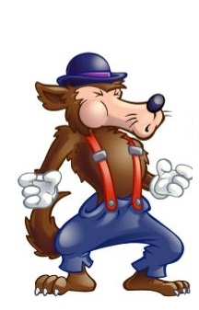
Big Bad

Slide 103
Character Analysis - Laser
Looks - Describe the character’s physical appearance. Remember to include things like age, size (compared to other characters), hair and eye color (if known), and any other significant details (eg: scars, tattoos, disabilities, etc.).
Remember: The PERSONALITY and MOTIVATIONS of a character are more important than their appearance. This should be the shortest section of your analysis.

Slide 104
Character Analysis - Laser
Actions - What does the character DO in the story? What do his or her actions show us about who the character is? How do his or her actions affect the plot?
Remember: Focus on impact moments in the story (moments that have a direct effect on the plot or characters). Minimum of TWO examples of actions WITH PROPERLY CITED EVIDENCE.

Slide 105
Character Analysis - Laser
Speech - WHAT does the character say in the story and HOW do they say it? Does the way they speak reveal anything about their character (background, education, maturity level, etc.)? Are they rude? Polite? Sarcastic? Formal? Casual? How do the things they say affect the plot?
Remember: Diction (word choice) is important and can tell us a lot about a character. Minimum of TWO examples of speech WITH PROPERLY CITED EVIDENCE.

Slide 106
Character Analysis - Laser
Effect - How does this character (their words, actions, thoughts, etc.) affect other characters in the story? What do other characters say about them? How do other characters react to them? How do their choices cause or solve conflicts for other characters?
Remember: Some characters have “history” with your character (they have known them longer...since before the story starts for us), so the way they react to them, speak to them, and speak about them can tell us a lot. Minimum of TWO examples of effect WITH PROPERLY CITED EVIDENCE.

Slide 107
Character Analysis - Laser
Reasoning - What are the character’s motivations (why they do and say what they do)? What drives them? What is important to them? What are their thought processes like (if they are revealed)?
Remember: Unless the character you chose is the NARRATOR of the story, you may not get to see directly into their thoughts. In these instances, we must INFER what and how they are thinking and their motivations through their words and actions. Minimum of TWO examples of thoughts/motivations WITH PROPERLY CITED EVIDENCE.

Slide 108
Character Analysis - Focus
Feelings - How do the characters emotions and emotional connections to others affect their choices? What emotions are they feeling strongly enough to drive them to action?
Remember: If one character cares for another, they are motivated by that emotion. The same is true if they fear them, are jealous of them, or despise them. Minimum of TWO examples of emotions/emotional connections WITH PROPERLY CITED EVIDENCE.

Slide 109
Character Analysis - Focus
Obligations - What does your character owe other characters and what do they owe him or her (eg: money, respect, love, an apology, etc.)? How are they tied to other characters?
Remember: If one person feels like they owe someone, or that they are owed something, it changes the way they behave. Minimum of TWO examples of obligations WITH PROPERLY CITED EVIDENCE.

Slide 110
Character Analysis - Focus
Conflict: With whom, or with what, is your character in conflict? Is there internal conflict, external conflict, or both? Is your character the protagonist or antagonist (or something in between)?
Remember: Without conflict, there is no story! Your character’s conflict pushes the plot forward. Minimum of TWO examples of conflicts WITH PROPERLY CITED EVIDENCE.

Slide 111
Character Analysis - Focus
Understandings - What does your character know? About other characters? About themselves? Do they have any secrets or things that only they know? Also, what do they NOT know or WANT to know?
Remember: If a character wants or needs knowledge, they may be inclined to take risks or do things outside their “normal.” Minimum of TWO examples of understandings/questions WITH PROPERLY CITED EVIDENCE.

Slide 112
Character Analysis - Focus
Shifts - How does your character change over the course of the story? Do their priorities shift? Do their beliefs change? Do they grow, learn, mature? Or are they a static (unchanging) character?
Remember: In most good novels, the characters change the plot, but the plot also changes the characters. Minimum of TWO examples of ways the character changes WITH PROPERLY CITED EVIDENCE.

Slide 113
Exit Ticket
9/19/19
Write about the following:
Which character from The Hobbit would you choose to write about?
Why would you choose them?
Do you identify with this character in any way?

Slide 114
Start-Up - Discussion
9/20/19
In your triads, discuss the following:
Of the parts to LASER analysis you will be working on today, which one would you say is the most important to understanding a character?
(LOOKS, ACTIONS, SPEECH, EFFECTS, REASONING)
Why is that element so important?

Slide 115
Start-Up - Writing
9/20/19
Write about the following:
Of the parts to LASER analysis you will be working on today, which one would you say is the most important to understanding a character?
(LOOKS, ACTIONS, SPEECH, EFFECTS, REASONING)
Why is that element so important?

Slide 116
Unit Objectives
CCSS.ELA-LITERACY.RL.9-10.1
Cite strong and thorough textual evidence to support analysis of what the text says explicitly as well as inferences drawn from the text.
CCSS.ELA-LITERACY.RL.9-10.2
Determine a theme or central idea of a text and analyze in detail its development over the course of the text, including how it emerges and is shaped and refined by specific details; provide an objective summary of the text.
CCSS.ELA-LITERACY.RL.9-10.3
Analyze how complex characters (e.g., those with multiple or conflicting motivations) develop over the course of a text, interact with other characters, and advance the plot or develop the theme.

Slide 117
Today’s Objectives
Analyze fictional characters and their development over the course of a novel.

Slide 118
Character Analysis – The Hobbit
Today you will be using what we practiced yesterday to analyze a character from the novel.
Because we are only halfway through, we will only be doing half of the analysis now.
We will do the LASER part now and save the FOCUS for after we finish the novel. That way we can truly see SHIFTS in the characters.
Go to Google Classroom and open the assignment labeled “LASER FOCUS Character Analysis.”
You will find there a template for the Google Slide presentation you will be responsible for creating.

Slide 119
Character Analysis – The Hobbit
The first 2 slides are just information. DO NOT MODIFY OR DELETE THEM.

Slide 120
Character Analysis – The Hobbit
Your job is to choose one of the three main characters we have learned the most about and complete an analysis of that character.
You will add information into the slides in your template.
For each character, you must provide THREE characteristics in each category in the left hand column.
For each characteristic on the left, you will provide PROPERLY CITED evidence from the novel that supports your claim that your character has that characteristic.

Slide 121
LASER FOCUS CHARACTER ANALYSIS
Now let’s look at some examples
of what is expected!

Slide 123
Character Analysis
Looks Actions Speech Effect Reasoning

Slide 124
Character Analysis - Laser
Looks - Describe the character’s physical appearance. Remember to include things like age, size (compared to other characters), hair and eye color (if known), and any other significant details (eg: scars, tattoos, disabilities, etc.).
Remember: The PERSONALITY and MOTIVATIONS of a character are more important than their appearance. This should be the shortest section of your analysis.

Slide 125
Character Analysis - Laser
Actions - What does the character DO in the story? What do his or her actions show us about who the character is? How do his or her actions affect the plot?
Remember: Focus on impact moments in the story (moments that have a direct effect on the plot or characters). Minimum of TWO examples of actions WITH PROPERLY CITED EVIDENCE.

Slide 126
Character Analysis - Laser
Speech - WHAT does the character say in the story and HOW do they say it? Does the way they speak reveal anything about their character (background, education, maturity level, etc.)? Are they rude? Polite? Sarcastic? Formal? Casual? How do the things they say affect the plot?
Remember: Diction (word choice) is important and can tell us a lot about a character. Minimum of TWO examples of speech WITH PROPERLY CITED EVIDENCE.

Slide 127
Character Analysis - Laser
Effect - How does this character (their words, actions, thoughts, etc.) affect other characters in the story? What do other characters say about them? How do other characters react to them? How do their choices cause or solve conflicts for other characters?
Remember: Some characters have “history” with your character (they have known them longer...since before the story starts for us), so the way they react to them, speak to them, and speak about them can tell us a lot. Minimum of TWO examples of effect WITH PROPERLY CITED EVIDENCE.

Slide 128
Character Analysis - Laser
Reasoning - What are the character’s motivations (why they do and say what they do)? What drives them? What is important to them? What are their thought processes like (if they are revealed)?
Remember: Unless the character you chose is the NARRATOR of the story, you may not get to see directly into their thoughts. In these instances, we must INFER what and how they are thinking and their motivations through their words and actions. Minimum of TWO examples of thoughts/motivations WITH PROPERLY CITED EVIDENCE.

Slide 129
Character Analysis - Laser
You have until Wednesday 9/25 to finish and submit the first 8 slides.
They will be graded and returned to you.
The second half of the slideshow will be due at a later date to be determined; after we finish the novel.
You will NOT have time to work on this in class because we will be continuing reading on Monday.

Slide 130
EXTRA CREDIT POLICY
I do, on occasion offer extra credit opportunities for my classes, but there are guidelines:
No student is eligible to receive extra credit unless they have completed and submitted 100% of the original credit work. If you have missing assignments or zeroes in Aeries, you are NOT ELIGIBLE.
Extra credit assignments, just like original credit, have due dates. Extra credit assignments submitted after the due date have NO value.
Extra credit assignments must be 100% complete when submitted. Extra credit assignments that are incomplete have NO value.
The value assigned to extra credit is stated in “TOTAL POSSIBLE POINTS.” Just turning something in does not guarantee you full points. The work is graded in the same way as any original credit work.

Slide 131
EXTRA CREDIT OPPORTUNITY
On my website, I have placed a blank copy of the template for the LASER FOCUS Character Analysis assignment.
For up to a TOTAL OF 20 POSSIBLE POINTS of extra credit:
Open and make a copy of that Google Slide Presentation
Using the novel, specifically Chapter 5, complete a character analysis of Gollum.
You must complete BOTH the first half (LASER) and the second half (FOCUS).
For “SHIFTS” show how he changes during the scene with Bilbo.
This EXTRA CREDIT is DUE, submitted to me by email @ jmcelroy@turlockusd.org, no later than
FRIDAY SEPTEMBER 27TH BY 5:00 P.M.

Slide 132
HOMEWORK
Work on your Google Slide presentation for the
LASER
Portion of the Character Analysis
This will be DUE
WEDNESDAY 9/25
By 7:00 am

Slide 133
EXIT TICKET
9/20/19
Although we try to focus on character traits, a character’s physical appearance can be important to the story.
How is this true of some of the characters in The Hobbit?
Give examples.

Slide 134
Start-Up - Discussion
9/23/19
At the end of Chapter 8, which member of their party was missing?
Where is he now?
Why might this be a problem?

Slide 135
Start-Up - Writing
9/23/19
At the end of Chapter 8, which member of their party was missing?
Where is he now?
Why might this be a problem?

Slide 136
Small Group Read
Today, in your groups, we will do a small group read of Chapter 9 to Page 196.
You will take turns reading in your groups with everyone participating.
One member of your group will be allowed to have their question sheet open on their chromebook.
As you read, they may NOT answer the questions, but they MAY note the pages where the answers are found and share that with the group at the end of class.

Slide 137
HOMEWORK
Finish Reading Chapter 9 TO PAGE 196 and Begin working on “QUESTIONS – Chapter 9”
In Google Classroom.
DUE WEDNESDAY BY 7:00 a.m.
LASER Character Analysis
ALSO DUE WEDNESDAY
By 7:00 am

Slide 138
EXIT TICKET
9/23/19
Why did the King of the Wood Elves get upset with Balin?
What did he say that the party was guilty of?

Slide 139
Start-Up - Discussion
9/24/19
How do the dwarves react when Bilbo tells them his plan?
What does he threaten if they don’t want to follow it?
Predict: What do you think he was planning?

Slide 140
Start-Up - Writing
9/24/19
How do the dwarves react when Bilbo tells them his plan?
What does he threaten if they don’t want to follow it?
Predict: What do you think he was planning?

Slide 141
Chapter 9
Let’s Read
Expectations:
Heads up
Following along
Asking questions if needed for clarification
Ready to discuss when we pause

Slide 142
HOMEWORK
Finish Reading Chapter 9
and continue working on
“QUESTIONS – Chapter 9”
In Google Classroom.
ALSO,
LASER Character Analysis
BOTH will be DUE TOMORROW
By 7:00 am

Slide 143
EXIT TICKET
9/24/19
What was Bilbo’s escape plan?
Do you think it was a good one?
Why or why not?
What would you have done differently?

Slide 144
No Start-Up Discussion/Writing No Exit Ticket
9/25/19

Slide 145
Start-Up - Discussion
9/26/19
Think about the story so far…
How might this story be different if it took place in our “reality?”
What obstacles could the party face in the real world instead of the “fantastic” ones in the novel?
Would it be as exciting? Interesting?

Slide 146
Start-Up - Writing
9/26/19
Think about the story so far…
How might this story be different if it took place in our “reality?”
What obstacles could the party face in the real world instead of the “fantastic” ones in the novel?
Would it be as exciting? Interesting?

Slide 147
Fantasy vs. Reality
Fantasy is vital for the human mind. It begins as the psychological process by which a child learns to fill the gaps between knowledge, reality and experience, and becomes a vital adult coping mechanism.
When we were small children, trying to get to sleep, a creaking floorboard was really spooky. Who or what could be making the noise?
The only way to make sense of the experience, for which there was no "certain“ answer, was to fantasize: there's a pirate or a burglar, or more probably a crocodile under the bed.
Children scare themselves silly like this, but while they have no knowledge of central heating pipes swelling, they have to engage with make-believe to bridge the gap between experience and knowledgeAs time passes and children learn about the effect of heat on pipes and floorboard, they will often prefer the crocodile theory.
Fear within a safe context is fun.

Slide 148
Fantasy vs. Reality
Children are born with the full spectrum of human emotions, wild, exciting, passionate, vigorous, totally irrational and raring to go.
They are also inexperienced and longing to explore their feelings.
This is why they need to be scared and fantasy is an excellent, "safe" way to do it - going out to find real crocodiles to play with is neither practical nor safe.
Fantasy offers children a rehearsed exploration of the too big, too wide, too dangerous world that is getting closer and more real every day.
But fantasy needn't just be dungeons and dragons - it can be any element of pretend.
This is why as they grow, children need stories that include divorce, bereavement, war, falling in love, becoming a hero and saving the world.
These provide developing emotions with a contextual framework within which to awaken and limber up, ready for "real life" when it hits.

Slide 149
Fantasy vs. Reality
Most importantly, fantasy isn't just for children.
Becoming a teenager, rites of passage, facing failure and defeat, coming to terms with betrayal and disappointment - all the stuff of emerging adult life also has to be faced and coped with.
Psychoanalysis and Counseling have their place, but the most important tool we as humans have to tackle reality, is the creation of metaphor - the allegorical story.
Taking one step away from reality to that "safe" place of pretend, prepares us to look the world's harsh realities in the face. From there we can name the horrors and celebrate the joys before going back, with a clearer perspective on situations that bother us.

Slide 150
Fantasy vs Reality
Go to Google Classroom and open up the Fantasy vs Reality Chart document.
Use the chart to give examples of elements of fantasy in the world of The Hobbit. Give each example as a statement followed by evidence (PROPERLY CITED, OF COURSE).
In the right column, discuss how this fantasy element relates to reality; either in general or to you personally.
You are required to provide at least one example of each for each chapter we have read so far.

Slide 151
HOMEWORK
Work on your
Fantasy vs. Reality Charts
This will be DUE MONDAY
By 7:00 am

Slide 152
EXIT TICKET
9/26/19
Do you agree that reading fantasy can help us to better deal with reality?
What can you learn from The Hobbit that could be applied to your real life?

Slide 153
NO START-UP NO EXIT TICKET Your Job Today…
9/27/19
Work on your
Fantasy vs Reality Charts
DUE MONDAY by 7:00 a.m.

Slide 154
Start-Up - Writing
9/30/19
How did Bilbo and the dwarves escape the Wood Elves?
How did Bilbo get separated from them?
What is he left wondering at the end of Chapter 9?

Slide 155
Small Group Read
Today, in your groups, we will do a small group read of Chapter 10 (only 13 pages).
You will take turns reading in your groups with everyone participating.
One member of your group will be allowed to have their question sheet open on their chromebook.
As you read, they may NOT answer the questions, but they MAY note the pages where the answers are found and share that with the group at the end of class.

Slide 156
HOMEWORK
Finish Reading Chapter 10 and Work on “QUESTIONS – Chapter 10”
In Google Classroom.
DUE WEDNESDAY BY 7:00 a.m.

Slide 157
EXIT TICKET
9/30/19
Why are the people of Lake-town excited to hear who Thorin is?
What do we learn from the song the people of Lake-town?
What are they hoping for?

Slide 158
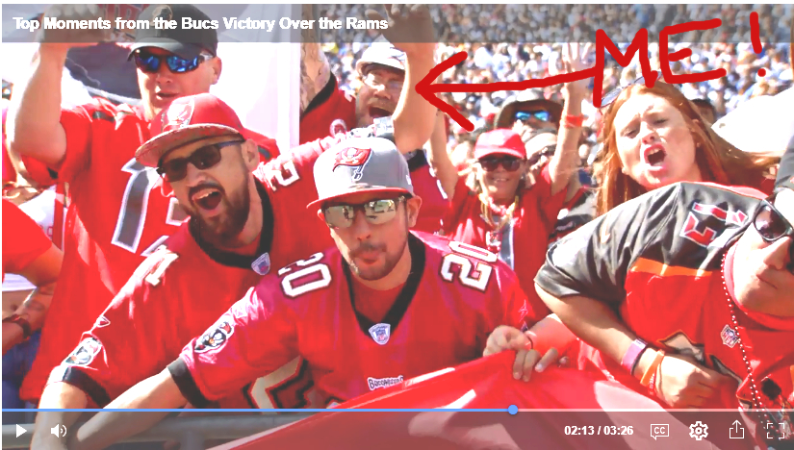
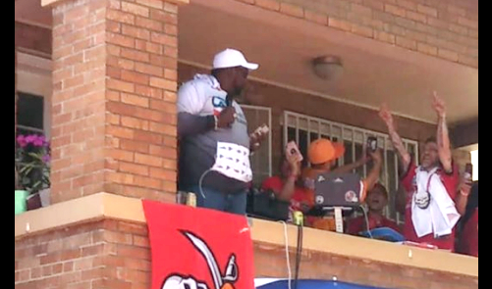
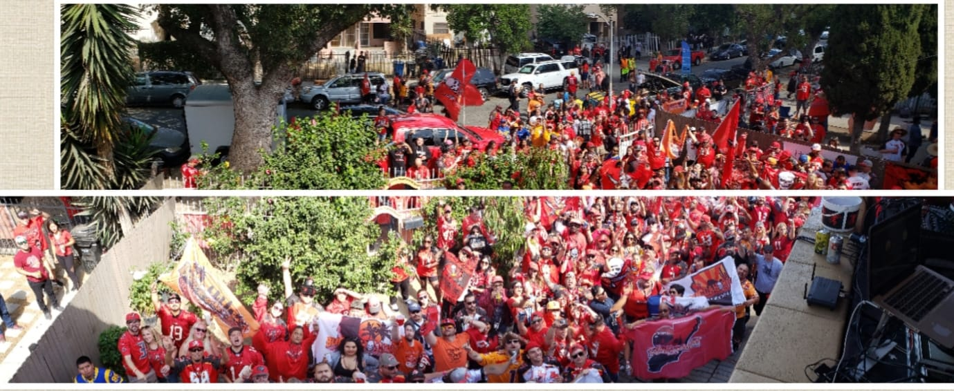
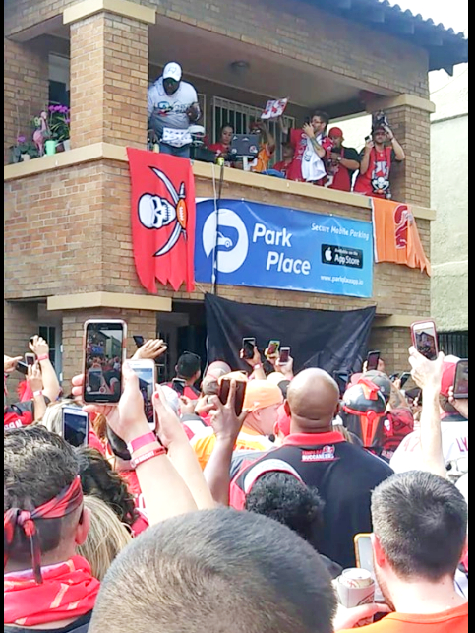
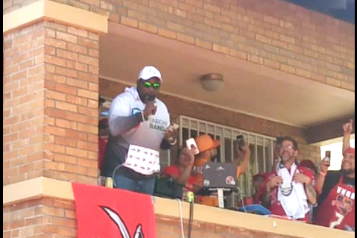
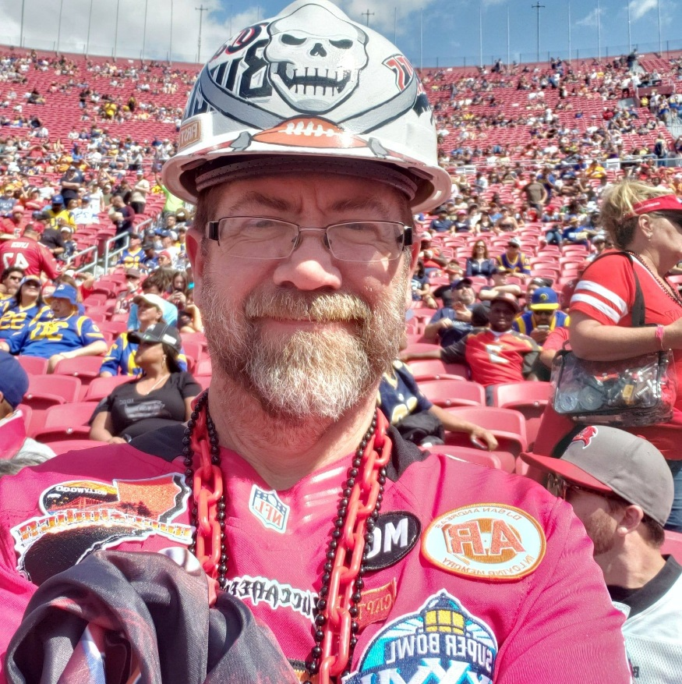
This is why I can’t talk today! First my best friends and I hosted this tailgate for about 500 of our friends and raised THOUSANDS of dollars for charity!
I even met one of my heroes,
Superbowl Champion and NFL Hall
Of Famer, Warren Sapp when he
Came to OUR party!!!
Then I sat in the endzone (row 1) and watched my team score 2 of their TDs right in front of me!
Then we WON!
So, yeah…no voice! It will be better soon!

Slide 159
Start-Up - Discussion
10/1/19
What does Thorin inform the Master of the Town that surprises him at the end of Chapter 10?
What did the Master really think of this group of travelers?
Why is he happy to let them leave?

Slide 160
Start-Up - Writing
10/1/19
What does Thorin inform the Master of the Town that surprises him at the end of Chapter 10?
What did the Master really think of this group of travelers?
Why is he happy to let them leave?

Slide 161
Chapter 11
Let’s Read
Expectations:
Heads up
Following along
Asking questions if needed for clarification
Ready to discuss when we pause

Slide 162
HOMEWORK
Finish Reading Chapter 11 and Work on “QUESTIONS – Chapter 11”
In Google Classroom.
DUE TOMORROW BY 7:00 a.m.

Slide 163
EXIT TICKET
10/1/19
Why were some of the dwarves getting frustrated with Bilbo?
What were they thinking about having him do?
How was that avoided?

Slide 164
NO START-UP NO EXIT TICKET
10/2/19

Slide 165
Start-Up - Discussion
10/3/19
What do you think of when you hear the word BLOG?
What is it? What are they typically about?
Have you ever read someone else’s blog?
What sort of things were in it?

Slide 166
Start-Up - Writing
10/3/19
What do you think of when you hear the word BLOG?
What is it? What are they typically about?
Have you ever read someone else’s blog?
What sort of things were in it?

Slide 167
The Hobbit Blog
Today we are going to work with CHARACTERIZATION again.
You will be using the same character you chose for your LASER FOCUS Character Analysis.
For your character, you will be creating a BLOG using WIX.COM
You will create FIVE BLOG ENTRIES…
One from the beginning of the novel JUST BEFORE we come in as readers.
One from any point from the beginning of the story to when Bilbo meets Gollum (Chapters 1-4).
One from any point from where Bilbo meets Gollum to where Thorin is shshown in the Wood Elf King’s dungeon (Chapters 5-8).
One from any point between when Thorin is shown in the Wood Elf King’s dungeon and when Smaug leaves his lair to go to Lake Town (Chapters 9-12).
One from any point between when Smaug leaves his lair to go to Lake Town and the end of the novel (Chapters 13-19).

Slide 168
The Hobbit Blog
CONTENT
Your entries must be written AS IF YOU ARE THE CHARACTER YOU HAVE CHOSEN.
To “CREATE” your character’s “VOICE,” use:
What they say in the story
What you learn from their actions
What other characters say about them
What the narrator says about them
As your character, you will write about:
What is HAPPENING in the plot or what has just happened
How they FEEL about what is happening
What they think or feel towards other characters
Internal conflicts your character has

Slide 169
The Hobbit Blog
CONTENT
Each entry must be:
A minimum of 150 but no more than 300 words (equal to a really good paragraph)
You are encouraged to:
Change font sizes, styles, and colors to any you like
Add background, images, GIFs, memes, etc. that relate to the entry
Be creative
REMEMBER: THIS IS BASICALLY YOUR CHARACTER’S DIARY. WHAT WOULD THEY ADD TO IT? WHAT WOULD BE IMPORTANT TO THEM

Slide 170
The Hobbit Blog
Getting Started
Go to Wix.com and start an account USING YOUR SCHOOL GOOGLE EMAIL.
Name your BLOG with your First Name, Last Initial and Period Number
EG: JonathanK1
Once you have created your blog…
There is an option to publish your site with a FREE DOMAIN NAME. Use that.
Go to Classroom and ANSWER THE QUESTION POSTED BY PASTING THE LINK TO YOUR BLOG THERE.

Slide 171
The Hobbit Blog
Getting Started
Number Your Posts as you create them.
EG: Post 1, Post 2, Post 3, Post 4, Post 5
After you write a post, you must PUBLISH IT to make it visible to me and your classmates.

Slide 172
The Hobbit Blog
SUBMISSION
You will not be submitting this through Google or Turnitin. I will be checking your links to grade your work.
Your first TWO entries are due, PUBLISHED TO WIX.COM with the LINK POSTED TO GOOGLE CLASSROOM as an answer to my question there by the end of class TOMORROW.
The other three entries will due at a later date to be determined as we finish the book!

Slide 173
The Hobbit Blog
RESPONDING
In addition to writing your 5 blog entries, you will be responsible for READING and COMMENTING on THREE of your classmates blogs.
By the end of class tomorrow, you should have plenty to choose from.
Your job is simply to read their entries, each of the three MUST be from DIFFERENT classmates, and then write a response of NO LESS THAN 2-3 SENTENCES.
IT IS NOT ENOUGH TO SAY SOMETHING LIKE: THIS IS GOOD, NICE JOB, I LIKE IT, ETC. If your comments are not more substantial, you will not get the points.
You can:
Respond as your character
Comment on the events they mention
Comment on their “voice”

Slide 174
HOMEWORK
Hobbit Blog Entries 1 & 2
Published to WIX and links in Google Classroom by
The end of TOMORROW’S class.
Hobbit Blog RESPONSES 1 & 2
Posted on your classmates’ blogs by
MONDAY @ 7:00 am

Slide 175
EXIT TICKET
10/3/19
What did you choose to write about as your first blog entry (PRE-NOVEL)?
Why did you choose that? Does your blog tell us anything that would help us understand your character prior to the start of the novel?
What?

Slide 176
NO START-UP NO EXIT TICKET YOUR WORK / HOMEWORK Hobbit Blog Entries 1 & 2 Published to WIX and links in Google Classroom by The end of TODAY’S class.
10/4/19

Slide 177
Start-Up - Discussion
10/7/19
At the end of Chapter 11, the hole in the mountain is described as “a yawning mouth leading in and down.”
What type of figurative language is this?
What sort of mood does this description set as they are about to enter the mountain?

Slide 178
Start-Up - Writing
10/7/19
At the end of Chapter 11, the hole in the mountain is described as “a yawning mouth leading in and down.”
What type of figurative language is this?
What sort of mood does this description set as they are about to enter the mountain?

Slide 179
Small Group Read
Today, in your groups, we will do a small group read of Chapter 12 (to page 242).
You will take turns reading in your groups with everyone participating.
One member of your group will be allowed to have their question sheet open on their chromebook.
As you read, they may NOT answer the questions, but they MAY note the pages where the answers are found and share that with the group at the end of class.

Slide 180
HOMEWORK
Begin Work on “QUESTIONS – Chapter 12”
In Google Classroom.
DUE WEDNESDAY BY 7:00 a.m.

Slide 181
EXIT TICKET
10/7/19
What was the weak point in the dwarves plan that Bilbo made them realize in Chapter 11?
What was his offer to the dwarves?

Slide 182
Start-Up - Discussion
10/8/19
How did Bilbo introduce himself to Smaug?
Why do you think he chose to do that?
What benefit could it have?

Slide 183
Start-Up - Writing
10/8/19
How did Bilbo introduce himself to Smaug?
Why do you think he chose to do that?
What benefit could it have?

Slide 184
Chapter 12
Let’s Read
Expectations:
Heads up
Following along
Asking questions if needed for clarification
Ready to discuss when we pause

Slide 185
HOMEWORK
Finish “QUESTIONS – Chapter 12”
In Google Classroom.
DUE TOMORROW BY 7:00 a.m.
Quiz tomorrow on chapters 9-12!

Slide 186
EXIT TICKET
10/8/19
What was the subject of conversation that got the dwarves all distracted?
Why do you think that is?
What is the Arkenstone?

Slide 187
No Start-Up Discussion/Writing (Keep Chromebooks Closed)
10/9/19
QUIZ ON
CHAPTERS 9-12
IN GOOGLE CLASSROOM

Slide 188
When You Are Finished With Your Quiz…
Begin a SILENT READ of
Chapter 13
(only about 12 pages).
We will continue reading tomorrow with CHAPTER 14!

Slide 189
HOMEWORK
Finish reading Chapter 13.
Begin working on Questions for
Chapters 13-15
DUE MONDAY!
NO EXIT TICKET

Slide 190
Start-Up - Discussion
10/10/19
What did Bilbo find when he went down into the mountain a third time?
What did he do with it?
Why do you think he made this choice?

Slide 191
Start-Up - Writing
10/10/19
What did Bilbo find when he went down into the mountain a third time?
What did he do with it?
Why do you think he made this choice?

Slide 192
Chapter 14
Let’s Read
Expectations:
Heads up
Following along
Asking questions if needed for clarification
Ready to discuss when we pause

Slide 193
HOMEWORK
Continue “QUESTIONS – Chapter 13-15”
In Google Classroom.
DUE MONDAY BY 7:00 a.m.

Slide 194
EXIT TICKET
10/10/19
Describe the inside of the dwarves mountain as they travel through it?
What does Bilbo think of it?
What is Thorin’s reaction?

Slide 195
Start-Up - Writing
10/11/19
Who is Bard?
What did he use against Smaug?
Did you expect Smaug to be defeated/gone from the story so easily?
Why or why not?

Slide 196
Chapter 15
Let’s Read
Expectations:
Heads up
Following along
Asking questions if needed for clarification
Ready to discuss when we pause

Slide 197
HOMEWORK
Finish “QUESTIONS – Chapter 13-15”
In Google Classroom.
DUE MONDAY BY 7:00 a.m.

Slide 198
EXIT TICKET
10/11/19
Who comes to the mountain at the end of Chapter 15?
Why?
What do you think will happen next?

Slide 199
Start-Up - Writing
10/14/19
Who do you think is in the right at this point in the story?
Is Thorin right for trying to keep the treasure?
Are the Lake-people right to think they should get something?
What about the elves?

Slide 200
Small Group Read
Today, in your groups, we will do a small group read of Chapter 16 and 17.
You will take turns reading in your groups with everyone participating.
One member of your group will be allowed to have their question sheet open on their chromebook.
As you read, they may NOT answer the questions, but they MAY note the pages where the answers are found and share that with the group at the end of class.

Slide 201
HOMEWORK
Begin Work on “QUESTIONS – Chapter 16-17”
In Google Classroom.
DUE WEDNESDAY BY 7:00 a.m.

Slide 202
EXIT TICKET
10/14/19
How does Bilbo justify stealing the Arkenstone?
Do you think he made the right move?
Why or why not?

Slide 203
10/15/19
NO START UP TODAY!
TODAY IS…

Slide 204
AMNESTY
DAY!!!

Slide 205
Amnesty Day
Amnesty: An official pardon given to people who have committed criminal offenses.
SOME of you have offended, but today is your lucky day!

Slide 206
Amnesty Day
If you have work that you are missing for this class (zeroes in Aeries), you can make that work up and turn it in with NO PENALTY for lateness…
TODAY ONLY!
MUST BE SUBMITTED BY 3:00 p.m. to receive credit!
If you received BELOW 50% on an assignment, you can make corrections and resubmit it to me for possible added points…
TODAY ONLY!
MUST BE SUBMITTED BY 3:00 p.m. to receive credit!

Slide 207
Amnesty Day
EXCEPTIONS
YOU CAN NOT RESUBMIT OR MAKE UP DAILY START-UPS AND EXIT TICKETS!
Those are DAILY and can not be added to or made up today!
No assignments from any further back than THE HOBBIT will be considered for amnesty.
If you submit/resubmit an assignment that is INCOMPLETE, it is worth NOTHING!

Slide 208
Amnesty Day
If you are done with EVERYTHING (no zeroes in Aeries), you have two choices:
Work on homework/ assignments for other classes OR
Work on an EXTRA CREDIT ASSIGNMENT for this class.
To get the assignment, you must show me that you have no zeroes in my class.
You can earn up to 20 points of extra credit for the assignment.
It must be completed and submitted by 7:00 am tomorrow to receive credit.

Slide 209
NO START-UP NO EXIT TICKET
10/16/19

Slide 210
Start-Up - Discussion
10/17/19
What agreement does Thorin make with Bard?
Why does he make it?
What is he hoping will actually happen?

Slide 211
Start-Up - Writing
10/17/19
What agreement does Thorin make with Bard?
Why does he make it?
What is he hoping will actually happen?

Slide 212
Chapter 18
Let’s Read
Expectations:
Heads up
Following along
Asking questions if needed for clarification
Ready to discuss when we pause

Slide 213
HOMEWORK
Continue “QUESTIONS – Chapter 18-19”
In Google Classroom.
DUE MONDAY BY 7:00 a.m.

Slide 214
EXIT TICKET
10/17/19
What happens that causes the elves, dwarves, and lake-men to join forces?
What did Bilbo see at the end of Chapter 18?
How will this affect the battle?

Slide 215
Start-Up - Discussion
10/18/19
What happened that turned the tide of The Battle of Five Armies?
Who won? Where are their enemies?
How did Bilbo find out about it?

Slide 216
Start-Up - Writing
10/18/19
What happened that turned the tide of The Battle of Five Armies?
Who won? Where are their enemies?
How did Bilbo find out about it?

Slide 217
Chapter 19
Let’s Read
Expectations:
Heads up
Following along
Asking questions if needed for clarification
Ready to discuss when we pause

Slide 218
HOMEWORK
Continue “QUESTIONS – Chapter 18-19”
In Google Classroom.
DUE MONDAY BY 7:00 a.m.

Slide 219
EXIT TICKET
10/18/19
What did you think about the ending?
What’s one thing you might change if you could?
Why?
(No “I wouldn’t change anything” answers)

Slide 220
NO START-UP NO EXIT TICKET
10/21/19

Slide 221
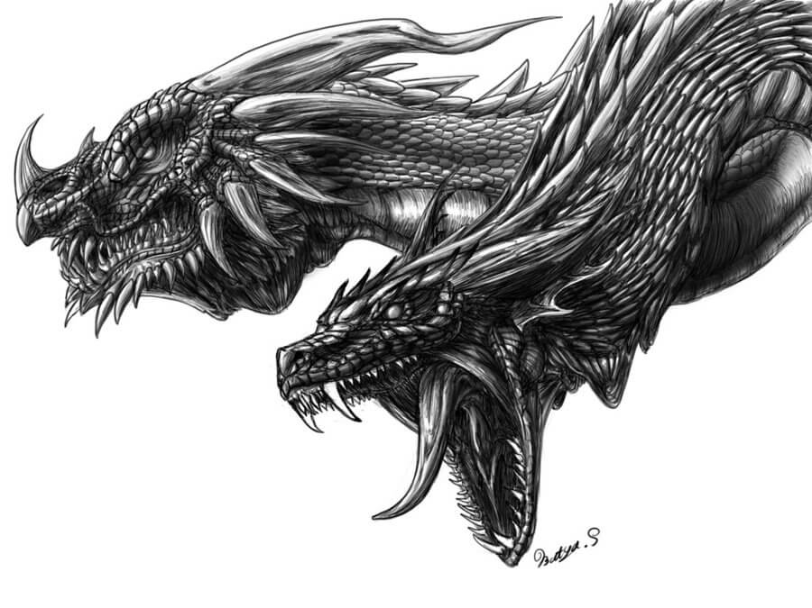
The Two-Headed Dragon
Your job is to slay it before it’s too late!
Luckily, you have faced this dragon before, and you should have weakened it already…although some of you ran away from that first fight…
Look out! There is a two-headed dragon about to devour your grade!

Slide 222
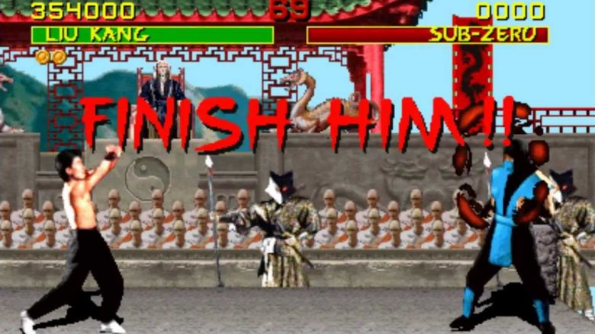
LASER FOCUS
CHARACTER
ANALYSIS
HOBBIT BLOGS
3-5
Go to Google Classroom
Re-open your LASER FOCUS
Character Analysis
FINISH IT!
Slides 224-228 have the
instructions for the
FOCUS Slides!
Go to your WIX site
Re-open your Blog section
FINISH IT!
Slides 229-231 have the
instructions for the
Hobbit Blogs!

Slide 223
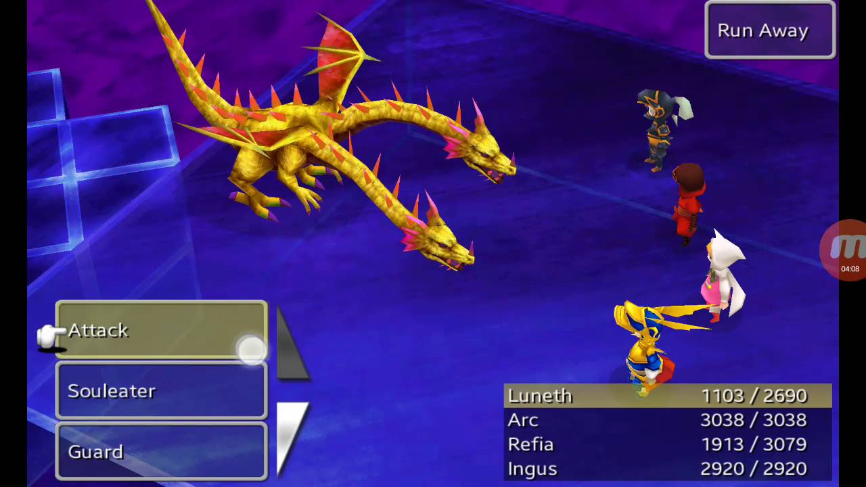
The Two-Headed Dragon
It is up to you which one of the two heads you choose to attack first…
To be VICTORIOUS,
you must to slay the
dragon, BOTH HEADS,
by sunrise on
WODEN’S DAY (Wednesday, 7:00 a.m.)

Slide 224
Character Analysis - Focus
Feelings - How do the characters emotions and emotional connections to others affect their choices? What emotions are they feeling strongly enough to drive them to action?
Remember: If one character cares for another, they are motivated by that emotion. The same is true if they fear them, are jealous of them, or despise them. Minimum of TWO examples of emotions/emotional connections WITH PROPERLY CITED EVIDENCE.

Slide 225
Character Analysis - Focus
Obligations - What does your character owe other characters and what do they owe him or her (eg: money, respect, love, an apology, etc.)? How are they tied to other characters?
Remember: If one person feels like they owe someone, or that they are owed something, it changes the way they behave. Minimum of TWO examples of obligations WITH PROPERLY CITED EVIDENCE.

Slide 226
Character Analysis - Focus
Conflict: With whom, or with what, is your character in conflict? Is there internal conflict, external conflict, or both? Is your character the protagonist or antagonist (or something in between)?
Remember: Without conflict, there is no story! Your character’s conflict pushes the plot forward. Minimum of TWO examples of conflicts WITH PROPERLY CITED EVIDENCE.

Slide 227
Character Analysis - Focus
Understandings - What does your character know? About other characters? About themselves? Do they have any secrets or things that only they know? Also, what do they NOT know or WANT to know?
Remember: If a character wants or needs knowledge, they may be inclined to take risks or do things outside their “normal.” Minimum of TWO examples of understandings/questions WITH PROPERLY CITED EVIDENCE.

Slide 228
Character Analysis - Focus
Shifts - How does your character change over the course of the story? Do their priorities shift? Do their beliefs change? Do they grow, learn, mature? Or are they a static (unchanging) character?
Remember: In most good novels, the characters change the plot, but the plot also changes the characters. Minimum of TWO examples of ways the character changes WITH PROPERLY CITED EVIDENCE.

Slide 229
The Hobbit Blog
Today we are going to work with CHARACTERIZATION again.
You will be using the same character you chose for your LASER FOCUS Character Analysis.
For your character, you will be creating a BLOG using WIX.COM
You will create FIVE BLOG ENTRIES…
One from the beginning of the novel JUST BEFORE we come in as readers.
One from any point from the beginning of the story to when Bilbo meets Gollum (Chapters 1-4).
One from any point from where Bilbo meets Gollum to where Thorin is shshown in the Wood Elf King’s dungeon (Chapters 5-8).
One from any point between when Thorin is shown in the Wood Elf King’s dungeon and when Smaug leaves his lair to go to Lake Town (Chapters 9-12).
One from any point between when Smaug leaves his lair to go to Lake Town and the end of the novel (Chapters 13-19).

Slide 230
The Hobbit Blog
CONTENT
Your entries must be written AS IF YOU ARE THE CHARACTER YOU HAVE CHOSEN.
To “CREATE” your character’s “VOICE,” use:
What they say in the story
What you learn from their actions
What other characters say about them
What the narrator says about them
As your character, you will write about:
What is HAPPENING in the plot or what has just happened
How they FEEL about what is happening
What they think or feel towards other characters
Internal conflicts your character has

Slide 231
The Hobbit Blog
CONTENT
Each entry must be:
A minimum of 150 but no more than 300 words (equal to a really good paragraph)
You are encouraged to:
Change font sizes, styles, and colors to any you like
Add background, images, GIFs, memes, etc. that relate to the entry
Be creative
REMEMBER: THIS IS BASICALLY YOUR CHARACTER’S DIARY. WHAT WOULD THEY ADD TO IT? WHAT WOULD BE IMPORTANT TO THEM

Slide 232
The Two-Headed Dragon
For BOTH Assignments:
The FIRST HALF of these assignments has already been graded. It WILL NOT BE GRADED A SECOND TIME…
BUT
Regardless of your grade on the first half, if BOTH HALVES ARE COMPLETE when you submit (FOCUS) or when I check (BLOGS), I will give you
TEN POINTS EXTRA CREDIT ADDED TO YOUR SCORE FOR THAT ASSIGNMENT!

Slide 233
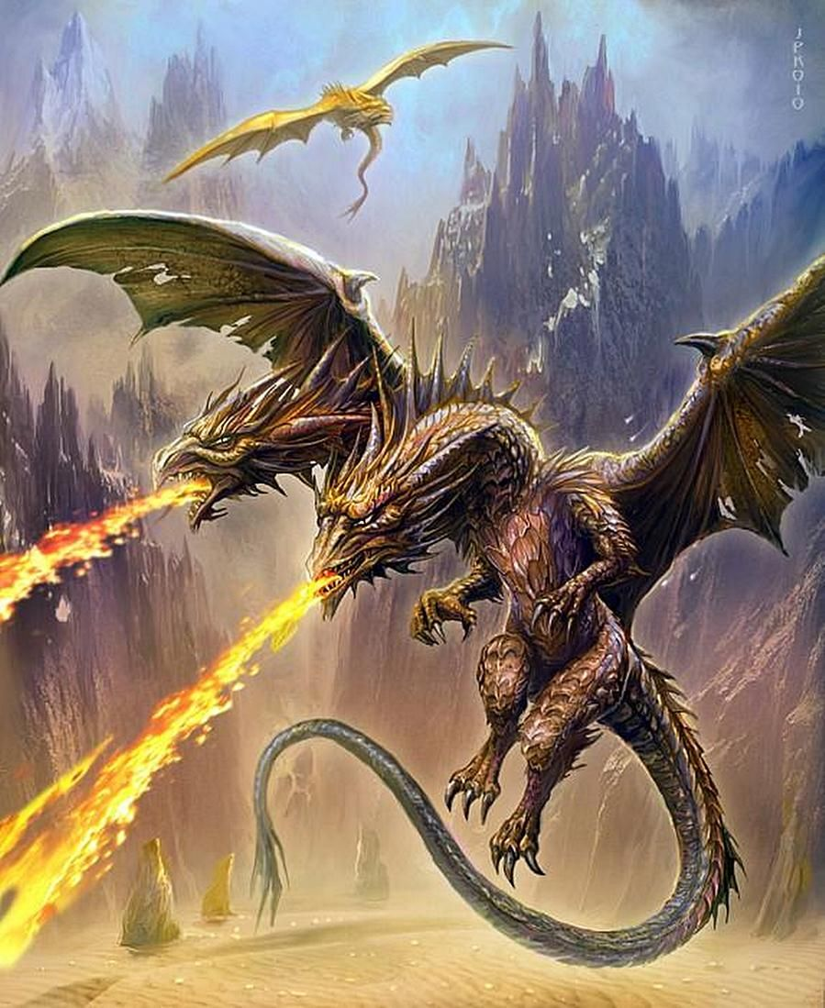
The Two-Headed Dragon
GET TO WORK!

Slide 234
START-UP - DISCUSSION
10/22/19
If you had to choose a way to represent
some of the events, characters, and
themes from this novel, and you could
Choose from: writing, drawing,
building something, or making a
creative video; which would you
Choose and why?

Slide 235
START-UP - WRITING
10/22/19
If you had to choose a way to represent
some of the events, characters, and
themes from this novel, and you could
Choose from: writing, drawing,
building something, or making a
creative video; which would you
Choose and why?

Slide 236
English 10 Final Projects
You will be working, for the next 9 days, on your
FINAL HOBBIT PROJECT!
The DUE DATE for this assessment in THURSDAY OCTOBER 31ST!
NO EXCEPTIONS! NO LATE WORK WILL BE ACCEPTED!!!

Slide 237
English 10 Final Projects
Option 1 – The One-Pager
A one pager is a single-page response to your reading that connects the ideas in the book to your thoughts creatively.
The purpose of the one-pager is so that your audience will understand the big ideas, themes, and connections within the book.

Slide 238
English 10 Final Projects
Option 1 – The One-Pager
Must do:
Title and border (5 points)
Write the title of the book and author’s name somewhere on the page (this can be done creatively!).
Include a border that reflects the unit of learning or theme. This can include words, pictures, symbols, or quotes from the text.
Two meaningful questions (10 points)
These should not be yes or no questions, but how or why questions.
Answers should include specific textual evidence and be cited by page number EX: (54)
Draw images (15 points)
Draw THREE images that represent themes, characters, conflict, or the setting of the book.
These should be strongly connected to the book and should stand out.
Interesting quotes (10 points)
Find two interesting quotes.
Include quotation marks and a citation.
If your passage/quote is a part of dialogue, include the character’s name who said it.

Slide 239
English 10 Final Projects
Option 1 – The One-Pager (cont.)
Must do:
Text opinion (on the back) (10 points)
In five to seven sentences add what your overall opinion of the novel is and what you would say when you recommend the book.
This, along with your name and period, is the ONLY aspect to go on the back of your paper.
Grammar, spelling, and mechanics (5 points)
There are little to no problems with grammar, spelling, mechanics.
Be colorful and neat. (5 points)
Your entire page should be filled with these elements.
If you find you have extra room, repeat any of the above steps/ elements.
No space should be blank. THERE SHOULD BE NO WHITE SPACE
Nothing should be left in pencil.
Your name,class period, and text opinion should be on the BACK of the one-pager.

Slide 240
English 10 Final Projects
Option 1 – The One-Pager (cont.)
You pick 2 from the following list:
Poem (15 points)
Write a poem about a part of the novel (such as a character, conflict, theme, etc.). If you struggle with writing poetry, consider an acrostic poem – each letter represents a word.
Personal statement (15 points)
Write THREE personal statements or connections about what you’ve read (these are not simple opinions).
EX: “I could relate to the main character feeling lost in the book because it reminded me of when I got to high school and didn’t know anyone.
Figurative language (15 points)
Create THREE examples of figurative language (simile, metaphor, hyperbole, alliteration, etc.) emphasizing some part of the novel (characters, conflicts, themes, settings, etc.)
Song (15 points)
Find two songs that represents a theme of the novel. Include the song title, singer/ band, and an explanation (at least 3 sentences) of how the lyrics connect to the book.
Connections (15 points)
What connections can you make between what you read today and the world outside of the story? There may be a connection to happenings at school, the community or the world, to similar events at other times or places, to other people or problems that you are reminded of, or to other stories/books that you have read.
Write three insightful, descriptive connections between you and the reading.

Slide 241
English 10 Final Projects
Option 1 – The One-Pager (cont.)
Presentation of Project (10 points)
Extra credit (up to 10 points): Pick an additional item from the list of five for up to five points of extra credit.

Slide 242
English 10 Final Projects
Option 2 – The Newspaper
The Newspaper Project is a single-page response to your reading that connects the ideas in the book to your thoughts creatively.
The purpose of the project is so that your audience will understand the big ideas, themes, and connections within the book.
This can be created digitally, but MUST be printed out for submission.

Slide 243
English 10 Final Projects
Option 2 – The Newspaper
Must do:
Title and Image (5 Points)
Create a title for your newspaper. You may NOT use “The Maycomb Tribune” (the actual paper from the story) as your title.
Include an image that reflects the novel or a theme from the novel.
One Headline Article - 200 word minimum (20 points)
Headlines are meant to do two things: draw attention to the story through eye-catching language and to summarize the main point of the story.
All headlines need a present tense verb.
Headlines should also give the reader some basic information. Think 5 W’s and 1H (who, what, when, where, why, and how) and choose the most important ones.
Should include quotes from the novel from at least two characters “interviewed.”
An Additional News Story - 150 word minimum (10 points)
Choose another less important event that happened in the novel.
Write a “National” or World” news article that gives details of that event.
Like your headline article, include the 5 Ws and 1 H.

Slide 244
English 10 Final Projects
Option 2 – The Newspaper (cont.)
Must do:
One Editorial Article - 150 word minimum (10 points)
An editorial is an article that presents a writer’s opinion on an issue. Much in the same manner of a lawyer, editorial writers build on an argument and try to persuade readers to think the same way they do.
Editorials are meant to influence public opinion, promote critical thinking, and sometimes cause people to take action on an issue.
In essence, an editorial is an opinionated news story where the writer presents his/her side cohesively and persuasively.
Two Pictures (5 points)
Find or draw two interesting pictures to go with your articles.
Grammar, spelling, and mechanics (5 points)
There are little to no problems with grammar, spelling, mechanics.
Be colorful and neat. (5 points)
Your entire page should be filled with these elements.
If you find you have extra room, repeat any of the above steps/ elements.
No space should be blank.
Nothing should be left in pencil.
Your name and class period should be on the BACK of the paper.

Slide 245
English 10 Final Projects
Option 2 – The Newspaper (cont.)
You pick 2 from the following list:
Personality Profile (15 points)
A human-interest story about a person who deserves recognition for something he/she did.
Choose a character OTHER THAN JEM, SCOUT, OR ATTICUS and write about them and something significant they did that affected the plot or showed a theme in the novel.
Eg: Dill, Miss Maudie, Mr. Underwood, Mr. Dolphus Raymond
Dear Abby section (15 points)
An advice column, including at least one letter asking a question related to the novel and or one of its themes and a response from the “advice columnist.”
Letter to the Editor (15 points)
Choose a minor character and write a letter to the editor of your newspaper in your character’s voice. You’d need to choose an event from the novel that prompts you to write.
Most people write letters to the editor when they have a problem with an issue that affects the community or when they want to praise the efforts of a community member.
Letters to the editor express the writer’s opinion.
Obituaries (15 points)
Choose 2 characters in the novel who die (Tom, Mrs. Radley, Mrs. Dubose) and write their obituaries.
Obituaries typically include: where and when they were born, where and when they died, who they leave behind (family and friends), and something (from the novel) they will be remembered for.
Comic Strip (Only choose this option if you have the skill to do it) (15 points)
Choose a theme from the novel and create a clever comic that illustrates the theme in a humorous way.
Must be at least 4 frames in length.

Slide 246
English 10 Final Projects
Option 2 – The Newspaper (cont.)
Presentation of Project (10 points)
Extra credit (up to 10 points): Pick an additional item from the list of five for up to five points of extra credit.

Slide 247
English 10 Final Projects
Option 3 – The Diorama
The Diorama Project is a three-dimensional, visual response to your reading that connects the ideas in the book to your thoughts creatively.
The purpose of the project is so that your audience will understand the big ideas, themes, and connections within the book.
If you choose this option, you must turn in the diorama itself AND the written elements (these can be all on one printed document).

Slide 248
English 10 Final Projects
Option 3 – The Diorama
Must do:
Title and Background (5 Points)
The title of the novel and the author’s name should appear somewhere on your diorama
Create a background image that reflects the novel or a theme from the novel.
One Symbolic Element - (20 points)
Choose something from the novel that is symbolic and create a 3-D representation of it in your diorama.
Write one complete paragraph (5-7 sentences minimum) explaining what that item is and what it symbolizes in the story.
Two Characters (10 points)
Choose two characters from the story and create a 3-D representation of them in your diorama.
Write TWO complete paragraphs (1 paragraph per character, 5-7 sentences minimum) describing each of the characters you chose.
NOT PHYSICAL DESCRIPTION…CHARACTER DESCRIPTION – personality, things that make them interesting, how they contribute to the story
A Significant Event (10 points)
The main focus of your diorama should be on ONE important moment in the story. Looking at your diorama, I should instantly be able to tell what moment you are portraying.
Write one complete paragraph (5-7 sentences minimum) describing the event you chose, why it was important to the plot, and why you chose it.

Slide 249
English 10 Final Projects
Option 3 – The Diorama (cont.)
Must do:
Two Pictures (5 points)
On the OUTSIDE SIDES of your diorama, include two pictures (can be drawn or printed out) that you think represent two different THEMES of the story.
For each image, include a written caption that explains what the image is and what theme it represents.
Grammar, spelling, and mechanics (5 points)
There are little to no problems with grammar, spelling, mechanics.
Be colorful and neat. (5 points)
Your entire diorama should be filled with these elements.
If you find you have extra room, repeat any of the above steps/ elements.
No space should be blank.
Nothing should be left in pencil.
Your name and class period should be on the BACK of the diorama.

Slide 250
English 10 Final Projects
Option 3 – The Diorama (cont.)
You pick 2 from the following list:
(These can be on the inside sides or part of your background)
Poem (15 points)
Write a poem about a part of the novel (such as a character, conflict, theme, etc.). If you struggle with writing poetry, consider an acrostic poem – each letter represents a word.
Personal statement (15 points)
Write THREE personal statements or connections about what you’ve read (these are not simple opinions).
EX: “I could relate to the main character feeling lost in the book because it reminded me of when I got to high school and didn’t know anyone.
Figurative language (15 points)
Create THREE examples of figurative language (simile, metaphor, hyperbole, alliteration, etc.) emphasizing some part of the novel (characters, conflicts, themes, settings, etc.)
Song (15 points)
Find two songs that represents a theme of the novel. Include the song title, singer/ band, and an explanation (at least 3 sentences) of how the lyrics connect to the book.
Connections (15 points)
What connections can you make between what you read today and the world outside of the story? There may be a connection to happenings at school, the community or the world, to similar events at other times or places, to other people or problems that you are reminded of, or to other stories/books that you have read.
Write three insightful, descriptive connections between you and the reading.

Slide 251
English 10 Final Projects
Option 3 – Diorama (cont.)
Presentation of Project (10 points)
Extra credit (up to 10 points): Pick an additional item from the list of five for up to five points of extra credit.

Slide 252
English 10 Final Projects
Option 4 – The Re-write
The Rewrite Project is a response to your reading that connects the ideas in the book to your thoughts creatively.
You are to write 3 scenes in the story from a different main character’s point of view in a personal diary style.
The purpose of the project is so that your audience will understand the big ideas, themes, and connections within the book.

Slide 253
English 10 Final Projects
Option 4 – The Rewrite
Must do:
Title and Image Cover Page (5 Points)
Create a cover page for your re-write. You may NOT use the actual title of the novel as your title.
Include an image that reflects the novel or a theme from the novel.
Rewrite Scene 1 - 150 word minimum (25 points)
Choose a scene from the story and re-write it from the perspective of one of the main characters.
Be sure to include all of the important details from the original scene.
Your re-write should be in the style of that character’s personal journal.
Include personal insights into the scene that would be expected from the chosen character.
Rewrite Scene 2 - 150 word minimum (25 points)
Choose a scene from the story and re-write it from the perspective of the same main character.
Be sure to include all of the important details from the original scene.
Your re-write should be in the style of that character’s personal journal.
Include personal insights into the scene that would be expected from the chosen character.

Slide 254
English 10 Final Projects
Option 4 – The Re-write (cont.)
Must do:
Rewrite Scene 3 - 150 word minimum (25 points)
Choose a scene from the story and re-write it from the perspective of the same main character.
Be sure to include all of the important details from the original scene.
Your re-write should be in the style of that character’s personal journal.
Include personal insights into the scene that would be expected from the chosen character.
Grammar, spelling, and mechanics (5 points)
There are little to no problems with grammar, spelling, mechanics.
Be colorful and neat. (5 points)
Your journals should be artistically and creatively bound.
Journals should be NEATLY handwritten.
Your name and class period should be on the BACK of the project.

Slide 255
English 10 Final Projects
Option 4 – The Re-write (cont.)
You pick 2 from the following list. These should be included AFTER the journal entries in your project.
Poem (15 points)
Write a poem about a part of the novel from the point of view of the character you are journaling as. If you struggle with writing poetry, consider an acrostic poem – each letter represents a word.
Personal statement (15 points)
Write a personal statement sharing how YOU personally relate to the character you chose to journal as.
EX: “I could relate to the main character__________________ feeling lost in the book because it reminded me of when I got to high school and didn’t know anyone.
Figurative language (15 points)
Create THREE examples of figurative language (simile, metaphor, hyperbole, alliteration, etc.) emphasizing some part of the character and their importance to the novel.
Song (15 points)
Find two songs that somehow connects to the character you chose. Include the song title, singer/ band, and an explanation (at least 3 sentences) of how the lyrics connect to the character.

Slide 256
English 10 Final Projects
Option 4 – The Re-write (cont.)
Presentation of Project (10 points)
Extra credit (up to 10 points): Pick an additional item from the list of five for up to five points of extra credit.

Slide 257
English 10 Final Projects
Option 5 – The Newsreel
The Newsreel Project is a video response to your reading that connects the ideas in the book to your thoughts creatively.
The purpose of the project is so that your audience will understand the big ideas, themes, and connections within the book.

Slide 258
English 10 Final Projects
Option 5 – The Newsreel (cont.)
Must do:
Title and Image (5 Points)
Create a title for your newsreel.
Include an image that reflects the novel or a theme from the novel.
One Headline Story – 2 minute minimum (20 points)
Headlines stories are meant to do two things: draw attention to the story through eye-catching language and to summarize the main point of the story.
All headline story titles need a present tense verb.
Headlines should also give the reader some basic information. Think 5 W’s and 1H (who, what, when, where, why, and how) and choose the most important ones.
Should include “interviews” of at least two characters.
An Additional World or National News Story – 1 minute minimum (10 points)
Choose another important historical event that happened in the time of the novel (Summer, 1935).
Report on a “National” or World” news event, giving details of that event.
Like your headline story, include the 5 Ws and 1 H.

Slide 259
English 10 Final Projects
Option 5 – The Newsreel (cont.)
Must do:
One Editorial Segment - 1 minute minimum (10 points)
An editorial segment is a segment that presents a news personality’s opinion on an issue. Much in the same manner of a lawyer, editorialists build on an argument and try to persuade readers to think the same way they do.
Editorial segments are meant to influence public opinion, promote critical thinking, and sometimes cause people to take action on an issue.
In essence, an editorial is an opinionated news story where the news personality presents his/her side cohesively and persuasively.
Two Pictures (5 points)
Find or draw two interesting pictures to go with your stories. Have them displayed on screen during your report.
Grammar and mechanics (5 points)
There are little to no problems with grammar or mechanics.
Be creative and visually stimulating. (5 points)
Your entire video should be between 4-6 minutes in length.
If you find you have extra time, repeat any of the above steps/ elements.
Your name and class period should be in the credits at the end of the reel.

Slide 260
English 10 Final Projects
Option 5 – The Newsreel (cont.)
You pick 2 from the following list.
Personality Profile (15 points)
A human-interest story about a person who deserves recognition for something he/she did.
Choose a character OTHER THAN JEM, SCOUT, OR ATTICUS and write about them and something significant they did that affected the plot or showed a theme in the novel.
Eg: Dill, Miss Maudie, Mr. Underwood, Mr. Dolphus Raymond
Commercial (15 points)
Create a product or business that would be used in Maycomb around the time of the novel and that somehow connects with an event in the novel (shovels, air rifles, a costume shop, etc.)
Create a commercial for that product that might air on a newsreel. Be creative. Include a slogan and logo for the company or product.
Obituaries (15 points)
Choose 2 characters in the novel who die (Tom, Mrs. Radley, Mrs. Dubose) and read their obituaries.
Obituaries typically include: where and when they were born, where and when they died, who they leave behind (family and friends), and something (from the novel) they will be remembered for.
A Sports Segment (15 points)
Create a sports segment focused on an event from the novel (the fight between Scout and Walter, The tire rolling incident, Atticus’ shooting display)

Slide 261
English 10 Final Projects
Option 5 – The Newsreel (cont.)
Presentation of Project (10 points)
Extra credit (up to 10 points): Pick an additional item from the list of five for up to five points of extra credit.

Slide 262
PRESENTATION OF PROJECTS
Rather than using class time for presentations, you will be doing a VIDEO PRESENTATION of your project.
Your video presentations are DUE on the SAME DAY as your projects are due in class, THURSDAY OCTOBER 31ST.
Your videos must be submitted to me BY EMAIL to
jmcelroy@turlockusd.org
BY THE END OF THE PERIOD ON THURSDAY 10/31!
THAT MEANS YOU ACTUALLY NEED TO HAVE YOUR PROJECTS FINISHED BY AT LEAST WEDNESDAY EVENING, SO YOU CAN DO YOUR VIDEO PRESENTATION AND GET IT SUBMITTED ON TIME!

Slide 263
HOMEWORK
By TOMORROW, you need to have chosen a project option AND decided which “You Choose” elements you plan to include!
PLEASE NOTE: ONCE YOU HAVE CHOSEN A PROJECT AND ELEMENTS, YOU WILL NOT BE ALLOWED TO CHANGE THEM!!!

Slide 264
Exit Ticket
10/22/19
Write about the following:
Which one of the 5 project options do you think you will choose to do?
Why is that one your choice?
Which project would you least like to try and complete?
Why?

Slide 265
English 10 Final Projects
You will be working, for the next 9 days, on your
FINAL HOBBIT PROJECT!
The DUE DATE for this assessment in THURSDAY OCTOBER 31ST!
NO EXCEPTIONS! NO LATE WORK WILL BE ACCEPTED!!!

Slide 266
Start-Up
Complete the “I plan to” portion of your checklist for today.
Today’s Goals
1- Report your choice of project and your choices of “you choose” elements to Mr. McElroy.
2- Complete at least 1 element of your project.
Exit Ticket
Complete the “I finished” portion of your checklist and get it initialed.
10/23/19

Slide 267
English 10 Final Projects
You will be working, for the next 9 days, on your
FINAL HOBBIT PROJECT!
The DUE DATE for this assessment in THURSDAY OCTOBER 31ST!
NO EXCEPTIONS! NO LATE WORK WILL BE ACCEPTED!!!

Slide 268
Start-Up
Complete the “I plan to” portion of your checklist for today.
Today’s Goals
1- Report your choice of project and your choices of “you choose” elements to Mr. McElroy.
2- Complete at least 1 element of your project.
Exit Ticket
Complete the “I finished” portion of your checklist and get it initialed.
10/24/19

Slide 269
English 10 Final Projects
You will be working, for the next 9 days, on your
FINAL HOBBIT PROJECT!
The DUE DATE for this assessment in THURSDAY OCTOBER 31ST!
NO EXCEPTIONS! NO LATE WORK WILL BE ACCEPTED!!!

Slide 270
Start-Up
Complete the “I plan to” portion of your checklist for today.
Today’s Goals
1- Report your choice of project and your choices of “you choose” elements to Mr. McElroy.
2- Complete at least 1 element of your project.
Exit Ticket
Complete the “I finished” portion of your checklist and get it initialed.
10/25/19

Slide 271
English 10 Final Projects
You will be working, for the next 9 days, on your
FINAL HOBBIT PROJECT!
The DUE DATE for this assessment in THURSDAY OCTOBER 31ST!
NO EXCEPTIONS! NO LATE WORK WILL BE ACCEPTED!!!

Slide 272
Start-Up
Complete the “I plan to” portion of your checklist for today.
Today’s Goals
1- Report your choice of project and your choices of “you choose” elements to Mr. McElroy.
2- Complete at least 1 element of your project.
Exit Ticket
Complete the “I finished” portion of your checklist and get it initialed.
10/28/19

Slide 273
English 10 Final Projects
You will be working, for the next 9 days, on your
FINAL HOBBIT PROJECT!
The DUE DATE for this assessment in THURSDAY OCTOBER 31ST!
NO EXCEPTIONS! NO LATE WORK WILL BE ACCEPTED!!!

Slide 274
Start-Up
Complete the “I plan to” portion of your checklist for today.
Today’s Goals
1- Report your choice of project and your choices of “you choose” elements to Mr. McElroy.
2- Complete at least 1 element of your project.
Exit Ticket
Complete the “I finished” portion of your checklist and get it initialed.
10/29/19

Slide 275
English 10 Final Projects
You will be working, for the next 9 days, on your
FINAL HOBBIT PROJECT!
The DUE DATE for this assessment in THURSDAY OCTOBER 31ST!
NO EXCEPTIONS! NO LATE WORK WILL BE ACCEPTED!!!

Slide 276
Start-Up
Complete the “I plan to” portion of your checklist for today.
Today’s Goals
1- Report your choice of project and your choices of “you choose” elements to Mr. McElroy.
2- Complete at least 1 element of your project.
Exit Ticket
Complete the “I finished” portion of your checklist and get it initialed.
10/30/19

Slide 277
This is it…..
10/31/19
YOUR PROJECT CHECKLISTS, VIDEOS, AND PROJECTS ARE DUE BY THE END OF THE PERIOD!
NO EXCEPTIONS!

