Slide 1
Start-Up
4/29/19
Before we begin,
Take a moment to watch and
consider the following video…

Slide 2
Start-Up - Discussion
4/29/19
In your groups, discuss the following:
How do Ben’s experiences and attitudes redefine what it means to have vision?

Slide 3
Start-Up - Writing
4/29/19
What is your opinion of the following statement:
Seeing Is Believing
Explain: do you agree or disagree with that statement? Why or why not?

Slide 4
Blindness and Sight
Remember, you will NOT write in these books, and you will NOT take them out of the room.
Open up your books to page 660.
Today we will be reading the short article, “Just Six Dots The Story of Braille.”
Consider as we read: How does the writer help the reader understand the sequence of events and the “Just Six Dots The Story of Braille” complexity of the topic?

Slide 5
Blindness and Sight
Your job now is to write me a brief summary of the article.
Your summary should be a COMPLETE, CONCISE overview of the article.
It should NOT contain any opinion or analysis.
It should be 5 sentences minimum.

Slide 6
Homework
Summary paragraphs for “Just Six Dots The Story of Braille”
DUE TOMORROW BY 7:00 a.m.

Slide 7
Exit Ticket
4/29/19
Think about and respond thoughtfully to the following:
Do you think there a difference between seeing and knowing?
If so, how are they different?
If not, why not?

Slide 8
Start-Up - Discussion
4/30/19
In your groups, discuss the following:
What could be some possible benefits of being blind?
Is there any good that could come from not being able (or having to) see the things that happen around us?

Slide 9
Start-Up - Writing
4/30/19
What could be some possible benefits of being blind?
Is there any good that could come from not being able (or having to) see the things that happen around us?

Slide 10
Greek Drama
The earliest origins of drama were ancient hymns called dithyrambs, sung in honor of the god of wine, Dionysus, in Athens.
Drama then evolved from religious festivals in honor of Dionysus.

Slide 11
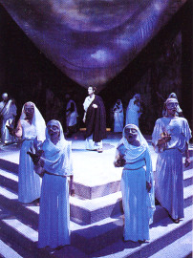
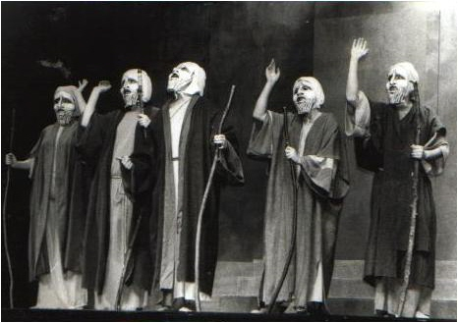
The Chorus
Greek plays featured a chorus, a group of actors who would sing and dance choral songs or odes in between episodes. They also engaged in dialogue with the actors.
Choruses were made up of 12-15 men (women could not participate) who wore matching costumes and masks.
VIDEO on CHORUS

Slide 12
The Purpose of the Chorus
The chorus acts as a “hinge” between scenes or speakers.
The chorus offers a commentary on the action that has just happened and looks forward to the action that is coming.
They do this from a 3rd person “collective” perspective.
The chorus expresses communal wisdom and helps the audience understand and deal with the exceptional circumstances in a tragedy.
The chorus always has an argument or opinion.

Slide 13
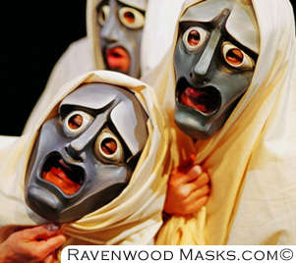
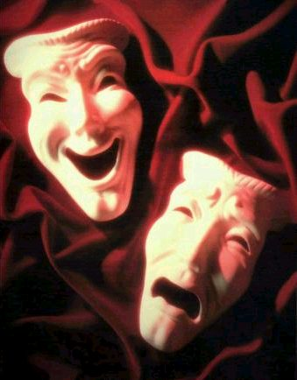
MASKS
The actors wore large masks that helped the audience members – even those in the back – identify the characters.
The masks also helped amplify their voices for the audience.

Slide 14
Layout of a Greek Theater
Theatron: Greek word for theater (from which our word is derived) meaning “viewing place”; the theatron was usually part of a hillside overlooking the orchestra and often wrapped around a large portion of the orchestra.
Orchestra: Means literally “dancing space”; Circular dancing area for the chorus.
Thymele: Altar to Dionysus in the center of the orchestra.
Parodos: means literally “passageways”; these were the paths by which the chorus and some actors made their entrances or exits and by which the audience entered and exited.

Slide 15
Layout of a Greek Theater
Skene: Means literally “tent” (from which our word “scene” is derived); this was the building directly behind the stage, usually decorated as a palace, temple, or other building through which actors could enter and exit.
Proscenium: or proskenion, meaning “in front of the skene.” The proskenion was a raised stage or platform in front of the skene which served simply to make the actors higher to aid visibility and to separate them from the chorus.

Slide 16
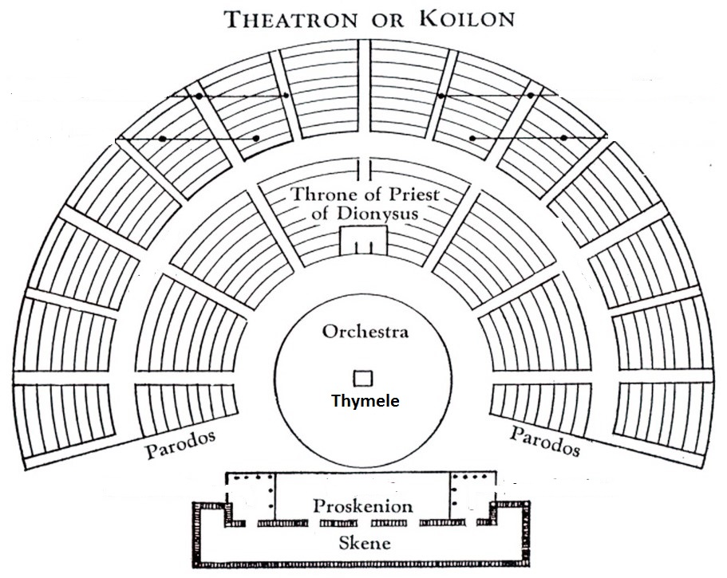
Layout of a Greek Theater

Slide 17
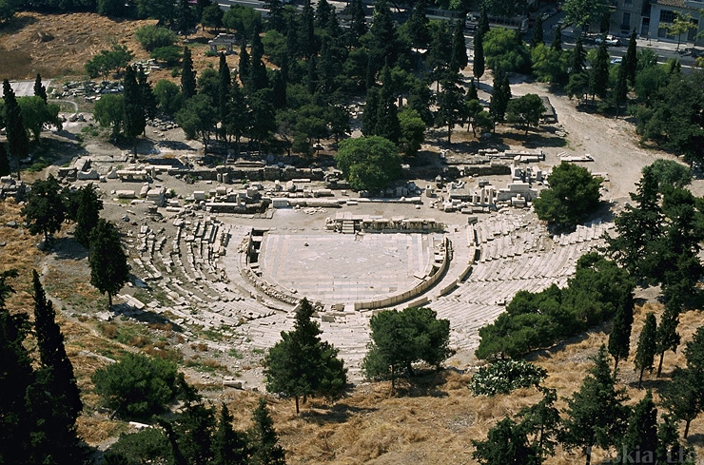
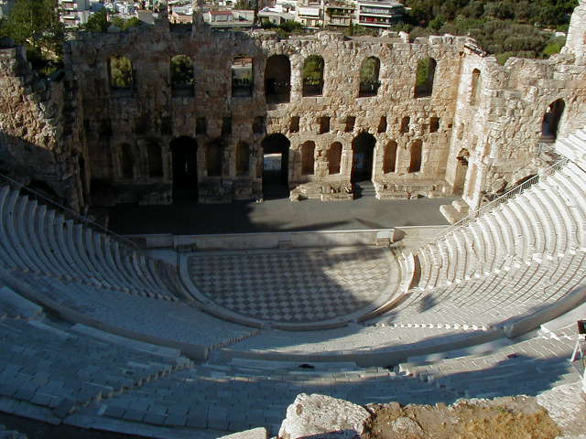
Theater of Dionysus in Athens
A Spectator’s View

Slide 18
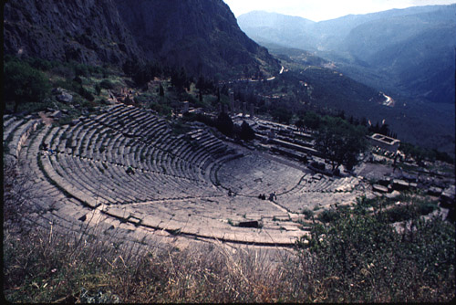
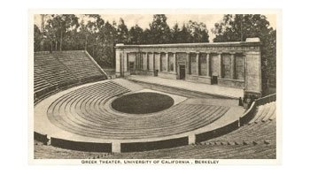
The Theater of Apollo
Greek Theater in
Berkeley, CA
VIDEO ON GREEK THEATER

Slide 19
Structure of Greek Plays
Many writers used an epic convention called en media res, which means “in the middle of things” in Latin. This refers to the idea that the action of the play or poem begins in the middle of the story, rather than at the beginning.
Prologue: Opening dialogue spoken by one or two characters before the chorus enters that gives the mythological background necessary to understand the play.
Parodos: Song sung by the chorus as it first enters the orchestra and dances.
First Scene/Episode: Scene of dialogue in which the characters and chorus talk.
First Ode/Stasimon: At the end of each episode, or scene, the characters leave the stage and the chorus dances and sings a stasimon, or choral ode. The ode usually reflects on the things said and done in the episodes.

Slide 20
Structure of Greek Plays
For the rest of the play, the episodes and stasima alternate until the final scene.
Exodus: The “exit scene” at the end of the play, the chorus exits singing a processional song that offers words of wisdom relating to the action and outcome of the play.
The chorus performed the songs, while the actors performed the scenes.
Odes typically followed this structure:
During the strophe (the first part of the ode), the chorus move/dance from right to left.
They moved in the opposite direction during the antistrophe, a verse that mirrored, but reversed, the strophe.

Slide 21
Homework
Review the TERMINOLOGY in your notes! There will be a QUIZ on Greek Theater and Greek Tragedy
On
FRIDAY!!!

Slide 22
Exit Ticket
4/30/19
Think about and respond thoughtfully to the following:
Do we have anything in modern theater/movies that does the job that a chorus did in Greek theater?
What?
If not, do you think we should? Why?

Slide 23
Start-Up - Discussion
5/1/19
In your groups, discuss the following:
What do you think of when you hear the word “tragedy?”
What are some examples of things that might be considered “tragic?”
What sort of emotions would you expect to be associated with a tragedy?

Slide 24
Start-Up - Writing
5/1/19
What do you think of when you hear the word “tragedy?”
What are some examples of things that might be considered “tragic?”
What sort of emotions would you expect to be associated with a tragedy?

Slide 25
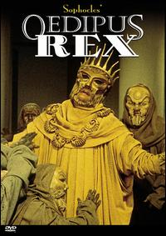
Introduction to Greek Tragedy
“Tragedy” refers primarily to tragic drama: a literary composition written to be performed by actors.
The central character called a tragic protagonist or hero suffers some serious misfortune that is logically connected with the hero’s actions.
One of the flaws often associated with tragic protagonists is called Hubris. Hubris is excessive pride or arrogance; often in defiance of the gods.
When a tragic hero ACTS out of hubris, that action is called an ate.
VIDEO FOR TRAGEDY
^

Slide 26
Characteristics of the Tragic Hero
Generally highborn
Must be good
Must aim at propriety
have good intentions or must be true to life—human
Must be consistent
Exhibits tragic flaw or flaws, often
Hubris—excessive pride
ate—rash actions taken; usually because of hubris
Experiences a reversal or fall
Brings about his own downfall (his prideful and/or rash actions lead to his downfall) or evokes both pity and fear in audience/reader
^
VIDEO FOR TRAGIC HERO

Slide 27
Tragic Protagonist/Hero Activity
In your groups, take the next few minutes to think about and discuss the characteristics of a tragic hero.
Try to come up with some examples of people/characters who fit the mold of a tragic hero.
Now, as a group, choose the ONE you think most resembles a tragic hero. Be prepared to defend your choice.

Slide 28
Important Vocabulary (Review)
Irony - the expression of one’s meaning by using language that normally signifies the opposite, typically for humorous or emphatic effect.
Situational irony: Literary device that occurs when incongruity appears between expectations of something to happen, and what actually happens.
Verbal Irony: where a person says or writes one thing and means another, or uses words to convey meaning that is the opposite of the literal meaning.
Sarcasm: is usually confused with irony – sarcasm which is the use of irony to mock or convey contempt – sarcasm creates ironic situations.
Dramatic Irony: a literary technique originally used in Greek Tragedy, by which the full significance of the characters words or actions are clear to the audience or reader, but is not known to the character. The audience knows something about the character or the plot that the character does not know.

Slide 29
Important Vocabulary
Pathos: A quality that evokes pity or sadness.
An example would be an actor who portrays humor and pathos in the role.
Catharsis is an emotional discharge through which one can achieve a state of moral or spiritual renewal or achieve a state of liberation from anxiety and stress.
Catharsis is a Greek word and it means cleansing. In literature it is used for the cleansing of emotions of the characters.

Slide 30
Sophocles and “Oedipus the King”
Born in 495 B.C., Sophocles is considered one of the greatest Greek playwrights of the golden age of Greek drama.
Oedipus Rex (the King), generally regarded as his masterpiece, was performed (and won a prize) at the festival of Dionysus in Athens around 427 B.C.
It is still considered one of the most important and famous plays of all time.

Slide 31
Homework
Review the TERMINOLOGY in your notes! There will be a QUIZ on Greek Theater and Greek Tragedy
On
FRIDAY!!!

Slide 32
Exit Ticket
5/1/19
Think about and respond thoughtfully to the following:
Do we have anything in modern theater/movies that does the job that a chorus did in Greek theater?
What?
If not, do you think we should? Why?

Slide 33
Start-Up - Discussion
5/2/19
In your groups, discuss the following:
"Which creature in the morning goes on four legs, at mid-day on two, and in the evening upon three, and the more legs it has, the weaker it be?"
This is known as the riddle of the Sphinx.
Can you figure it out?
(If you know it already, NO SPOILERS!)

Slide 34
Start-Up - Writing
5/2/19
"Which creature in the morning goes on four legs, at mid-day on two, and in the evening upon three, and the more legs it has, the weaker it be?"
Did you: already know the answer, figure out the answer, or not know the answer at all.
In your writing, now that you know, explain the riddle and why it makes sense.

Slide 35
En Media Res
“In the middle of things”
We begin the play, “Oedipus the King,” EN MEDIA RES.
The Greeks who attended the play would have already been VERY familiar with Oedipus. He had been written about in a few other plays by other authors.
Oedipus’ story, prior to the start of “Oedipus the King” is very important to understanding this play.
Let’s see where this all ACTUALLY started…
Sphinx Video

Slide 36
Now Let’s Read…
We begin “Oedipus the King” with the Prologue, a short scene of background that involves 3 characters.
As we read, look for and highlight or underline:
Anything that helps you to understand WHO Oedipus is and WHAT KIND OF PERSON he is.
Anything that helps you to understand what has been happening in Thebes.
Anything that describes what Oedipus is doing or is going to do about the problems in Thebes.

Slide 37
Homework
Close Reading Questions for
the Prologue and Parados
DUE MONDAY!

Slide 38
Exit Ticket
5/2/19
Think about and respond thoughtfully to the following:
Why do you think the people cry out to Oedipus to help them?
Why do you think Oedipus agrees to help them?
Does Oedipus seem like a “good” king?

Slide 39
NO Start-Up Today! You have the next 5 minutes to review your notes on Greek Theater, Tragedy, and the Tragic Hero!
5/3/19

Slide 40
Homework
Close Reading Questions for
the Prologue and Parados
DUE MONDAY!

Slide 41
NO Exit Ticket Today!!!
5/3/19

Slide 42
Start-Up - Discussion
5/6/19
In your groups, discuss the following:
What does Oedipus believe may have been the real cause of Laius’ death?
What “evidence” is he relying on?
Is the source of this evidence credible?
How do you know?

Slide 43
Start-Up - Writing
5/6/19
What does Oedipus believe may have been the real cause of Laius’ death?
What “evidence” is he relying on?
Is the source of this evidence credible?
How do you know?

Slide 44
Now Let’s Read…
We CONTINUE “Oedipus the King” with Scene 1 and Ode 1.
As we read, look for and highlight or underline:
What does the prophet, Teiresias, accuse Oedipus of?
How does Oedipus react?
What is the significance of BLINDNESS in this scene?

Slide 45
Homework
Close Reading Questions for
Scene 1 and Ode 1
DUE WEDNESDAY!

Slide 46
Exit Ticket
5/6/19
Think about and respond thoughtfully to the following:
What does Teiresias tell Oedipus about the man who killed (BE SPECIFIC)?
What is Oedipus’ reaction to this prophecy?

Slide 47
Start-Up - Discussion
5/7/19
In your groups, discuss the following:
In yesterday’s reading, Oedipus is accused of being the murderer of King Laius. He immediately denies the accusation and pushes the blame onto Teiresias and Creon.
Why do you think he does this?
Why do you think people in general seem to naturally blame others for things as a way of coping with unpleasant truths?

Slide 48
Start-Up - Writing
5/7/19
In yesterday’s reading, Oedipus is accused of being the murderer of King Laius. He immediately denies the accusation and pushes the blame onto Teiresias and Creon.
Why do you think he does this?
Why do you think people in general seem to naturally blame others for things as a way of coping with unpleasant truths?

Slide 49
Your Job Now…
Use the time remaining to work on your Close Reading Questions for Scene 1 and Ode 1.

Slide 50
Homework
Close Reading Questions for
Scene 1 and Ode 1
DUE TOMORROW!
QUIZ FRIDAY ON PART 1 OF THE PLAY!

Slide 51
Exit Ticket
5/7/19
Think about and respond thoughtfully to the following:
At the end of Ode 1, the Chorus, speaking for the people, says Oedipus is “wise and guilt-free.”
Why do you think they sided with him over their own prophet?

Slide 52
Start-Up - Writing
5/8/19
How do you think Creon will react when he hears that Oedipus has accused him of “conspiracy” to murder King Laius?
Have you ever been accused of something you did not do? If so, how did you feel?
If not, how would you react if you were completely innocent but found out that you were being accused?

Slide 53
Now Let’s Read…
We Continue “Oedipus the King” with Scene 2.
As we read, look for and highlight or underline:
What is Creon’s reaction to being accused?
Why does Jocasta tell Oedipus that she doesn’t believe in prophecy?
What does Oedipus hope that the shepherd will say?

Slide 54
Homework
Close Reading Questions for
Scene 2
DUE FRIDAY!
QUIZ FRIDAY ON PART 1 OF THE PLAY!

Slide 55
Exit Ticket
5/8/19
Think about and respond thoughtfully to the following:
In line 684, Oedipus tells Jocasta, “A shadow crossed my mind as you spoke, and the shadow chilled my mind.”
Oedipus realizes that he has made a mistake…
Think of an example, from literature or life, where someone made a mistake.
What kinds of feelings came up for that person/character when the mistake was uncovered?
What qualities or character traits does someone need to have in order to ADMIT a mistake?

Slide 56
Start-Up - Discussion
5/9/19
In your groups, discuss the following:
What does Jocasta give as her reason for not believing in prophets/prophecies?
What story does she share with Oedipus as “proof” that prophesies should not be trusted?
What is the IRONY of this?

Slide 57
Start-Up - Writing
5/9/19
What does Jocasta give as her reason for not believing in prophets/prophecies?
What story does she share with Oedipus as “proof” that prophesies should not be trusted?
What is the IRONY of this?

Slide 58
Your Job Now…
Use the time remaining to work on your Close Reading Questions for Scene 2.

Slide 59
Homework
Close Reading Questions for
Scene 2
DUE TOMORROW!
QUIZ TOMORROW ON PART 1 OF THE PLAY!

Slide 60
Exit Ticket
5/9/19
Think about and respond thoughtfully to the following:
Based on what you know about Oedipus so far, what do you think will happen next?
Will he come to terms with the truth or do whatever he can to keep his crown?
What qualities in him make you think so?

Slide 61
5/10/19
No
START-UP
TODAY!
You have a QUIZ!!!
Go straight to Google Classroom and begin!

Slide 62
Your Job Now…
In Google Classroom, you will find an assignment labeled, “Tragic Hero Graphic Organizer.”
Begin working on this today. You will be using it to help you WRITE later, so be sure to get enough EVIDENCE! It will be DUE WEDNESDAY!

Slide 63
No Homework NO EXIT TICKET
5/10/19

Slide 64
Start-Up - Discussion
5/13/19
In your groups, discuss the following:
Do you believe in fate?
Do you believe that things happen because they are meant to happen, or do we have any control over what happens to us/around us?
Why or why not?

Slide 65
Start-Up - Writing
5/13/19
Do you believe in fate?
Do you believe that things happen because they are meant to happen, or do we have any control over what happens to us/around us?
Why or why not?

Slide 66
Let’s Read…
In Ode 2, what is the Chorus singing about?
What do they warn?

Slide 67
Your Job Now…
Use the time remaining to work on your Tragic Hero Graphic Organizer.

Slide 68
Homework
Tragic Hero Graphic OrganIzer
DUE WEDNESDAY!
QUIZ FRIDAY ON PART 2 OF THE PLAY!

Slide 69
Exit Ticket
5/13/19
Think about and respond thoughtfully to the following:
What does the Chorus want to see and why?
What do they fear will happen if the prophecies do not come true??

Slide 70
Start-Up - Discussion
5/14/19
In your groups, discuss the following:
There is a saying that goes, “Don’t ask the question if you are not prepared to hear the answer.”
Would you be determined to hear the truth, even if you knew that truth might ruin your life?
Would you be able to live a full, contented life knowing that you had avoided the truth?

Slide 71
Start-Up - Writing
5/14/19
There is a saying that goes, “Don’t ask the question if you are not prepared to hear the answer.”
Would you be determined to hear the truth, even if you knew that truth might ruin your life?
Would you be able to live a full, contented life knowing that you had avoided the truth?

Slide 72
Let’s Read…
What is the news the messenger came to bring to Oedipus?
What news is actually revealed?

Slide 73
Homework
Tragic Hero Graphic Organizer
DUE TOMORROW!
Scene 3 / Ode 3 Close Read Questions
DUE THURSDAY!
QUIZ MONDAY ON PART 2 OF THE PLAY!

Slide 74
Exit Ticket
5/14/19
Think about and respond thoughtfully to the following:
Suspense is the feeling of curiosity, anxiety, or tension that a reader feels about the outcome of a story. Even though we know the outcome, Sophocles still builds suspense in the play as the evidence comes to light.
What are the individual pieces of evidence (there are several…list at least 3) that have been revealed in the play?
How has the revealing of those pieces of evidence helped to build the suspense?

Slide 75
No Start-up
No Exit Ticket
Watch Scene 3 and Ode 3
Work on questions
DUE THURSDAY!
5/15/19

Slide 76
Start-Up - Writing
5/16/19
If you were in Jocasta’s position, what would you do?
Would you try to keep the truth a secret or let it come out?
Why?

Slide 77
Homework
Scene 4 / Ode 4 / Exodus
Close Read Questions
DUE MONDAY!
QUIZ MONDAY ON PART 2 OF THE PLAY!

Slide 78
Exit Ticket
5/16/19
It has been said that Oedipus’ hamartia (tragic flaw) was his relentless pursuit of the truth. This could be a good quality or a bad one depending on the situation.
Think of other qualities that could be either good or bad depending on the situation?
Choose one and then describe how it could be either good or bad in different circumstances.

Slide 79
No Start-up
No Exit Ticket
Watch Scene 4, Ode 4, and Exodus
Work on questions
DUE MONDAY!
5/17/19

Slide 80
No Start-ups OR Exit Tickets
this week!!
You have the first 5 minutes to review for the quiz!
5/20/19

Slide 81
After you finish the quiz…
Go back to Google Classroom
I have placed there a SECOND Tragic Hero Graphic Organizer.
Your job is to CHOOSE another character from literature, TV, or film that you think qualifies as a Tragic Hero.
Using the chart in Google Classroom, complete it for your chosen character as you did for Oedipus.
This second chart is DUE WEDNESDAY!
On THURSDAY, you will be using both charts to WRITE!

Slide 82
Homework
5/20/19
Tragic Hero Graphic Organizer #2
DUE WEDNESDAY!

Slide 83
No Start-ups OR Exit Tickets
this week!!
5/21/19

Slide 84
Silent Conversation
In just a moment, you will be directed, by groups, to one of the 4 posters on the walls.
You will have about 5-6 minutes to read the question and write your own 1-2 sentence answer.
WRITE SMALL! There needs to be room for everyone’s answers.
BE SURE TO INITIAL YOUR RESPONSES!!
When time is up, you will rotate to the next poster.
You will have a few extra minutes here because you must write your own answer AND write a one-sentence reply to someone else’s answer.
You will rotate through all 5 posters.
This all takes place IN SILENCE!

Slide 85
Questions
Do you think Oedipus has free will or is his fate determined?
Who/what is guilty for this tragedy? Who/what is to blame?
How does the symbolism of “seeing” and “blindness” function in this play?
Is it true that Oedipus suffered from a tragic flaw? What was his flaw and where do we see it in the play?

Slide 86
Reply Starters
I agree with you because…
I agree with you, but…
I disagree with you because…
I understand your point, but…
You are correct, but I would add that…

Slide 87
Now Write One…
Your job now is to choose ONE of the four questions from our Silent Conversation.
You will answer that question in writing, in the Google Doc provided in Classroom.
Make sure you TYPE OUT the full question you are answering.
Your response should be no less than ONE FULL PAGE, TYPED, DOUBLESPACED in MLA FORMAT.
You must include NO LESS THAN THREE PROPERLY CITED PIECES OF EVIDENCE FROM THE PLAY TO SUPPORT YOUR RESPONSE.
Your paragraph(s) should be in TBDAT or TBDABDAT format

Slide 88
TBDAT
TBDABDAT
T – Topic Sentence
B – Background
D – Detail (also known as evidence)
A – Analysis (also known as commentary)
T – Tie Back (also known as concluding sentence)
T – Topic Sentence
B – Background
D – Detail (also known as evidence)
A – Analysis (also known as commentary)
B – Background
D – Detail (also known as evidence)
A – Analysis (also known as commentary)
T – Tie Back (also known as concluding sentence)

Slide 89
Now Write One…
You will have the time remaining in today’s class, after Silent Conversation, to begin working on your writing.
You will have ALL of tomorrow’s class period to finish it.
ALL SILENT CONVERSATION RESPONSES ARE DUE BY THE END OF THE CLASS PERIOD TOMORROW!

Slide 90
Questions
Do you think Oedipus has free will or is his fate determined?
Who/what is guilty for this tragedy? Who/what is to blame?
How does the symbolism of “seeing” and “blindness” function in this play?
Is it true that Oedipus suffered from a tragic flaw? What was his flaw and where do we see it in the play?

Slide 91
Homework
5/21/19
Tragic Hero Graphic Organizer #2
DUE WEDNESDAY!
Silent Conversation Response
DUE BY THE END OF CLASS TOMORROW!

Slide 92
No Start-ups OR Exit Tickets
this week!!
SILENT CONVERSATION RESPONSE
DUE BY THE END OF THE PERIOD!
ABSOLUTELY NO LATE WORK WILL BE ACCEPTED!!!
NO EXCUSES!!!
5/22/19

Slide 93
No Start-ups OR Exit Tickets
this week!!
5/23/19

Slide 94
Tragic Hero Comparison Essay
Today, you will be using the Tragic Hero Graphic Organizers you completed for Oedipus and your chosen character.
Your writing MUST:
Be a minimum of one complete page, typed, double-spaced, Times New Roman, size 12, proper MLA format
Be a minimum of THREE complete paragraphs.
NOT include first or second person language
Be PROPERLY CITED for all examples/evidence from the play. For this paper, proper citation should look like this: (Sophocles line 65).

Slide 95
Tragic Hero Comparison Essay
Paragraph ONE
In TBDABDAT format…
Describe Oedipus and PROVE that he meets the qualifications (characteristics from your chart) to be considered a Tragic Hero.
Give A MINIMUM OF TWO pieces of evidence from ANY of the 5 characteristics to support your claim.
Paragraph TWO
In TBDABDAT format…
Describe YOUR CHOSEN CHARACTER and PROVE that he meets the qualifications (characteristics from your chart) to be considered a Tragic Hero.
Give A MINIMUM OF TWO pieces of evidence from ANY of the 5 characteristics to support your claim.

Slide 96
Tragic Hero Comparison Essay
Paragraph THREE
In TBDABDAT format…
Argue, based on the evidence you presented in paragraph one and two, which one of the two characters is a BETTER representation of a Tragic Hero.
Directly compare the evidence for both characters and decide, for yourself, which one is the stronger representation of the characteristics in your chart.
CONVINCE ME that you are right!

Slide 97
Tragic Hero Comparison Essay
You have the rest of today’s class period and all of tomorrow’s class time to complete your essay.
ALL PAPERS MUST BE SUBMITTED
BY THE END OF THE CLASS PERIOD ON FRIDAY!
ABSOLUTELY NO LATE WORK WILL BE ACCEPTED!!!
NO EXCUSES!!!

Slide 98
No Start-ups OR Exit Tickets
this week!!
You have the entire period to work on your Tragic Hero Comparison Writing.
ALL PAPERS MUST BE SUBMITTED
BY THE END OF THE CLASS PERIOD TODAY!
ABSOLUTELY NO LATE WORK WILL BE ACCEPTED!!!
NO EXCUSES!!!
5/24/19

