Slide 1
Start-Up - Discussion
10/10/18
How familiar are you with the events of World War II?
How familiar are you with the persecution of the Jewish people (genocide, the Holocaust)?
Discuss these topics with your group briefly.

Slide 2
Start-Up - Writing
10/10/18
How familiar are you with the events of World War II?
How familiar are you with the persecution of the Jewish people (genocide, the Holocaust)?
Share, briefly in writing, any facts you know about these two topics.

Slide 3
Unit Objectives
Analyze a particular point of view or cultural experience reflected in a work of literature from outside the United States, drawing on a wide reading of world literature.
CCSS.ELA-LITERACY.RL.9-10.6

Slide 4
Unit Objectives
Determine the meaning of words and phrases as they are used in the text, including figurative and connotative meanings; analyze the cumulative impact of specific word choices on meaning and tone
(e.g., how the language evokes a sense of time and place; how it sets a formal or informal tone).
CCSS.ELA-LITERACY.RL.9-10.4

Slide 5
Unit Objectives
Analyze how an author's choices concerning how to structure a text, order events within it (e.g., parallel plots), and manipulate time (e.g., pacing, flashbacks) create such effects as mystery, tension, or surprise.
CCSS.ELA-LITERACY.RL.9-10.5

Slide 6
Today’s Objective
By the end of the period, students will be able to understand background information related to the novel Night and its author, Elie Wiesel, as well as some vocabulary which will prepare them for the reading of the novel.

Slide 7
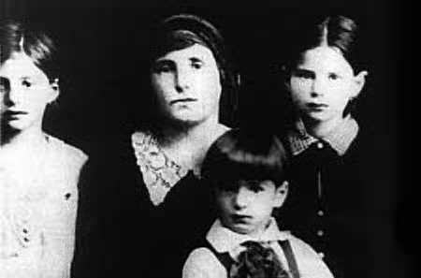
Night Elie Wiesel
Eliezer "Elie" Wiesel
Born: September 30, 1928
Sighet, Kingdom of Romania
Died: July 2, 2016 (aged 87)
Manhattan, NY
Romanian-born American Jewish writer, professor, political activist, Nobel Laureate, and Holocaust survivor.
Elie his mother and sisters in 1939 before the war came to their home.
He was the author of 57 books, written mostly in French and English,
including Night, a work based on his experiences as a prisoner in the
Auschwitz and Buchenwald concentration camps.

Slide 8
Elie Wiesel at 15
In March 1944, Germany occupied Hungary
which extended the Holocaust into that
country. Wiesel was 15, and he with his
family, along with the rest of the town's
Jewish population, were placed in one of the
two confinement ghettos set up in
Máramarossziget (Sighet), the town where
he had been born and raised.
In May 1944, the Hungarian authorities,
under German pressure, began to deport the
Jewish community to the Auschwitz
concentration camp, where up to 90 percent
of the people were exterminated on arrival.
This is how Wiesel would
have appeared before going
into the concentration camp.

Slide 9
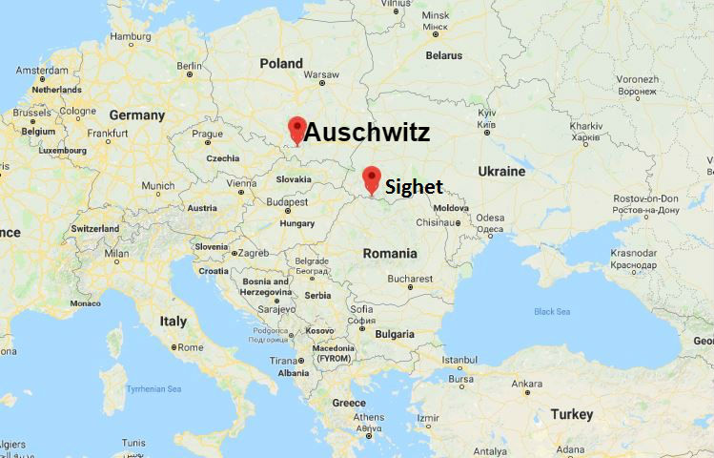
Sighet to Auschwitz

Slide 10
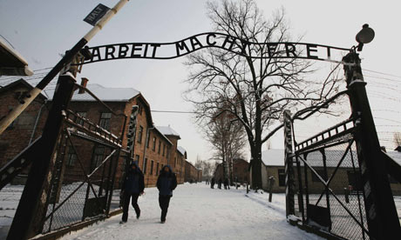
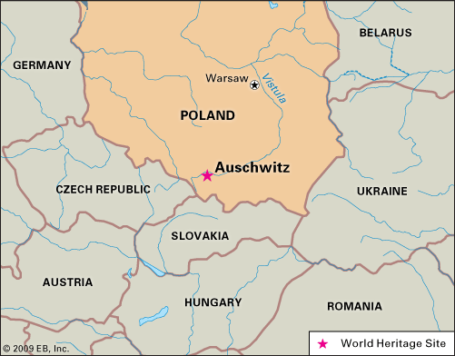
Auschwitz.
The Auschwitz concentration camp complex was the largest of its kind
established by the Nazi regime. It included three main camps. All three
camps used prisoners for forced labor. One of them also functioned for
an extended period as a killing center. The camps were located
approximately 37 miles west of Krakow.

Slide 11
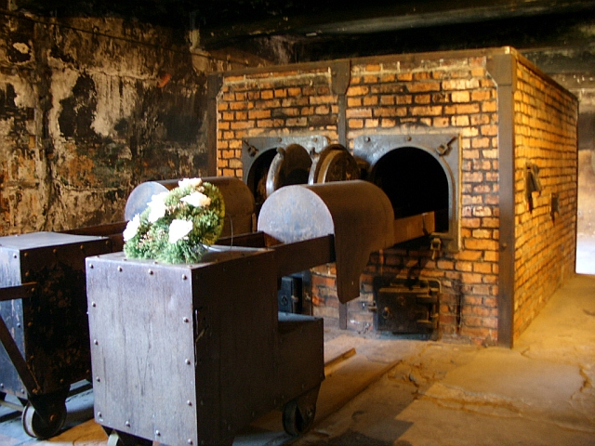
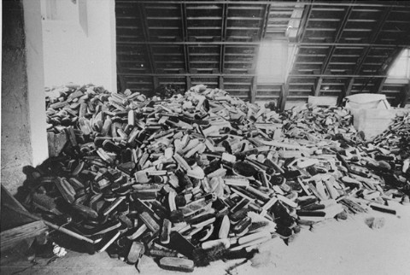
1.1 million died in the years that the camp was in operation ,
90 percent of them Jews.
Others deported to Auschwitz included 150,000 Poles, 23,000 Roma and 15,000 Sinti.

Slide 12
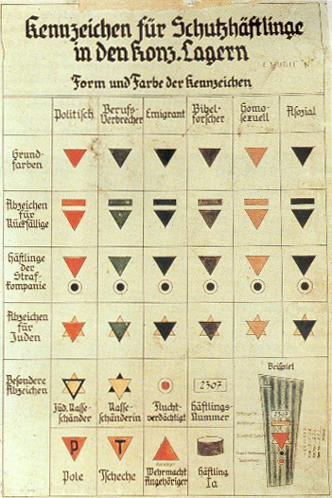
First they came for the communists, and I did not speak out—because I was not a communist; Then they came for the trade unionists, and I did not speak out—because I was not a trade unionist; Then they came for the Jews, and I did not speak out—because I was not a Jew; Then they came for me—and there was no one left to speak out for me.
Martin Niemöller (1892–1984)
Jews were not the only people who were imprisoned in WWII by Nazi forces: homosexuals, convicted criminals, emigrants, Jehovah’s Witnesses, Catholics, and those who were considered physically or mentally handicapped were also incarcerated.
Notes:
was a prominent Protestant pastor who emerged as an outspoken public foe of Adolf Hitler and spent the last seven years of Nazi rule in concentration camps.

Slide 13
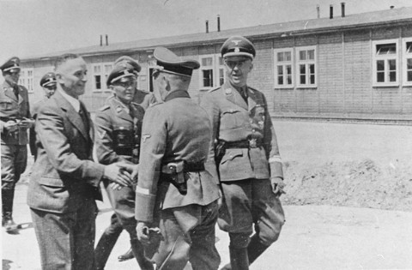
Selection
The Jews who were sent to Auschwitz, and then assigned to work at Monowitz, had a much better chance of survival because the factory workers were considered too valuable to send to the gas chambers, at least while they were still able to work.

Slide 14
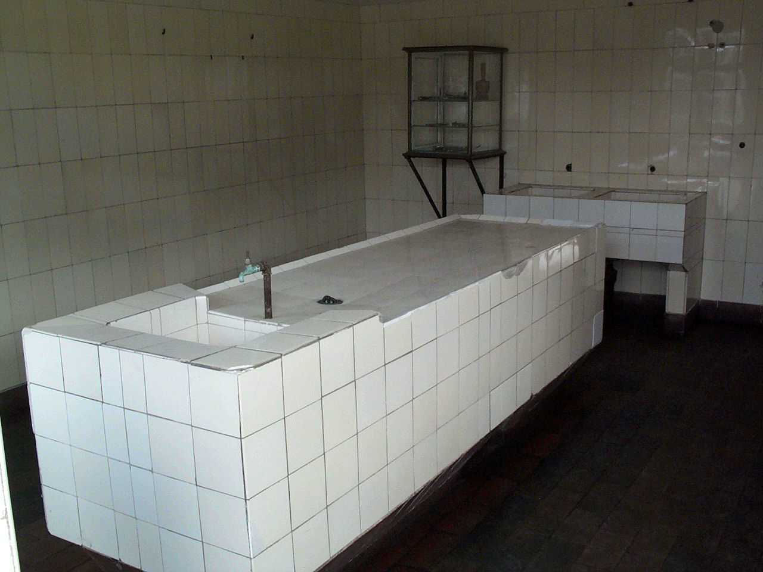
Experimentation
Dissection Table: after a “patient” died the doctors performed “dissections” in order to find the exact cause.

Slide 15
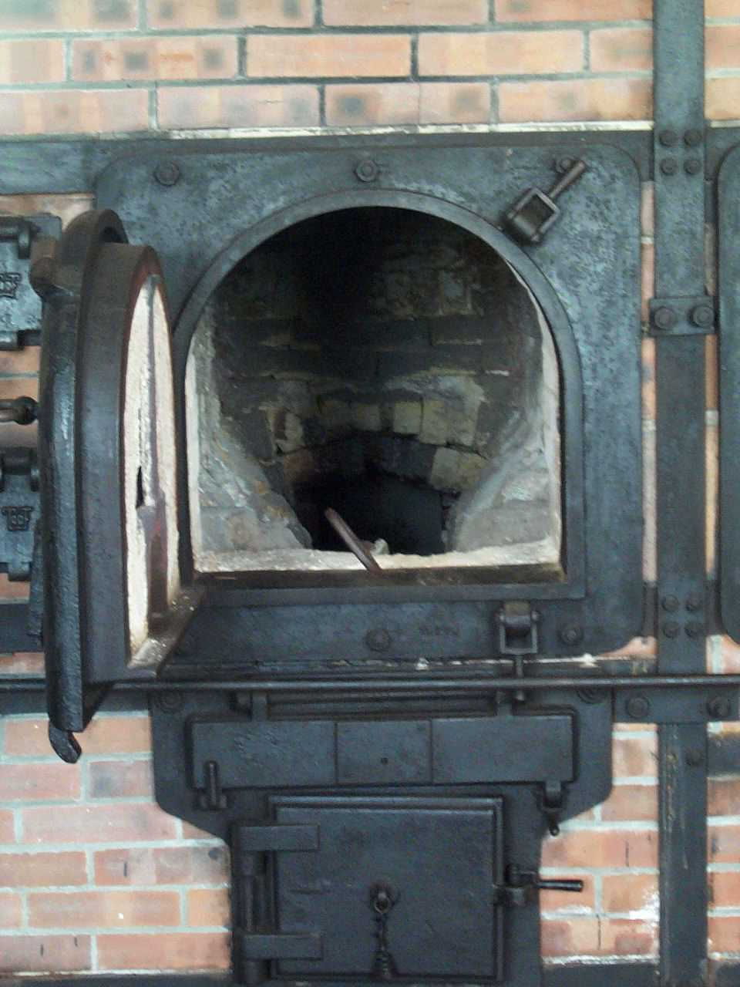
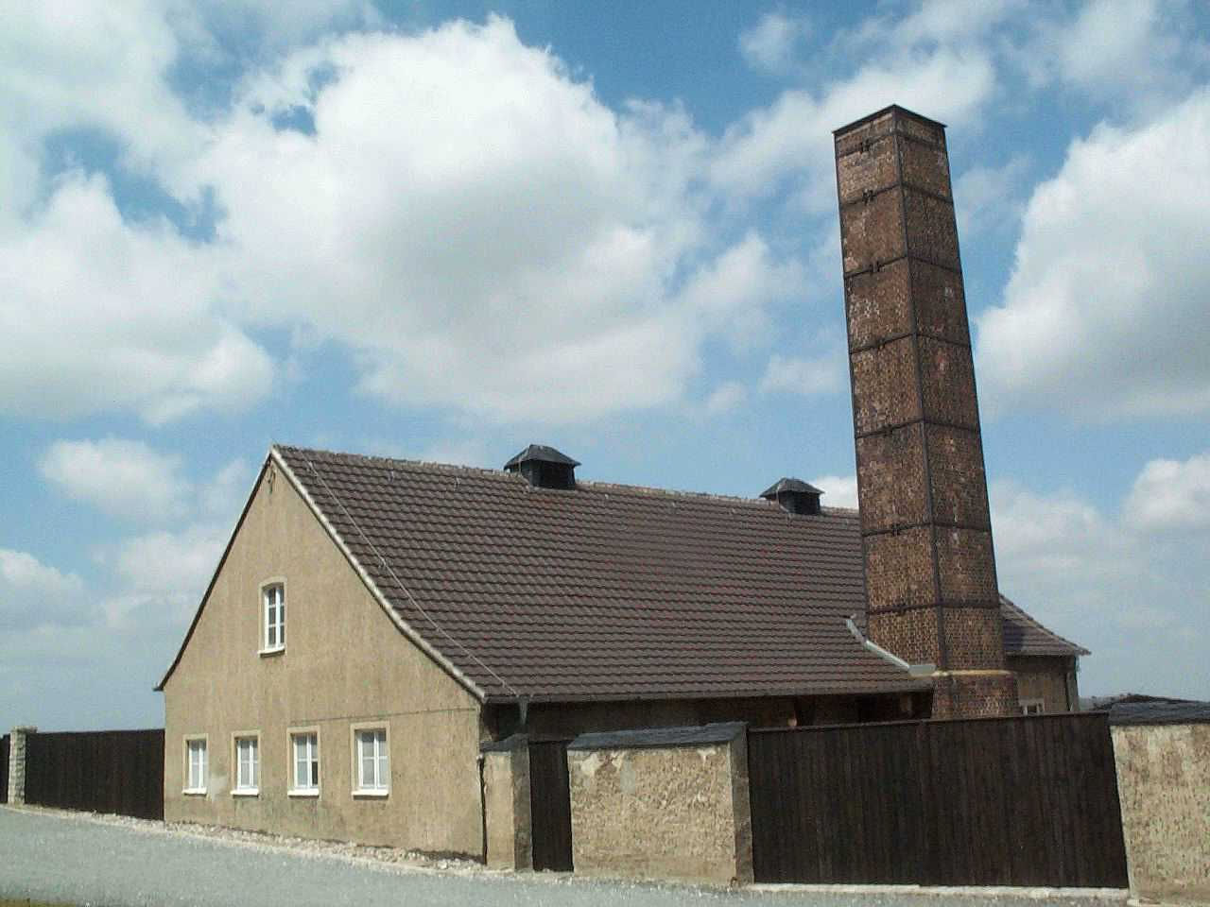
The Furnace: in Buchewald the dead were placed into the crematorium.

Slide 16
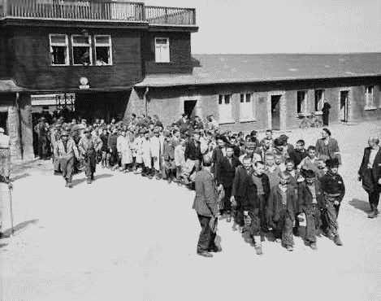
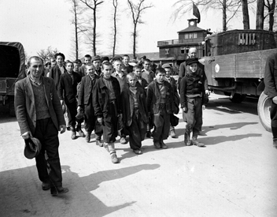
Evacuation
The largest Auschwitz sub-camp, called Buna, was located here from 1942 to 1945. The Nazis sent thousands of prisoners from various countries, the majority of them Jewish, to Buna (there were approximately 10,000 prisoners in this camp in 1944).
A significant proportion of them died because of arduous slave labor, starvation, savage mistreatment, and executions. Those who were unable to go on working fell victim to selection and were taken to their deaths in the Birkenau concentration camp gas chambers.
The Evacuation of the
children from Buna.

Slide 17
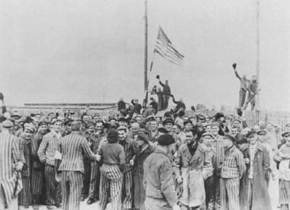
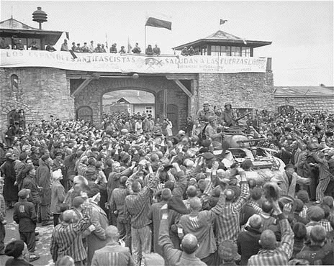
Some camps did not have time to evacuate before Allied Forces reached them; here are two such camps where American soldiers were met with cheers and seen as saviors.

Slide 18
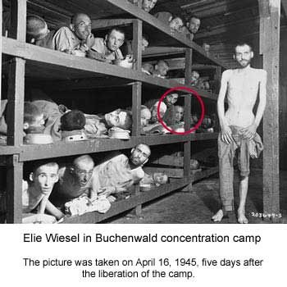
After the Camp
After Elie was freed he spent several months in the hospital fighting infections that ravaged his body.

Slide 19
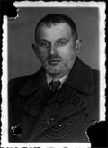
Family Reunited
When Wiesel was released from the hospital, he had no family to return to. He joined a group of 400 orphan children being taken to France. Upon arrival, he tried to immigrate to Palestine but was not allowed. From 1945 to 1947, he was in different homes in France found for him by a Jewish group called the Children’s Rescue Society.
In 1947, he began to study French with a tutor. By chance, Wiesel’s sister, Hilda, saw his picture in a newspaper and got in touch with him. Months later, Wiesel was also reunited with his sister Bea in Antwerp.

Slide 20
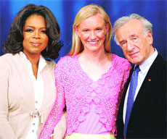
Elie Wiesel – Later Life
1969--married Marion Rose
1972--son is born
1978--appointed chair of Presidential Commission on the Holocaust
1980--Commission renamed U.S. Holocaust Memorial Council
1985--awarded Congressional Gold Medal of Achievement
1986--awarded Nobel Peace Prize
1986-The Elie Wiesel Foundation for Humanity
1995--publishes memoirs
1996- Beit Tzipora Centers open
2016 – Wiesel died in his home in Manhattan, NY
Notes:
The Elie Wiesel Foundation for Humanity-The Foundation's mission, rooted in the memory of the Holocaust, is to combat indifference, intolerance and injustice through international dialogue and youth-focused programs that promote acceptance, understanding and equality.
Beit Tzipora Centers-Study & Enrichment in Israel that give Ethiopian Jewish children the opportunity to overcome early educational inequality and participate fully in Israeli society

Slide 21
Jewish Vocabulary
The following are some Jewish
(and a few German/holocaust related)
terms that will help you understand
occurrences in the novel.

Slide 22
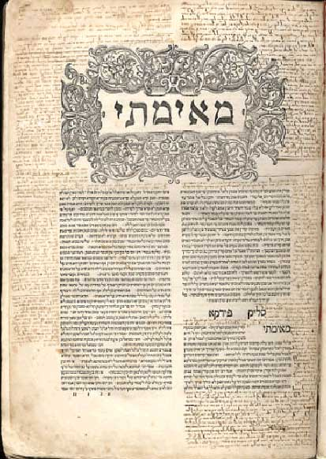
Talmud
Like an encyclopedia, this collection of a thousand years of Jewish law and tradition takes up 40 volumes. To become a rabbi a Jew must study the Talmud, becoming an expert in the laws and traditions.

Slide 23
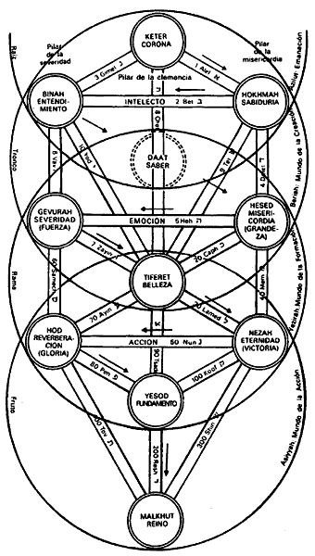
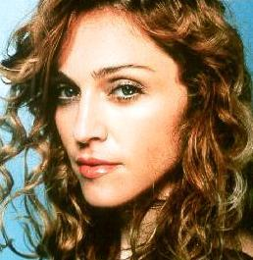
Cabbala (Kabbalah)
A system of mystical interpretation of the Scriptures allowing followers to understand sacred mysteries and foretell the future.

Slide 24
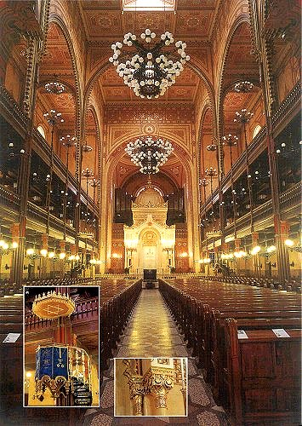
Synagogue
A Jewish house of worship and assembly, the synagogue is used for worship, prayer, and meetings.

Slide 25
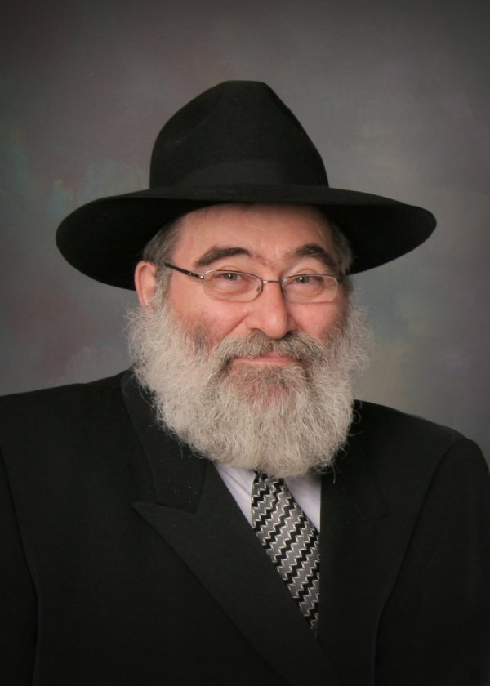
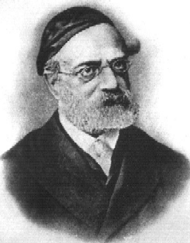
Rabbi
The title means “my teacher” or “my master” and is given to a religious leader.

Slide 26
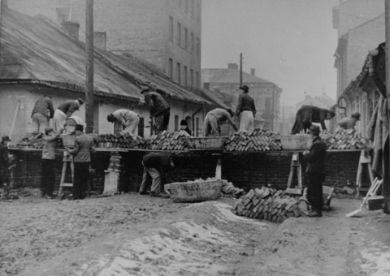
Ghetto
Beginning in 1939, the Nazis forced Jews into small, restricted, sections of cities surrounded by walls, guards, and barbed wire. Within there overpopulated ghettos, Jewish councils kept order.

Slide 27
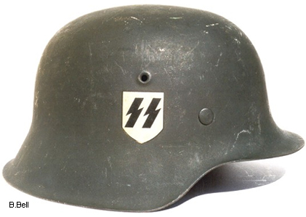
SS
Originally Hitler’s own bodyguard, the SS (Schrutzstaffel) became an elite, highly trained force in charge of security for the Nazi state. The SS ruled the concentration camps.

Slide 28
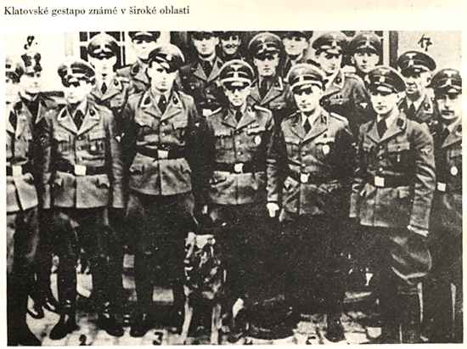
Gestapo
A division of the SS, the Gestapo was a secret police force in charge of imprisoning all enemies of the Nazi state, including Jews, and could send anyone to a concentration camp for any length of time.

Slide 29
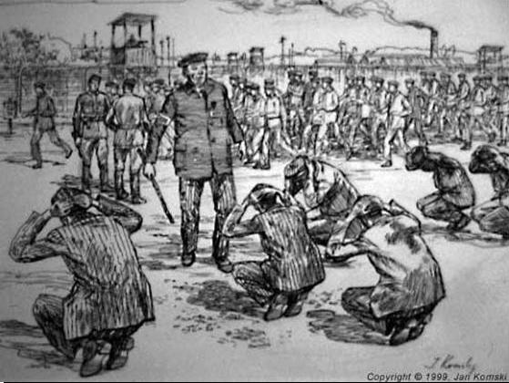
Kapos
Prisoners who supervised other prisoners in return for special privileges. Very often these Kapos were hardened criminals sadists, who delighted in terrorizing and beating their charges.

Slide 30
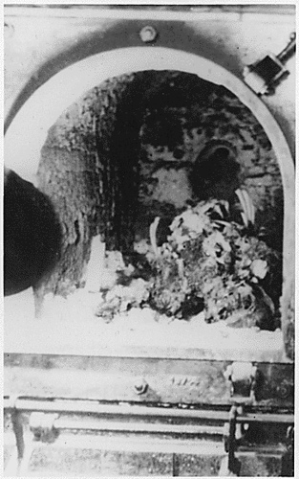
Crematory
A furnace for burning the dead. At the death camps, victims were gassed to death; their bodies were then loaded into the crematories.

Slide 31
The Kaddish
The Jewish prayer for the dead, recited during the deceased’s burial service and on the death anniversary every year thereafter.
"May His great name be blessed for ever, and to all eternity"

Slide 32
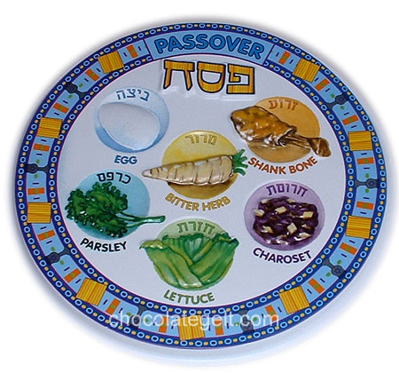
Passover
Passover week commemorates the exodus of the Jews from their captivity in Egypt.

Slide 33
Rosh Hashanah
A high holy day which marks the beginning of the Jewish new year.

Slide 34
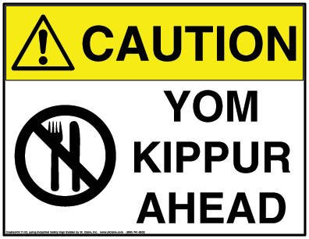
Yom Kippur
The day of atonement, this is another high holy day occurring nine days after Rosh Hashanah, and marked by fasting and day-long recitation of prayers of repentance.

Slide 35
Exit Ticket
10/10/18
Look at the quote below again.
What do you think was the point that Niemoller was trying to make?
First they came for the communists, and I did not speak out—because I was not a communist; Then they came for the trade unionists, and I did not speak out—because I was not a trade unionist; Then they came for the Jews, and I did not speak out—because I was not a Jew; Then they came for me—and there was no one left to speak out for me.
Martin Niemöller (1892–1984)

Slide 36
Start-Up - Discussion
10/11/18
In your triads, discuss the following:
Part of our discussion of the novel Night will revolve around the author’s use of symbolism.
We have discussed symbolism before in class.
What do you remember about symbolism?
What does it mean?
What are some examples of symbols we have discussed in class?

Slide 37
Start-Up - Writing
10/11/18
Now write about the following:
Part of our discussion of the novel Night will revolve around the author’s use of symbolism.
We have discussed symbolism before in class.
What do you remember about symbolism?
What does it mean?
What are some examples of symbols we have discussed in class?

Slide 38
Unit Objectives
Analyze a particular point of view or cultural experience reflected in a work of literature from outside the United States, drawing on a wide reading of world literature.
CCSS.ELA-LITERACY.RL.9-10.6

Slide 39
Unit Objectives
Determine the meaning of words and phrases as they are used in the text, including figurative and connotative meanings; analyze the cumulative impact of specific word choices on meaning and tone
(e.g., how the language evokes a sense of time and place; how it sets a formal or informal tone).
CCSS.ELA-LITERACY.RL.9-10.4

Slide 40
Unit Objectives
Analyze how an author's choices concerning how to structure a text, order events within it (e.g., parallel plots), and manipulate time (e.g., pacing, flashbacks) create such effects as mystery, tension, or surprise.
CCSS.ELA-LITERACY.RL.9-10.5

Slide 41
Today’s Objective
By the end of the period, students should be able to determine the meanings of words used in Chapter 1 of Night, including literal, figurative, and connotative meanings and analyze the impact of specific word choices on meaning and tone.

Slide 42
As We Read…
Consider the questions you will be asked to answer tonight for homework.
Do NOT answer them while we are reading, but keep the document open and be mindful of those things you will be asked to discuss.

Slide 43
Homework
Finish reading through page 31.
Questions 1-7 from the question sheet.
DUE MONDAY BY 7:00 A.M.

Slide 44
Exit Ticket
10/11/18
Why do you think the Jewish people of Sighet refused to listen to or believe the stories told by Moshe the Beadle?
What reasons could they have for ignoring his warnings?

Slide 45
Start-Up - Discussion
10/12/18
In your triads, discuss the following:
Who was Martha?
What did she try to convince Elie’s father to do and why?
What was Elie’s father’s response?

Slide 46
Start-Up - Writing
10/12/18
Now write about the following:
Who was Martha?
What did she try to convince Elie’s father to do and why?
What was Elie’s father’s response?

Slide 47
Unit Objectives
Analyze a particular point of view or cultural experience reflected in a work of literature from outside the United States, drawing on a wide reading of world literature.
CCSS.ELA-LITERACY.RL.9-10.6

Slide 48
Unit Objectives
Determine the meaning of words and phrases as they are used in the text, including figurative and connotative meanings; analyze the cumulative impact of specific word choices on meaning and tone
(e.g., how the language evokes a sense of time and place; how it sets a formal or informal tone).
CCSS.ELA-LITERACY.RL.9-10.4

Slide 49
Unit Objectives
Analyze how an author's choices concerning how to structure a text, order events within it (e.g., parallel plots), and manipulate time (e.g., pacing, flashbacks) create such effects as mystery, tension, or surprise.
CCSS.ELA-LITERACY.RL.9-10.5

Slide 50
Today’s Objective
By the end of the period, students should be able to write clearly and cohesively to explain their chosen “Backpack Items” and why they chose them.

Slide 51
The Backpack Project
Today you will be working on a quick project based on what we started reading yesterday.
You are a Jewish citizen from Sighet. You have been informed that you are being “expelled” from your home and can only take one small backpack full of your belongings.
For this assignment, you are limited to THREE items.
On the front page, inside your backpack, draw pictures of the three items you would choose to take.
NOTE:NO ELECTRONICS, NO WEAPONS

Slide 52
The Backpack Project
On the second page, write, in at least one detailed, complete paragraph (7 sentence minimum), describing to me…
WHAT ITEMS YOU WOULD CHOOSE
WHY THOSE ITEMS ARE SIGNIFICANT.
NOTE: NO ELECTRONICS, NO WEAPONS

Slide 53
Homework
Backpacks and writing
DUE MONDAY!
Questions for Night Section 1
ALSO DUE MONDAY!

Slide 54
Exit Ticket
10/12/18
Was it difficult to decide on three things to bring with you? Why?
What if you were limited to only two?
Which item would you eliminate and why?

Slide 55
Start-Up – Activity/Discussion
10/15/18
Take the next few minutes to look over the paper you were just given.
Rank these rights from 1 – 9 in order of their importance to you.
Be prepared to discuss your choices.

Slide 56
Anti- Semitic Laws
Between 1933 and 1939, the Nazi regime influenced the passing of a number of anti-semitic laws. Some of these included:
All non-“Aryans” were dismissed from holding government jobs. This regulation applied to public school teachers, university professors, doctors, lawyers, engineers, etc
Jews were prohibited from owning land.
Jews were prohibited from producing kosher meat.
Marriage and intimate relations between Jews and those of “Aryan” blood were declared criminal acts.
Jews could no longer attend plays and concerts, own phones, or have drivers’ licenses, car registrations, etc
Jews had to abide by curfews.

Slide 57
Start-Up – Writing
10/15/18
What did you rank as #1 on your list of rights?
Why did you choose that as the most important to you?
What did you rank as #9 on your list of rights?
Why did you choose that as the least important to you?

Slide 58
Unit Objectives
Analyze a particular point of view or cultural experience reflected in a work of literature from outside the United States, drawing on a wide reading of world literature.
CCSS.ELA-LITERACY.RL.9-10.6

Slide 59
Unit Objectives
Determine the meaning of words and phrases as they are used in the text, including figurative and connotative meanings; analyze the cumulative impact of specific word choices on meaning and tone
(e.g., how the language evokes a sense of time and place; how it sets a formal or informal tone).
CCSS.ELA-LITERACY.RL.9-10.4

Slide 60
Unit Objectives
Analyze how an author's choices concerning how to structure a text, order events within it (e.g., parallel plots), and manipulate time (e.g., pacing, flashbacks) create such effects as mystery, tension, or surprise.
CCSS.ELA-LITERACY.RL.9-10.5

Slide 61
Today’s Objective
By the end of the period, students should be able to determine the meanings of words used in Chapter 2 of Night, including literal, figurative, and connotative meanings and analyze the impact of specific word choices on meaning and tone.

Slide 62
As We Read…
Consider the questions you will be asked to answer tonight for homework.
Do NOT answer them while we are reading, but keep the document open and be mindful of those things you will be asked to discuss.

Slide 63
Vocabulary for Night
In Google Classroom, you have a google slide presentation that is already prepared for you.
You are responsible for completing these slides.
For each word, you have been given the definition already. Your job is to:
Write a sentence using the word that shows that you understand its meaning.
Find the word as it is used in the text and copy the sentence where it is found.
Be SURE to add a citation for the quote that includes the author’s last name and a page number.
The first word has been done for you as an example.

Slide 64
Vocabulary for Night

Slide 65
Homework
Questions 1-3 from the question sheet.
DUE TOMORROW BY 7:00 A.M.
Vocabulary slides for the first 11 words from pages 1-73 of the book
(insignificant through solemn)
DUE FRIDAY BY 7:00 A.M.

Slide 66
Exit Ticket
10/15/18
When the men returned to the train after getting water, what was the news they brought back to those on the train?
What was the reaction to that news?

Slide 67
Start-Up - Writing
10/16/18
Now write about the following:
What is your opinion of Madame Schachter’s “visions?” Do you think she was somehow seeing the future or had she simply started to go insane? Why do you think so?
How do you feel about how the young men treated her; tying her up, beating her, etc.?

Slide 68
Unit Objectives
Analyze a particular point of view or cultural experience reflected in a work of literature from outside the United States, drawing on a wide reading of world literature.
CCSS.ELA-LITERACY.RL.9-10.6

Slide 69
Unit Objectives
Determine the meaning of words and phrases as they are used in the text, including figurative and connotative meanings; analyze the cumulative impact of specific word choices on meaning and tone
(e.g., how the language evokes a sense of time and place; how it sets a formal or informal tone).
CCSS.ELA-LITERACY.RL.9-10.4

Slide 70
Unit Objectives
Analyze how an author's choices concerning how to structure a text, order events within it (e.g., parallel plots), and manipulate time (e.g., pacing, flashbacks) create such effects as mystery, tension, or surprise.
CCSS.ELA-LITERACY.RL.9-10.5

Slide 71
Today’s Objective
By the end of the period, students should be able to determine the meanings of words used in Chapter 3 of Night, including literal, figurative, and connotative meanings and analyze the impact of specific word choices on meaning and tone.

Slide 72
As We Read…
Consider the questions you will be asked to answer tonight for homework.
Do NOT answer them while we are reading, but keep the document open and be mindful of those things you will be asked to discuss.

Slide 73
Homework
Finish reading through page 54.
Questions 1-9 from the question sheet.
DUE THURSDAY BY 7:00 A.M.

Slide 74
Exit Ticket
10/16/18
What were your impressions of the other prisoners Elie met?
Why do you think the different prisoners treated them so differently?
Why were some kind and some cruel?

Slide 75
NO
START-UP
TODAY!
10/17/18

Slide 76
Unit Objectives
Analyze a particular point of view or cultural experience reflected in a work of literature from outside the United States, drawing on a wide reading of world literature.
CCSS.ELA-LITERACY.RL.9-10.6

Slide 77
Unit Objectives
Determine the meaning of words and phrases as they are used in the text, including figurative and connotative meanings; analyze the cumulative impact of specific word choices on meaning and tone
(e.g., how the language evokes a sense of time and place; how it sets a formal or informal tone).
CCSS.ELA-LITERACY.RL.9-10.4

Slide 78
Unit Objectives
Analyze how an author's choices concerning how to structure a text, order events within it (e.g., parallel plots), and manipulate time (e.g., pacing, flashbacks) create such effects as mystery, tension, or surprise.
CCSS.ELA-LITERACY.RL.9-10.5

Slide 79
Today’s Objective
By the end of the period, students should be able to analyze the text in order to create a clear, coherent, properly formatted and cited paragraph discussing elements of word choice, theme, and author’s purpose.

Slide 80
TBDAT
T – Topic Sentence
B – Background
D – Detail (also known as evidence)
A – Analysis (also known as commentary)
T – Tie Back (also known as concluding sentence)

Slide 81
Topic Sentence
The main idea of the paragraph
It explains what you will prove in that paragraph.
This should not be a specific detail from the story, but rather it should take a stance on an issue from the story that can be debated. (In this case, it will connect to your theme.)

Slide 82
Background
Gives the background of the supporting detail.
WHO says the quote or does the action?
WHEN does he/she say that or do that?
WHERE does the action take place?
Comes before the supporting detail in the paragraph

Slide 83
Detail (Evidence, Quote)
This is the evidence that comes directly from the story.
You should be able to turn to a page and say, “See, it happens right here.”
Can be a direct quote that a character says or a specific detail of an event that occurs.

Slide 84
Analysis
Explains the significance of the detail.
What does that quote literally mean?
What does that quote or event show?

Slide 85
Tie Back
Connect the detail and the analysis back to the topic sentence.
How does that detail prove your main point?

Slide 86
Night Paragraph Prompts 1
1: Why do the European Jews remain optimistic in the face of what Moishe tells them and rumors they hear of other anti-Semitic incidents in Europe?
2: How is Mrs. Schachter proved not to be crazy but perhaps a visionary? (Consider how she acts on the train and then what they all notice upon their arrival at the camp.)
3: What is Wiesel referring to when he writes, “Those were the first human words” (50). What is the significance of these words?

Slide 87
Homework
Questions 1-9 from the Section 3 question sheet.
DUE TOMORROW BY 7:00 A.M.
Vocab Slides for words 1-11 DUE FRIDAY BY 7:00 a.m.

Slide 88
10/17/18
NO
EXIT TICKET
TODAY!

Slide 89
Start-Up - Writing
10/18/18
Write about the following:
Who was it that came to visit Elie’s father in Auschwitz?
What did he want to know?
Why do you think Elie’s father lied to him?
Would you have done the same?

Slide 90
Unit Objectives
Analyze a particular point of view or cultural experience reflected in a work of literature from outside the United States, drawing on a wide reading of world literature.
CCSS.ELA-LITERACY.RL.9-10.6

Slide 91
Unit Objectives
Determine the meaning of words and phrases as they are used in the text, including figurative and connotative meanings; analyze the cumulative impact of specific word choices on meaning and tone
(e.g., how the language evokes a sense of time and place; how it sets a formal or informal tone).
CCSS.ELA-LITERACY.RL.9-10.4

Slide 92
Unit Objectives
Analyze how an author's choices concerning how to structure a text, order events within it (e.g., parallel plots), and manipulate time (e.g., pacing, flashbacks) create such effects as mystery, tension, or surprise.
CCSS.ELA-LITERACY.RL.9-10.5

Slide 93
Today’s Objective
By the end of the period, students should be able to determine the meanings of words used in Chapter 4 of Night, including literal, figurative, and connotative meanings and analyze the impact of specific word choices on meaning and tone.

Slide 94
As We Read…
Consider the questions you will be asked to answer tonight for homework.
Do NOT answer them while we are reading, but keep the document open and be mindful of those things you will be asked to discuss.

Slide 95
Homework
Finish reading through page 72.
Questions 1-6 from the question sheet.
DUE TOMORROW BY 7:00 A.M.
Vocab Slides for the first 11 words also DUE TOMORROW!
QUIZ TOMORROW ON SECTIONS 1 – 4 OF THE NOVEL AND THE FIRST 11 VOCAB WORDS!

Slide 96
Exit Ticket
10/18/18
Why Was Elie sent to the dentist?
How did he get out of the situation?
What ended up happening to the dentist?

Slide 97
Start-Up - Discussion
10/19/18
In your triads, discuss the following:
Which one of the hangings that Elie witnessed seemed to affect him the most?
Why was that?
What is the significance of him mentioning the taste of the soup that night?

Slide 98
Start-Up - Writing
10/19/18
Now write about the following:
Which one of the hangings that Elie witnessed seemed to affect him the most?
Why was that?
What is the significance of him mentioning the taste of the soup that night?

Slide 99
Unit Objectives
Analyze a particular point of view or cultural experience reflected in a work of literature from outside the United States, drawing on a wide reading of world literature.
CCSS.ELA-LITERACY.RL.9-10.6

Slide 100
Unit Objectives
Determine the meaning of words and phrases as they are used in the text, including figurative and connotative meanings; analyze the cumulative impact of specific word choices on meaning and tone
(e.g., how the language evokes a sense of time and place; how it sets a formal or informal tone).
CCSS.ELA-LITERACY.RL.9-10.4

Slide 101
Unit Objectives
Analyze how an author's choices concerning how to structure a text, order events within it (e.g., parallel plots), and manipulate time (e.g., pacing, flashbacks) create such effects as mystery, tension, or surprise.
CCSS.ELA-LITERACY.RL.9-10.5

Slide 102
QUIZ TIME
Today, you will be taking a quiz which covers the first 4 sections of the novel AND the first 11 vocabulary words.
There is to be NO TALKING during the quiz!
Go to Google Classroom, open up the form, and take the quiz.
IF YOU FINISH EARLY:
Work on missing or unsubmitted work! Remember, late work is only accepted up to 10 days after the due date! CHECK THE DUE DATE before you waste time making up an assignment that will not get you any points added!

Slide 103
Exit Ticket
10/19/18
After the bombing of Buna, why would Elie say that they “went cheerfully to clear away the ruins” (Weisel 68)?
What did the bombing mean to the prisoners?

Slide 104
Start-Up - Discussion
10/22/18
In your triads, discuss the following:
Who was the “the young French girl?”
Why do you think she spoke kindly to Elie?
What was she risking just to be kind to him?

Slide 105
Start-Up - Writing
10/22/18
Write about the following:
Who was the “the young French girl?”
Why do you think she spoke kindly to Elie?
What was she risking just to be kind to him?

Slide 106
Unit Objectives
Analyze a particular point of view or cultural experience reflected in a work of literature from outside the United States, drawing on a wide reading of world literature.
CCSS.ELA-LITERACY.RL.9-10.6

Slide 107
Unit Objectives
Determine the meaning of words and phrases as they are used in the text, including figurative and connotative meanings; analyze the cumulative impact of specific word choices on meaning and tone
(e.g., how the language evokes a sense of time and place; how it sets a formal or informal tone).
CCSS.ELA-LITERACY.RL.9-10.4

Slide 108
Unit Objectives
Analyze how an author's choices concerning how to structure a text, order events within it (e.g., parallel plots), and manipulate time (e.g., pacing, flashbacks) create such effects as mystery, tension, or surprise.
CCSS.ELA-LITERACY.RL.9-10.5

Slide 109
Today’s Objective
By the end of the period, students should be able to determine the meanings of words used in Chapter 5 of Night, including literal, figurative, and connotative meanings and analyze the impact of specific word choices on meaning and tone.

Slide 110
As We Read…
Consider the questions you will be asked to answer tonight for homework.
Do NOT answer them while we are reading, but keep the document open and be mindful of those things you will be asked to discuss.

Slide 111
Homework
Questions 1-3 from the question sheet.
DUE WEDNESDAY BY 7:00 A.M.
Vocab Slides for the second 11 words also DUE FRIDAY!
QUIZ FRIDAY ON SECTIONS 5 – 6 OF THE NOVEL AND THE SECOND 11 VOCAB WORDS!

Slide 112
Exit Ticket
10/22/18
On Yom Kippur, they debated whether or not they should fast; which was tradition.
What did Elie decide to do about Yom Kippur?
What reasons (more than one) did he have for making that decision?

Slide 113
Start-Up - Discussion
10/23/18
In your triads, discuss the following:
What was the one thing Elie had hoped would not happen that happened in yesterday’s reading?
How do you think this affected Elie?
How do you think it affected his father?

Slide 114
Start-Up - Writing
10/23/18
Write about the following:
What was the one thing Elie had hoped would not happen that happened in yesterday’s reading?
How do you think this affected Elie?
How do you think it affected his father?

Slide 115
Unit Objectives
Analyze a particular point of view or cultural experience reflected in a work of literature from outside the United States, drawing on a wide reading of world literature.
CCSS.ELA-LITERACY.RL.9-10.6

Slide 116
Unit Objectives
Determine the meaning of words and phrases as they are used in the text, including figurative and connotative meanings; analyze the cumulative impact of specific word choices on meaning and tone
(e.g., how the language evokes a sense of time and place; how it sets a formal or informal tone).
CCSS.ELA-LITERACY.RL.9-10.4

Slide 117
Unit Objectives
Analyze how an author's choices concerning how to structure a text, order events within it (e.g., parallel plots), and manipulate time (e.g., pacing, flashbacks) create such effects as mystery, tension, or surprise.
CCSS.ELA-LITERACY.RL.9-10.5

Slide 118
Today’s Objective
By the end of the period, students should be able to determine the meanings of words used in Chapter 5 of Night, including literal, figurative, and connotative meanings and analyze the impact of specific word choices on meaning and tone.

Slide 119
As We Read…
Consider the questions you will be asked to answer tonight for homework.
Do NOT answer them while we are reading, but keep the document open and be mindful of those things you will be asked to discuss.

Slide 120
Homework
Questions 1-9 from the question sheet.
DUE WEDNESDAY BY 7:00 A.M.
Vocab Slides for the second 11 words also DUE FRIDAY!
QUIZ FRIDAY ON SECTIONS 5 – 6 OF THE NOVEL AND THE SECOND 11 VOCAB WORDS!

Slide 121
Exit Ticket
10/23/18
What was the decision that Elie and his father had to make?
What happened to the prisoners who stayed behind in the hospital?

Slide 122
Start-Up - Discussion
10/24/18
In your triads, discuss the following:
What happened to Akiba Drumer at the end, before he was selected?
What does Elie say could have saved him?
What did he ask Elie and the others to do for him?

Slide 123
Start-Up - Writing
10/24/18
Write about the following:
What happened to Akiba Drumer at the end, before he was selected?
What does Elie say could have saved him?
What did he ask Elie and the others to do for him?

Slide 124
Unit Objectives
Analyze a particular point of view or cultural experience reflected in a work of literature from outside the United States, drawing on a wide reading of world literature.
CCSS.ELA-LITERACY.RL.9-10.6

Slide 125
Unit Objectives
Determine the meaning of words and phrases as they are used in the text, including figurative and connotative meanings; analyze the cumulative impact of specific word choices on meaning and tone
(e.g., how the language evokes a sense of time and place; how it sets a formal or informal tone).
CCSS.ELA-LITERACY.RL.9-10.4

Slide 126
Unit Objectives
Analyze how an author's choices concerning how to structure a text, order events within it (e.g., parallel plots), and manipulate time (e.g., pacing, flashbacks) create such effects as mystery, tension, or surprise.
CCSS.ELA-LITERACY.RL.9-10.5

Slide 127
Today’s Objective
By the end of the period, students should be able to determine the meanings of words used in Chapter 6 of Night, including literal, figurative, and connotative meanings and analyze the impact of specific word choices on meaning and tone.

Slide 128
As We Read…
Consider the questions you will be asked to answer tonight for homework.
Do NOT answer them while we are reading, but keep the document open and be mindful of those things you will be asked to discuss.

Slide 129
Homework
Questions 1-7 from the question sheet.
DUE TOMORROW BY 7:00 A.M.
Vocab Slides for the second 11 words also DUE FRIDAY!
QUIZ FRIDAY ON SECTIONS 5 – 6 OF THE NOVEL AND THE SECOND 11 VOCAB WORDS!

Slide 130
Exit Ticket
10/24/18
Who was Rabbi Eliahou and what was he looking for?
What did Elie remember that he did not tell Rabbi Eliahou?
What does Elie pray for in that moment?

Slide 131
NO
START-UP
TODAY!
10/25/18

Slide 132
Unit Objectives
Analyze a particular point of view or cultural experience reflected in a work of literature from outside the United States, drawing on a wide reading of world literature.
CCSS.ELA-LITERACY.RL.9-10.6

Slide 133
Unit Objectives
Determine the meaning of words and phrases as they are used in the text, including figurative and connotative meanings; analyze the cumulative impact of specific word choices on meaning and tone
(e.g., how the language evokes a sense of time and place; how it sets a formal or informal tone).
CCSS.ELA-LITERACY.RL.9-10.4

Slide 134
Unit Objectives
Analyze how an author's choices concerning how to structure a text, order events within it (e.g., parallel plots), and manipulate time (e.g., pacing, flashbacks) create such effects as mystery, tension, or surprise.
CCSS.ELA-LITERACY.RL.9-10.5

Slide 135
Today’s Objective
By the end of the period, students should be able to analyze the text in order to create a clear, coherent, properly formatted and cited paragraph discussing elements of word choice, theme, and author’s purpose.

Slide 136
TBDAT
T – Topic Sentence
B – Background
D – Detail (also known as evidence)
A – Analysis (also known as commentary)
T – Tie Back (also known as concluding sentence)

Slide 137
Topic Sentence
The main idea of the paragraph
It explains what you will prove in that paragraph.
This should not be a specific detail from the story, but rather it should take a stance on an issue from the story that can be debated. (In this case, it will connect to your theme.)

Slide 138
Background
Gives the background of the supporting detail.
WHO says the quote or does the action?
WHEN does he/she say that or do that?
WHERE does the action take place?
Comes before the supporting detail in the paragraph

Slide 139
Detail (Evidence, Quote)
This is the evidence that comes directly from the story.
You should be able to turn to a page and say, “See, it happens right here.”
Can be a direct quote that a character says or a specific detail of an event that occurs.

Slide 140
Analysis
Explains the significance of the detail.
What does that quote literally mean?
What does that quote or event show?

Slide 141
Tie Back
Connect the detail and the analysis back to the topic sentence.
How does that detail prove your main point?

Slide 142
Night Paragraph Prompts 1
1: Why are the prisoners unafraid and even joyful during the air-raid?
2: Earlier in the book, Wiesel describes Akiba Drumer as a deeply religious and faithful man. What finally happens to him? What impact does this have on other devout Jews?
3: What does Rabbi Eliahou’s son do to his father? What is the significance of the prayer Wiesel makes in response to this occurrence?

Slide 143
Homework
Vocab Slides for the second 11 words
DUE TOMORROW BY 7:00 a.m.
QUIZ TOMORROW ON SECTIONS 5 & 6 AND VOCABULARY

Slide 144
10/25/18
NO
EXIT TICKET
TODAY!

Slide 145
Start-Up - Discussion
10/26/18
In your triads, discuss the following:
Who did Elie find on the train (by nearly crushing him)?
What was this person concerned about in that moment?
How did he die?

Slide 146
Start-Up - Writing
10/26/18
Now write about the following:
Who did Elie find on the train (by nearly crushing him)?
What was this person concerned about in that moment?
How did he die?

Slide 147
Unit Objectives
Analyze a particular point of view or cultural experience reflected in a work of literature from outside the United States, drawing on a wide reading of world literature.
CCSS.ELA-LITERACY.RL.9-10.6

Slide 148
Unit Objectives
Determine the meaning of words and phrases as they are used in the text, including figurative and connotative meanings; analyze the cumulative impact of specific word choices on meaning and tone
(e.g., how the language evokes a sense of time and place; how it sets a formal or informal tone).
CCSS.ELA-LITERACY.RL.9-10.4

Slide 149
Unit Objectives
Analyze how an author's choices concerning how to structure a text, order events within it (e.g., parallel plots), and manipulate time (e.g., pacing, flashbacks) create such effects as mystery, tension, or surprise.
CCSS.ELA-LITERACY.RL.9-10.5

Slide 150
QUIZ TIME
Today, you will be taking a quiz which covers the sections 5 & 6of the novel AND the second 11 vocabulary words.
There is to be NO TALKING during the quiz!
Go to Google Classroom, open up the form, and take the quiz.
IF YOU FINISH EARLY:
Work on missing or unsubmitted work! Remember, late work is only accepted up to 10 days after the due date! CHECK THE DUE DATE before you waste time making up an assignment that will not get you any points added!

Slide 151
Exit Ticket
10/26/18
What happened to Elie’s father when they were leaving Gleiwitz?
What did Elie do about it?
What was the result?

