Slide 1
Start-Up - Discussion
10/27/17
In your triads, discuss the following:
Do you like scary stories/movies?
If so, why? What is it about them that you enjoy?
If not, why not?

Slide 2
Start-Up - Writing
10/27/17
Now write about it:
Do you like scary stories/movies?
If so, why? What is it about them that you enjoy?
If not, why not?

Slide 3
CCSS Standard
CCSS.ELA-LITERACY.W.9-10.3
Write narratives to develop real or imagined experiences or events using effective technique, well-chosen details, and well-chosen details, and well-structured event sequences.

Slide 4
Unit Objectives
By the end of the lesson, students will be able to write a narrative to develop real or imagined experiences or events.
They will be able to use effective technique, well-chosen details, and well-structured event sequences in narrative writing.

Slide 5
Today’s Objective
By the end of the period, students will gain an understanding of the expectations for their fictional narratives.
They will have an opportunity to preview the images they will be choosing from for their inspiration.

Slide 6
The Assignment
Your task is to write an original, fictional narrative inspired by an illustration you will be choosing today.
Your story should include all the elements of plot including an exposition that introduces your audience to your characters, rising action that builds suspense, a clear defined climax, falling action and resolution.
Your narrative should also incorporate at least one type of irony.

Slide 7
The Assignment
Characters should be believable and speak in properly punctuated dialogue.
Your setting should be described using concrete imagery that appeals to more than one setting.
The page length for this assignment should be no more than two pages.

Slide 8
The Images
You will be choosing one of the images that follow as the inspiration for your narrative.
That choice will be made at the beginning of class on Monday. It will be FIRST COME, FIRST SERVED, so if there is one particular image you want to use, you will want to be here ON TIME to increase your chances of getting it!

Slide 9
Exit Ticket
10/27/17
Did you see a picture that you are interested in working with?
Which one was it?
What is it about that image that caught your attention?

Slide 10
Start-Up - Discussion
10/30/17
In your triads, discuss the following:
Did you get the picture you hoped you would get? Share your picture with your triad and discuss:
What are the first things that come to mind when you look at the picture you now have?
What is it? What do you think is happening in the picture?

Slide 11
Start-Up - Writing
10/30/17
Now write about it:
Did you get the picture you hoped you would get?
What are the first things that come to mind when you look at the picture you now have?
What is it? What do you think is happening in the picture?

Slide 12
CCSS Standard
CCSS.ELA-LITERACY.W.9-10.3
Write narratives to develop real or imagined experiences or events using effective technique, well-chosen details, and well-chosen details, and well-structured event sequences.

Slide 13
Unit Objectives
By the end of the lesson, students will be able to write a narrative to develop real or imagined experiences or events.
They will be able to use effective technique, well-chosen details, and well-structured event sequences in narrative writing.

Slide 14
Today’s Objective
By the end of the period, students will be able to define characterization and explain the difference between direct and indirect characterization.
They will have the opportunity to practice creating characters and dialogue.

Slide 15
Writing A Narrative
(and making it interesting)
Characterization - Characterization is a word that describes how the author develops the personality of the story characters in a story.

Slide 16
Types of Characterization
Direct Characterization
In DIRECT CHARACTERIZATION authors tell the readers exactly what they want them to know about a character.
i.e. Harriet was a nasty little girl who was mean to everyone.
DIRECT CHARACTERIZATION is mostly used in children’s stories.
Indirect Characterization
In INDIRECT CHARACTERIZATION authors shows the readers the character’s personality through the character’s actions, the character’s reactions, the character’s interactions and dialogue.
i.e. Harriet kicked the ball sending it flying at the kindergarten class. She smiled as one of the smaller children began to cry.
INDIRECT CHARACTERIZATION follows the “show don’t tell” structure of good narrative writing.

Slide 17
Characterization
Comes through what characters
And
Characters become real life breathing people to our readers IF we describe decisions they make, what they say, and how they say it!
Sometimes a writer will also reveal the thoughts running through a character’s mind.
SAY

Slide 18
Character Creation
Tip One - Use an unusual
name. Use description,
alliteration, nicknames.
Example - Biscuits was too large for the t-shirt he wore. Bits of him bulged out in unlikely places. But he didn’t seem to care. His round, red face grinned at me. “Hiyah!” said Biscuits, thrusting his pudgy hand our towards mine.

Slide 19
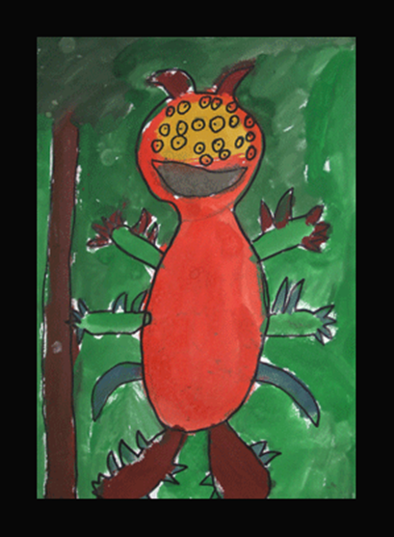
Character Creation
Tip Two – Create contrasting
characters. A simple contrast is
most effective. One character
could be gentle, the other harsh.
How do the characters in the text below contrast?
Example - The Grabber stood blocking their way. Tom hesitated, then turned on his heal and rushed back up the corridor screaming. Victor picked up the whalebone wand. He faced the Grabber and without saying a word gazed deep into its eyes.

Slide 20
Character Creation
Tip Three – We should be able to describe our character’s feelings by what they do. Take care not to write over simplified sentences such as He was sad. He was angry.
Example - Grandma gently took
the box from its secret place in
the wardrobe. Immediately her
eyes began to prickle. She opened
the lid carefully and took in the
familiar scent.

Slide 21
Character Creation
Tip Four – Use Dialogue.
To show fear: h-h-hesitate, um, er.
To show power or confidence: Begin sentences with imperative verbs (bossy verbs) Or I, I , I.
Use synonyms for said.
Example - The old king stood up
and gazed around the room.
Everyone fell silent. “I will not
wait,” he roared. “I must have
porridge! And I want it now!”

Slide 22
Practice Time
In your triad, work together to create TWO characters for a short narrative. Remember the tips!
Tip One – Create a name for your characters.
In your packets, record the names of your two characters
Tip Two - Think of a contrast between your character’s personalities.
Shy / confident brave / nervous bossy / gentle
Angry / sweet lonely / happy thoughtful / stupid
In your packets, record some personality traits of each character. Be sure to include their contrasting traits.

Slide 23
Practice Time
Now let’s set up a story…
Your two characters are
cousins. They are in one of
your homes, in the bedroom.
The parents are downstairs.
There is a creak from the
room above, the attic. It
should be empty.
What will your characters do?

Slide 24
Practice Time
Discuss with your triad what your characters will DO in this situation. Remember that their actions should reflect their character traits!
Tip three – show characterization through what your characters DO.
Don’t forget to show the CONTRASTS between the characters.
Now, in your packets, record some lines of dialogue between your two characters. Remember, we should be able to tell what your characters are like by what they SAY!
Tip four – show characterization by what your characters SAY.

Slide 25
Practice Time
In your packets, continue the story in the box provided. Use the following as a prompt:
Your characters are in the attic. It is very dusty,
full of cobwebs, spiders etc. Its difficult to see
as when they tried the light it flashed one and
flickered out. They are surrounded by a mass
of boxes and strange shaped objects draped in
cloth. They hear a noise coming from the back
of the room…
You do NOT have to write the complete story BUT you should write enough that I am able to see the traits of your two characters through the way they act.

Slide 26
Homework
You should have your packets complete up to the point where we stopped today (the plot continues).
If they are not complete to that point, use the powerpoint on my website to make sure they are by tomorrow!
Complete your Developing Vocabulary Charts

Slide 27
Exit Ticket
10/30/17
Have you ever written a fictional story before?
Do you think that the tips we went over today would be helpful in creating characters for a story?
Which one of the tips do you think would be the most helpful?

Slide 28
Start-Up - Discussion
10/31/17
In your triads, discuss the following:
Think of a character that you know well from a book
(NOT MOVIES OR TV…A BOOK).
Briefly describe that character and, as you do, think about HOW YOU KNOW those things about that character.
How did the author reveal that character’s traits; directly or indirectly? Did they use dialogue and actions to reveal the character’s personality? Give examples.

Slide 29
Start-Up - Writing
10/31/17
Now write about it:
Think of a character that you know well from a book
(NOT MOVIES OR TV…A BOOK).
Briefly describe that character and, as you do, think about HOW YOU KNOW those things about that character.
How did the author reveal that character’s traits; directly or indirectly? Did they use dialogue and actions to reveal the character’s personality? Give examples.

Slide 30
CCSS Standard
CCSS.ELA-LITERACY.W.9-10.3
Write narratives to develop real or imagined experiences or events using effective technique, well-chosen details, and well-chosen details, and well-structured event sequences.

Slide 31
Unit Objectives
By the end of the lesson, students will be able to write a narrative to develop real or imagined experiences or events.
They will be able to use effective technique, well-chosen details, and well-structured event sequences in narrative writing.

Slide 32
Today’s Objectives
By the end of the period, students should be able to show a character’s traits by revealing their thoughts.
They will also begin planning their narratives; including making decisions about point of view, mood, and setting.

Slide 33
A Quick Review
Tip One
Interesting names
Tip Two
Contrasting personalities
Tip Three
Indirect Characterization
Tip Four
Dialogue

Slide 34
Character Creation
Tip Five – Develop characterization through showing a character’s thoughts.

Slide 35
Character Creation
Physicality of Thought
What do people look like when they are thinking?
Mrs. Cooper pursed her lips. Tilting her head to the side.
Directly state what the character is thinking.
She had had enough of Brian’s behavior for one day. That boy ought to be taught a lesson. He had stepped over the line once too often. And bullying was not something that Mrs. Cooper was going to tolerate.

Slide 36
Character Creation
Writing thoughts as internal dialogue.
Sometimes writers need to stress a thought and they will write it as dialogue.
Example: “Oh no, she’s in a strop… again!” Brian thought. “She’s really got it in for me these days.”
Only do this when the character is not engaging in conversation or it can become confusing for the audience.

Slide 37
Drama Time
Partner A will try to portray an emotion with a facial expression.
Partner B and C will write a description of the look on Partner A’s face, as well as a guess as to what the emotion is supposed to be.
Partner B and C will share their writing and check to see if their guess is correct.
After 3 emotions, switch roles.

Slide 38
Emotions
Here are a few to choose from…
Fear
Anger
Joy
Sadness
Frustration
Disgust
Surprise
Contempt

Slide 39
Flashbacks
A flashback is where you go back in time to something that has happened in the past that lends insight into what is happening in the present.
Anna stared wide eyed at the shattered Christmas ornament; its tiny head spun once more on the ground before it stopped. “Be careful with it,” her father had said ten years ago when he first cradled the angel in her hands. It was the first Christmas without her mother and things had just started to resemble normal. The little angel had curly black hair just like her own, just like her mother’s. When she was young she had pretended that it was her mother coming to visit every Christmas. Now it was little more than a small heap of shattered porcelain.

Slide 40
Writing Practice
Combining Characters’ Thoughts and Flashback
We are going to:
Use inference to explore character’s thoughts.
We are going to use flashback to give us insight into a character’s background

Slide 41
Writing Practice
Combining Characters’ Thoughts and Flashback
Together we are going to write from the point of view of Patrick Maloney a split second before Mary kills him.
He must be thinking about either the conversation they had before Mary leaves, or about his day at work.
In the box provided, write out what you believe Patrick would have been thinking.

Slide 42
Writing Practice
Combining Characters’ Thoughts and Flashback
Now check yourself…
What do we know about Patrick?
Marriage?
Occupation?
Hobbies?
Habits?
Diction?
Does what you have written fit with what we know?

Slide 43
Planning Your Narrative
Now its time to start planning your narrative.
Look at the illustration you chose.
Look at the words that you came up with as inspiration for your story.
Lets start planning.

Slide 44
Planning Your Narrative
Point of View
First person will the narrator be part of the story.
i.e. I sat on the bleachers watching the sun go down, scared of the night to come.
Second person - super rare.
i.e. You won’t believe what has happened Manny, I am not sure I believe it. You must never come here, I will be gone by the time you read this.

Slide 45
Planning Your Narrative
Point of View
Third Person Limited Omniscient- The narrator is not part of the story, they have knowledge of some characters thoughts and feelings.
i.e. Mike sat staring at Rose, she could not be saying this. “It is not true,” he thought. But her voice was steady and she looked him in they eye as she uttered again. “I really hate hot Cheetos”
Third Person Omniscient- The narrator knows everything, what everyone feels and thinks.
i.e. Mike sat staring at Rose, she could not be saying this. “It is not true,” he thought. But Rose had enough of the red stains on her car seats. She was finished side stepping the issue. She made her voice steady and she looked him in the eye and repeated, “I really hate hot Cheetos”

Slide 46
Planning Your Narrative
Mood
Remember that mood is the feelings that the author instills in their reader.
Your choice of setting, diction and the tone will affect the mood.
The following will show you how the same stories mood can be drastically altered by pace and word choice.

Slide 47
Exit Ticket
10/31/17
Think about how your story will begin. What is the mood at the start of your story?
Will it be “real time” or a flashback?
What are your reasons for those choices?

Slide 48
No
Start-Up
Today!
11/1/17

Slide 49
Planning Your Narrative
Setting
Location- where is the story going to be taking place?
The visitor’s side of the TUSD stadium, Turlock High School Dog Pound, back row.
Time: Time of year, time of day and year.
A clear November night in 2017.
Climate: What is the political, social or emotional environment like?
The tension could be cut with a knife as the entire crowd holds its breath as THS kicks a field goal with 12 seconds left on the clock.

Slide 50
Planning Your Narrative
Plot Map
Strangely enough most good writers start with a clear ending to their story.
Just like planning a road trip we first have to have a destination.
Looking at your plot map and illustration do you have a clear idea how you want the story to end?
Is it a happy ending?
Is it a cliff hanger and no one knows what will happen?
Is it a sad ending?
How does your illustration tie into it?

Slide 51
Planning Your Narrative
Plot Map
Starting your story
Never start exposition with a full description of your characters and setting.
It is tedious.
It is boring.
It is third grade writing.

Slide 52
Planning Your Narrative
Plot Map
In Media Res = into the middle of things
Starting in the middle of the action.
The story has already begun and you will be flashing back.
Example:
“Don’t look back!” Stacy screamed as she put on another burst of speed.
“What was that!” Jared demanded as he rounded
the street corner.
“I don’t know!” I replied, almost hitting the
street lamp.
What was supposed to be a typical Friday night
in Turlock had turned into a fight for our lives.

Slide 53
Planning Your Narrative
Creating Characters
Looking at your character sketches you will realize you have a lot to decide about your characters.
Physical Description – What does the character look like?
General Information – Sense of humor, likes/dislikes, quirks and habits
Background – Where do they live? What is their family like? What do they do for work/school?
Attitudes – How do they feel about the people and the world around them?

Slide 54
Planning Your Narrative
Indirect Characterization
REMEMBER: SHOW, DON’T TELL
Instead of telling the reader a ton of details about the characters and the setting. Let it be revealed a little at a time.

Slide 55
Planning Your Narrative
Indirect Characterization
Example:
NO: Stacy was the meanest girl in Every High School, a small high school in California. Mary is a girl with brown hair who is bullied by Stacy and is graduating in six days.
Yes: As the bell rang I shoved my notebook in my backpack.
“Ow!” I gripped the sharp pain in the back of my head.
“Sorry, didn’t see you there,” Stacy said as she plastered a fake smile across her overly made up face. A metal water bottle, her new weapon of choice still in her hand.
I ignore her, “Six days, just six more days and we are out of here.” I remind myself, not for the first time, six more days until graduation. Six days and I leave this little school, I leave these little minded people and their little town. Six days until freedom.

Slide 56
Homework
Clos Notes
Plot Maps
And
Character Sketches!

Slide 57
No
Exit Ticket
Today!
11/1/17

Slide 58
Start-Up - Discussion
11/2/17
In your triads, discuss the following:
Do you think it is difficult to write dialogue? What are some of the challenges involved in writing what characters are saying? Think about stories you have read and liked.
What made the dialogue realistic?

Slide 59
Start-Up - Writing
11/2/17
Now write about it:
Do you think it is difficult to write dialogue? What are some of the challenges involved in writing what characters are saying? Think about stories you have read and liked.
What made the dialogue realistic?

Slide 60
CCSS Standard
CCSS.ELA-LITERACY.W.9-10.3
Write narratives to develop real or imagined experiences or events using effective technique, well-chosen details, and well-chosen details, and well-structured event sequences.

Slide 61
Unit Objectives
By the end of the lesson, students will be able to write a narrative to develop real or imagined experiences or events.
They will be able to use effective technique, well-chosen details, and well-structured event sequences in narrative writing.

Slide 62
Today’s Objective
By the end of the period, students should be able to understand how to write dialogue for their narratives that is realistic and properly formatted.

Slide 63
Writing Dialogue
Writing verbal conversations or dialogue is often one of the trickiest parts of creative writing. New writers often go into a story thinking it should be easy; after all, we all hold conversations several times a day!
What new story writers quickly realize is that crafting a relevant dialogue within the context of a story requires much more work than carrying out natural conversation.

Slide 64
Writing Dialogue
Dialogue isn't just about creating direct quotations from different characters. Sometimes dialogue is best when it's put into a summarized form, rather than the drawn-out form of an actual conversation.
"Hi Tony," said Katy. "Hey," Tony answered. "What's wrong?" Katy asked. "Nothing," Tony said. "Really? You don't act like nothing's wrong."
BORING

Slide 65
Writing Dialogue
By condensing a conversation within the narrative, the writer can convey relevant information that isn't important enough to merit its own dialogue segment.
"Hi Tony." Tony looked down at his shoe, dug in his toe, and pushed around a pile of dust. "Hey," he replied. Katy could tell something was wrong.

Slide 66
Writing Dialogue
Multitasking
Dialogue should:
Set the scene
Advance action
Give insight into the character
Foreshadow.
Dialogue should always be doing many things at once.

Slide 67
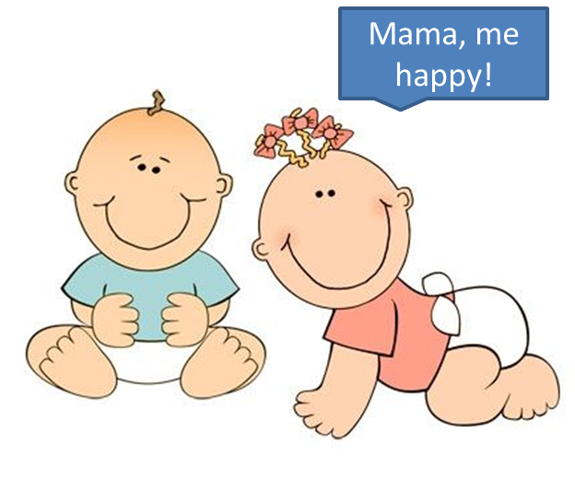
Writing Dialogue
Believability
Keep the character's voice in mind but keep it readable.
Dialogue should read like actual speech. However, there must be a balance between realistic speech and
readability.
Dialogue does NOT have
to be grammatically
correct.

Slide 68
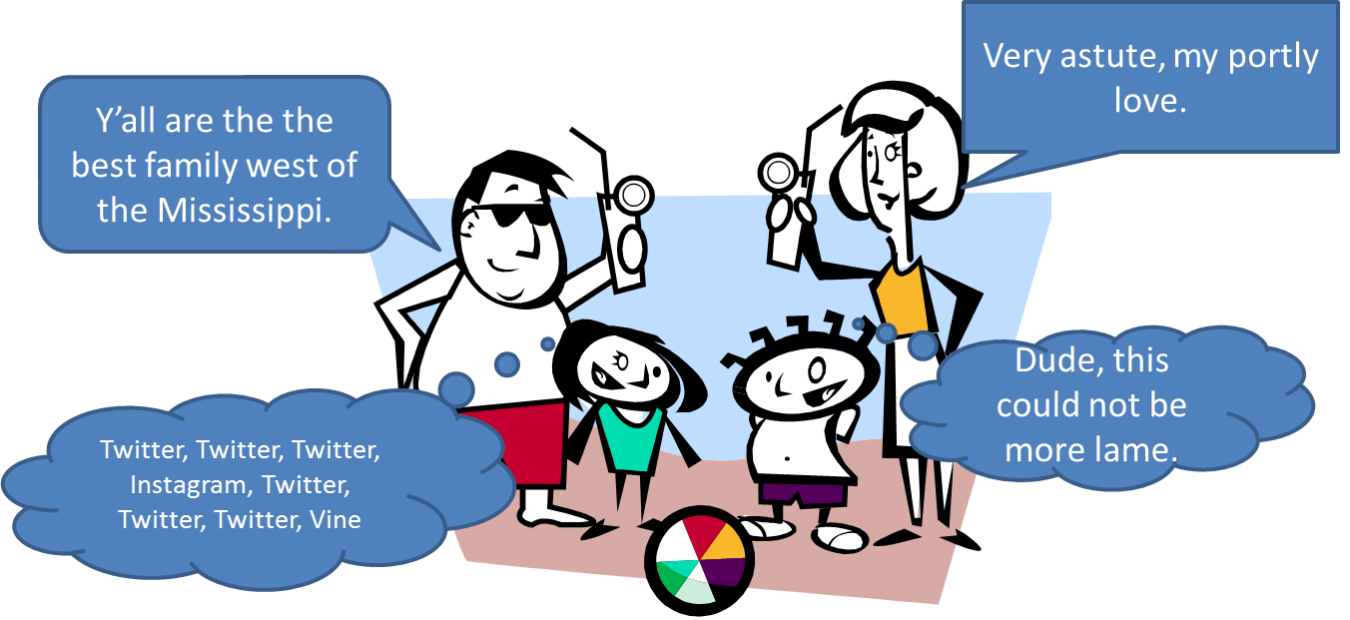
Writing Dialogue
Diction = Word Choice
Don't use too much slang in order to create a character's voice.
Remember to use speech as a characterization tool.
Word choice tells
a reader a lot
about a person:
appearance,
intelligence,
age, background,
and morality.

Slide 69
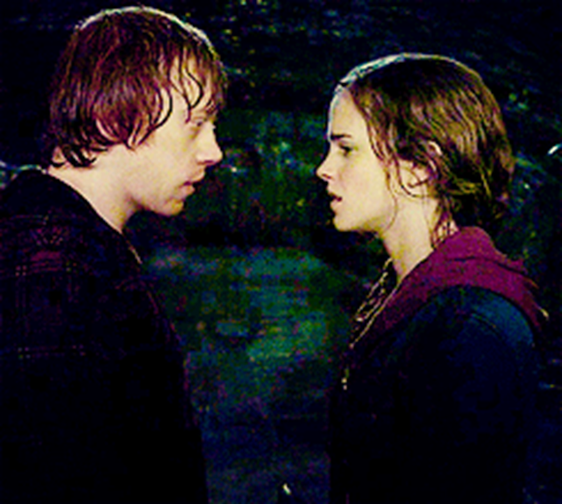
Writing Dialogue
Tension
Sometimes saying nothing, or the opposite of what we know a character feels, is the best way to create tension.
If a character wants to say 'I love you!" but their actions or words say 'I don't care,' the reader cringes at the
missed opportunity.
Eg: Ron has ample opportunity
to tell Hermione how he feels
but instead wastes all of them.

Slide 70
Writing Dialogue
Using Thoughts in Dialogue
Using thoughts or memories can also show important details of a story without unnecessary character interaction.
This indirect dialogue is another way of creating the feel of exchange without quotations..
"Hi Tony." Tony looked down at his shoe, dug in his toe, and pushed around a pile of dust. "Hey," he replied. Katy braced herself. Something was wrong.

Slide 71
Writing Dialogue
Formatting Dialogue
The first thing to remember is that question marks and exclamation points go inside quotations…
NO MATTER WHAT!
Ex: “I can't believe you just did that!”
“Did you just do that?”

Slide 72
Writing Dialogue
Dialogue TAGS
Dialogue tags are the he said/she said's of quotations.
Ex: "But I don't want to go to sleep yet," he whined.
"But I don't want to go to sleep yet," he whispered.
"But I don't want to go to sleep yet," he yelled.
"But I don't want to go to sleep yet," he murmured.
"But I don't want to go to sleep yet," he thundered.
"But I don't want to go to sleep yet," he said.
"But I don't want to go to sleep yet," he told her.
"But I don't want to go to sleep yet," he proclaimed.
These types of tags should only be used sparingly. The dialogue and narration should be used to show the emotion or action stated in the tag.

Slide 73
Writing Dialogue
Commas in Dialogue
You use a comma to separate the tag from the dialogue.
Examples: “He loved you,” she said.
She said, “He loved you.”
She said, “He loved you!”
“He loved you?” she asked.

Slide 74
Writing Dialogue
A character’s actions should convey (show) his or her emotions.
Describe for the reader how the speaker is acting or how they look while saying it.
This will still remind the reader who is speaking without the repetitive; “he said”/ “she said”.
He stood in the doorway with his hands balled into little fists at his sides. His red,
tear-rimmed eyes glared up at his mother.
"But I don't want to go to sleep yet."

Slide 75
Writing Dialogue
Paragraphs in Dialogue
Paragraphs are very important to the flow and comprehension of the dialogue.
Remember to start a new paragraph each time the speaker changes within the dialogue.
This helps the reader know when someone new is speaking (and who it is).
"Why, that's the most ridiculous thing I've ever heard," she exclaimed. Turning away in disgust, she continued, "the mere thought of it makes me cringe!" "But, mom!" he shouted in exasperation, "everybody else is doing it!" He headed towards the door with his head hung low. "You're never going to get it," he muttered, as he slammed the door behind him. His mother sighed deeply and whispered under her breath, “Why would anyone stick a barbell through his nose...hoops look so much better."

Slide 76
Dialogue Challenge
Each of you has been given a slip with a line of dialogue on it.
Your first challenge is to find the TWO other people whose dialogue matches yours (is part of the same conversation)
Once you have found them, you must get a “script sheet.”
Place your dialogue slips on the script sheet in the order that makes the conversation make sense.
Now look at the slips in your conversation. Only ONE of them is properly formatted and punctuated.
Decide which one is correct and put a check mark in the box next to it.
For the other TWO, work together with your partners to decide what is wrong with the format and/or punctuation and RE-WRITE IT CORRECTLY in the box next to the slip.

Slide 77
Homework
Continue Working on Your Narratives!
Your FIRST DRAFT needs to be completed and ready for
PEER REVIEW
on TUESDAY (11/7/17)

Slide 78
Exit Ticket
11/2/17
How can the use of slang affect a story? What can we learn about the story through the use of slang?
Why do you think it is important to not overuse slang?

Slide 79
No
Start-Up
Or
Exit Ticket
Today!
Today is for WRITING!
Your FIRST DRAFT needs to be completed and ready for
PEER REVIEW
on TUESDAY (11/7/17)
11/3/17

Slide 80
No
Start-Up
Or
Exit Ticket
Today!
Today is for WRITING!
Your FIRST DRAFT needs to be completed and ready for
PEER REVIEW
TOMORROW (11/7/17)!!!
11/6/17

Slide 81
Start-Up - Discussion
11/7/17
In your triads, discuss the following:
How can having someone else read your writing be beneficial to you as a writer? What do you think are the most important things you would want your peers to be looking for when they read your story?

Slide 82
Start-Up - Writing
11/7/17
Now write about it:
How can having someone else read your writing be beneficial to you as a writer? What do you think are the most important things you would want your peers to be looking for when they read your story?

Slide 83
CCSS Standard
CCSS.ELA-LITERACY.W.9-10.3
Write narratives to develop real or imagined experiences or events using effective technique, well-chosen details, and well-chosen details, and well-structured event sequences.

Slide 84
Unit Objectives
By the end of the lesson, students will be able to write a narrative to develop real or imagined experiences or events.
They will be able to use effective technique, well-chosen details, and well-structured event sequences in narrative writing.

Slide 85
Today’s Objective
By the end of the period, students should be able to give and receive feedback on their narratives that will inform their self-editing process.

Slide 86
Peer Editing
FIRST READ-THROUGH
Does the opening grab your attention?
Does it have a “flow?”
Is it descriptive? Does it affect the senses?
Is there dialogue (required)? Does it seem realistic?
Does it make sense?
Does the ending make it feel “finished?”

Slide 87
Peer Editing
MECHANICS READ-THROUGH
For typed Google doc papers, use the side comments and or highlighting to mark errors.
RED = spelling error
BLUE = capitalization error
GREEN = punctuation error
UNDERLINE/COMMENT = incomplete sentences and/or run-ons
For hand-written documents, make comments in the margins.
CIRCLE = spelling error
TRIPLE UNDERLINE = capitalization error
ADD-IN = punctuation error
UNDERLINE/COMMENT = incomplete sentences and/or run-ons

Slide 88
Peer Editing
PLOT MAP
Can you identify:
Exposition
Climax
Resolution
If you have those identified, go back and look for:
Rising action
Falling action
Protagonist/antagonist

Slide 89
Homework
Tomorrow we MOVE ON to new material. You are ON YOUR OWN to complete your final drafts!
Your FINAL DRAFTS need to be completed and submitted IN GOOGLE CLASSROOM USING THE TEMPLATE PROVIDED BY NO LATER THAN MONDAY (11/13/17)
BY 7:00 A.M.

Slide 90
NO Exit Ticket Today
11/7/17

