Slide 1
Start-Up - Discussion
1/7/2020
In your groups, discuss the following:
Why do you think so? What determines this?

Slide 2
Start-Up - Writing
1/7/2020
Now write about the following:
Why do you think so? What determines this?

Slide 3
Video

Slide 4
First Read - Solo
Grab a pen or highlighter and open up your Module 1 Books and go to Page 14.
Take a moment to read the section titled, “Why Do I Need to Study This.”
As you read, underline or highlight any words you do not recognize or can not define.
Now take a moment, with your group, to look at the words you all noted. Make sure that you have definitions for these words before you move on.

Slide 5
Second Read - Group
Now, read the section again together as a Small Group Read.
Take a few minutes to discuss what it says.

Slide 6
Group Summarization
As a group, on the card provided, write out a BRIEF summary of the section you just read.
Your summary should include ALL the important points the section makes but should be NO MORE THAN 3-4 SENTENCES in length.
You have 5 minutes to discuss and word your summary which will be shared with the class.

Slide 7
Careeronestop.org
You will be doing some research tomorrow into some fast growing careers.
To prepare for that, let’s see what they have to show you.
Open up chromebooks and go to:
Careeronestop.org

Slide 12
Homework
Choose 3 Careers from the list of Fastest Growing Careers that look like they would match your profile. Record them at the bottom of Page 14 in your Module 1 Workbook.
This should be done by the time you come to class tomorrow!

Slide 13
Exit Ticket - Writing
1/7/2020
Now write about the following:
Do you already know what your future career will be? If so, what is it? If not, what areas are you interested in?
Does it, or anything related to it, show up on the list of fast growing careers?
What do you think about that? Does it cause you concern or relief?

Slide 14
Start-Up - Discussion
1/8/2020
In your groups, discuss the following:
Think about and discuss the following phrases:
“career-path-specific” and “Skills-based.”
How could these two phrases relate to your EDUCATIONAL PLAN for your future?
Why would these things be important to consider?

Slide 15
Start-Up - Writing
1/8/2020
Now write about the following:
Think about the following phrases:
“career-path-specific” and “Skills-based.”
How could these two phrases relate to your EDUCATIONAL PLAN for your future?
Why would these things be important to consider?

Slide 16
Careeronestop.org
Today, you will be doing some research and reporting on the three “Fast Growing” careers you chose yesterday.
You will use the website for this.
As you do your research, you will be recording information about those careers in a Google Doc.
Open up “Fastest Growing Careers – Research”
You will need to complete this for ALL THREE of the fast growing careers you chose.
In addition, you are responsible for the questions on Page 15 in your Module 1 Workbook.

Slide 17
Homework
Fastest Growing Careers – Research
AND
Page 15 Questions in your Mod1 Workbook
DUE TOMORROW!

Slide 18
Exit Ticket - Writing
1/8/2020
Now write about the following:
Of the three careers you are researching, which one is the fastest growing?
Why do you think that is?
Is this an area you would consider as a career possibility?
Why or why not?

Slide 19
Start-Up - Discussion
1/9/2020
In your groups, discuss the following:
What do you think would be involved in creating an “Education Plan?”
What sort of things would you want or need to know?
Why would these things be important?

Slide 20
Start-Up - Writing
1/9/2020
Now write about the following:
What do you think would be involved in creating an “Education Plan?”
What sort of things would you want or need to know?
Why would these things be important?

Slide 21
First Read - Solo
Grab a pen or highlighter and open up your Module 1 Books and go to Page 20.
Take a moment to read the section titled, “Why Is This Critical to Your Future Success and Happiness?” and “To Make the Best Choices for Yourself, It Is Important to Know:”
As you read, underline or highlight any words you do not recognize or can not define.
Now take a moment, with your group, to look at the words you all noted. Make sure that you have definitions for these words before you move on.

Slide 22
Second Read - Group
Now, read the section again together as a Small Group Read.
Take a few minutes to discuss what it says.

Slide 23
Group Summarization
As a group, on the card provided, write out a BRIEF summary of the section you just read.
Your summary should include ALL the important points the sections make but should be NO MORE THAN 3-4 SENTENCES in length.
You have 5 minutes to discuss and word your summary which will be shared with the class.

Slide 24
Building Your Plan
On page 22, you will find instructions for building your Education Plan.
Follow those to complete the activity on the my10yearplan.com website.
If you are still not able to login to my10yearplan.com, we will get that taken care of right now!

Slide 25
Homework
Complete the ACTIVITY from Page 22 in your Mod1 Workbook on the website
AND
Answer the questions on Page 23.
DUE TOMORROW!

Slide 26
Exit Ticket - Writing
1/9/2020
Now write about the following:
“Fact: Too many high school students do not understand why the courses they are taking are required. The resulting disengagement causes them to be unprepared when they enter college” (Bingham et al, 21).
Do you agree or disagree?
Why?
What do you think would be a way to change this or make it better?

Slide 27
Start-Up - Discussion
1/10/2020
In your groups, discuss the following:
How was your schedule decided for this year at THS?
Did you get all the classes you needed? Wanted?
How many choices did YOU have to (or get to) make?
How do you think this could be different when you go to college?

Slide 28
Start-Up - Writing
1/10/2020
Now write about the following:
How was your schedule decided for this year at THS?
Did you get all the classes you needed? Wanted?
How many choices did YOU have to (or get to) make?
How do you think this could be different when you go to college?

Slide 29
Why Develop an Education Plan and Course Schedule Now?
Your practice education plan will help you to determine what you can do in high school to make sure that you are college ready.
It is important to make sure you don’t have to waste time or money with remediation classes.
You will be making an education plan for your high demand career – it is important to increase your employability.

Slide 30
College Navigator
Choose a college that is close to us (regardless of your personal choice…this is just practice).
MJC
Fresno State
UC Davis
Stan State
???
Go to Page 24 in your Mod1 Workbook. You will be completing the activity on pages 24 and 25 USING A NEARBY COLLEGE AND A CAREER YOU CHOSE FROM “FASTEST GROWING.”
(videos)

Slide 31
College Navigator
Name of college:
Location:
Web address for college:
Web address for the course catalog for this college:
The high-demand career you are writing your practice
Education Plan for:
Web address on careeronestop.org for the details about that career:

Slide 32
Homework
Practice Education Plan
Pgs 24-25 in Mod1 Workbook
Step 1 & 2
DUE MONDAY!
Step THREE on My10YearPlan.com
DUE NEXT FRIDAY!

Slide 33
Exit Ticket - Writing
1/10/2020
Now write about the following:
Do you plan to go to college?
If so, do you know where you would like to go? If not, what do you plan to do instead?
In a BROAD sense, Do you think that college is necessary for success?
Why or why not?

Slide 34
Start-Up - Discussion
1/13/2020
In your groups, discuss the following:
Brainstorm a list of post-secondary options
BESIDES COLLEGE
that could lead to success?
What reasons can you think of that someone would choose one of those options over going to a 2 or 4 year college?
What careers can you think of that would begin with one of those options?

Slide 35
Start-Up - Writing
1/13/2020
Now write about the following:
Brainstorm a list of post-secondary options
BESIDES COLLEGE
that could lead to success?
What reasons can you think of that someone would choose one of those options over going to a 2 or 4 year college?
What careers can you think of that would begin with one of those options?

Slide 36
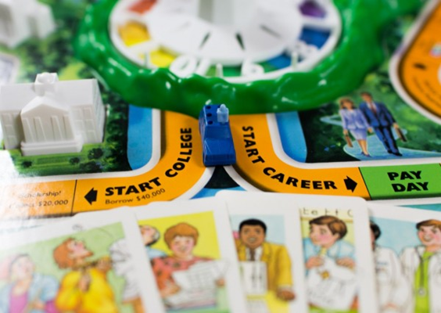
Which Post-Secondary Option is Right for You?
Starting Your Education Plan
This doesn’t only mean college!
Gone are the days when people graduate high school and support a family without additional training.
There are a variety of ways to get the training you need based on your level of commitment and your desired lifestyle

Slide 37
Did you know?
Only 68% of graduating high school students enter the traditional college track

Slide 39
Remember the Alternate Career Ladder that you completed in Success 101?
Partner Talk: Turn and talk to your partner to tell them about some of the alternate careers paths in your career ladder that you found in your research during Success 101.

Slide 40
Workforce Credentials
Various methods used in the workplace to measure on-the-job- competency
Licenses
Certifications
Apprenticeship Programs
Educational Degrees (AA, BA, BS, MA, PhD)
Work Experience
Military
Brainstorm a list of additional jobs that require credentials on page 35

Slide 41
The more you learn, the more you earn

Slide 42
Complete the online research on page 36
Search the career that you are most interested in under each of the categories
Use the Google Document labeled “Researching Career Credentials” to record your findings:
Licenses
Certification
Apprenticeship Programs
Educational Degrees or Training Course
Work Experience
Military

Slide 43
Homework
Complete Researching Career Credentials
DUE TOMORROW

Slide 44
Exit Ticket - Writing
1/13/2020
Now write about the following:
Do you know anyone who started college but didn’t finish?
If so, what were there reasons for not finishing?
If not, what reasons can you think of that might cause someone to leave college without finishing?
Are there things they did or didn’t do that you should be mindful of?

Slide 45
Start-Up - Discussion
1/14/2020
In your groups, discuss the following:
Which should come first, the choice of college or the choice of major?
Why?
Which should come first, the choice of major or the choice of career?
Why?

Slide 46
Start-Up - Writing
1/14/2020
Now write about the following:
Which should come first, the choice of college or the choice of major?
Why?
Which should come first, the choice of major or the choice of career?
Why?

Slide 47
Online Research for College and Post-Secondary Options
Ask someone you know who went to college… (any teacher/counselor)
Did you choose your college, career, or major first and why?
How did this decision impact you in your career prep?

Slide 48
Post-Secondary Options
Let’s look at some post-secondary options that you all have open to you…

Slide 49
Community College
Educational institution offering workforce and college transfer academic programs
Associates Degree or Certification
Typically 2 years

Slide 50
Four-year public college or university in your state
These are publicly funded universities that in state residents, received reduced tuition
Bachelor's degree can be obtained here as well as some Masters and Doctoral degrees
Typically 4 years for a Bachelor’s

Slide 51
Four-year Private College Anywhere
Privately funded colleges and university, generally no out of state tuition rates
Often times having a religious affiliation
Bachelor’s degree can be obtained here as well as some Masters and Doctoral degrees
Typically 4 years for a Bachelor’s

Slide 52
For-profit College
Refers to higher education institutions operated by private, profit-seeing businesses
Offer a variety of degrees
Varying duration of programs

Slide 53
Technical College, apprenticeship, or internship
Technical college offers hands-on training leading to certifications, license, or degree
Apprenticeship programs offer opportunities to learn and earn simultaneously
Internship is offered to students or trainees who works in an organization, sometimes without pay, to gain work experience or satisfy requirements for a qualification

Slide 54
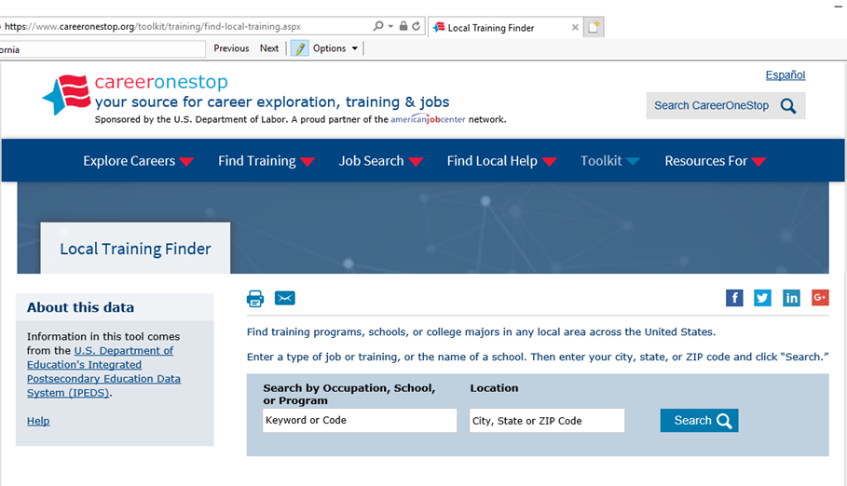
Go to www.careerinfonet.org/edutraining

Slide 55
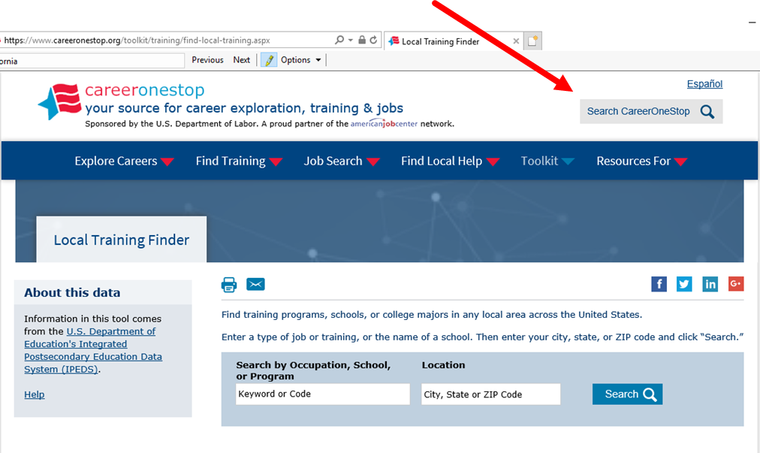
Type your desired occupation into keyword

Slide 56
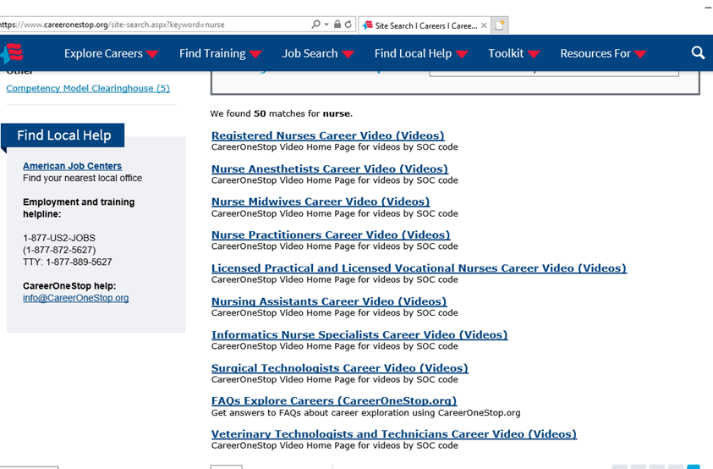
Select occupation that most closely describes your chosen career

Slide 57
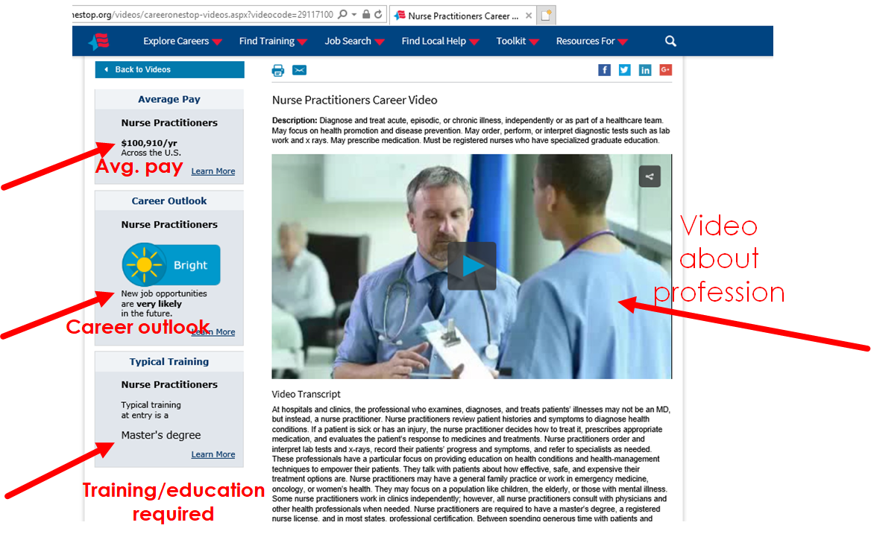

Slide 58
Complete the chart on pg. 39

Slide 59
With research, complete the college comparison chart on pg. 41

Slide 60
Homework
Complete Pgs 39-41
In your My10YearPlan Workbook
(except costs…we will look at that tomorrow)
DUE FRIDAY

Slide 61
Exit Ticket - Writing
1/14/2020
Now write about the following:
What advantages/disadvantages can you think of to choosing a post-secondary option that does not include college?
What factors do you think people need to consider when making that choice?

Slide 62
Start-Up - Discussion
1/15/2020
In your groups, discuss the following:
Watch…
(video in drive…lesson 12)
Now discuss…

Slide 63
Start-Up - Writing
1/15/2020
Now write about the following:
What were you thinking while watching the video?
Did anything in it surprise you? What?
What was your biggest take-away from it?

Slide 64
College costs How much?
Looking at the cost of attendance is very important in making your decision on where to go.
Some colleges are very expensive, others are more affordable
By planning ahead, you can can save thousands of dollars
If possible you want to avoid paying off student loans for 20-30 years!

Slide 65
College Costs?
Let’s focus on just tuition.
Go back to the website for the college you worked with in the last activity.
Do some research to find out the cost of tuition.
In the document in Google Classroom, write down the tuition per year.
Now go to: https://bigfuture.collegeboard.org/pay-for-college/college-costs/college-costs-calculator
Link is in Google Classroom
Enter your yearly total
Set your “Percentage from savings” to 25%
Leave the rest and hit “See Results”
Write that total under the first one you wrote down.

Slide 66
Comparison
In your groups, share that new annual total you calculated.
Discuss: What are the differences in cost between your and other group members? What could be the reasons for those differences?
Log your results in your Google Doc.

Slide 67
Individual Comparison
Your job now is to find TWO MORE OPTIONS… Two different colleges or training programs that also offer your degree.
Do a quick dive into their website and find their annual tuition costs.
Write those down with your other total…be sure to write what school or program that total comes from.
When you have your THREE options in front of you, answer the questions on Pg. 43.

Slide 68
Keep in Mind…
Room and board
Utilities
Clothing/laundry
Medical expenses
Transportation
?
?
?
?
?

Slide 69
Homework
Complete Pgs 39-41
In your My10YearPlan Workbook
AND
College Cost Worksheet in Google Classroom
DUE FRIDAY

Slide 70
Exit Ticket - Writing
1/15/2020
Now write about the following:
Do you have a plan to pay for your post-secondary education?
If so, what is it?
(eg: scholarships, grants, loans, parents, work, etc.)
After looking at the yearly tuition data, do you have any concerns? How can you start to address them?

Slide 71
Start-Up - Discussion
1/16/2020
In your groups, discuss the following:
Can you think of any ways that you could reduce your college costs?
What are they and how would they help?

Slide 72
Start-Up - Writing
1/16/2020
Now write about the following:
Can you think of any ways that you could reduce your college costs?
What are they and how would they help?

Slide 73
Reducing College Costs
In your workbooks, go to page 47.
Take a few minutes to read over the list, “30 Ways to Reduce College Costs”
As you do, circle or highlight ANY that you think you could apply to your situation.
MARK AT LEAST 3
Now take a few minutes to discuss/compare with your group.
Did you mark the same options? Why or why not?

Slide 74
Reducing College Costs
As a group, choose the SIX strategies that you all agree would be beneficial.
Write those down on page 45 in your workbook.
Next to each one, estimate how much money you could save with each option and write that total down.

Slide 75
Getting Ready
In Google Classroom, you will find a template for a short writing assignment.
Using the list of

Slide 76
Homework
Complete Pg. 45
Parent/guardian section
In your My10YearPlan Workbook
AND
“Getting Ready” writing assignment
DUE FRIDAY

Slide 77
Exit Ticket - Writing
1/16/2020
Now write about the following:
Consider this common phrase:
“Where there’s a will, there’s a way.”
How does this relate you your post-secondary planning; especially when it comes to the financial considerations?

Slide 78
Start-Up - Discussion
1/17/2020
In your groups, discuss the following:
What, besides, GPA, do you think colleges look at to decide acceptance?
What qualities do employers look for when they interview/hire?
Do you feel like you have qualities/experiences that will make you stand out?
If so, what are they? If not, why not?

Slide 79
Start-Up - Writing
1/17/2020
Now write about the following:
What, besides, GPA, do you think colleges look at to decide acceptance?
What qualities do employers look for when they interview/hire?
Do you feel like you have qualities/experiences that will make you stand out?
If so, what are they? If not, why not?

Slide 80
Acceptance Requirements
On pages 53-55 in your workbook, you are asked to do some more research.
You will research ALL options on these pages, regardless of which you are planning to follow.
Use the COLLEGE/PROGRAM/PLAN you actually plan to follow in whichever category it fits.
Use your charts on Pages 39 and 41 to complete the other options.

Slide 81
Homework
Pages 53-55
DUE TUESDAY

Slide 82
Exit Ticket - Writing
1/17/2020
Now write about the following:
Has going through this program made you think about your future plans?
What are your most significant take-aways from this process?
Do you think it was worth taking the time in class to do?
Why or why not?

Slide 83
Start-Up - Discussion
1/21/2020
In your groups, discuss the following:
Think about the things you have done since entering high school that will help you in your future.
If you were to write a letter to an 8th grade student who will be coming here next year, what advice would you give them to help them start preparing for their futures?
What things have you done that they should do (or not do)?

Slide 84
Start-Up - Writing
1/21/2020
Now write about the following:
Think about the things you have done since entering high school that will help you in your future.
If you were to write a letter to an 8th grade student who will be coming here next year, what advice would you give them to help them start preparing for their futures?
What things have you done that they should do (or not do)?

Slide 85
Final Steps – Updating Online
Go to page 56 in your workbook.
Follow the instructions on pages 56-58 to finish the last steps and update your plan on the My10YearPlan website.

Slide 86
Homework
Completed Workbooks AND
Website Updates
DUE TOMORROW

Slide 87
Exit Ticket - Writing
1/21/2020
Now write about the following:
Do you know anyone who has changed careers later in their lives?
What reasons could cause someone to make a change like that?
If you found yourself needing to give up your chosen career, what would you do?

