Slide 1
Start-up - Discussion
9/1/16
With your VERTICAL partner, discuss the following:
What could be some positive benefits to using a digital textbook instead of a paper-based book? What might be some negatives?
BE PREPARED TO SHARE!

Slide 2
Start-up - Writing
9/1/16
Now write about the following:
What could be some positive benefits to using a digital textbook instead of a paper-based book? What might be some negatives?

Slide 3
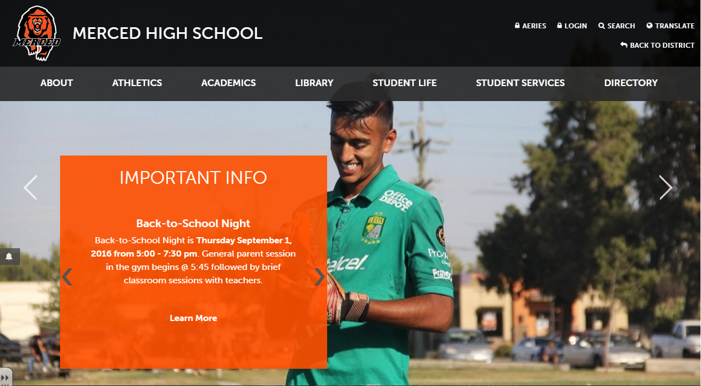
Go to school website:
http://mhs.muhsd.org/merced-high-school and navigate to the library

Slide 4
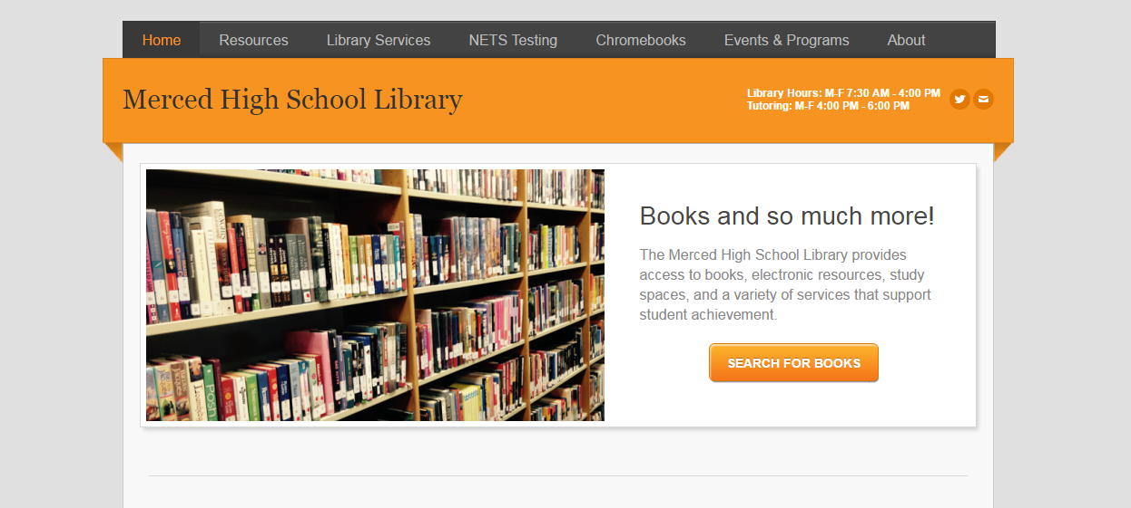
Select Resources and click “HMH English and Math”

Slide 5
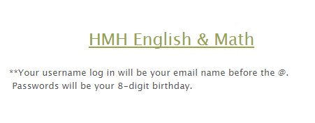
Then click the link and log in
YOUR USERNAME IS YOUR FIRST INITIAL, LAST NAME, AND ID # - jmcelroy100100
YOUR PASSWORD IS YOUR EIGHT DIGIT BIRTHDATE - 09101970

Slide 6
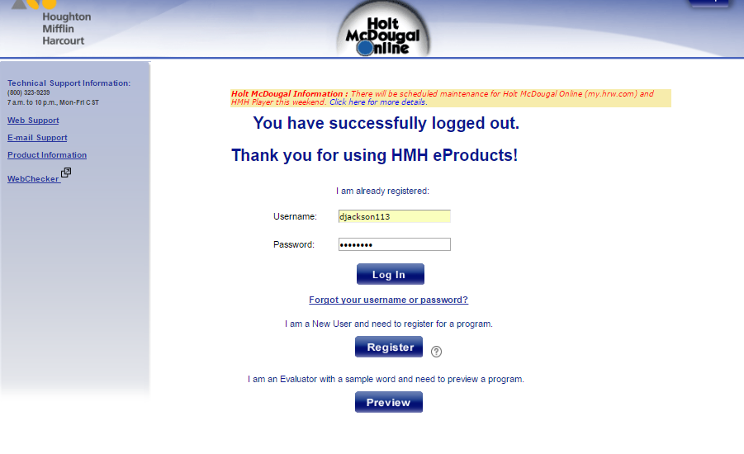
Be sure to enter your date of birth with the entire year, not just the last two digits: MMDDYYYY

Slide 7
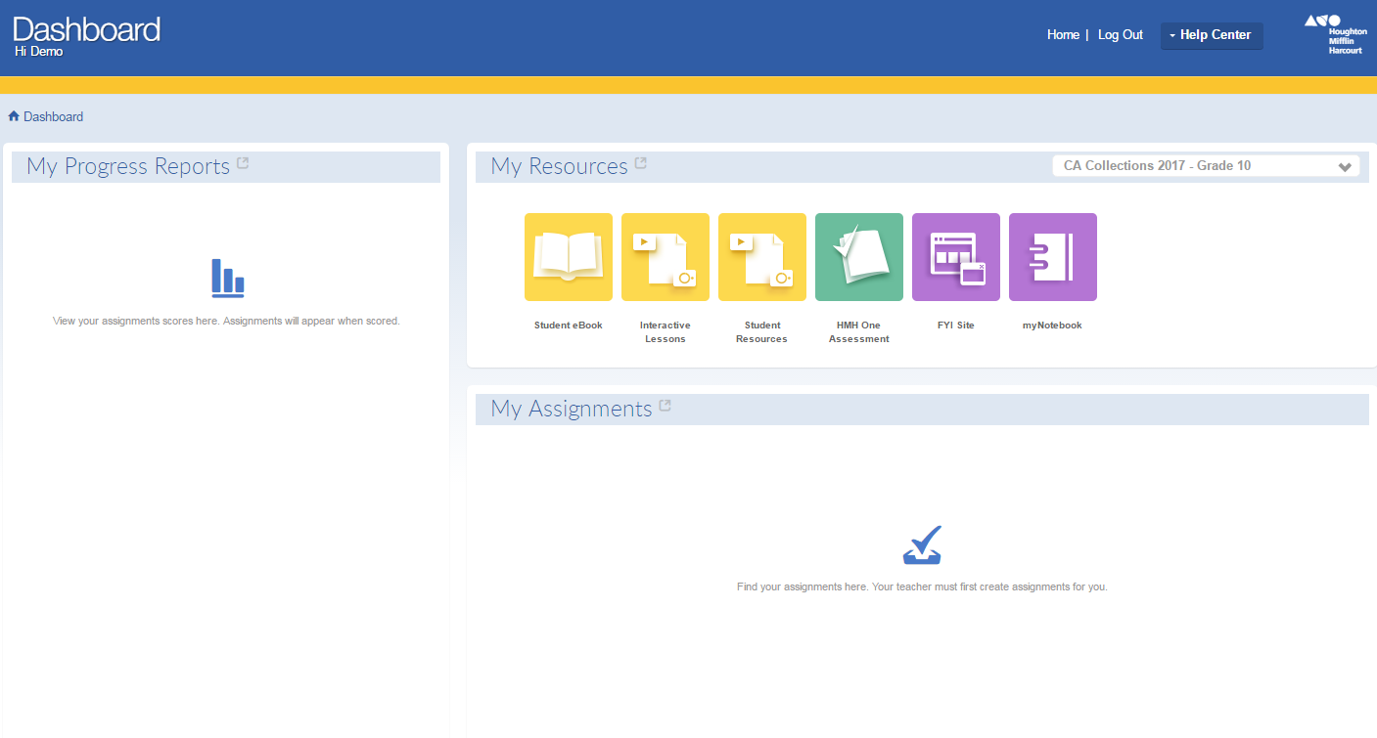
First, let your teacher know if the book displaying does not look exactly like this.
Then click “Student eBook”

Slide 8
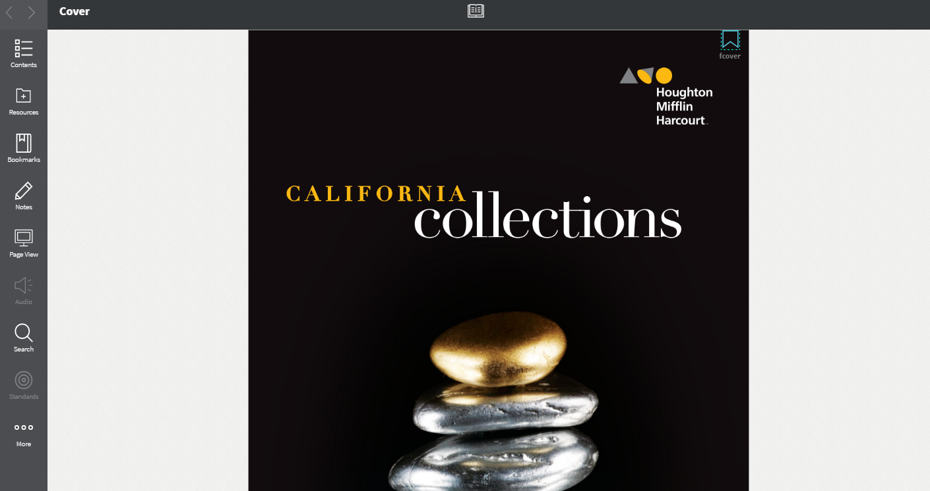
Welcome to your textbook! Let’s explore some useful features.

Slide 9
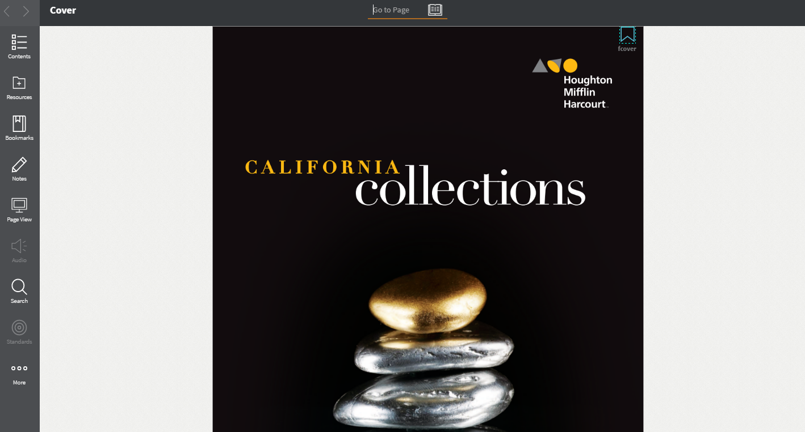
This is where you can manually enter a page number to advance without having to scroll through the entire book. Go to page 71.

Slide 10
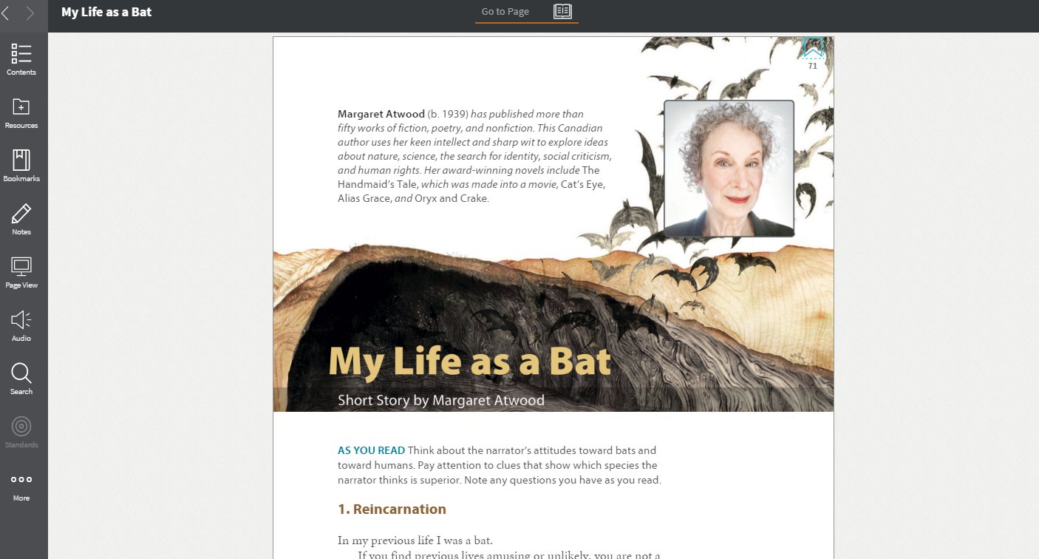
First: Bookmark this page by clicking this shape: it should fill in.
Second: If you click here, you will see all the pages you have bookmarked. After bookmarking page 71, check to see that it shows up here.

Slide 11
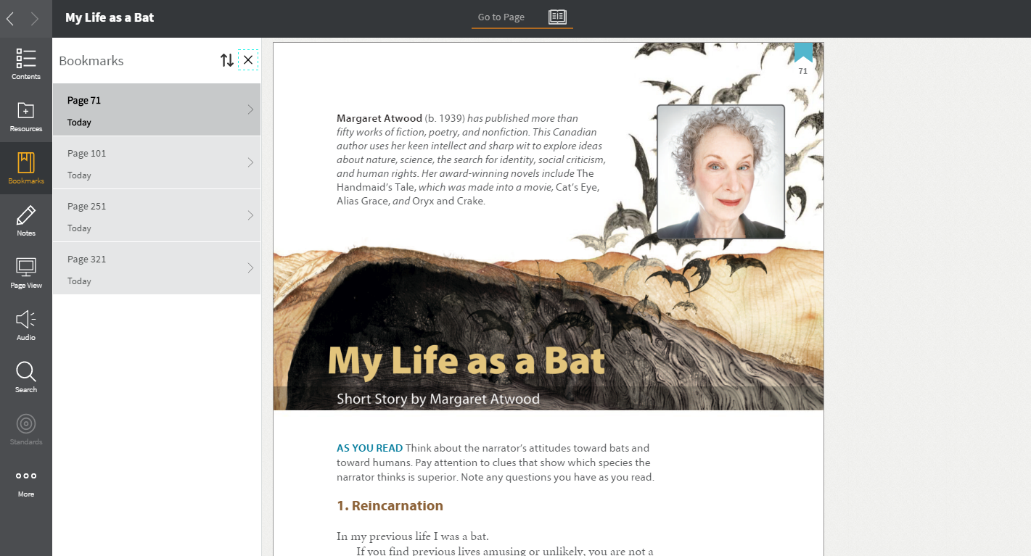
Here are your bookmarks. Clicking on any of them will take you directly to that page in the text.

Slide 12
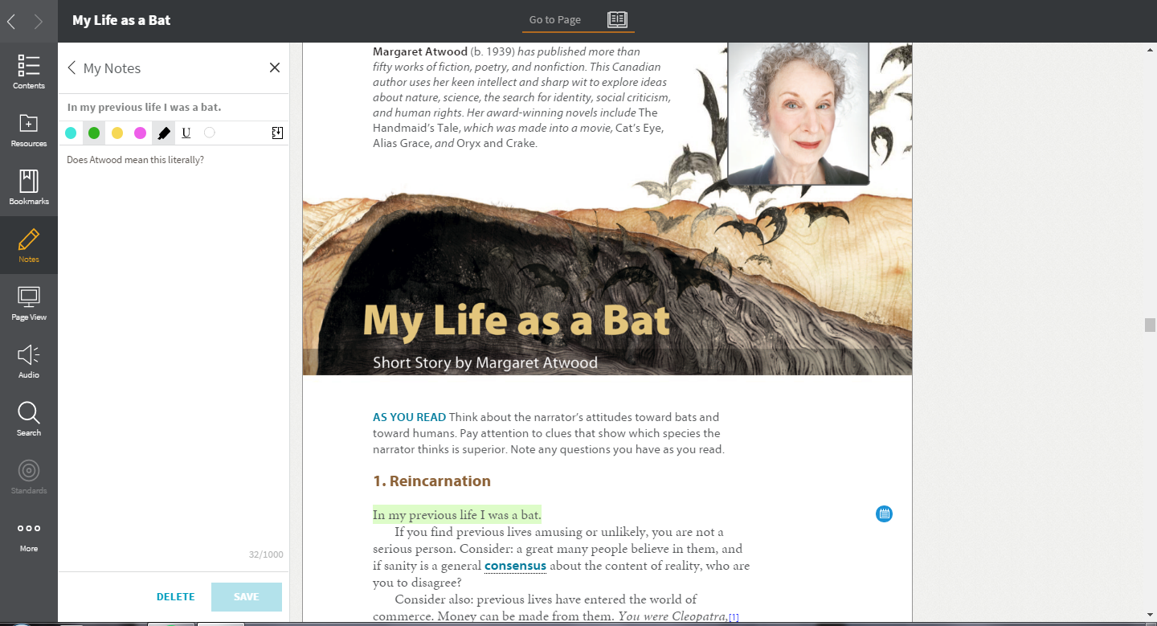
Then highlight a portion of the text, and click “add note.” Change the color of the highlighted portion if you’d like, or if your teacher has asked you to use a particular color for a particular thing. Write a question about what you have highlighted, click the notebook with the down arrow, and then click “save.”

Slide 13
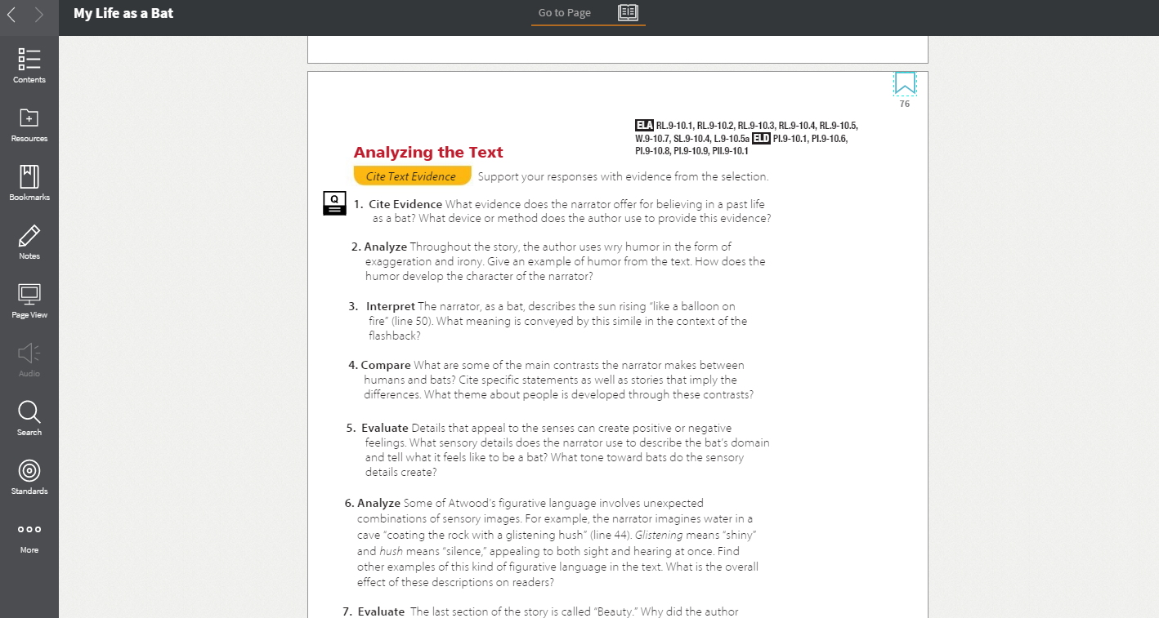
Navigate to page 76 in your text. See this icon? It means you can click on these questions to type your response. Try clicking on one. A box should open up with room to type.

Slide 14
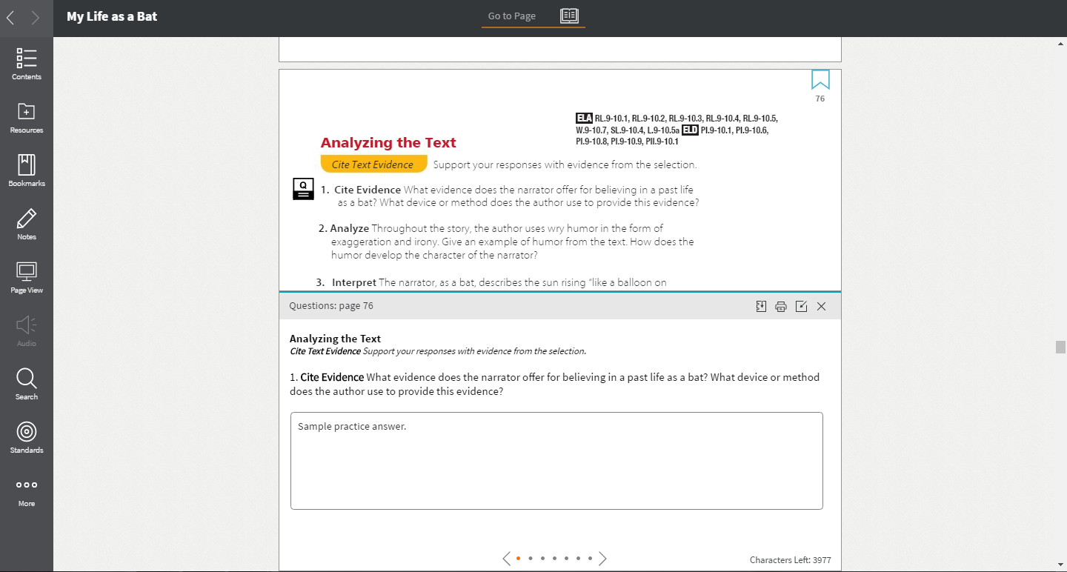
Type “sample practice answer” in the box, and then click the small notebook icon with the down arrow on it to save it to your notebook. Do this only once, on the first question so your teacher can view your responses. If you do it more than once, your answers will still be in the text, but not saved to the notebook. Click “x” to close the box. Your answers are automatically saved.

Slide 15
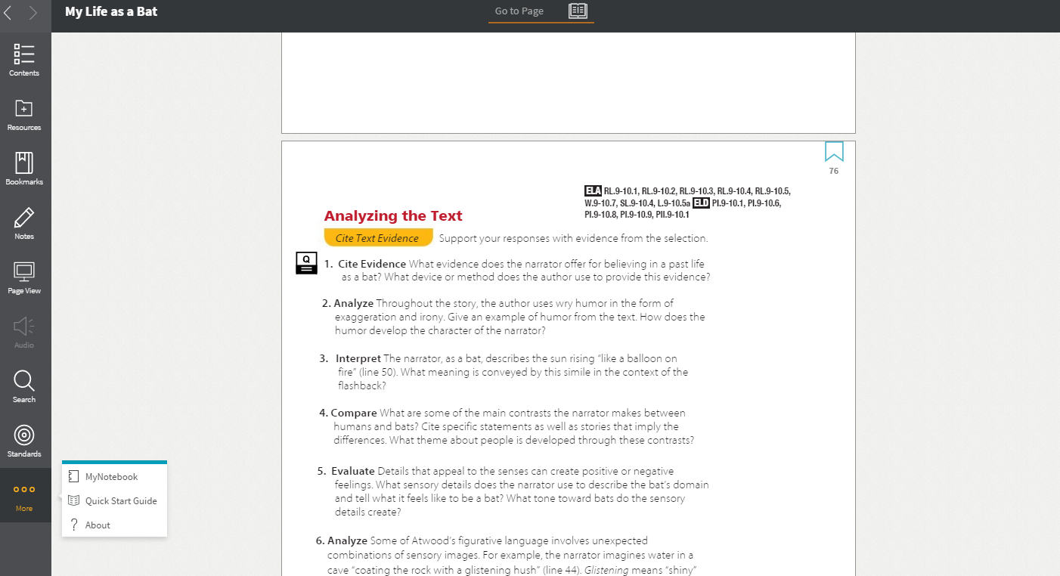
To view your notebook, click “More” and then “MyNotebook”

Slide 16
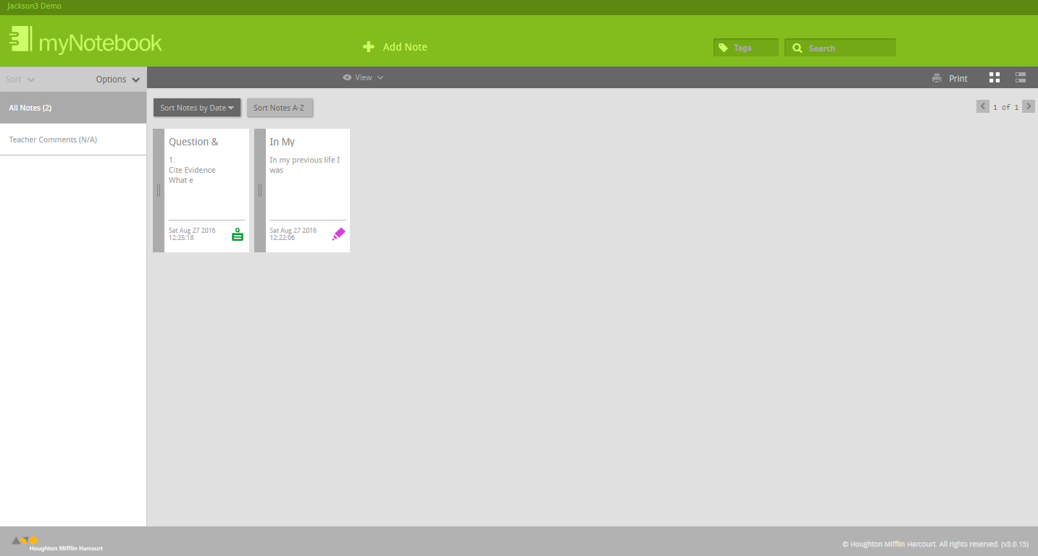
All of your notes will appear here. If you can’t see the questions you just responded to, go back to one of them and click the notebook with the down arrow icon to save them to your notebook.

Slide 17
TEXTBOOK SCAVENGER HUNT
In Google Classroom, find the assignment titled “HMH Textbook Scavenger Hunt.”
You have the rest of the period today to work on this assignment.
Anything not done in class is…

Slide 18
HOMEWORK
Complete the HMH Textbook Scavenger Hunt!
It is DUE, submitted to Google Classroom, NO LATER THAN 7:00 A.M.
TOMORROW!!!

Slide 19
How to take a screenshot on a Chromebook
Whole Screen
Press Control + Switch Window
Part of the Screen
Press Control + Shift + Switch Window

Slide 20
Exit Ticket
9/1/16
Now write about the following:
What are some of the features we looked at in the digital textbook that you think might be helpful? Why?

