Slide 1
Start-Up
What was the job Tom Walker agreed to do for the devil? How did he make money at it? Would you say that the work he did was “honest work?” Why or why not? What modern-day companies do the same job?

Slide 2
Today’s Objective
By the end of the period, students will be able to relate the practice of usury in “The Devil and Tom Walker to modern-day financial principles. They will discuss and reflect on the importance of financial literacy.

Slide 3
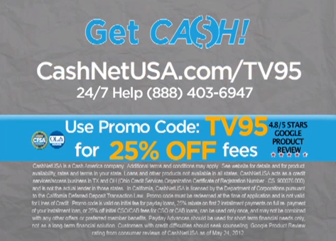
Modern Day Tom Walker
Watch the Public Service Announcement on Payday loans. In what ways are they similar to Tom Walker in his work as a usurer?
Watch

Slide 4
Applying Symbolism to Today
Let’s take some of the things we see in Tom Walker’s story and apply them to today.
As we discuss the following financial principles, answer the questions on your papers.

Slide 5
Financial Principle #1
There are no shortcuts to wealth!
Tom Walker’s “ill chosen” shortcut leads him to his meeting with the devil, which then leads to his ill-gotten riches. What are some modern day shortcuts to wealth?
What usually happens when people take these shortcuts?

Slide 6
Financial Principle # 2
Understand interest rates
3. Compare Tom’s interest rate, 4% monthly, to
an average mortgage rate of 6% annually.
Many see the 4% and assume it is better.
Why is this not the case?
4. How do lenders often try to trick us? Where
do they hide the details?

Slide 7
Financial Principle #3
Payday loans are bad
Tom Walker loaned money at high rates to people who had no guarantee that they would be able to pay him back. Short term lenders charge $15 per week for each $100 borrowed. That’s a 390% interest rate. If you were to borrow $1000 at that rate and then got injured at work the next day and had to stop working for a year, you would owe your lender over $32,000.
5. What happened to the people Tom loaned to if they
couldn’t pay? What could happen to you in this
situation?
6. Can people avoid being taken advantage of
by this type of lender? How?

Slide 8
Financial Principle # 4
Just because a lender acts like he cares about your best interests, all he really cares about is INTEREST.
Tom Walker was “the universal friend of the needy, and he acted like a friend in need; that is to say he always exacted good pay and good security.”
7. How can people avoid falling for these kinds of
tactics?

Slide 9
Financial Principle # 5
Avoid credit card debt
8. Tom Walker could not have gotten so rich if
the people of Boston were not such “eager
speculators.” How is buying things on credit
similar to speculation?
9. What can people do to avoid credit card
debt?

Slide 10
Financial Principle # 6
The choice of whether or not to “make a deal with the devil” is yours alone.
10. Ultimately, it was Tom Walker alone who
made the choice to deal with the devil. How
can people today make sure that the
financial choices they make are wise ones?

Slide 11
Financial Literacy Poster/Flier
You will be working to create a mini-poster/flier (one page size) to illustrate one of the 6 financial principles we just discussed.
You will create this as a Google Document and submit it to my webpage.

Slide 12
Financial Literacy Poster/Flier
Your poster/flier must include:
The financial principle you have chosen
An explanation of and commentary on that principle.
No less than 2 (two) images that relate to that principal.
No blank spaces in your ad. Use all the room you have!

Slide 13
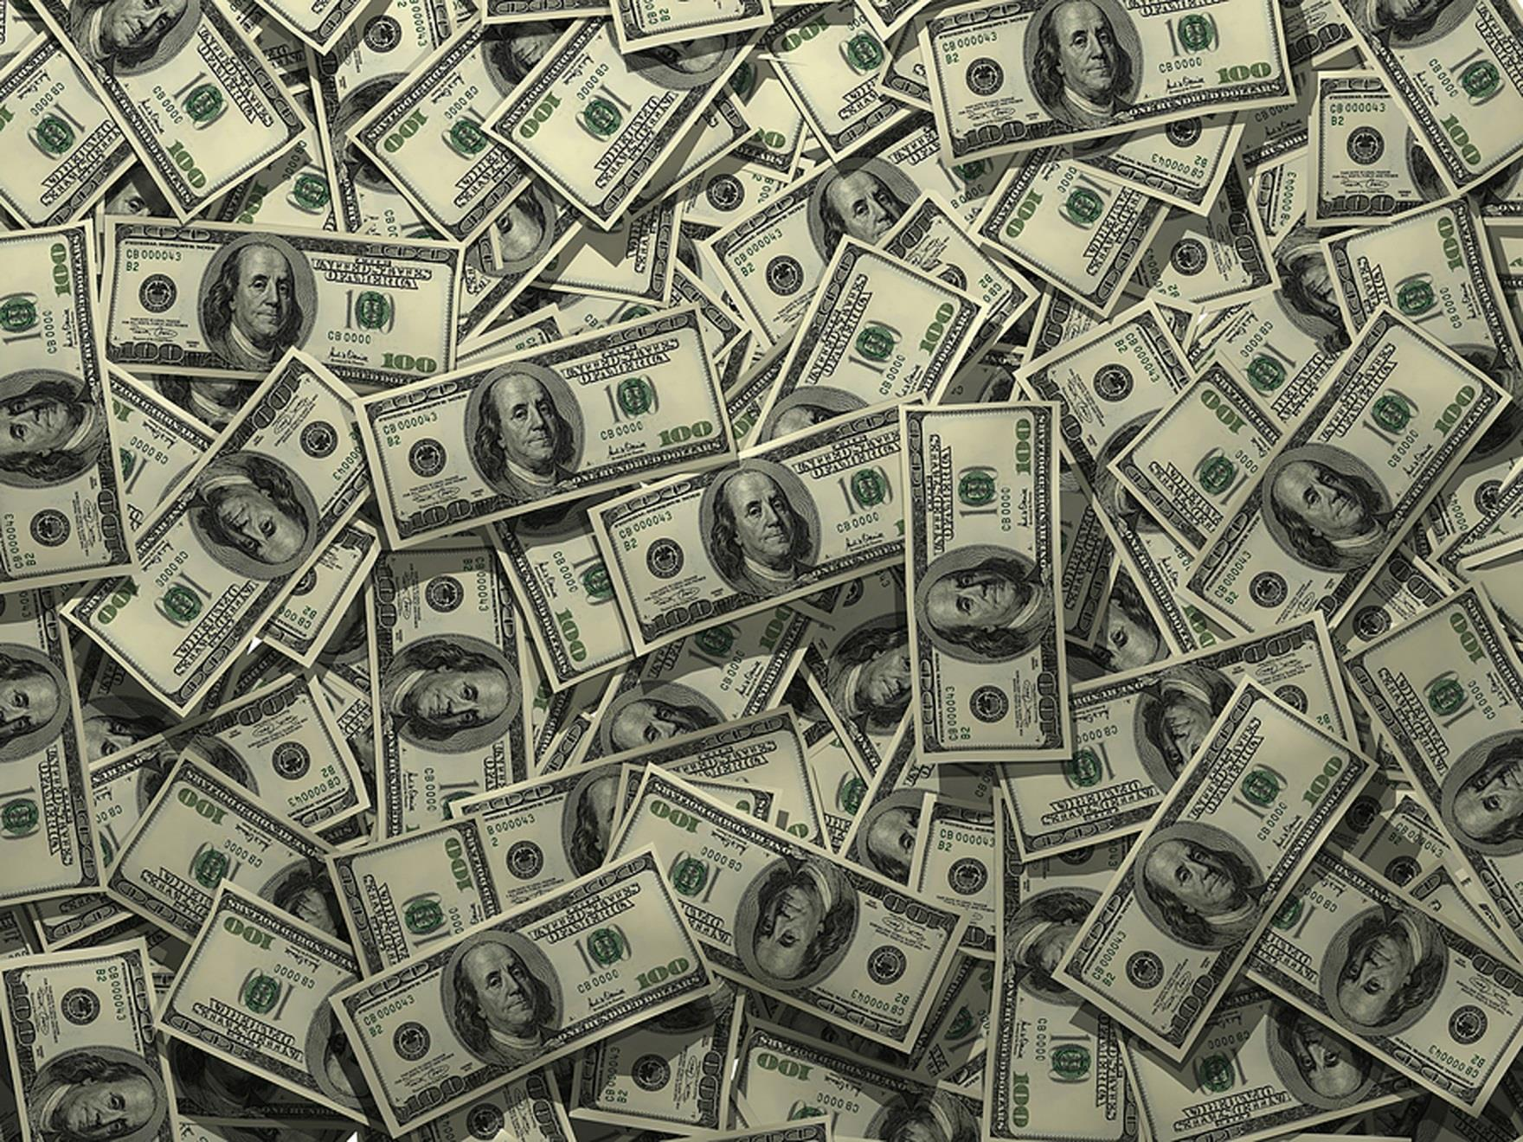
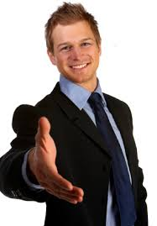
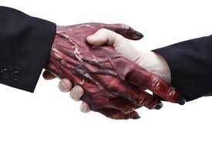
Poster/Flier Example
Friend or Foe? A nice tie, a smile, and a claim to care doesn’t really mean they care!
All he’s really interested in
is… INTERE$T!
Remember who you are dealing with! The person you THINK is your friend is really just trying to MAKE MONEY from the INTEREST on your loan! BUSINESS is BUSINESS! Don’t be fooled into thinking they want the best for you!

Slide 14
Homework
Questions on financial principles are due TOMORROW!
Posters/Fliers are due, SUBMITTED TO MY WEBPAGE, by FRIDAY!

Slide 15
Exit Ticket
Which one of the financial principles discussed do you think is the most important for people to be aware of? Why? Which one do you think you will do your poster on? Why?

