Slide 1
Daily Start-Up
8/12/19
Your Name Your ID #
Class Period
Birthdate Your Age
Home Phone Number
Parent/Guardian’s Parent/Guardian’s
Name Email

Slide 2
Daily Start-Up (Example)
James “Jay” McElroy 123456
Period _______
9/10/1970 44
(209) XXX-XXXX
Margaret McElroy mrmacsmom@gmail.com

Slide 3
Welcome to English 9
Mr. McElroy
http://mrmcelroysclass.weebly.com/

Slide 4
Classroom Vocabulary
Quad – Yourself and the 2 or 3 people with desks which touch yours.
3
4
1
2

Slide 5
Classroom Vocabulary (Cont.)
The 4 L’s:
- Look at your partner’s eyes.
- Lean toward your partner.
- Lower your voice.
- Listen attentively.

Slide 6
60 Second Speeches
You will be writing, this week AS A HOMEWORK ASSIGNMENT, a 60 second (1 Minute) speech which you will be delivering to the class at the end of this week.

Slide 7
60 Second Speeches
Your speech must include:
Name
Age
Your speech may include:
Where did your name come from? What is significant?
Where and when were you born?
Family – Tell about them – parents (or whomever you live with), brothers and sisters (or whomever lives with you)?
Hobbies – What do you like to do in your free time (sports, video games, etc.)?
Favorites – foods, places to hang out, sports teams, activities, movies, TV shows, etc.

Slide 8
60 Second Speeches
On Wednesday, you will complete and submit to me:
An outline of your speech. Make sure you keep a copy for yourself to use when you speak in front of the class.
We will work on the writing of these outlines in class on Wednesday.

Slide 9
60 Second Speeches
You will be graded using the PVLEGS Rubric:
Poise - You appeared calm and confident. There was no distracting behavior.
Voice - Your voice was just right for the space—not too loud or too soft. Every word was heard. You didn’t mumble or blur words together. You didn’t have any strange vocal pattern.
Life - You had a lot of feeling in your voice. We heard emotion, passion, excitement, sadness, etc. You were fun to listen to.
Eye-Contact - You constantly looked at your audience. You looked at each member of the audience. You barely glanced at your note cards.
Gestures - You had very effective hand, face, and body gestures. Your motions added a lot to your speech.
Speed - You were not too fast or too slow. You varied your speed—faster for exciting parts, slower to add emphasis. You used pauses to let main points sink in with the listeners.

Slide 10
CLASSROOM RULES
Look around – Find the classroom rules
Point it out to your group
WE will create the rules for this class – starting today!
We will do it by thinking about/ answering 4 questions.

Slide 11
The 3 Questions
How do you, as a student, want to be treated by me as your teacher?
How do you think I, as your teacher, want to be treated by you as students?
How do you want to be treated by your classmates?
How do you think your classmates want to be treated by you?

Slide 12
“With Respect”
Let’s take a minute to clear this up…
The most common answer I get to these questions is “with respect.”
That answer is hereby FORBIDDEN!
Why? Because it tells us NOTHING!
Instead of just saying, “Treat me with respect,” you have to GIVE EXAMPLES of what that respect LOOKS LIKE!

Slide 13
“With Respect”
Examples
Don’t embarrass me in front of my classmates.
Give me time to get work done.
Don’t talk when I am talking.
Don’t touch my stuff.
Come to class prepared.

Slide 14
Question 1 – How do you, as a student, want to be treated by me as your teacher?
In your QUADS, you will pass the card around for 1 minute.
Each person will add to the list of ideas.
You may only pass ONCE!

Slide 15
Question 1 – How do you, as a student, want to be treated by me as your teacher?
Now take 2 minutes to discuss, with your QUAD, the answers on your card. Each person should discuss the answers they added.
What did you mean by that answer and why do you think it’s important?
BE PREPARED TO SHARE!

Slide 16
Homework
Begin working on your 60 Second Speech!
Bring back your 20 questions page COMPLETE by Friday!
Bring back the signature portion of your syllabus by Friday.
YOUR GRADES IN THIS CLASS WILL NOT BE COUNTED UNTIL THESE HAVE BEEN SIGNED AND RETURNED!

Slide 17
Exit Ticket
8/12/18
Your Exit Ticket for today is your Start-up 3x5 card, completed.
Turn it in to me before you leave today.

Slide 18
Start-Up - Discussion
8/13/18
In your QUADS, discuss the following questions:
Think of a teacher you have had in the past whose class you really liked. What was it about them or their class that made you like it? DO NOT USE THEIR NAMES!!!
Now do the same for a teacher whose class you did not like. DO NOT USE THEIR NAMES!!!
Be prepared to share!

Slide 19
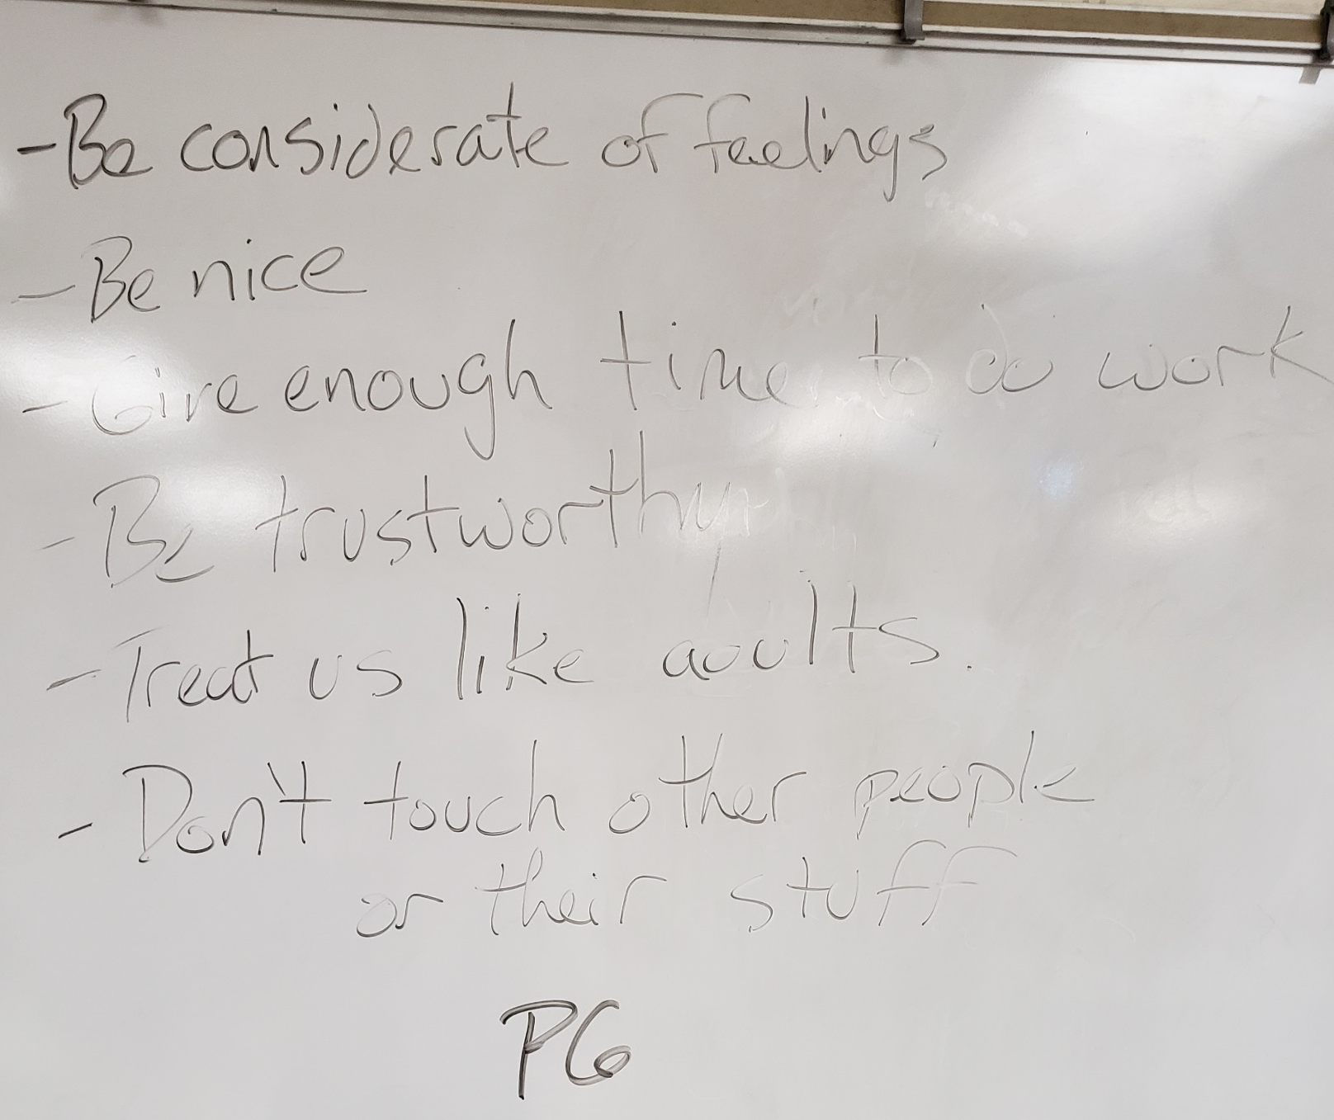
P6

Slide 20
Question 2 – How do you think I, as your teacher, want to be treated by you as students?
In your QUADS, you will pass the card around for 2 minutes.
Each person will add to the list of ideas.
You may only pass ONCE!

Slide 21
Question 2 – How do you think I, as your teacher, want to be treated by you as students?
Now let’s share as a class and add to our CLASSROOM CONTRACT.

Slide 22
Question 3 – How do you want to be treated by your classmates? How do you think they want to be treated by you?
In your QUADS, you will pass the card around for 1 minute.
Each person will add to the list of ideas.
You may only pass ONCE!

Slide 23
Question 3 – How do you want to be treated by your classmates? How do you think they want to be treated by you?
Now let’s share as a class and add to our CLASSROOM CONTRACT.

Slide 24
Homework
Continue working on your 60 Second Speech!
Bring back your 20 questions page COMPLETE by FRIDAY!
Bring back the signature portion of your syllabus and your Academic Honesty Policy page by FRIDAY!
YOUR GRADES IN THIS CLASS WILL NOT BE COUNTED UNTIL THESE HAVE BEEN SIGNED AND RETURNED!

Slide 25
Exit Ticket
8/13/18
NO
EXIT TICKET
TODAY!

Slide 26
Start-Up - Discussion
8/14/18
In your QUADS, discuss the following:
Looking at the items added to the board yesterday and Monday, are there any things there that you were surprised got mentioned?
With your group, discuss whether you think these rules are enough or if there is anything else we need to add.
Be prepared to share!

Slide 27
60 Second Speech Outlines
Tomorrow, and Friday as necessary, you will be presenting your 60 second speeches to the class.
One requirement for your speeches is to complete and turn in an outline for your speech.
These outlines must be turned in to me BEFORE you go up to speak, so IT IS CRITICAL that you MAKE YOURSELF A COPY of your outline or have your full speech in hand when you are called on to present.
Your Outlines are set up for your success.

Slide 28
60 Second Speech Outlines
Greeting / Name and Age
My name is _______________________________
I am _________ years old
Intro statement - ____________________________________________________________________________________________________________________________________________________________
Topic 1 - _________________________________________
Subtopic/Detail 1 - ____________________________________
Subtopic/Detail 2 - ____________________________________
Subtopic/Detail 3 - ____________________________________

Slide 29
60 Second Speech Outlines Example
Greeting / Name and Age
My name is _James F. McElroy Jr.___
I am __47__ years old
Intro statement - _I am excited to be back at THS for another year, my second, year teaching here. I look forward to getting to know all of you better this year and hopefully learn as much from you as you do from me.
Topic 1 - _My Family_______________________________
Subtopic/Detail 1 - _Amber - my wife_____________________
Subtopic/Detail 2 - _J.T. - My son_________________________
Subtopic/Detail 3 - _Jillian - My daughter__________________

Slide 30
Your Job…
You have the remainder of the period to work on your outlines for your 60 second speeches.
Remember, part of your grade will be based on your ability to keep this speech as close to 60 seconds as possible.
You may need to adjust/add to/delete information from your outline and speech in order to make sure your timing is good.
Be sure to PRACTICE giving your speech in front of a mirror or with family/friends. This will help you with timing and fluency.

Slide 31
Homework
Continue working on your 60 Second Speech and PRACTICE IT! Be prepared to present tomorrow!
Bring back your 20 questions page COMPLETE by FRIDAY!
Bring back the signature portion of your syllabus and your Academic Honesty Policy page by FRIDAY!
YOUR GRADES IN THIS CLASS WILL NOT BE COUNTED UNTIL THESE HAVE BEEN SIGNED AND RETURNED!

Slide 32
Exit Ticket
8/14/18
On your card, write about the following:
What do you think is the most difficult thing about the 60 Second Speech assignment for you personally
(eg: the timing, coming up with content, speaking fluently, speaking in front of the class)?
What could you do tonight to help you be better prepared to present in class tomorrow?
Why would that help?

Slide 33
Start-Up - Discussion
8/15/18
In your TRIADS, discuss the following:
How do you feel about speaking in front of a class or group? Does it make you nervous or scared? Why do you think that is?
Are you confident and calm about it? Why do you think that is?
Be prepared to share!

Slide 34
Start-ups and Exit Tickets
Beginning NEXT WEEK, you will be responsible for DAILY Start-up and Exit Ticket writing.
This writing will be done in Google Classroom.

Slide 35
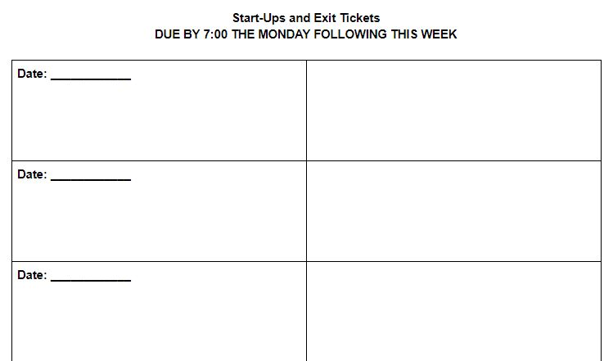
Start-ups and Exit Tickets
Each week, you should see an ASSIGNMENT labeled “Start-ups and Exit Tickets – Week _.”
With that assignment is a document. When you open the document, you are looking at a copy that is yours alone. Take a look at it now.

Slide 36
Start-ups and Exit Tickets
Some important things to note:
At the top of the page
The Start-up and Exit Ticket documents for each week are DUE SUBMITTED IN GOOGLE CLASSROOM by 7:00 a.m. on the Monday of the following week.
To receive full points, each entry MUST BE NO LESS THAN FOUR COMPLETE SENTENCES (a.k.a. a PARAGRAPH).

Slide 37
Start-ups and Exit Tickets
Some important things to note:
There are two columns in the chart.
The left column is for your Start-up writing.
The right column is for your Exit Ticket writing.
There are five rows in the chart.
Each row represents a day in the week.
Row 1 = Monday, row 2 = Tuesday, etc.
There is a place for you to enter the DATE for each day’s writing.
Missing date = -2 points off that entry.

Slide 38
Start-ups and Exit Tickets
Some important things to note:
If there are days that we do not have an Start-up or Exit Ticket, you must WRITE IN THOSE BOXES “No Start-up” or “No Exit Ticket.”

Slide 39
Start-ups and Exit Tickets
*** CRITICAL NOTE ***
At the end of every day, I will ensure that the powerpoint used for that day’s class is uploaded to my website.
That means that YOUR ABSENCE FROM CLASS IS NOT AN ACCEPTABLE EXCUSE FOR FAILING TO COMPLETE START-UPS AND EXIT TICKETS!
If you are absent for any reason, IT IS YOUR RESPONSIBILITY to visit my website and find the Start-up and Exit Ticket prompts and complete them as part of your HOMEWORK!

Slide 40
60 Second Speeches
You will be called at random to present your speech.
I will take volunteers, if there are any, who would like to get it over with.
Remember that I need your outline before you present.
Speak loudly and clearly enough for the whole room to hear you!
I will try to signal you when you are about 10 seconds from the one minute mark.

Slide 41
60 Second Speeches
Listening
For those NOT speaking, you also have an assignment.
You will be LISTENING and taking down a few simple notes while your classmates are delivering their speeches.
You are only required to do this for THREE people who get up to speak.

Slide 42
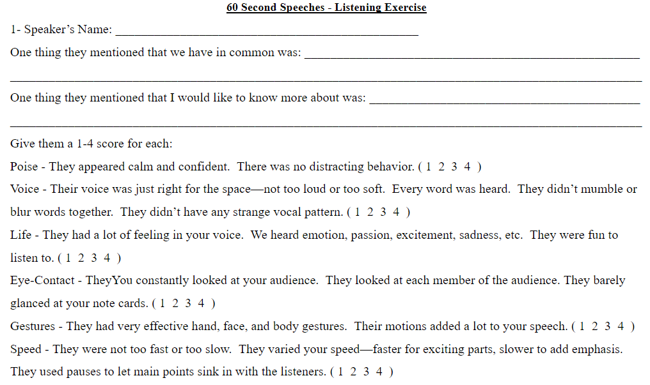
60 Second Speeches
Listening

Slide 43
Exit Ticket
8/15/19
In your Exit Ticket chart for today, write about the following:
What was one interesting fact that you learned about a classmate today? Why did that particular thing stand out to you?
What is one thing you hope that your fellow classmates learned (or will learn tomorrow) about you?

Slide 44
Start-Up - Discussion
8/16/19
In your TRIADS, discuss the following:
Which is easier for you: speaking to a group of 35 or speaking to a group of 3?
What is it that makes the difference?
Why is one easier than the other?
Be prepared to share!

Slide 45
60 Second Speeches
You will be called at random to present your speech.
I will take volunteers, if there are any, who would like to get it over with.
Remember that I need your outline before you present.
Speak loudly and clearly enough for the whole room to hear you!
I will try to signal you when you are about 10 seconds from the one minute mark.

Slide 46
60 Second Speeches
Listening

Slide 47
Exit Ticket
8/16/19
In your Exit Ticket chart for today, write about the following:
What was one interesting fact that you learned about a classmate today? Why did that particular thing stand out to you?
What is one thing you heard that you wish you could find out more about?

