Slide 1
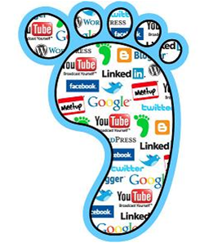
Start-Up - Discussion
What do you think is meant by the term “digital footprint?”
Why would it be important to know what makes up your personal digital footprint?

Slide 2
Start-Up - Writing
What do you think is meant by the term “digital footprint?”
Why would it be important to know what makes up your personal digital footprint?

Slide 3
What is a Digital Footprint?
*Article Reading
A “digital footprint” is all of the information online about a person either posted by that person or by others, intentionally or unintentionally.
It can be searched, copied, and passed on, and it can be seen by a large, invisible audience.

Slide 4
Digital Footprint
Digital footprints can be small or large. Small ones have information about students that are appropriate to put on the internet
The larger a footprint gets, the more unsafe it can become because it has more of a chance to include inappropriate information

Slide 5
What are examples of safe and unsafe things to post online?
Safe
Unsafe
interests
hobbies
their first name
students’ last names
home addresses
hurtful information about others
In my opinion, some safe things to post online are ___________________.
In my opinion, some unsafe things to post online are ___________________.

Slide 6
Digital Footprint
Being a “digital citizen” means acting safely, responsibly, and respectfully online.
You should behave online the same way you would offline and face to face with others.
It’s good to ask yourself, “Would I do or say this if I weren’t on a computer?”

Slide 7
Why Do I Need to Worry About My Digital Footprint?
Could cause you to not get accepted into a college
Could cause you to not get a job
In my opinion, I think I should be conscious of my digital footprint because ______________.

Slide 8
What does your digital footprint
say
about
you?

Slide 10
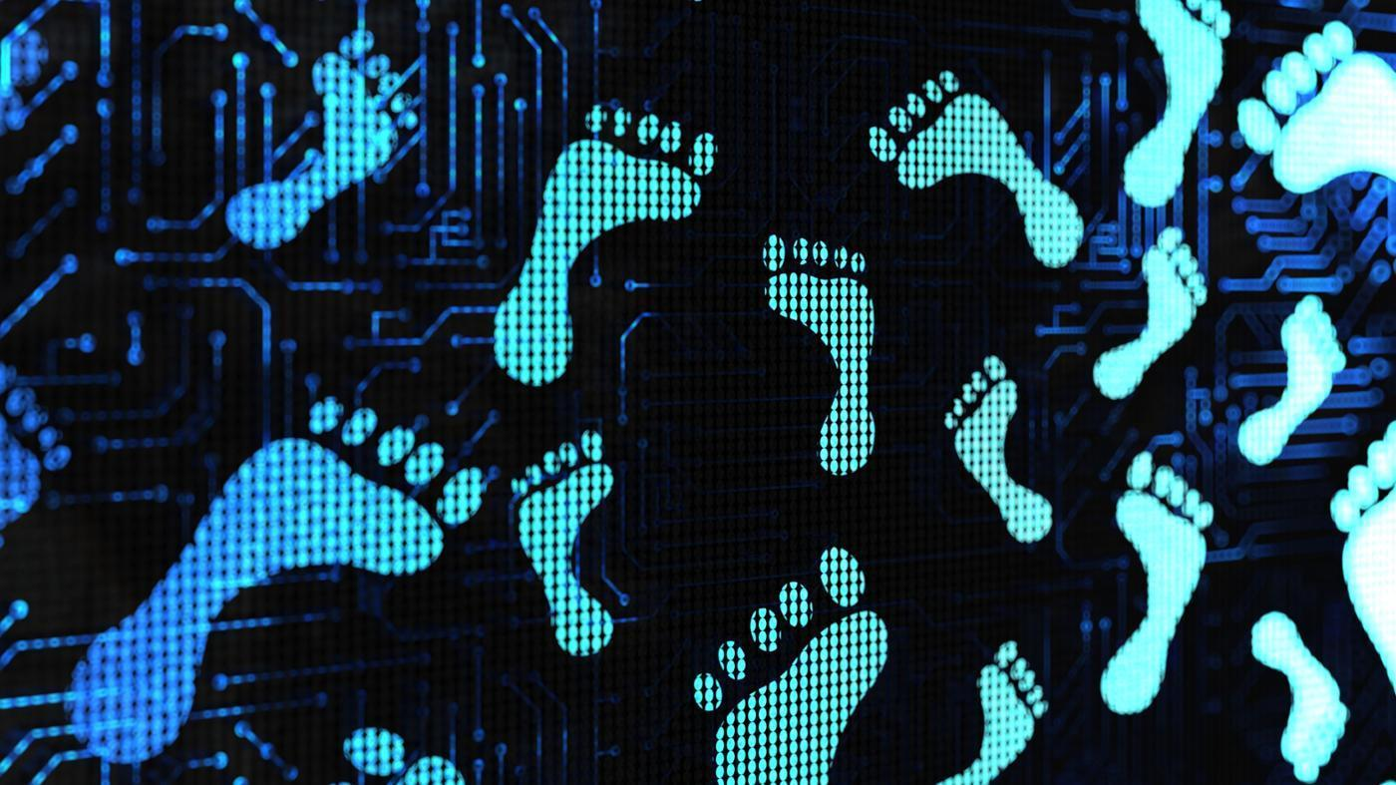
Digital Footprint:
Trillion Dollar Footprint
Tech in TUSD

Slide 11
Review: What is a Digital Footprint?
A “digital footprint” is all of the information online about a person either posted by that person or by others, intentionally or unintentionally.
It can be searched, copied, and passed on, and it can be seen by a large, invisible audience.

Slide 12
Trillion Dollar Footprint: Choose a Host
“Trillion Dollar Footprint” is a TV show that tours the country looking for teens to compete in a talent show.

Slide 13
Trillion Dollar Footprint: Choose a Host
You are the producers for the show. You job is to do the following:
Look over the online information of the two fictional host applicants.
Decide which applicant should be the host based on who works better with others and is more honest.
Give a convincing pitch to the class about which candidate you chose and why.

Slide 14
Trillion Dollar Footprint: Choose a Host
Which candidate would you choose and why?
My group and I decided that ______ would be the best candidate for the show Trillion Dollar Footprint. One reason is ______. Another reason is ______. Finally, we believe ______ would be the best host because ______.

Slide 15
Who helped shape Linda’s and Jason’s digital footprint?
They did.
Who decided their future based on their digital footprint?
We did.
Can you tell what a person is like in real life from what you see and read about them online?

Slide 17
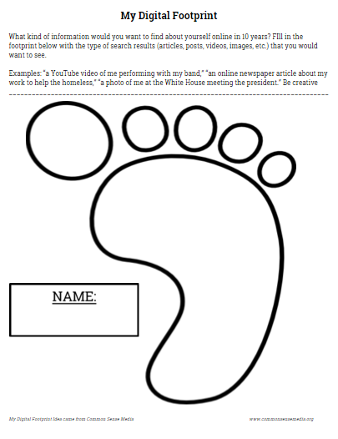
Digital Footprint Activity
What kind of information would you want to find about yourself online in 10 years?
Fill out in the footprint the type of search results that you would want to see.
Examples:
“a YouTube video of me performing with my band”
“a picture of me at the White House meeting the president”
“an online news article about my work to help the homeless”

Slide 18
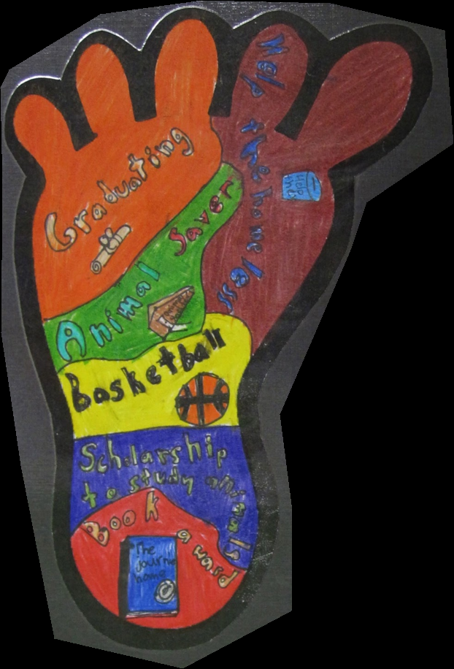
http://aroomwithaview.edublogs.org/2014/05/12/our-digital-footprints/

Slide 19
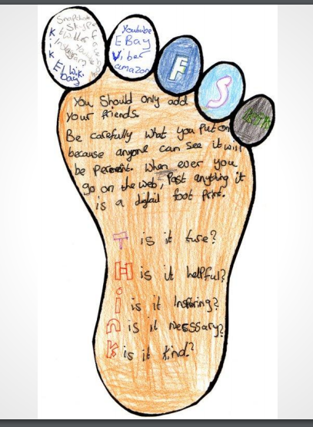
http://aroomwithaview.edublogs.org/2014/05/12/our-digital-footprints/

Slide 20
Exit Ticket
Look at this poster.
How could following these
guidelines for internet and
social media posting help
you to be sure your
digital footprint is what you
want it to be?

