Slide 1
Start-Up – Partner Talk
11/3/14
With your partner, discuss the common phrase, “Making a deal with the Devil.”
Have you heard this phrase before? Where? What does it usually refer to? What is the “price” that is asked for when making a deal with the Devil?

Slide 2
Start-Up - Writing
Write about your knowledge of this common phrase, “Making a deal with the Devil.”
Where have you heard it? What does it refer to? What is the “price” that is asked for? Why do you think you have heard of it before?

Slide 3
Today’s Objective
By the end of the period, students will be able to answer questions related to mood, archetype, and symbolism as they apply to The Devil and Tom Walker by Washington Irving.
CCSS.ELA-LITERACY.RL.11-12.1
CCSS.ELA-LITERACY.RL.11-12.3
CCSS.ELA-LITERACY.RL.11-12.9

Slide 4
Archetype
An archetype is a character, story plot, or element that shows up in literature (and film) repeatedly, even spanning centuries.
Some common archetypal characters include:

Slide 5
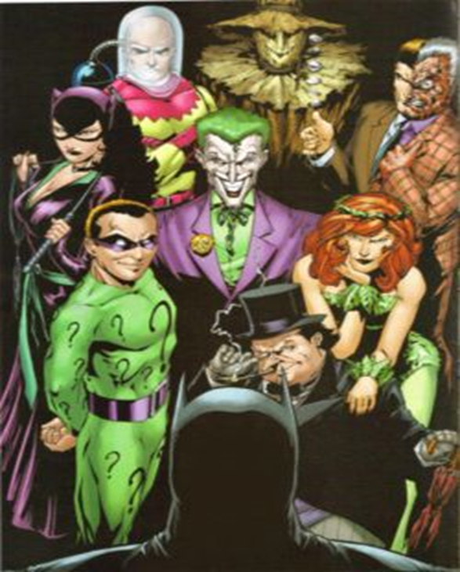
The Villain

Slide 6
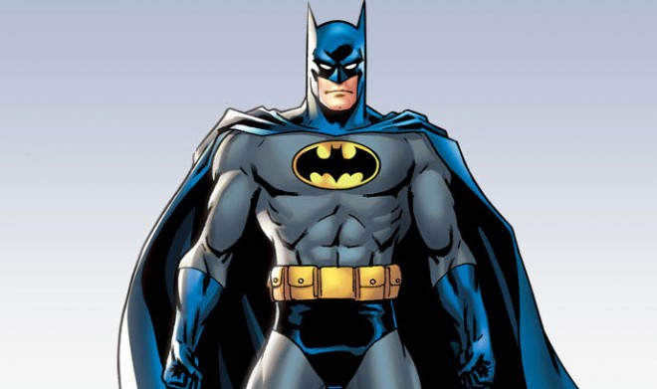
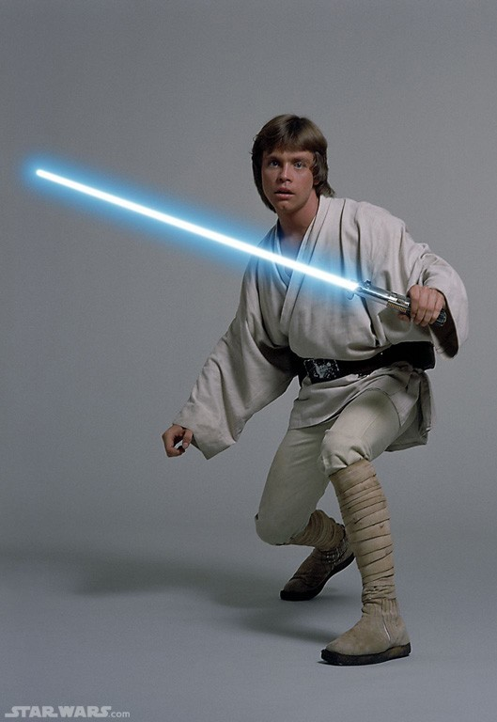
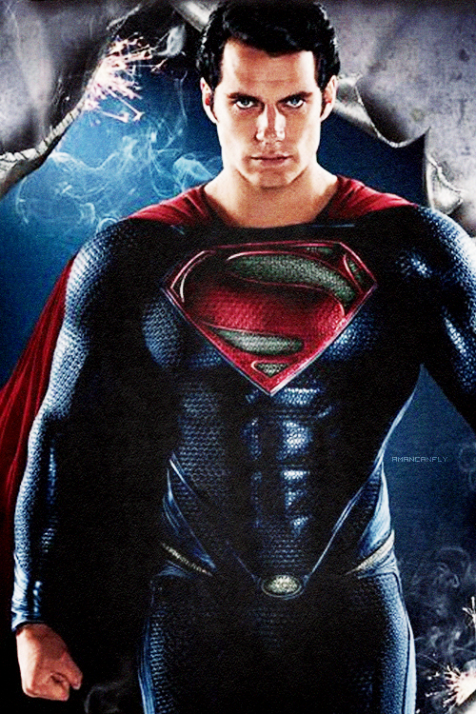
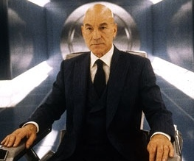
The Hero

Slide 7
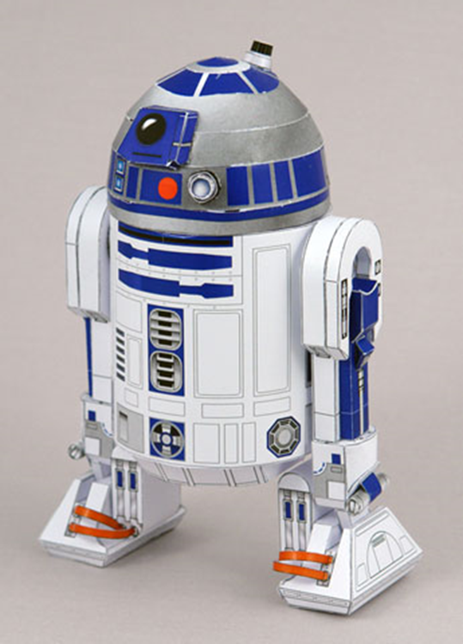
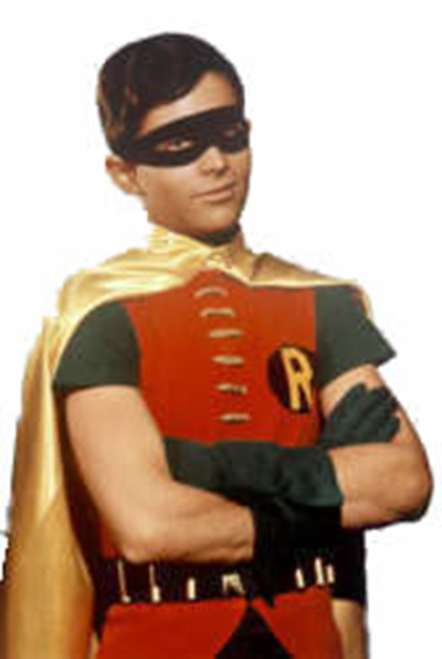
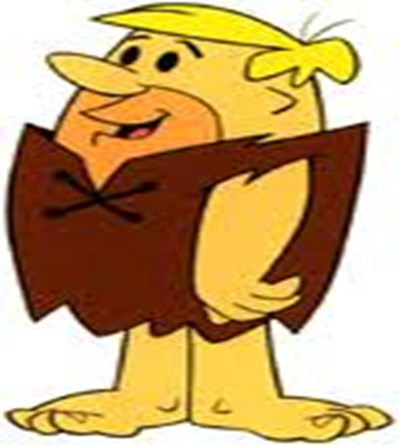
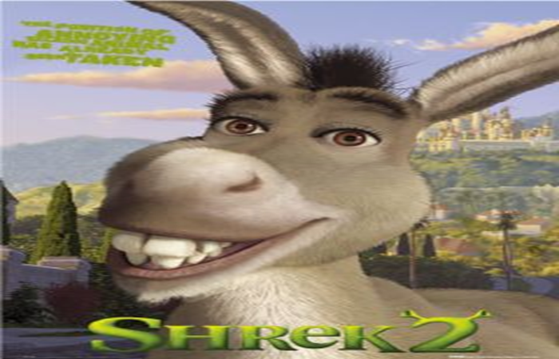
The Sidekick

Slide 8
Plot Archetypes
As common as archetypal characters are, plot archetypes are even more common.
We have all seen the same stories played out in different settings but the basic plot is still the same.
Consider these plot archetypes…

Slide 9
Star-Crossed Lovers

Slide 10
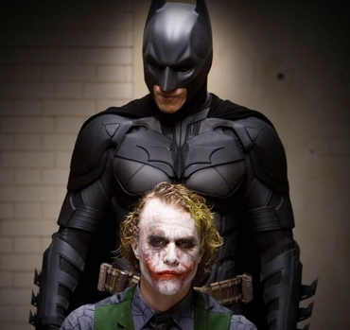
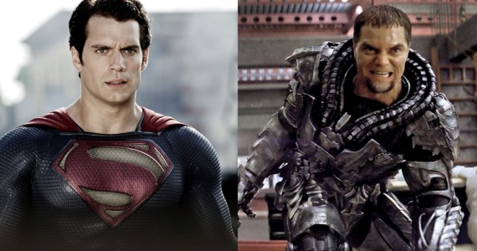
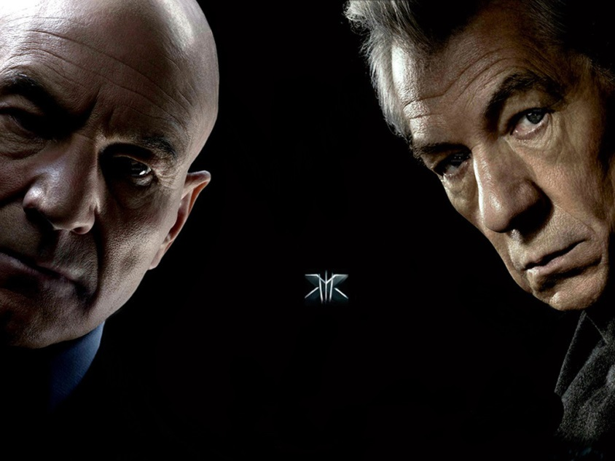
Hero vs. Villain/Good vs. Evil

Slide 11
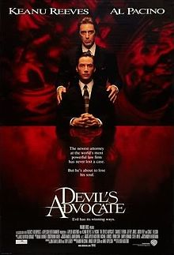
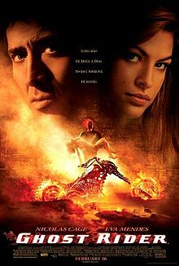
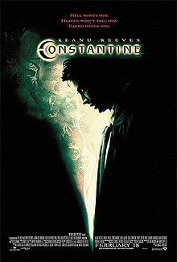
Deals with the Devil

Slide 12
The Devil and Tom Walker
Written by Washington Irving (1783-1859)
First American author widely admired in Europe
Also wrote “Rip van Winkle” and “The Legend of Sleepy Hollow”
Published The Devil and Tom Walker in 1824 as part of a larger book of stories titled Tales of a Traveler.
Received such bad reviews for the book that he gave up fiction writing completely.

Slide 13
The Devil and Tom Walker
Follow along as we listen to the reading of the story.
We will stop frequently to discuss the development of the mood and the plot of the story.
Audio

Slide 14
Question Sheets
Answer all questions in complete sentence form and be sure to CITE if necessary.

Slide 15
Exit Ticket
What do you think will happen next in the story? Make a prediction about how the story will end.

Slide 16
Start-Up – Partner Talk
11/4/14
Discuss the following question with your quad:
What would you be willing to give up to have unlimited wealth? Would you give up your health? Your family? Your soul?

Slide 17
Start-Up - Writing
Now write about the most interesting answer you heard in your group.

Slide 18
Review
What is the setting of the story?
What important information is given in the first paragraph that might become important to the plot?
What did Tom see “scored” into the trees around the old fort?
Who is “Old Scratch?”
What are some of the evil activities he took credit for?
Why did the story say that Tom did not fear the devil?
What did the devil offer to Tom?

Slide 19
The Devil and Tom Walker
Follow along as we listen to the reading of the story.
We will stop frequently to discuss the development of the mood and the plot of the story.
Audio

Slide 20
Question Sheets
Answer all questions in complete sentence form and be sure to CITE if necessary.

Slide 21
Exit Ticket
Did the story end the way you expected? Why, based on the ending, do you think the story is often referred to as “darkly humorous?”

