Slide 1
No Start-Up Today

Slide 2
Career Activity – Day 1
Today, you will begin working on a career activity which you will continue to add to over the next two years.
This will eventually include your Senior Portfolio and can be a useful resource to send to colleges and potential employers.
It begins by creating your own personal website.

Slide 3
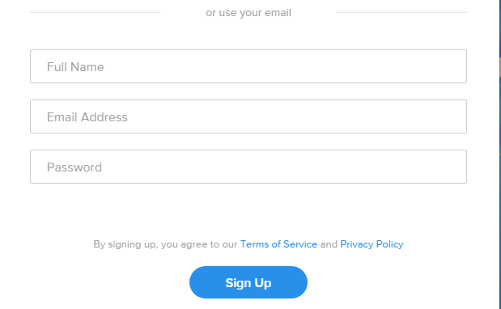
Weebly Website Creation
Weebly.com is a simple, effective website building tool. You will use it to create your personal website.
Step 1 – Go to weebly.com and click “Sign Up”
Step 2 – Register. DO NOT USE YOUR SCHOOL EMAIL!

Slide 4
Weebly Website Creation
Step 3 - Choose a template for your page.

Slide 5
Weebly Website Creation
Step 4 – Click “Start Editing.”
Step 5 – Click “Use a subdomain.” This is the only FREE option. Use your name as your subdomain.

Slide 6
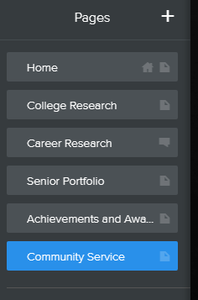
Weebly Website Creation
Step 6 - BEFORE you get caught up in designing your website, create the pages that are REQUIRED!
Pages required are: COLLEGE RESEARCH, CAREER RESEARCH, SENIOR PORTFOLIO, ACHIEVEMENTS AND AWARDS, and COMMUNITY SERVICE

Slide 7
Weebly Website Creation
Now you can start to edit your home page.
You HOME page MUST include:
A SCHOOL/BUSINESS APPROPRIATE PICTURE OF YOURSELF
A SIGNIFICANT QUOTE
A BRIEF BIOGRAPHY
Keep this classy and business appropriate.
You might include: essential information about yourself, extracurricular activities, academic and career goals
REMEMBER: TEACHERS, COMMUNITY MEMBERS, AND POTENTIAL COLLEGES AND EMPLOYERS MAY SEE THIS!

Slide 8
Weebly Website Creation
Use the tools provided in the tool bar to build/edit your home page.

Slide 9
Weebly Website Creation

Slide 10
Weebly Website Creation
Important: Before exiting or
moving to a different page,
always PUBLISH to save your
work!

Slide 11
Homework
Finish building your website.
Make sure you have all
of the required pages.

Slide 12
No Start-Up Today

Slide 13
Career Activity – Day 2
Today you will be doing some college/career research.
The results of this research will be used on your Weebly website as well as turned into a Google Slideshow which you will submit for a grade.

Slide 14
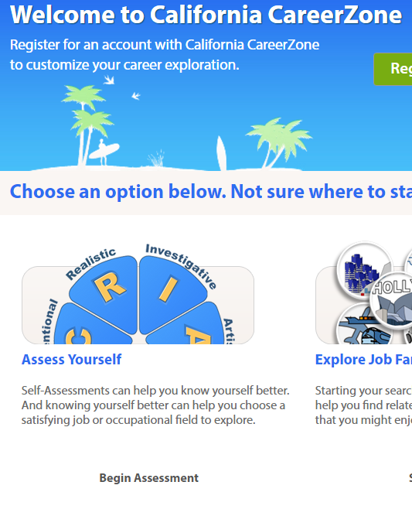
College/Career Research
Step 1 – Go to www.cacareerzone.org and click “Assess Yourself”

Slide 15
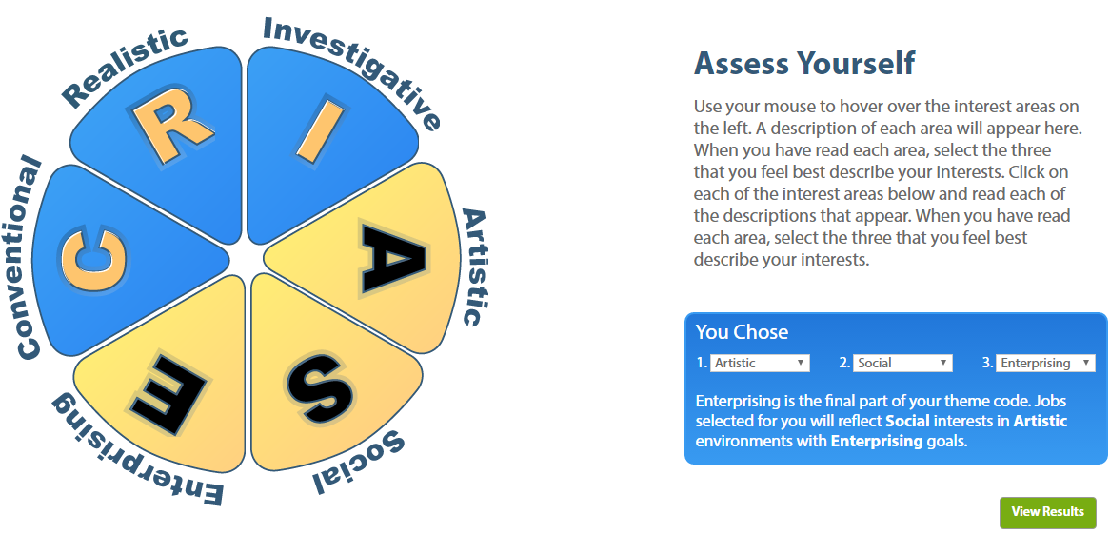
College/Career Research
Step 2 – Choose “Quick Assessment”
Step 3 – Follow the directions and choose 3 areas of interest. Click “View Results”

Slide 16
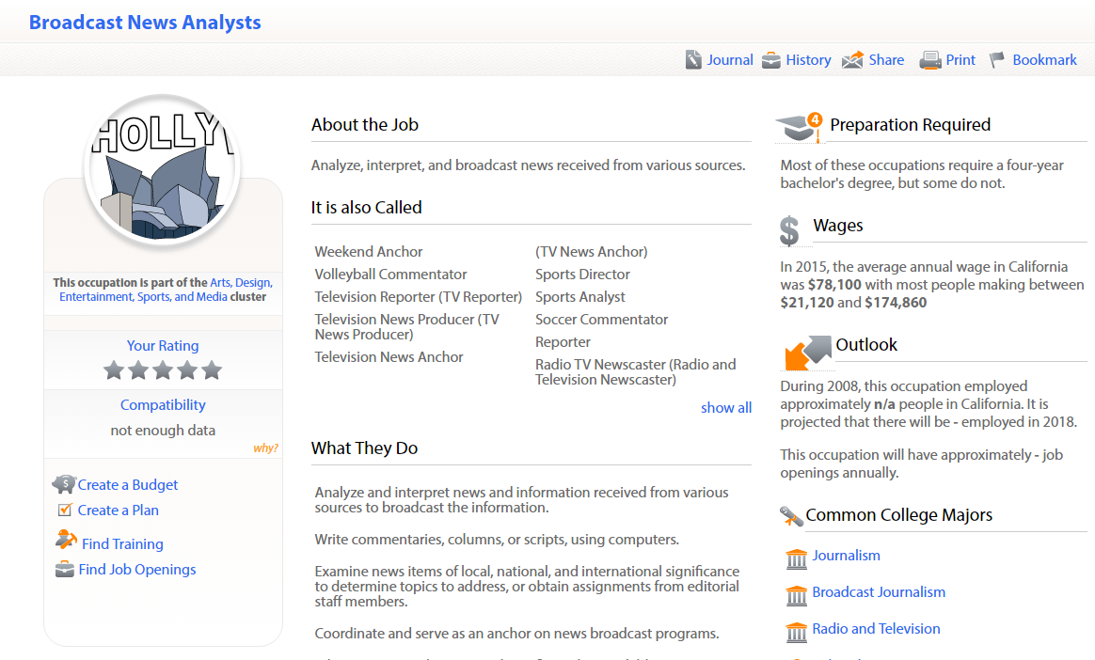
College/Career Research
Step 4 – Choose the career you would most like to explore.
Step 5 – Take a few minutes to explore the information for that career.

Slide 17
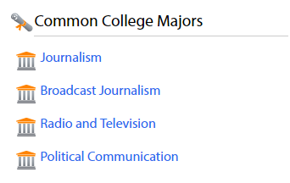
College/Career Research
Step 6 - Click on a college major that fits your goals and interests for that career.
Step 7 - Click on the “Find Institutions” button in the top right corner of the page for your major.

Slide 18
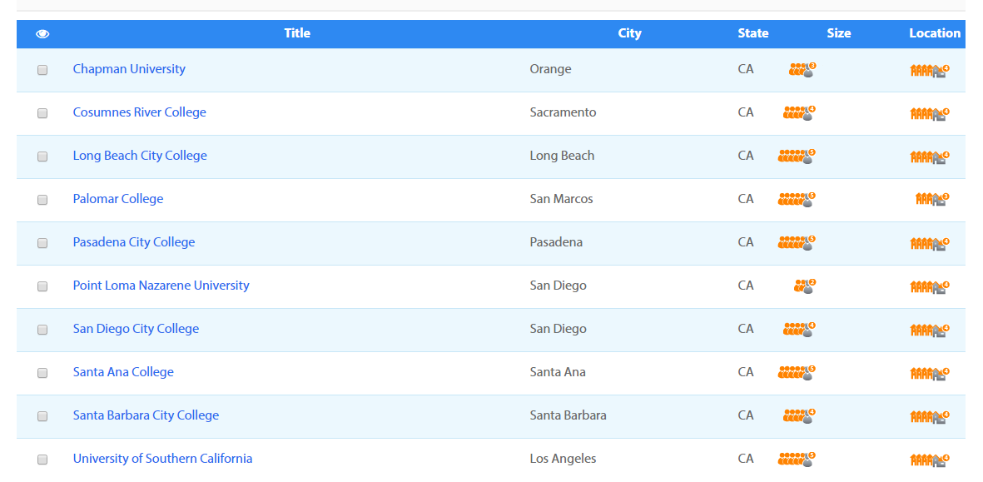
College/Career Research
Choose a college or university you are interested in from the list generated. If none of them interest you, go back to Step 4 and choose a different career to get a different result.

Slide 19
College/Career Research
Begin looking at the information shown for your college. You will need the following:
Name and Location
List of Admissions Requirements
List of Costs: tuition, on/off campus housing, any additional fees (parking, health facilities, athletic fees, etc.)
Clubs and Social Organizations on campus
Types of Financial Aid Available
Classes Needed to Graduate with Your Chosen Degree
Number of Years Needed to Graduate with Your Chosen Degree
What Interests You Most About This School
The Most Surprising/Interesting Fact You learned About This School
Some of this information will be found on this page. For the rest, you will need to visit the school’s website.

Slide 20
Google Slideshow
Open Google Classroom.
Use the slideshow assigned as a template to build YOUR OWN slideshow.
Creativity and use of colors, fonts, images, etc. is HIGHLY ENCOURAGED and will affect your grade for this slideshow.

Slide 21
Career Activity – Day 3
Today you have time in class to finish your Google Slideshow.
Remember that creativity counts.
When you are finished with your slideshow, you will need to EMBED IT onto your College Research page on your Weebly Website.

Slide 22
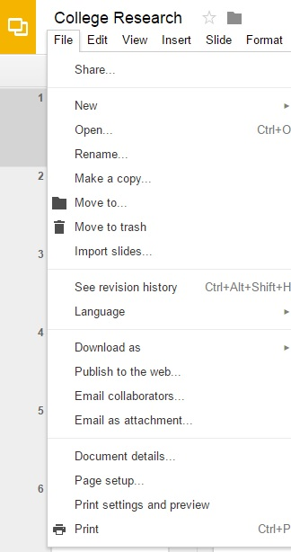
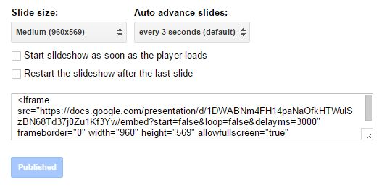
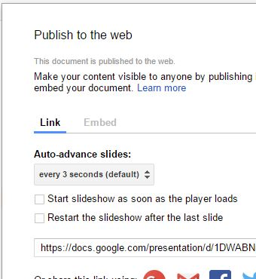
Embedding Your Slideshow
Step 1 – Get the embed code.
COPY
THIS CODE

Slide 23
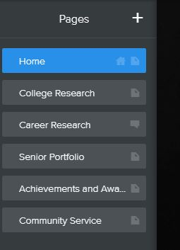
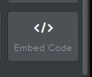
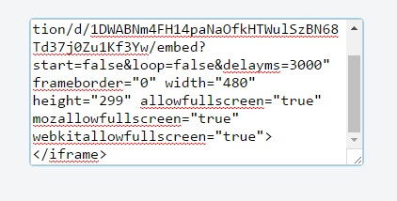
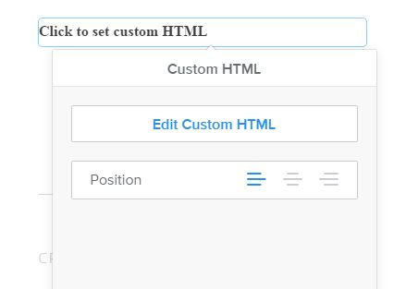
Embedding Your Slideshow
Step 2 – Embed the slideshow on your COLLEGE RESEARCH page.
DRAG THIS TO
WHERE YOU
WANT YOUR
SLIDESHOW
When you drop it
in place, it will
look like this.
CLICK IT.
Paste the embed code
into the box and hit enter.

