Slide 1
Start-Up
11/4/19
Before we begin,
Take a moment to watch and
consider the following video…

Slide 2
Start-Up - Discussion
11/4/19
In your groups, discuss the following:
How do Ben’s experiences and attitudes redefine what it means to have vision?

Slide 3
Start-Up - Writing
11/4/19
What is your opinion of the following statement:
Seeing Is Believing
Explain: do you agree or disagree with that statement? Why or why not?

Slide 4
Blindness and Sight
Open up your books to page 660.
Today we will be reading the short article, “Just Six Dots The Story of Braille.”
Consider as we read: How does the writer help the reader understand the sequence of events and the “Just Six Dots The Story of Braille” complexity of the topic?

Slide 5
Blindness and Sight
Your job now is to write me a brief summary of the article.
Your summary should be a COMPLETE, CONCISE overview of the article.
It should NOT contain any opinion or analysis.
It should be 5 sentences minimum.

Slide 6
Homework
Summary paragraphs for “Just Six Dots The Story of Braille”
DUE TOMORROW BY 7:00 a.m.

Slide 7
Exit Ticket
11/4/19
Think about and respond thoughtfully to the following:
Do you think there a difference between seeing and knowing?
If so, how are they different?
If not, why not?

Slide 8
Start-Up - Discussion
11/5/19
In your groups, discuss the following:
What could be some possible benefits of being blind?
Is there any good that could come from not being able (or having to) see the things that happen around us?

Slide 9
Start-Up - Writing
11/5/19
What could be some possible benefits of being blind?
Is there any good that could come from not being able (or having to) see the things that happen around us?

Slide 10
Greek Drama
The earliest origins of drama were ancient hymns called dithyrambs, sung in honor of the god of wine, Dionysus, in Athens.
Drama then evolved from religious festivals in honor of Dionysus.

Slide 11
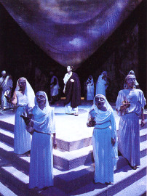
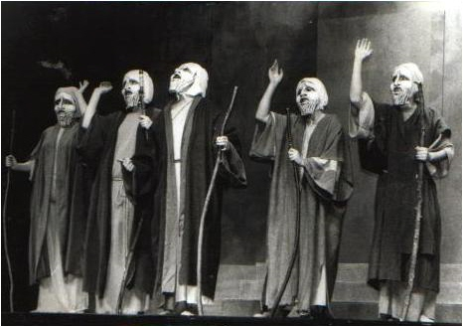
The Chorus
Greek plays featured a chorus, a group of actors who would sing and dance choral songs or odes in between episodes. They also engaged in dialogue with the actors.
Choruses were made up of 12-15 men (women could not participate) who wore matching costumes and masks.
VIDEO on CHORUS

Slide 12
The Purpose of the Chorus
The chorus acts as a “hinge” between scenes or speakers.
The chorus offers a commentary on the action that has just happened and looks forward to the action that is coming.
They do this from a 3rd person “collective” perspective.
The chorus expresses communal wisdom and helps the audience understand and deal with the exceptional circumstances in a tragedy.
The chorus always has an argument or opinion.

Slide 13
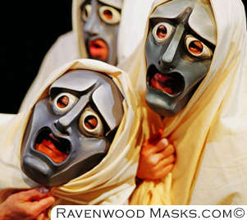
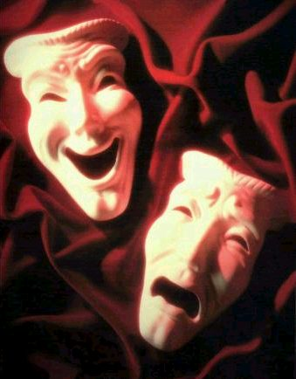
MASKS
The actors wore large masks that helped the audience members – even those in the back – identify the characters.
The masks also helped amplify their voices for the audience.

Slide 14
Layout of a Greek Theater
Theatron: Greek word for theater (from which our word is derived) meaning “viewing place”; the theatron was usually part of a hillside overlooking the orchestra and often wrapped around a large portion of the orchestra.
Orchestra: Means literally “dancing space”; Circular dancing area for the chorus.
Thymele: Altar to Dionysus in the center of the orchestra.
Parodos: means literally “passageways”; these were the paths by which the chorus and some actors made their entrances or exits and by which the audience entered and exited.

Slide 15
Layout of a Greek Theater
Skene: Means literally “tent” (from which our word “scene” is derived); this was the building directly behind the stage, usually decorated as a palace, temple, or other building through which actors could enter and exit.
Proscenium: or proskenion, meaning “in front of the skene.” The proskenion was a raised stage or platform in front of the skene which served simply to make the actors higher to aid visibility and to separate them from the chorus.

Slide 16
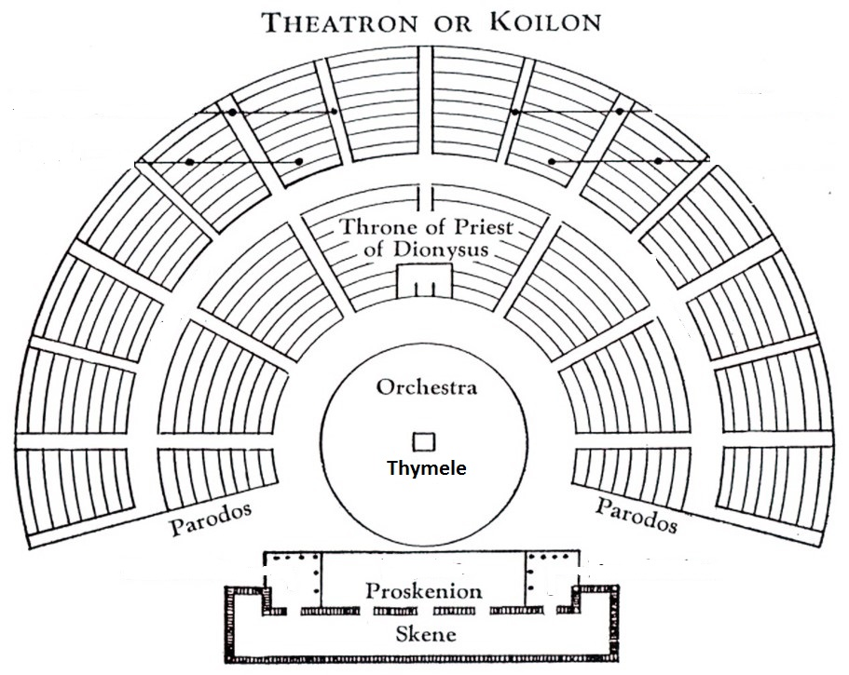
Layout of a Greek Theater

Slide 17
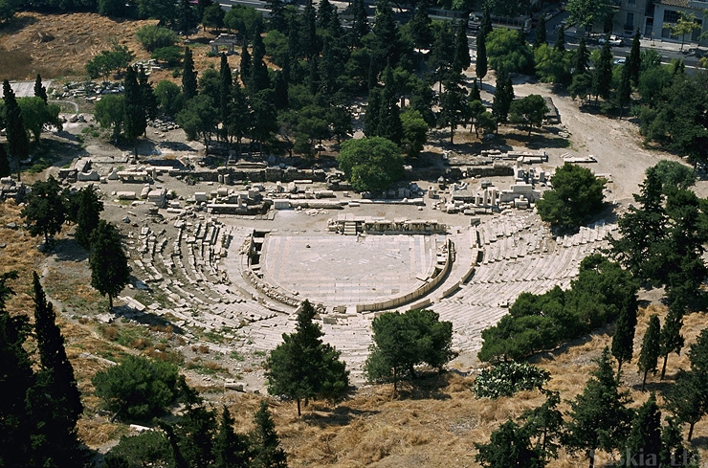
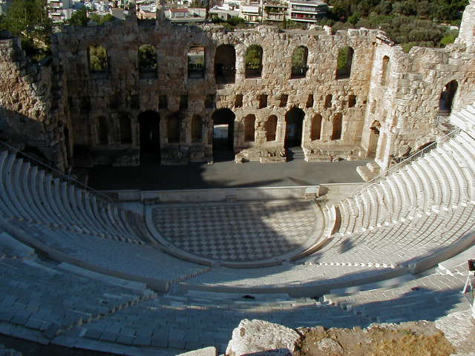
Theater of Dionysus in Athens
A Spectator’s View

Slide 18
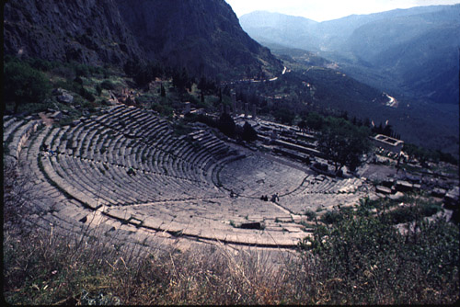
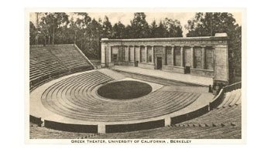
The Theater of Apollo
Greek Theater in
Berkeley, CA
VIDEO ON GREEK THEATER

Slide 19
Structure of Greek Plays
Many writers used an epic convention called en media res, which means “in the middle of things” in Latin. This refers to the idea that the action of the play or poem begins in the middle of the story, rather than at the beginning.
Prologue: Opening dialogue spoken by one or two characters before the chorus enters that gives the mythological background necessary to understand the play.
Parodos: Song sung by the chorus as it first enters the orchestra and dances.
First Scene/Episode: Scene of dialogue in which the characters and chorus talk.
First Ode/Stasimon: At the end of each episode, or scene, the characters leave the stage and the chorus dances and sings a stasimon, or choral ode. The ode usually reflects on the things said and done in the episodes.

Slide 20
Structure of Greek Plays
For the rest of the play, the episodes and stasima alternate until the final scene.
Exodus: The “exit scene” at the end of the play, the chorus exits singing a processional song that offers words of wisdom relating to the action and outcome of the play.
The chorus performed the songs, while the actors performed the scenes.
Odes typically followed this structure:
During the strophe (the first part of the ode), the chorus move/dance from right to left.
They moved in the opposite direction during the antistrophe, a verse that mirrored, but reversed, the strophe.

Slide 21
Homework
Review the TERMINOLOGY in your notes! There will be a QUIZ on Greek Theater and Greek Tragedy
On
FRIDAY!!!

Slide 22
Exit Ticket
11/5/19
Think about and respond thoughtfully to the following:
Do we have anything in modern theater/movies that does the job that a chorus did in Greek theater?
What?
If not, do you think we should? Why?

Slide 23
Start-Up - Discussion
11/6/19
In your groups, discuss the following:
What do you think of when you hear the word “tragedy?”
What are some examples of things that might be considered “tragic?”
What sort of emotions would you expect to be associated with a tragedy?

Slide 24
Start-Up - Writing
11/6/19
What do you think of when you hear the word “tragedy?”
What are some examples of things that might be considered “tragic?”
What sort of emotions would you expect to be associated with a tragedy?

Slide 25
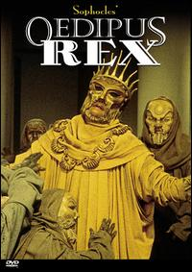
Introduction to Greek Tragedy
“Tragedy” refers primarily to tragic drama: a literary composition written to be performed by actors.
The central character called a tragic protagonist or hero suffers some serious misfortune that is logically connected with the hero’s actions.
One of the flaws often associated with tragic protagonists is called Hubris. Hubris is excessive pride or arrogance; often in defiance of the gods.
When a tragic hero ACTS out of hubris, that action is called an ate.
VIDEO FOR TRAGEDY
^

Slide 26
Characteristics of the Tragic Hero
Generally highborn
Must be good
Must aim at propriety
have good intentions or must be true to life—human
Must be consistent
Exhibits tragic flaw or flaws, often
Hubris—excessive pride
ate—rash actions taken; usually because of hubris
Experiences a reversal or fall
Brings about his own downfall (his prideful and/or rash actions lead to his downfall) or evokes both pity and fear in audience/reader
^
VIDEO FOR TRAGIC HERO

Slide 27
Tragic Protagonist/Hero Activity
In your groups, take the next few minutes to think about and discuss the characteristics of a tragic hero.
Try to come up with some examples of people/characters who fit the mold of a tragic hero.
Now, as a group, choose the ONE you think most resembles a tragic hero. Be prepared to defend your choice.

Slide 28
Important Vocabulary (Review)
Irony - the expression of one’s meaning by using language that normally signifies the opposite, typically for humorous or emphatic effect.
Situational irony: Literary device that occurs when incongruity appears between expectations of something to happen, and what actually happens.
Verbal Irony: where a person says or writes one thing and means another, or uses words to convey meaning that is the opposite of the literal meaning.
Sarcasm: is usually confused with irony – sarcasm which is the use of irony to mock or convey contempt – sarcasm creates ironic situations.
Dramatic Irony: a literary technique originally used in Greek Tragedy, by which the full significance of the characters words or actions are clear to the audience or reader, but is not known to the character. The audience knows something about the character or the plot that the character does not know.

Slide 29
Important Vocabulary
Pathos: A quality that evokes pity or sadness.
An example would be an actor who portrays humor and pathos in the role.
Catharsis is an emotional discharge through which one can achieve a state of moral or spiritual renewal or achieve a state of liberation from anxiety and stress.
Catharsis is a Greek word and it means cleansing. In literature it is used for the cleansing of emotions of the characters.

Slide 30
Sophocles and “Oedipus the King”
Born in 495 B.C., Sophocles is considered one of the greatest Greek playwrights of the golden age of Greek drama.
Oedipus Rex (the King), generally regarded as his masterpiece, was performed (and won a prize) at the festival of Dionysus in Athens around 427 B.C.
It is still considered one of the most important and famous plays of all time.

Slide 31
Homework
Review the TERMINOLOGY in your notes! There will be a QUIZ on Greek Theater and Greek Tragedy
On
FRIDAY!!!

Slide 32
Exit Ticket
11/6/19
Think about and respond thoughtfully to the following:
Why do you think people relate to Tragic Heroes?
What do we get out of watching their story arcs?

Slide 33
Start-Up - Discussion
11/7/19
In your groups, discuss the following:
"Which creature in the morning goes on four legs, at mid-day on two, and in the evening upon three, and the more legs it has, the weaker it be?"
This is known as the riddle of the Sphinx.
Can you figure it out?
(If you know it already, NO SPOILERS!)

Slide 34
Start-Up - Writing
11/7/19
"Which creature in the morning goes on four legs, at mid-day on two, and in the evening upon three, and the more legs it has, the weaker it be?"
Did you: already know the answer, figure out the answer, or not know the answer at all.
In your writing, now that you know, explain the riddle and why it makes sense.

Slide 35
En Media Res
“In the middle of things”
We begin the play, “Oedipus the King,” EN MEDIA RES.
The Greeks who attended the play would have already been VERY familiar with Oedipus. He had been written about in a few other plays by other authors.
Oedipus’ story, prior to the start of “Oedipus the King” is very important to understanding this play.
Let’s see where this all ACTUALLY started…
Sphinx Video

Slide 36
Now Let’s Read…
We begin “Oedipus the King” with the Prologue, a short scene of background that involves 3 characters.
As we read, look for:
Anything that helps you to understand WHO Oedipus is and WHAT KIND OF PERSON he is.
Anything that helps you to understand what has been happening in Thebes.
Anything that describes what Oedipus is doing or is going to do about the problems in Thebes.

Slide 37
Homework
Close Reading Questions for
the Prologue and Parados
DUE TUESDAY!

Slide 38
Exit Ticket
11/7/19
Think about and respond thoughtfully to the following:
Why do you think the people cry out to Oedipus to help them?
Why do you think Oedipus agrees to help them?
Does Oedipus seem like a “good” king?

Slide 39
NO Start-Up Today! You have the next 5 minutes to review your notes on Greek Theater, Tragedy, and the Tragic Hero!
11/8/19

Slide 40
Homework
Close Reading Questions for
the Prologue and Parados
DUE MONDAY!

Slide 41
NO Exit Ticket Today!!!
11/8/19

Slide 42
11/11/19
VETERANS’ DAY – NO SCHOOL

Slide 43
Start-Up - Discussion
11/12/19
In your groups, discuss the following:
What does Oedipus believe may have been the real cause of Laius’ death?
What “evidence” is he relying on?
Is the source of this evidence credible?
How do you know?

Slide 44
Start-Up - Writing
11/12/19
What does Oedipus believe may have been the real cause of Laius’ death?
What “evidence” is he relying on?
Is the source of this evidence credible?
How do you know?

Slide 45
Now Let’s Read…
We CONTINUE “Oedipus the King” with Scene 1 and Ode 1.
As we read, look for and highlight or underline:
What does the prophet, Teiresias, accuse Oedipus of?
How does Oedipus react?
What is the significance of BLINDNESS in this scene?

Slide 46
Homework
Close Reading Questions for
Scene 1 and Ode 1
DUE FRIDAY!

Slide 47
Exit Ticket
11/12/19
Think about and respond thoughtfully to the following:
What does Teiresias tell Oedipus about the man who killed (BE SPECIFIC)?
What is Oedipus’ reaction to this prophecy?

Slide 48
Start-Up - Discussion
11/13/19
Have you ever imagined what it would be like to be blind?
What do you imagine?
Do you think it is actually even possible for a sighted person to imagine or understand being blind?
Why or why not?

Slide 49
Start-Up - Writing
11/13/19
Have you ever imagined what it would be like to be blind?
What do you imagine?
Do you think it is actually even possible for a sighted person to imagine or understand being blind?
Why or why not?

Slide 50
Figurative Language in Nonfiction
Take a moment to read the “About the Author” paragraph on page 738.
If you were to describe Helen Keller in one word? What word would you use?
(Discuss in Groups / Whole Class)
Now look at the title of the article on page 739.
Why is this title unusual considering the source?
(Discuss in Groups / Whole Class)

Slide 51
Figurative Language in Nonfiction
Let’s Read…
Figurative Language Refresher
Metaphor: directly compares two unlike terms, demonstrating a surprising similarity
EX: The sun is a red-hot coal blazing down on us
Simile: uses an explicit comparison word such as like or as to compare two unlike items
EX: The sun is like a red-hot coal in the sky
Hyperbole: the deliberate use of exaggeration to express heightened emotion or add humor
EX: My anger burned hotter than ten thousand suns
Personification: gives a non-human thing the characteristics of a person
EX: The red-hot eye of the sun stares down on us

Slide 52
Figurative Language in Nonfiction
Go to Google Classroom and open the document “Figurative Language in “View From the Empire State Building”
Using the chart, find AT LEAST 5 examples of figurative language used by Helen Keller in her letter.
Identify the TYPE of figurative language in the left column
Give the EVIDENCE (the actual quote) in the right hand column and CITE IT PROPERLY.

Slide 53
HOMEWORK
Complete the
Figurative Language Chart
It is DUE TOMORROW
By 8:00 a.m.

Slide 54
Exit Ticket
11/13/19
What has reading this selection taught you about what it means to see?
How is the way Helen Keller “saw” unique/different?
Would your one-word description of Helen Keller change after reading her letter? Why or why not?

Slide 55
Start-Up - Discussion
11/14/19
In your groups, discuss the following:
In Tuesday’s reading, Oedipus is accused of being the murderer of King Laius. He immediately denies the accusation and pushes the blame onto Teiresias and Creon.
Why do you think he does this?
Why do you think people in general seem to naturally blame others for things as a way of coping with unpleasant truths?

Slide 56
Start-Up - Writing
11/14/19
In Tuesday’s reading, Oedipus is accused of being the murderer of King Laius. He immediately denies the accusation and pushes the blame onto Teiresias and Creon.
Why do you think he does this?
Why do you think people in general seem to naturally blame others for things as a way of coping with unpleasant truths?

Slide 57
Your Job Now…
Use the time remaining to work on your Close Reading Questions for Scene 1 and Ode 1.

Slide 58
Homework
Close Reading Questions for
Scene 1 and Ode 1
DUE TOMORROW!
QUIZ TUESDAY ON PART 1 OF THE PLAY!

Slide 59
Exit Ticket
11/14/19
Think about and respond thoughtfully to the following:
At the end of Ode 1, the Chorus, speaking for the people, says Oedipus is “wise and guilt-free.”
Why do you think they sided with him over their own prophet?

Slide 60
Start-Up - Writing
11/15/19
How do you think Creon will react when he hears that Oedipus has accused him of “conspiracy” to murder King Laius?
Have you ever been accused of something you did not do? If so, how did you feel?
If not, how would you react if you were completely innocent but found out that you were being accused?

Slide 61
Now Let’s Read…
We Continue “Oedipus the King” with Scene 2.
As we read, look for and highlight or underline:
What is Creon’s reaction to being accused?
Why does Jocasta tell Oedipus that she doesn’t believe in prophecy?
What does Oedipus hope that the shepherd will say?

Slide 62
Homework
Close Reading Questions for
Scene 2
DUE TUESDAY!
QUIZ TUESDAY ON PART 1 OF THE PLAY!

Slide 63
Exit Ticket
11/15/19
Think about and respond thoughtfully to the following:
In line 684, Oedipus tells Jocasta, “A shadow crossed my mind as you spoke, and the shadow chilled my mind.”
Oedipus realizes that he has made a mistake…
Think of an example, from literature or life, where someone made a mistake.
What kinds of feelings came up for that person/character when the mistake was uncovered?
What qualities or character traits does someone need to have in order to ADMIT a mistake?

Slide 64
Start-Up - Discussion
11/18/19
In your groups, discuss the following:
What does Jocasta give as her reason for not believing in prophets/prophecies?
What story does she share with Oedipus as “proof” that prophesies should not be trusted?
What is the IRONY of this?

Slide 65
Start-Up - Writing
11/18/19
What does Jocasta give as her reason for not believing in prophets/prophecies?
What story does she share with Oedipus as “proof” that prophesies should not be trusted?
What is the IRONY of this?

Slide 66
Your Job Now…
Use the time remaining to work on your Close Reading Questions for Scene 2.

Slide 67
Homework
Close Reading Questions for
Scene 2
DUE TOMORROW!
QUIZ TOMORROW ON PART 1 OF THE PLAY!

Slide 68
Exit Ticket
11/18/19
Think about and respond thoughtfully to the following:
Based on what you know about Oedipus so far, what do you think will happen next?
Will he come to terms with the truth or do whatever he can to keep his crown?
What qualities in him make you think so?

Slide 69
11/19/19
No
START-UP
TODAY!
You have a QUIZ!!!
But before you begin…

Slide 70
When You Finish…
In Google Classroom, you will find an assignment labeled, “Tragic Hero Graphic Organizer.”
Begin working on this today. You will be using it to help you WRITE later, so be sure to get enough EVIDENCE! It will be DUE FRIDAY!

Slide 71
Tragic Hero Characteristics
A tragic hero is of noble birth, meaning that he is royalty. AND/OR A tragic hero has a noble disposition, meaning that he is a good person (better than most people) at some point in the play.
A tragic hero suffers a reversal of fortune, meaning that he has everything at one point in the play and then loses it.
A tragic hero recognizes the consequences of his actions.
A tragic hero has a tragic flaw, a defect in his character (e.g. hubris) that leads to his downfall.
The audience watches the actions of the tragic hero and is moved to pity and fear (catharsis).

Slide 72
Tragic Hero Graphic Organizers DUE FRIDAY! NO EXIT TICKET
11/19/19

Slide 73
Start-Up - Discussion
11/20/19
Do you think that our minds can sometimes affect what we see?
Can you think of any examples where what we see is not what is really there?
Why do you think this happens?

Slide 74
Start-Up - Writing
11/20/19
Do you think that our minds can sometimes affect what we see?
Can you think of any examples where what we see is not what is really there?
Why do you think this happens?

Slide 75
How Your Eyes Trick Your Mind
Go to Google Classroom and click on the link I left you there: http://www.bbc.com/future/bespoke/story/20150130-how-your-eyes-trick-your-mind/index.html
Scroll down to the image of the waterfall.
Stare at the water moving down the rocks for a few seconds…
Now look at the rocks.
Can you see it?
Let’s Read…

Slide 76
How Your Eyes Trick Your Mind
Now go back to Google Classroom
Open up the document “How Your Eyes Trick Your Mind”
You will be selecting one of the optical illusions from the article and writing about it.

Slide 77
HOMEWORK
Complete the writing for
“How Your Eyes Trick Your Mind”
This is DUE TOMORROW
BY 8:00 a.m.

Slide 78
Exit Ticket
11/20/19
How does the idea of “what we see may not be what’s real”
connect to Oedipus?
What does Oedipus “see” or “not see?”

Slide 79
Start-Up - Discussion
11/21/19
In your groups, discuss the following:
Do you believe in fate?
Do you believe that things happen because they are meant to happen, or do we have any control over what happens to us/around us?
Why or why not?

Slide 80
Start-Up - Writing
11/21/19
Do you believe in fate?
Do you believe that things happen because they are meant to happen, or do we have any control over what happens to us/around us?
Why or why not?

Slide 81
Let’s Read…
Scene 3 and Ode 3
As we read:
Look for the IRONY in the TIMING in this scene.
What is Oedipus’ view of Chance (a.k.a. Fortune)?

Slide 82
Your Job Now…
You have questions to answer for Scene3/Ode3, but they are not DUE UNTIL TUESDAY after Thanksgiving week.
Use the time remaining to work on your Tragic Hero Graphic Organizer.

Slide 83
Homework
Tragic Hero Graphic OrganIzer
DUE TOMORROW!
Scene 3 Ode 3 Questions
DUE TUESDAY 12/3
QUIZ THURSDAY 12/5 ON PART 2 OF THE PLAY!

Slide 84
Exit Ticket
11/21/19
Think about and respond thoughtfully to the following:
What does the Chorus want to see and why?
What do they fear will happen if the prophecies do not come true??

Slide 85
Start-Up - Discussion
11/22/19
In your groups, discuss the following:
There is a saying that goes, “Don’t ask the question if you are not prepared to hear the answer.”
Would you be determined to hear the truth, even if you knew that truth might ruin your life?
Would you be able to live a full, contented life knowing that you had avoided the truth?

Slide 86
Start-Up - Writing
11/22/19
There is a saying that goes, “Don’t ask the question if you are not prepared to hear the answer.”
Would you be determined to hear the truth, even if you knew that truth might ruin your life?
Would you be able to live a full, contented life knowing that you had avoided the truth?

Slide 87
Your Job Now…
In Google Classroom, you will find an assignment labeled, “CHOSEN Tragic Hero Graphic Organizer.”
You will be CHOOSING a character you are familiar with from other books, movies, or TV and filling out a Tragic Hero Graphic Organizer for them. Citations are not required.
Begin working on this today. You will be using it to help you WRITE later, so be sure to get enough EVIDENCE! It will be DUE WEDNESDAY 12/4!

Slide 88
Homework
Scene 3 / Ode 3 Close Read Questions
DUE TOMORROW!
Chose Character – Tragic Hero Graphic Organizer
DUE WEDNESDAY 12/4!
QUIZ THURSDAY 12/5 ON PART 2 OF THE PLAY!

Slide 89
Exit Ticket
11/22/19
Think about and respond thoughtfully to the following:
Suspense is the feeling of curiosity, anxiety, or tension that a reader feels about the outcome of a story. Even though we know the outcome, Sophocles still builds suspense in the play as the evidence comes to light.
What are the individual pieces of evidence (there are several…list at least 2) that have been revealed in the play?
How has the revealing of those pieces of evidence helped to build the suspense?

Slide 90
Start-Up - Discussion
12/2/19
In your groups, discuss the following:
Think about the main characters in the play: Oedipus, Jocasta, and Creon.
Come up with some examples of
FIGURATIVE LANGUAGE
(similes, metaphors, hyperbole, personification, etc.)
describing any of the three characters.
Share with your group.

Slide 91
Start-Up - Writing
12/2/19
In your groups, discuss the following:
Think about the main characters in the play: Oedipus, Jocasta, and Creon.
Create FOUR examples of
FIGURATIVE LANGUAGE
(similes, metaphors, hyperbole, personification, etc.)
describing any of the three characters.
Write them as separate sentences, not as a paragraph.

Slide 92
Figurative Language FLEX
We took a look at the letter from Helen Keller last week, and you were asked to identify figurative language.
Many of you struggled with this assignment and with properly identifying examples.
Today, we are going to review these elements again, and you will have a chance to work with them again.
When you are finished, you will do complete another assignment similar to the one from last week to see if you have improved…

Slide 93
Metaphors and Similes
Metaphor: directly compares two unlike terms, demonstrating a surprising similarity
EX: The sun is a red-hot coal blazing down on us
Simile: uses an explicit comparison word such as like or as to compare two unlike items
EX: The sun is like a red-hot coal in the sky
NOTES
If there is NO COMPARISON OF UNLIKE THINGS there is no metaphor/simile.
Just because you see the word LIKE or AS does not automatically mean it is a simile.
NON-EXAMPLES
“I felt like being frivolous with the stars” (Keller 740).
“Frankly, I was so entranced “seeing” that I did not think about the sight” (Keller 739).
VIDEO

Slide 94
Metaphors and Similes
Now go to Google Classroom and open the document
FIGURATIVE LANGUAGE PRACTICE
Complete the section on
METAPHORS AND SIMILES
DO NOT GO ON TO THE NEXT SECTION!

Slide 95
Hyperbole
Hyperbole: the deliberate use of exaggeration to express heightened emotion or add humor
EX: My anger burned hotter than ten thousand suns
NOTES
Hyperbole MUST INCLUDE EXAGGERATION.
That exaggeration will be EXTREME and BEYOND BELIEF.
NON-EXAMPLES
“I was pleasantly surprised to find the Empire Building so poetical” (Keller 9).
“I saw a romantic structure wrought by human brains and hands that is to the burning eye of the sun a rival luminary” (Keller 740).
VIDEO

Slide 96
Hyperbole
Now go to Google Classroom and open the document
FIGURATIVE LANGUAGE PRACTICE
Complete the section on
HYPERBOLE
DO NOT GO ON TO THE NEXT SECTION!

Slide 97
Personification
Personification: gives a non-human thing the characteristics of a person
EX: The red-hot eye of the sun stares down on us
NOTES
You have to be talking about a non-human thing; describing it.
Whatever you make that non-human thing do has to be something only people usually do.
NON-EXAMPLES
“...The strange grass and skies the blind behold are greener grass and bluer skies than ordinary eyes see” (Keller 739).
¨I was pleasantly surprised to find the Empire Building so poetical¨(Keller 740).
“The highest, the largest, the most costly is the breath of his vanity” (Keller 740).
VIDEO

Slide 98
Personification
Now go to Google Classroom and open the document
FIGURATIVE LANGUAGE PRACTICE
Complete the section on
PERSONIFICATION
DO NOT GO ON TO THE NEXT SECTION!

Slide 99
Comprehensive Review/Reassessment
Take a moment to read the paragraph at the bottom of the page under Comprehensive Review.
You have the time remaining in class to complete this.
Anything not done in class is
HOMEWORK DUE TOMORROW!

Slide 100
Homework
Figurative Language Flex
DUE TOMORROW!
Scene 3 / Ode 3 Close Read Questions
DUE TOMORROW!
Chosen Character – Tragic Hero Graphic Organizer
DUE WEDNESDAY 12/4!
QUIZ THURSDAY 12/5 ON PART 2 OF THE PLAY!

Slide 101
Exit Ticket
12/2/19
Choose an item in the room…any item.
Now write me FOUR examples of figurative language to describe that item.
Write them as four separate sentences, not a paragraph.

Slide 102
Start-Up - Writing
12/3/19
If you were in Jocasta’s position, what would you do?
Would you try to keep the truth a secret or let it come out?
Why?

Slide 103
Let’s Read…

Slide 104
Homework
Scene 4 / Ode 4 / Exodus
Close Read Questions
DUE THURSDAY!
QUIZ THURSDAY ON PART 2 OF THE PLAY!

Slide 105
Exit Ticket
12/3/19
It has been said that Oedipus’ hamartia (tragic flaw) was his relentless pursuit of the truth. This could be a good quality or a bad one depending on the situation.
Think of other qualities that could be either good or bad depending on the situation?
Choose one and then describe how it could be either good or bad in different circumstances.

Slide 106
No Start-up
No Exit Ticket
Watch Scene 4, Ode 4, and Exodus
Work on questions
DUE TOMORROW!
QUIZ ON PART 2 TOMORROW!
12/4/19

Slide 107
NO Start-Up
NO Exit Ticket
You have a QUIZ!
You have 15 minutes for the quiz, then we have more to do!
12/5/19

Slide 108
How to TREAT a Source Properly
One of THE MOST IMPORTANT skills you will need to survive English 10 (and 11 and 12 and College) is the ability to read a source and then use information from that source in your writing.
This is a skill you will need for your final assessment for Speak as well, so we’re going to take a look at it today.
I am going to teach you, today, a method of writing a paragraph that, if done correctly, will make sure you get a solid score!
It’s called The TREAT Method or How to TREAT a Source.
It’s what your English 11 teachers will use too!

Slide 109
How to TREAT a Source Properly
T – Topic Sentence
R – Relevance (Background)
E – Evidence (a PROPERLY CITED QUOTE from the source)
A – Analysis (paraphrase and commentary)
T – Tie Back (concluding sentence)

Slide 110
How to TREAT a Source Properly
T – TOPIC SENTENCE
The main idea of the paragraph. IT SHOULD ANSWER THE PROMPT!
It explains what you will prove in that paragraph.
This should not be a specific detail from the story, but rather it should take a stance on an issue from the story that can be debated.
Topic sentence includes the title, author, and claim
One sentence only.

Slide 111
How to TREAT a Source Properly
R – RELEVANCE
Gives the background of the supporting detail.
WHO says the quote or does the action?
WHEN does he/she say or do that?
WHERE does the action take place?
Comes before the supporting detail in the paragraph

Slide 112
How to TREAT a Source Properly
E – Evidence
This is the evidence that comes directly from the story.
You should be able to turn to a page and say, “See, it happens right here.”
It is a direct quote from the novel.
MUST BE CITED PROPERLY!! Example: (Sophocles line 233).

Slide 113
How to TREAT a Source Properly
A – Analysis
Explains the significance of the detail.
What does that quote literally mean?
PARAPHRASE IT!
What does that quote or event show?
WHY IS IT IMPORTANT?
HOW DOES IT HELP MAKE YOUR POINT?

Slide 114
How to TREAT a Source Properly
T - Tie Back
RESTATE your main point in a new way!
Connect the evidence and the analysis back to the topic sentence.

Slide 115
How to TREAT a Source Properly
What if you need/are required to share
MORE THAN ONE
piece of evidence?
T – Topic Sentence
R – Relevance (Background)
E – Evidence (a PROPERLY CITED QUOTE from the source)
A – Analysis (paraphrase and commentary)
R – Relevance (Background)
E – Evidence (a PROPERLY CITED QUOTE from the source)
A – Analysis (paraphrase and commentary)
T – Tie Back (concluding sentence)

Slide 116
How to TREAT a Source Properly
EXAMPLE
T- TOPIC SENTENCE
Notice how they…
Answer the prompt (Which character was the loneliest?) AND give us a quick outline of their reasons.
Include the title and author and a claim.

Slide 117
How to TREAT a Source Properly
EXAMPLE
R – RELEVANCE
Notice how they…
Give the WHO, WHEN, AND WHERE to set up their evidence
Provide some BACKGROUND to the evidence, so it makes sense to the reader

Slide 118
How to TREAT a Source Properly
EXAMPLE
EVIDENCE
Notice how they…
Provide a DIRECT QUOTE from the novel that supports the claim they made in their topic sentence.
CITE IT PROPERLY

Slide 119
How to TREAT a Source Properly
EXAMPLE
A – ANALYSIS
Notice how they…
Explain the significance of the detail.
Tell what that quote literally means
PARAPHRASE IT!
Tell what that quote shows
WHY IS IT IMPORTANT?
HOW DOES IT HELP MAKE YOUR POINT?

Slide 120
How to TREAT a Source Properly
CITATION
Parenthetical in-text citation - a brief reference in your text that indicates the source you consulted.
In general, the in-text citation will be the author’s last name (or abbreviated title) with a page number, enclosed in parentheses.
For this play, your citation should look like this:
(Sophocles line 208).
Notice:
NOTHING BUT AUTHOR NAME AND A LINE NUMBER
The period for the sentence goes AT THE END, AFTER THE PARENTHESIS!

Slide 121
Your Job Now
Go to Google Classroom and open the Practice Paragraph – TREAT.
Let’s look at it…

Slide 122
Homework
Practice Paragraphs – TREAT
DUE MONDAY!

Slide 123
No Start-up OR Exit Ticket
12/6/19

Slide 124
No Start-ups OR Exit Tickets
this week!!
Let’s finish the movie first…
12/9/19

Slide 125
FINAL ASSESSMENT – OEDIPUS
Your FINAL for Oedipus will be in TWO PARTS.
PART 1 – Essay Writing
PART 2 – Multiple Choice Test
Next week – On FINALS days

Slide 126
FINAL ASSESSMENT – OEDIPUS PART 1
For your final ESSAY ASSESSMENT, you have two options of topics…
Option 1 – The Tragic Hero Comparison Essay
Option 2 – The Keller Comparison Essay

Slide 127
Tragic Hero Comparison Essay
You will be using the Tragic Hero Graphic Organizers you completed for Oedipus and your chosen character.
Your writing MUST:
Be a minimum of one complete page, typed, double-spaced, Times New Roman, size 12, proper MLA format
Be a minimum of THREE complete paragraphs.
NOT include first or second person language
Be PROPERLY CITED for all examples/evidence from the play. For this paper, proper citation should look like this: (Sophocles line 65).

Slide 128
Tragic Hero Comparison Essay
Paragraph ONE
In TREAREAT format…
Describe Oedipus and PROVE that he meets the qualifications (characteristics from your chart) to be considered a Tragic Hero.
Give A MINIMUM OF TWO pieces of evidence from ANY of the 5 characteristics to support your claim.
Paragraph TWO
In TREAREAT format…
Describe YOUR CHOSEN CHARACTER and PROVE that he meets the qualifications (characteristics from your chart) to be considered a Tragic Hero.
Give A MINIMUM OF TWO pieces of evidence from ANY of the 5 characteristics to support your claim.

Slide 129
Tragic Hero Comparison Essay
Paragraph THREE
In TREAREAT format…
Argue, based on the evidence you presented in paragraph one and two, which one of the two characters is a BETTER representation of a Tragic Hero.
Directly compare the evidence for both characters and decide, for yourself, which one is the stronger representation of the characteristics in your chart.
CONVINCE ME that you are right!

Slide 130
Keller Comparison Essay
You will be using the “View From the Empire State Building,” “The Miracle Worker,” and Oedipus.
Your writing MUST:
Be a minimum of one complete page, typed, double-spaced, Times New Roman, size 12, proper MLA format
Be a MINIMUM of THREE complete paragraphs.
NOT include first or second person language
Be PROPERLY CITED for all examples/evidence from the play. For this paper, proper citation should look like this: (Sophocles line 65).

Slide 131
Keller Comparison Essay
Paragraph ONE
In TREAREAT format…
Describe Oedipus and his “blindness.” Give details that show HOW and TO WHAT Oedipus was blind.
Give A MINIMUM OF TWO pieces of evidence from the play to support your claim.
Paragraph TWO
In TREAREAT format…
Describe Helen Keller’s “sight.” Give details that show HOW she was able to “see” without her eyes.
Give A MINIMUM OF TWO pieces of evidence the letter OR the film to support your claim.

Slide 132
Keller Comparison Essay
Paragraph THREE
In TREAREAT format…
Argue, based on the evidence you presented in paragraph one and two, which one of the two characters is a was MORE BLIND, Oedipus or Helen Keller.
Directly compare the evidence for both and decide, for yourself, which one was better able to see.
CONVINCE ME that you are right!

Slide 133
BOTH Comparison Essays
You have the WEEK to complete your essay.
Rough Drafts will be DUE FOR REVIEW THURSDAY!
ALL PAPERS MUST BE SUBMITTED
BY MONDAY AT the END OF THE PERIOD.
ABSOLUTELY NO LATE WORK WILL BE ACCEPTED!!!
NO EXCUSES!!!

Slide 134
No Start-ups OR Exit Tickets
this week!!
You have the entire period to work on your Comparison Writing.
Rough Drafts will be DUE FOR REVIEW THURSDAY!
ALL PAPERS MUST BE SUBMITTED
BY MONDAY 12/16 AT the END OF THE PERIOD.
ABSOLUTELY NO LATE WORK WILL BE ACCEPTED!!!
NO EXCUSES!!!
12/10/19

Slide 135
No Start-ups OR Exit Tickets
this week!!
You have the entire period to work on your Comparison Writing.
Rough Drafts will be DUE FOR REVIEW THURSDAY!
ALL PAPERS MUST BE SUBMITTED
BY MONDAY 12/16 AT the END OF THE PERIOD.
ABSOLUTELY NO LATE WORK WILL BE ACCEPTED!!!
NO EXCUSES!!!
12/11/19

Slide 136
No Start-ups OR Exit Tickets
this week!!
Continue editing/revising your Comparison Writing.
I will be calling people up today/tomorrow for 1:1 reviews of their Rough Drafts.
ALL PAPERS MUST BE SUBMITTED
BY MONDAY 12/16 AT the END OF THE PERIOD.
ABSOLUTELY NO LATE WORK WILL BE ACCEPTED!!!
NO EXCUSES!!!
12/12/19

Slide 137
No Start-ups OR Exit Tickets
this week!!
Continue editing/revising your Comparison Writing.
I will be calling people up today/tomorrow for 1:1 reviews of their Rough Drafts.
ALL PAPERS MUST BE SUBMITTED
BY MONDAY 12/16 AT the END OF THE PERIOD.
ABSOLUTELY NO LATE WORK WILL BE ACCEPTED!!!
NO EXCUSES!!!
12/13/19

Slide 138
No Start-ups OR Exit Tickets
this week!!
FINAL DRAFTS ARE DUE BY THE END OF THIS PERIOD!
ABSOLUTELY NO LATE WORK WILL BE ACCEPTED!!!
NO EXCUSES!!!
12/16/19

Slide 139
12/17 AND 12/18
Review for
Multiple Choice Final
12/19 and 12/20
FINALS SCHEDULE!

